Slide 1
3.5) moles to molecules
how many molecules of O are present in 0.8333 mol of C₆ H₁₂O₆?
=3*10²⁴
3.6) molecules to moles
how many moles of C₆ H₁₂O₆ are formed from 5.04*10²⁵ atoms of H ?
7 moles

Slide 2
3.7 mass to molecules:
how many molecules of C₆ H₁₂O₆ form from 96 g of C ?
8 *10²³ molecules of C₆H₁₂O₆
3.8 atoms to mass:
how many grams of H are combined with 2.7*10²⁴ atoms of O in C₆H₁₂O ₆ ?
9 grams H

Slide 3
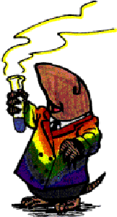
Body parts calculations across a reaction:
Reaction `stoichiometry’ problems
Some Examples of the problem `form’:
Given the balanced chemical reaction
C₃H₈ + 5O₂--------> 3CO₂ + 4H₂O
Calculate the moles of O₂ necessary to produce 0.6 moles of CO₂ .
Calculate the grams of CO₂ created by burning 0.00757 moles of C₃H₈
Calculate the moles of H₂O formed by burning 40 grams of O₂.
Calculate the grams of O₂ to form 1.50*10²² molecules of H₂O .

Slide 4
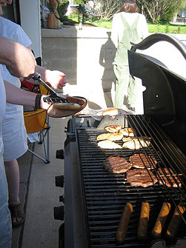
Reaction `stoichiometry’ problems
A sample reaction
C₃H₈ + O₂ CO₂ + H₂O
First concern:
Is the reaction as written balanced???
…no

Slide 5
Balancing a reaction
Unbalanced
_C₃H₈ + _O₂ _CO₂ +_H₂O
After blackboard balancing exercise
1C₃H₈ + 5O₂ 3CO₂ +4H₂O
Stoichiometric coefficients
C
H
O
3
8
10
3
8
10

Slide 6
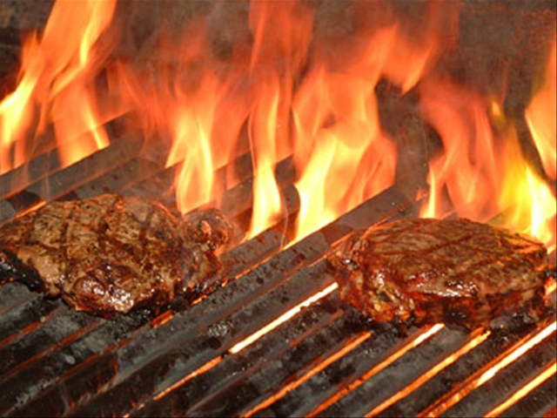
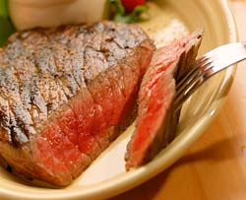
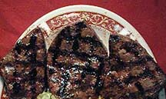
Sometimes several answers possible
Barbecuing steaks…
C₃H₈ + 5O₂ → 4H₂O +3CO₂
Complete combustion
C₃H₈ + 4O₂ → 4H₂O +2CO₂ + C
Incomplete combustion
C₃H₈ + 3O₂ → 4H₂O + CO₂ + 2C
C₃H₈ + 2O₂ → 4H₂O + 3C
Low O₂
→Low CO₂
₋→ High C
(charred)
Hi O₂
→Hi CO₂
→Low C
(no `char’)

Slide 7
Reaction Stoichiometry Problems part 1:
Class Practice Balancing Reactions
1
2
1
2
___CH₄ + ___O₂ __CO₂ + __H₂O
2
3
2
4
___CH₄ + ___O₂ __CO + __H₂O
3
1
1
3
__AgNO₃ + ___Na₃PO₄ __Ag₃PO₄ +___NaNO₃
2
6
2
3
____Al + ___HCl __AlCl₃ + ___H₂
Gasoline combustion reaction
2
25
16
18
__C₈H₁₈ + __O₂ __CO₂ + __ H₂O

