Slide 1
Mole calculations level 3
3.1)mole to mole:
how many moles of O are present in 0.1666 mole of C₆ H₁₂O₆?
1 mol O
3.2) mole to mole
how many moles of C₆H₁₂O₆ can be made with 12 mole of O ?
2moles C₆H₁₂O₆

Slide 2
In-class exercise #7b: chem 1114 Mole Calculations: part 2
3.3) weight to moles
how many moles of C₆H₁₂O₆ in a sample containing 216 g C ?
3 mol
3.4) moles to weight
how many grams of C₆H₁₂O₆ are formed with 0.2666 mol H?
= 4 g

Slide 3
In-class exercise : chem 1114 Body parts calculations (continued)
3.3) weight to moles
how many moles of C₆H₁₂O₆ in a sample containing 216 g C ?
3 mol
3.4) moles to weight
how many grams of C₆H₁₂O₆ are formed with 0.2666 mol H?
= 4 g

Slide 4
3.5) moles to molecules
how many molecules of O are present in 0.8333 mol of C₆ H₁₂O₆?
=5*10²³
3.6) molecules to moles
how many moles of C₆ H₁₂O₆ are formed from 5.04*10²⁵ atoms of H ?
7 moles

Slide 5
3.7 mass to molecules:
how many molecules of C₆ H₁₂O₆ form from 96 g of C ?
8 *10²³ molecules of C₆H₁₂O₆
3.8 atoms to mass:
how many grams of H are combined with 2.7*10²⁴ atoms of O in C₆H₁₂O ₆ ?
9 grams H

Slide 6

Body parts calculations across a reaction:
Reaction `stoichiometry’ problems
Some Examples of the problem `form’:
Given the balanced chemical reaction
C₃H₈ + 5O₂--------> 3CO₂ + 4H₂O
Calculate the moles of O₂ necessary to produce 0.6 moles of CO₂ .
Calculate the grams of CO₂ created by burning 0.00757 moles of C₃H₈
Calculate the moles of H₂O formed by burning 40 grams of O₂.
Calculate the grams of O₂ to form 1.50*10²² molecules of H₂O .

Slide 7
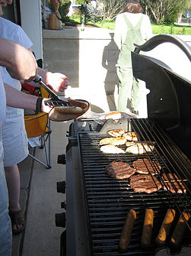
Reaction `stoichiometry’ problems
A sample reaction
C₃H₈ + O₂ CO₂ + H₂O
First concern:
Is the reaction as written balanced???
…no

Slide 8
Balancing a reaction
Unbalanced
_C₃H₈ + _O₂ _CO₂ +_H₂O
After blackboard balancing exercise
1C₃H₈ + 5O₂ 3CO₂ +4H₂O
Stoichiometric coefficients
C
H
O
3
8
10
3
8
10

Slide 9
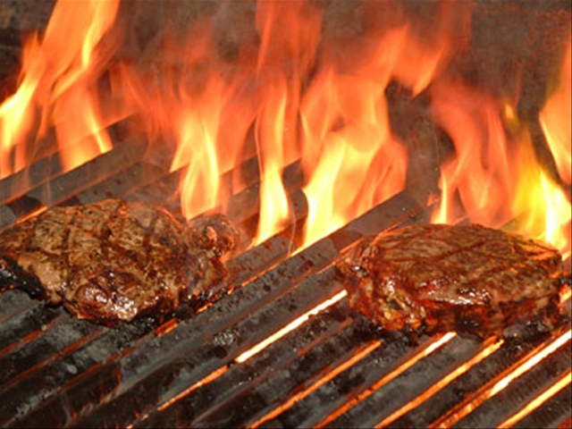
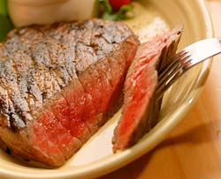
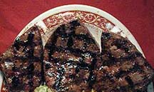
Sometimes several answers possible
Barbecuing steaks…
C₃H₈ + 5O₂ → 4H₂O +3CO₂
Complete combustion
C₃H₈ + 4O₂ → 4H₂O +2CO₂ + C
Incomplete combustion
C₃H₈ + 3O₂ → 4H₂O + CO₂ + 2C
C₃H₈ + 2O₂ → 4H₂O + 3C
Low O₂
→Low CO₂
₋→ High C
(charred)
Hi O₂
→Hi CO₂
→Low C
(no `char’)

Slide 10
Reaction Stoichiometry Problems part 1:
Class Practice Balancing Reactions
1
2
1
2
___CH₄ + ___O₂ __CO₂ + __H₂O
2
3
2
4
___CH₄ + ___O₂ __CO + __H₂O
3
1
1
3
__AgNO₃ + ___Na₃PO₄ __Ag₃PO₄ +___NaNO₃
2
6
2
3
____Al + ___HCl __AlCl₃ + ___H₂
Gasoline combustion reaction
2
25
16
18
__C₈H₁₈ + __O₂ __CO₂ + __ H₂O

Slide 11

“So…why give an excremental ejection about stoichiometric coefficients and equation balancing ???”

Slide 12

C₃H₈ + 5O₂--------> 3CO₂ + 4H₂O why care ???
In-class demonstration of the importance of
stoichiometry…..using a modest modification
of the story of Goldilocks and the 3 Bears
The unrepentant bad girl…
Goldilocks: known breaking and entering felon

Slide 13
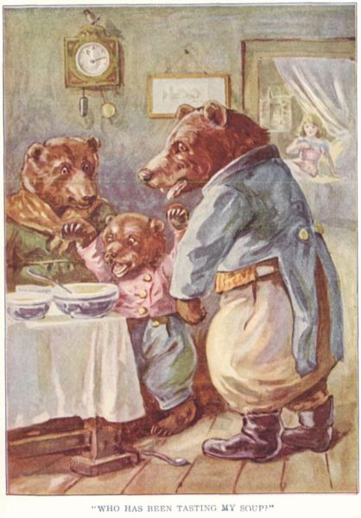
C₃H₈ + 5O₂--------> 3CO₂ + 4H₂O why care ???
The outraged victims….
Mama Bear
Papa Bear
O₂__ >> 5
C₃H₈
O₂ << 5
C₃H₈
The molested porridge
O₂ = 5..Just right
C₃H₈
Baby Bear

Slide 14
Take home message:
Good `cooking’-whether it be steaks or bombs, starts with controlling the stoichiometry…=> the porridge is just right

Slide 15

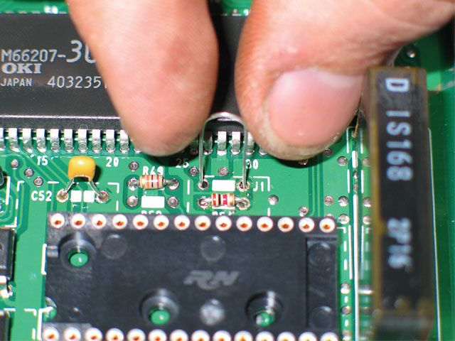
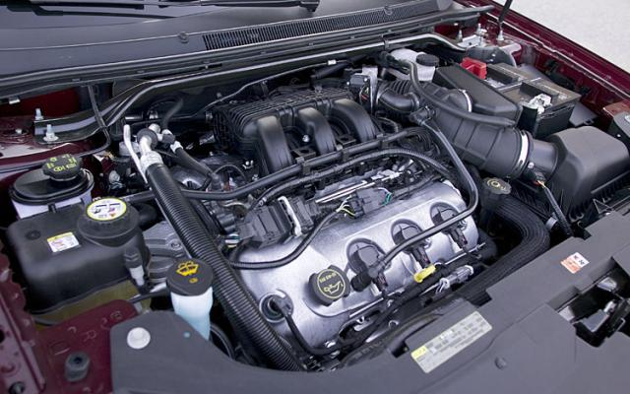
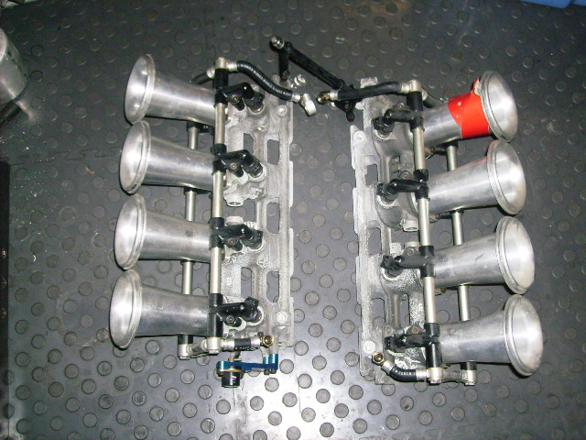
Individual fuel injectors
Stoichiometric control in the real world
Gas/O₂ ratio and flow rate to each fuel injector controlled by engine block microchip
Microchip controlling engine operation
V-8 fuel injection module
Goes under here*

Slide 16
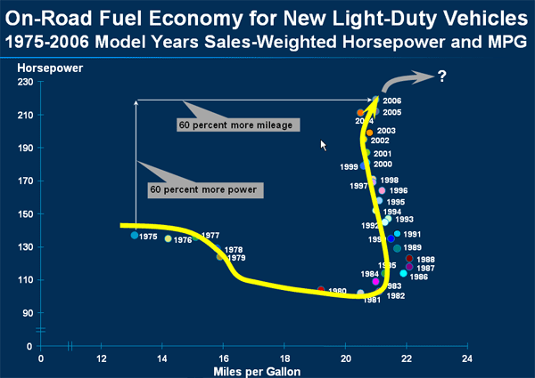
Variation of mpg and hp vs time for light-duty trucks
1975 US Congressional mandate for 23.5 mpg fleet average enacted
8 bit PROM chips become reasonably cheap

Slide 17

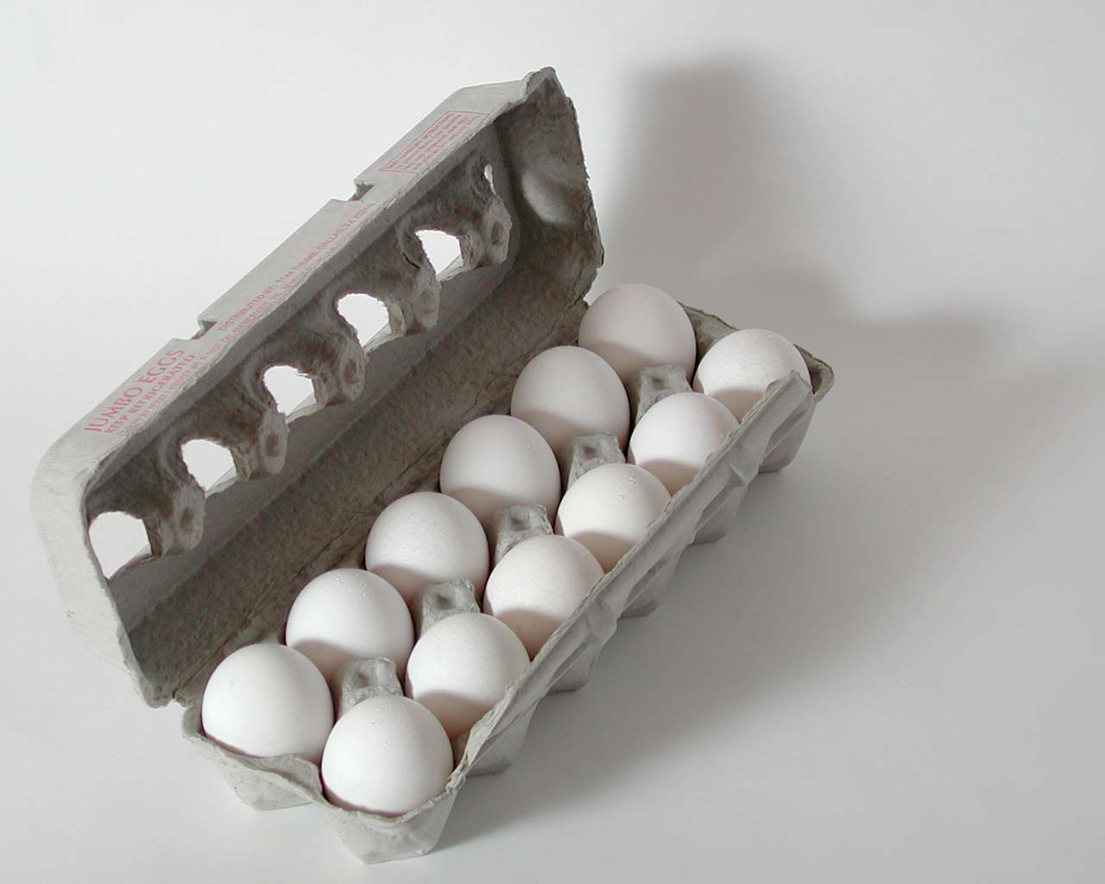
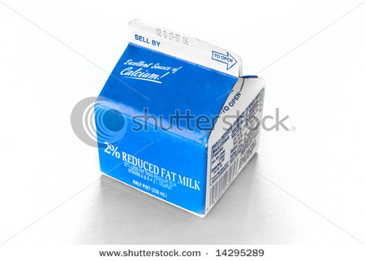
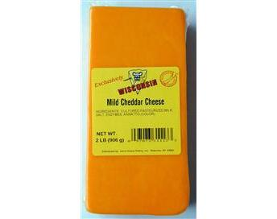
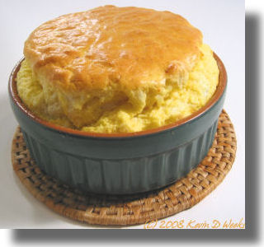
Stoichiometry is cooking: Recipe for egg and cheese souffle
IN
1
+
2
+
3
200 g/box
300 g/block
500 g/dozen
OUT
Mass of 1 output souffle ?
1 *300 g
+
2* 500 g
+
3*200
cheese
eggs
condensed milk
=1900 g/souffle

Slide 18
Cooking and stoichiometry
THE RECIPE
1
+
2
+
3
300 g/block
500 g/dozen
200 g/box
1900 g/souffle
How many….to make whole # of souffles ?
How many boxes of cream to make 4 souffles ?
12
600 grams cheese makes how many souffles ?
2
How many grams of eggs combine with 9 boxes of cream ?
3000 g
48 eggs combine with how many blocks of cheese ?
2

Slide 19
Cooking and stoichiometry (continued)
THE RECIPE
1
+
2
+
3
300 g/block
500 g/dozen
200 g/box
1900 g/souffle
*How many eggs needed to combine with 1200 g cream?
48
*900 grams cheese makes what weight of souffles?
5700 g
*1200 eggs combines with how many grams cheese?
1500 g
*How many boxes of cream combine with 600 g cheese
6

Slide 20
BLACKBOARD EXERCISES
Given the balanced chemical reaction
C₃H₈ + 5O₂--------> 3CO₂ + 4H₂O
Calculate the moles of O₂ necessary to produce 6 moles of CO₂
= 10 mol O₂
Calculate the grams of CO₂ created by burning 0.0757 moles of C₃H₈
= 10 grams CO₂

Slide 21
BLACKBOARD EXERCISES (continued)
Given the balanced chemical reaction
C₃H₈ + 5O₂--------> 3CO₂ + 4H₂O
Calculate the moles of H₂O formed by burning 400 grams of O₂
= 10 mol H₂O
Calculate the grams of O₂ to form 1.506*10²² H₂O molecules
=10.0 gram O₂

