Slide 1
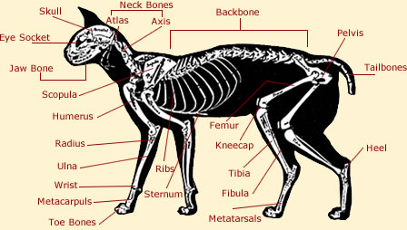

Moles: part 3 body parts (mole ratio) math: the knee bone is connected to the thigh bone….

Slide 2
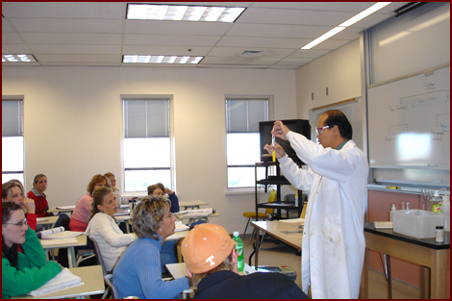
How many hands ???
1
6
5
2
3
4
7
9
8
10
11
2 hands
1 people
= 22 hands
11 people
x

Slide 3

How many toes connected to the hands (assuming no deformities) ?
5
4
3
2
1
5 hands
x
1 person
hand
10 toes
person
x
= 50 toes

Slide 4

Mole parts (ratios) math
given 6 moles C₃H₄O₆
How many moles of C ?
6 mol C₃H₄O₆ x 3 moles C =
1 mol C₃H₄O₆
18 moles C

Slide 5
Mole parts (ratio) math continued
Given 45 grams of C₆H₁₂O₆
…and MW of C₆H₁₂O₆
=180 g/mol
How many grams of C are present ??
First, convert mass to moles (all roads lead through moles)
45 g C₆H₁₂O₆
x 1 mole C₆H₁₂O₆
180 g C₆H₁₂O₆
= 0.25 moles
C₆H₁₂O₆

Slide 6
Mole parts (ratio) math
continued
Next, relate given moles to desired moles via mole ratio (need C moles )
0.25 moles C₆H₁₂O₆
6 mole C
1 mole C₆H₁₂O₆
x
???
=1.5 moles C
Finally, convert moles to grams in usual way:
x
12 g C
1 mole C
1.5 moles C
= 18 g C

Slide 7
Solving Mole parts (ratio) problems
Convert any given weight or molecule count to moles (“all roads lead through moles”)
Relate the computed moles above to desired moles
If necessary, convert desired moles to target grams or molecule count

Slide 8
In-class exercise #3b: chem 1114
Mole Calculations: part 2
3.1)mole to mole:
how many moles of O are present in 0.1666 mole of C₆ H₁₂O₆?
1 mol O
3.2) mole to mole
how many moles of C₆H₁₂O₆ can be made with 12 mole of O ?
2moles C₆H₁₂O₆

Slide 9
In-class exercise #7b: chem 1114 Mole Calculations: part 2
3.3) weight to moles
how many moles of C₆H₁₂O₆ in a sample containing 216 g C ?
3 mol
3.4) moles to weight
how many grams of C₆H₁₂O₆ are formed with 0.2666 mol H?
= 4 g

