Slide 1
Micro chip manufacture requires nearly oxygen-free conditions wherein the concentration of O₂ is at or below 17 pg/L. Given that the molecular mass of O₂ is 32 g/mol, about how many molecules of O₂ /L does this represent ? Note: 1 mol count=6.022*10²³
5.4*10²⁴
6.4*10¹²
3.2*10¹¹
1.9*10¹³
My answer is here

Slide 2
A brief digression on Avogadro’s Number N_{o}
1) There’s nothing magic or special about it. It reflects the arbitrary assumption of the use of grams to replace the unitless `relative’ masses in the Periodic Table. Change the choice of units…change N_{o}
2) Its’ magnitude has only definitively been determined in the 20th century (It’s a hard one to measure.) Until then, chemists got along just fine counting moles not atoms.

Slide 3
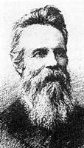
The evolution of Avogadro’s number, N_{o}
1st semi-ok guess in 1865
(N_{o} originally called Loschmidt’s Number)
Loschmidt 1865
N_{o}~72 *10²³

Slide 4
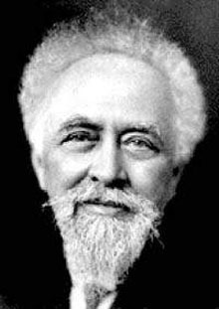
The evolution of Avogadro’s number, N_{o} (cont.)
Next big advance doesn’t come for 43 years
1908 Perrin
Uses 4 methods to find N_{o}; wins
Nobel Prize; re-names
N_{o} `Avogadro’s #’
N_{o} = 6.7 *10²³

Slide 5
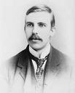
The evolution of Avogadro’s number, N_{o} (cont.)
Things pick up speed in the 20th century….in less than a year after Perrin’s work , a better N_{o} is obtained
1909 Rutherford
Counted alpha particles
N_{o}= 6.16*10²³

Slide 6
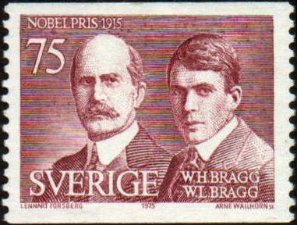
The evolution of Avogadro’s number, N_{o} (cont.)
Rutherford’s protégés at the Cavendish lab creep closer to the right value….
1918
The Braggs (father & son)
… win Nobel Prizes in Physics separately
Used x-rays and counted atoms in a unit cell
N_{o} =6.019*10²³

Slide 7
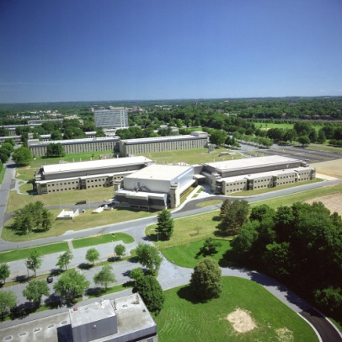
The evolution of Avogadro’s number, N_{o} (cont.)
….the current value…from NIST (National Institute of Standards & Technology)
2001
De Bièvre et. al.
NIST Gaithersburg Md
N_{o} =6.022133530*10²³

Slide 8
The evolution of Avogadro’s number, N_{o} reflects the technological advance of our speices
1865 N_{o}~ 72 *10²³
1908 N_{o} = 6.7 *10²³
1909 N_{o}= 6.16*10²³
1918 N_{o} = 6.019*10²³
2001 N_{o} = 6.022133530*10²³

