Slide 1
The gram molecular mass of o ‘crystal meth’ is 149.2 g/mol. How many moles of crystal meth are in a typical street `teenth’ = 1/16 of an ounce= 1.80 grams ?
(1 mol count=6.022*10²³ .)
7.27*10²¹
0.0121
82.9
2.48*10⁻²²
My answer isn’t above

Slide 2
B1-Aflatoxin (MW=328.2 g/mol) is a naturally occurring, horribly toxic poison derived from Aspergillus fungi, a common contaminant in corn. It causes cancer in most humans at the staggeringly low exposure level of 1*10¹⁷ molecules. What is the equivalent mass of aflatoxin represented by this count ? ( 1 mol count=6.022*10²³ .)
3.28*10⁻¹⁵ g
1.84*10⁻⁴ g
5.45*10⁻⁵ g
5.06*10⁻¹⁰ g
1.98*10⁻¹⁰ g
6.02*10⁶ g
My answer isn’t above

Slide 3
Micro chip manufacture requires nearly oxygen-free conditions wherein the concentration of O₂ is at or below 17 pg/L. Given that the atomic mass of O is 16 g/mol, about how many molecules of O₂ /L does this represent ? Note: 1 mol count=6.022*10²³
5.4*10²⁴
3.5*10²²
5.3*10²²
3.2*10¹¹
6.4*10¹²
1.9*10¹³
My answer isn’t above

Slide 4
A brief digression on Avogadro’s Number N_{o}
1) There’s nothing magic or special about it. It reflects the arbitrary assumption of the use of grams to replace the unitless `relative’ masses in the Periodic Table. Change the choice of units…change N_{o}
2) Its’ magnitude has only definitively been determined in the 20th century (It’s a hard one to measure.) Until then, chemists got along just fine counting moles not atoms.

Slide 5
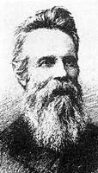
The evolution of Avogadro’s number, N_{o}
1st semi-ok guess in 1865
(N_{o} originally called Loschmidt’s Number)
Loschmidt 1865
N_{o}~72 *10²³

Slide 6
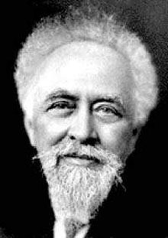
The evolution of Avogadro’s number, N_{o} (cont.)
Next big advance doesn’t come for 43 years
1908 Perrin
Uses 4 methods to find N_{o}; wins
Nobel Prize; re-names
N_{o} `Avogadro’s #’
N_{o} = 6.7 *10²³

Slide 7
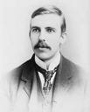
The evolution of Avogadro’s number, N_{o} (cont.)
Things pick up speed in the 20th century….in less than a year after Perrin’s work , a better N_{o} is obtained
1909 Rutherford
Counted alpha particles
N_{o}= 6.16*10²³

Slide 8
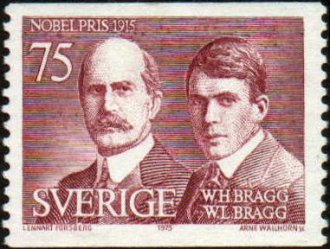
The evolution of Avogadro’s number, N_{o} (cont.)
Rutherford’s protégés at the Cavendish lab creep closer to the right value….
1918
The Braggs (father & son)
… win Nobel Prizes in Physics separately
Used x-rays and counted atoms in a unit cell
N_{o} =6.019*10²³

Slide 9

The evolution of Avogadro’s number, N_{o} (cont.)
….the current value…from NIST (National Institute of Standards & Technology)
2001
De Bièvre et. al.
NIST Gaithersburg Md
N_{o} =6.022133530*10²³

Slide 10
The evolution of Avogadro’s number, N_{o} reflects the technological advance of our speices
1865 N_{o}~ 72 *10²³
1908 N_{o} = 6.7 *10²³
1909 N_{o}= 6.16*10²³
1918 N_{o} = 6.019*10²³
2001 N_{o} = 6.022133530*10²³

Slide 11
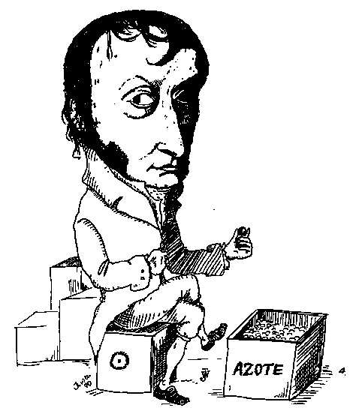
And yet little more trivia about Avogadro’s #, N_{o}
Avogadro Myth debunked:
Avogadro never derived N_{o} and did not count the N₂ molecules in a flask (as the cartoon to the left suggests…)
Lorenzo Romano Amedeo Carlo Avogadro di Quaregna e di Cerreto, Count of Quaregna and Cerreto (9 August 1776 – 9 July 1856)
...ostensibly counting `azote’ = Nitrogen molecules

Slide 12
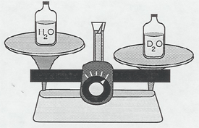
His real contribution: Avogadro’s Gas Law
“Equal numbers of gas particles occupy the same volume if at the same temperature and pressure regardless of gas identity.”
Y nitrogens
weigh 28 g
Y oxygens
weigh 32 g
=> Experimental path to finding the relative masses of elements on Periodic table
Y *Mass of one O atom = 32 g
= 16
14
Y* Mass of one N atom 28 g
Now unit-less ratio
See Periodic table entries

Slide 13
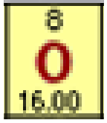
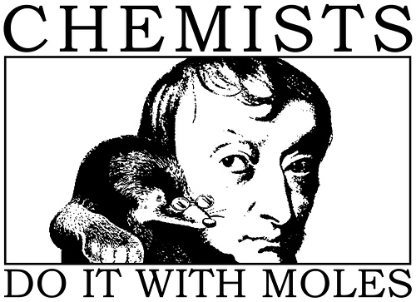
I gave you this…
NOT this….
N_{o} =6.022 133530*10²³

Slide 14
How gram atomic masses (AW) let us know the ratios of atoms in compounds (even if we don’t know how big N_{o} is)
EXAMPLE 1:
Element
C
O
Mass of element in X
GAW
# mole
24.0 grams
12.0 grams/mol C
24/12=2
64.0 grams
16.0 grams/mol O
64/16=4
What is the ratio C atoms to O atoms in compound X ?
2C to 4O
=> C₂O₄
= CO₂

Slide 15
How gram atomic masses (AW) let us know the ratios of atoms in compounds (cont.)
EXAMPLE 2:
Element
C
H
Mass of element in Y
GAW (grams/ mol)
# mol
6.0 grams
12.0 grams/mol C
6/12= ½
2.0 grams
1.0 grams/mol H
2/1 =2
What is the ratio of H to C atoms in compound Y ?
2 H to ½ C
x 2
=> C_{1/2}H₂
CH₄

Slide 16
How gram atomic masses (AW) let us know the ratios of atoms in compounds (cont.)
EXAMPLE 3:
Element
C
H
O
Mass of element in Z
GAW (grams/1 mol)
#mol
8.0 grams
12.0 grams/mol C
8.0/12=0.666
2.0 grams
1.0 grams/mol H
2.0/1= 2.0
5.33 grams
16.0 grams/mol O
5.33/16=0.333
What is the ratio of C to H to O atoms in Z ?
Mol C Mol H Mol O
0.666
2.0
0.333
How to simplify to produce whole numbers only ?
Divide by smallest mol count
0.666
0.333
2.0
0.333
0.333
0.333
2 6 1
=> C₂H₆O (grain alcohol)

Slide 17

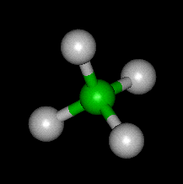
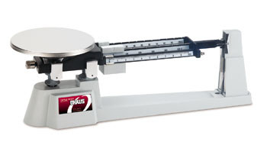
% composition problems: using mole concept to convert weights to formulas
Sample problem #1
A compound of N and O contains 63.63 wt % N and 36.36 wt % O. What is the empiric formula of the compound ?
empiric formula= mole ratio of elements in compound expressed in lowest whole numbers
Definition:
Example: CH₂O = empiric formula of glucose
Actual molecular formula (what it really has in atom count)
C₆H₁₂O₆=
(CH₂O)₆
Sugar =Carbo hydrate

Slide 18
Which formulas below are empiric
(= lowest common denominator form) ??
÷ 3
EMPIRIC
C₃H₆O₃
NOT EMPIRIC
CH₂O
N₃F₇
EMPIRIC…3 & 7 have no shared factors
H₃P₉O₁₂S₅
EMPIRIC …5 has no shared factors with 3,9 or 12
Do not write HP₃O₄S_{5/3}

Slide 19
Sample problem #1 continued
A compound of N and O contains 63.63% N and 36.36 %O. What is the empiric formula of the compound ?
table approach
=>N₂O
=Laughing gas
Dinitrogen monoxide
CORRECT NAME…
n
n_{min}
element
N
O
w(g)
AW=Atomic wt (g/mol)
n=w/AW
moles
63.63
14
63.63/14=
4.545
4.545 = 2
2.273
36.36
36.36/16=
2.273
2.273 =1
2.273
16

Slide 20
Problem 2: formula determination with a few more twists
A compound contains: 0.3158 g C, 0.0526 g H and 0.631 g O. It’s molecular weight (MW) is 228 g/mol. What is the molecular formula of the compound ?
element
C
H
O
AW (g/mol)
n=w/AWmoles
n
n _{min}
x 2 to get whole #
w(g)
0.3158
0.0526
0.631
12
1
16
0.0263 = 1
0.0263
0.3158/12=0.0263
1*2=2
0.0526/1
=0.0526
0.0526 = 2 0.0263
2*2=4
0.631/16
=0.0394
0.0394=1.5
0.0263
2*1.5=3

Slide 21
Problem 2: formula determination with a few more twists (continued)
From table: Empirical formula…C₂H₄O₃
Empiric mass = 2*12 + 4*1 + 3*16= 76
Given Molecular mass =228 g/mol
Compute ratio of molecular mass to empiric mass (> 1)
Molecular mass = 228 = 3
Empiric mass 76
Molecular formula= C_{2*3} H_{4*3} O_{3*3}
= C₆ H₁₂ O₉

Slide 22
In-class exercise Chemical Composition
Element | Weight % | Atomic mass | moles | ratio
C | 27.27 | 12 g/mol
O | 72.73 | 16
27.27/12
=2.2725
1
4.5456/2.2725 =2
72.73/16
=4.5456
C₁O₂=CO₂
Empiric formula: ____________________
Element | Weight % | Atomic mass | moles | ratio
C | 33.3 | 12
H | 8.3 | 1
O | 44.4 | 16
33.3/12
=2.775
1
8.3/2.775
=3
8.3/1=8.3
44.4/16
=2.775
1
Empiric formula: _____C₁H₃O₁___= CH₃O____

Slide 23
Molecular formula problem
A compound contains: 0.3158 g C, 0.0526 g H and 0.631 g O. It’s molecular weight (MW) is 228 g/mol. What is the molecular formula of the compound ?
element
C
H
O
AW (g/mol)
n=w/AWmoles
n
n _{min}
x 2 to get whole #
w(g)
0.3158
0.0526
0.631
12
1
16
0.0263 = 1
0.0263
0.3158/12=0.0263
1*2=2
0.0526/1
=0.0526
0.0526 = 2 0.0263
2*2=4
0.631/16
=0.0394
0.0394=1.5
0.0263
2*1.5=3

