Slide 1
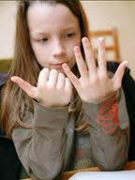
How do chemists count atoms
and molecules without actually
having to count them ???
read Chapter 3: sections 3.1-3.4

Slide 2

Chemists count atoms and molecules using…
Moles

Slide 3
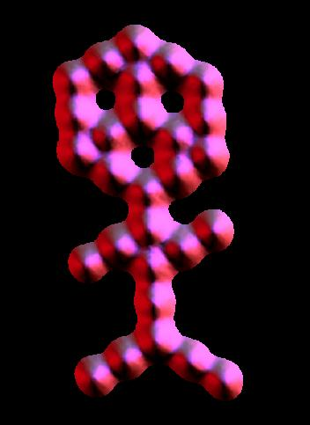
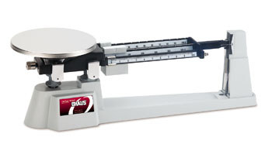

A trip to Mole land…
Moles connect the atomic world to human world
~ 10²⁷ molecules in the shape of a couch potato
~0.00000002 m
~2 m
~30 CO₂ molecules arranged in shape of muffin man (IBM)
Moles allow us to conveniently connect between these worlds using a scale.

Slide 4
The mole: starting definitions
What is a chemical mole ?
The classic textbook rant…….(but not your text’s rant, fortunately)
≡ # atoms in 12.000 g of ¹²C
≅ 6.0221335 *10²³ atoms
(Avogadro’s Number)
…Not that helpful when first starting out… ☹

Slide 5
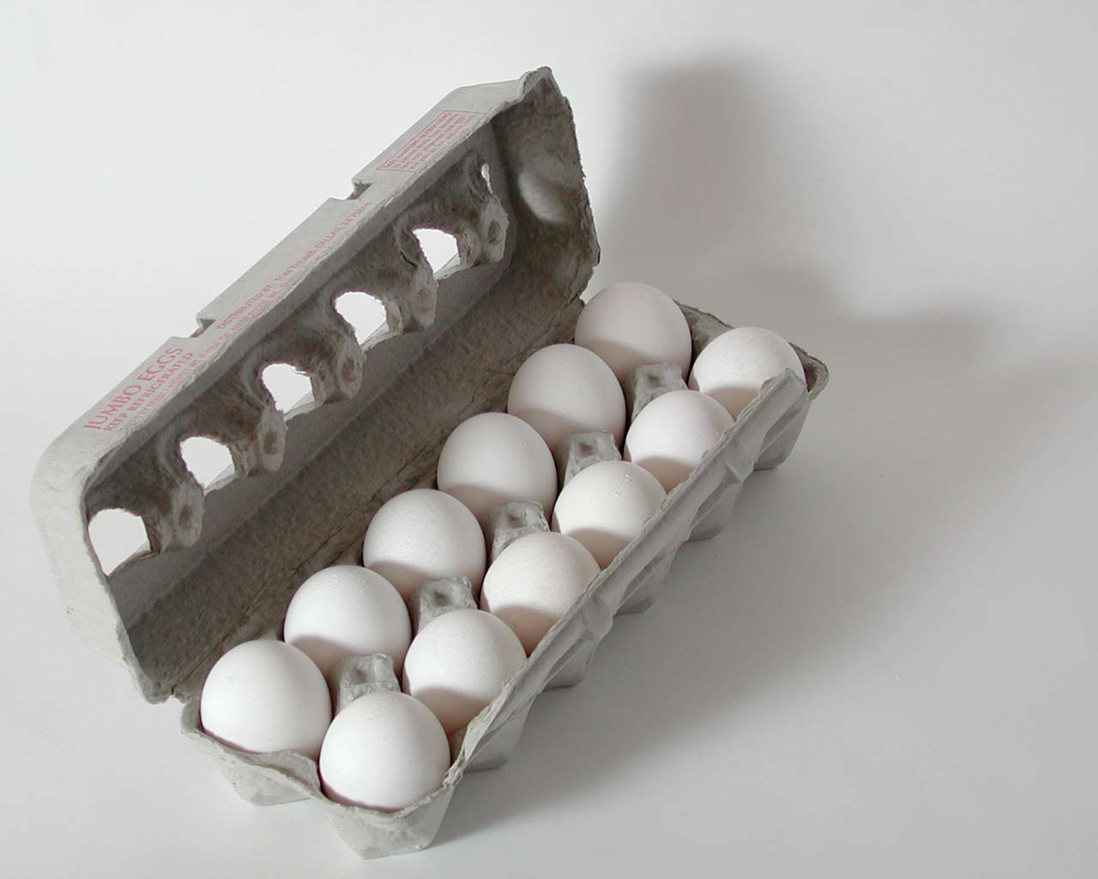
A better beginning:
the mole concept is really …
the same idea as a `dozen.’
≈

Slide 6
IN-CLASS EGG CALCULATIONS

Slide 7
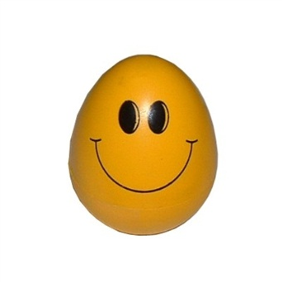
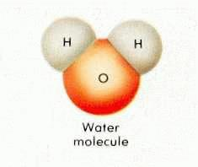
EGG WORLD
CHEMISTRY WORLD
Smallest unit
1 egg
1 molecule
Practical
Counting unit
Mole
(The chemist’s dozen)
Dozen

Slide 8
Eggs vs. chemistry world (continued)
EGG WORLD
CHEMISTRY WORLD
# units in practical counting unit
1 dozen=12
1 mole ≈ 6.022 *10²³
(Avogadro’s #)
grams/mole
=gram molecular weight
= MW (molecular weight)
(ADD)
Practical mass unit
grams/dozen
(WEIGH)

Slide 9
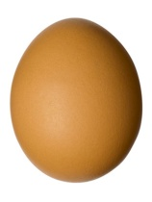
THE ONE PLACE EGG WORLD AND CHEMISTRY WORLD DEVIATE A TEENY BIT:
Egg world
Chemistry world
Mass
dozen
Mass = molecular weight
mol (MW)
Must weigh box of eggs
Just add up atomic masses using Periodic Table in grams

Slide 10
Mass (grams) = MW=Molecular
mol Weight
= sum of masses in grams of component elements in a compound .
(element masses are average masses taken from Periodic Table)

