Slide 1

15 μm = ??? pm

Slide 2

2 ways to convert between metric units
1) Algebraic (‘Marine’ way)
Doc’s story about his HS chem teacher
Divide and conquer,
maggot !

Slide 3
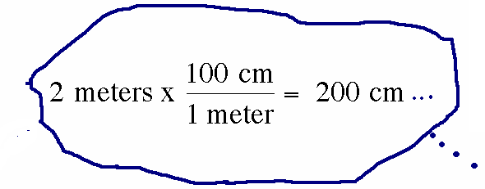
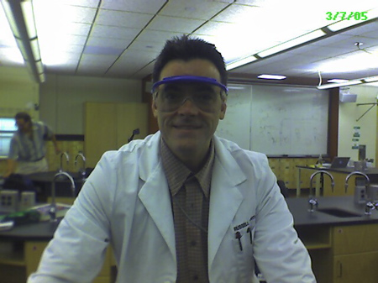
2) Factor-label (commonly taught by high school teachers)

Slide 4
15 μm = ??? pm
Done two ways on blackboard

Slide 5
Guided practice Unit conversions
(via factor-label & Algebraic)
answers
Convert 45.7 kg to g
4.57*10⁴ g
Convert 0.73 mL to μL
730 μL =7.3*10² μL
Convert 100 ps to ns
100 ps =0.1 ns
Convert 7.2 kg/L to mg/ μL
7.2 mg/μL

Slide 6
Convert 100 pm to nm
0.01 nm
0.001 nm
1 nm
0.1 nm
No clue…help !

Slide 7
Convert 5000 kg to Mg
5 Mg
50 Mg
0.5 Mg
500 Mg
Still no clue…need nap

Slide 8
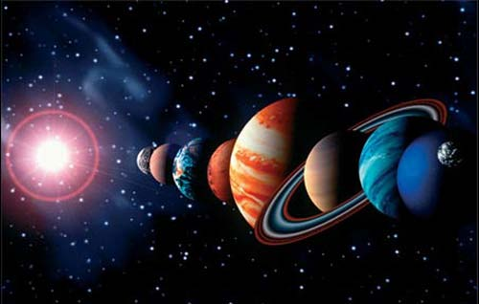
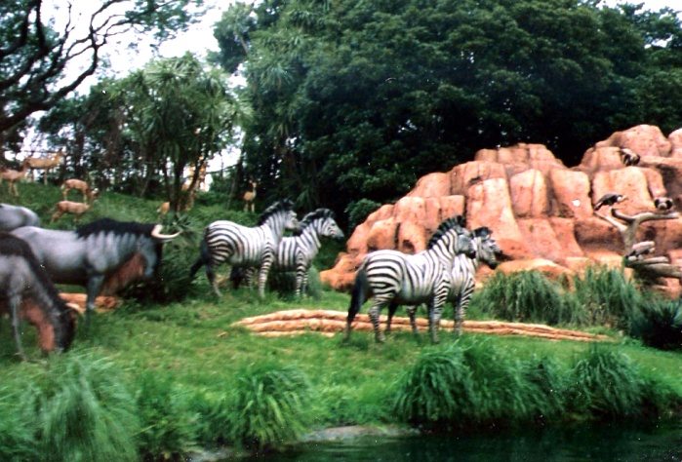
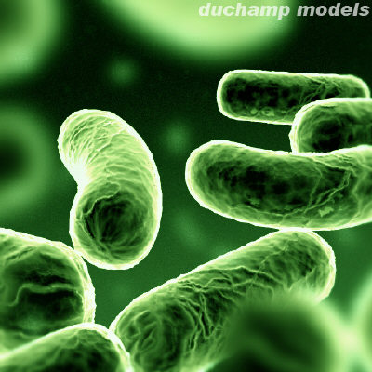
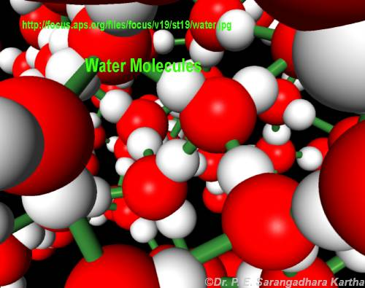
INTRO TO MOLES: Every science involves counting
Astronomers count ……
Animal biologists count …….
Bacteriologists count …..
Chemists count…….

Slide 9

Doc asks another dumb question:
How long would it take the current, fastest computer in the world (The Chinese Tihane-2 as of June 2013 ) to count all the molecules of water in a teacup assuming it counted at its maximum processor rate =
34,000,000,000,000,000 molecules/second
(=3400 THz=3.4*10⁶ GHz¹ ) ?
Answer: ~ 3.2 years
¹ ~ 1 million times faster than a typical laptop

Slide 10

How do chemists count atoms
and molecules without actually
having to count them ???
read Chapter 3: sections 3.1-3.4

