Slide 1
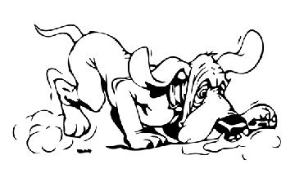
Ion formation viewed a different way: `redox’ reactions (pp 64-67)
Ionic compound formation results from e⁻ `pitch and catch’
e-
Na + Cl
Na⁺ Cl⁻
Loses e-
Gains e-
Reduction-oxidation
Abbreviated as Redox
Na pitches
=> oxidized (ox)
Cl catches
=> reduced (red)
ox=oxidation
red= reduction

Slide 2
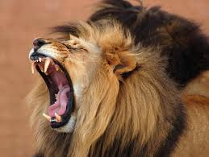
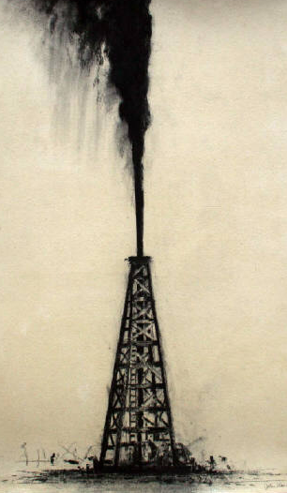
Old school Memory devices:
e-
Na + Cl
Na⁺ Cl⁻
Loses e-
Gains e-
ox=oxidation
red= reduction
Leo-Ger
Lose electrons oxidation-Gain electrons reduction
Oil
Rig
Oxidation is losing (e-).
Reduction is gaining (e-).

Slide 3
Identifying who loses and gains….follow the charge change
ID `ox’ and ‘red’ in reaction below
2e-
Mgº + Cu²⁺
Mg ²⁺ + Cuº
Loses 2e-
Gains 2e-
Memory device: Leo-Ger
Lose electrons oxidation (ox)
Gain electrons reduction (red)
ox
red
2e-
+1
-1
2Naº + Cl₂
2NaCl
Loses 2e-
Gains 2e-
…more practice in class on board….
ox
red

Slide 4
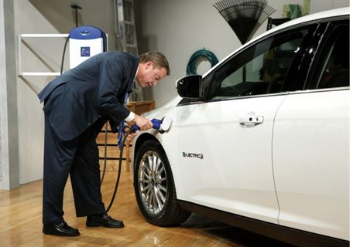
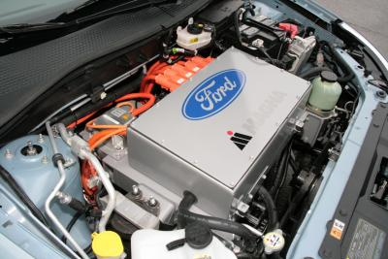
Ford Focus all electric car
High surface area lithium ion batteries

Slide 5
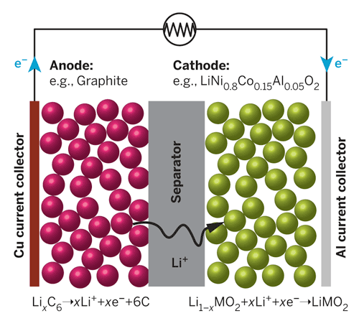
Power cycle – what happens as you drive
Key Chemistry trick:
LOAD
0
+1
Li_{x} C₆→ xLi⁺ + 6C + xe-
Anode (left side =ox)
+1
0
Li_{1-x}CoO₂ + xe- + xLi+→LiCoO₂
Cathode (right side=red)
Liº embedded in `intercalation’ compounds on both sides

Slide 6
http://www.youtube.com/watch?v=6evFK8y-zdw

Slide 7
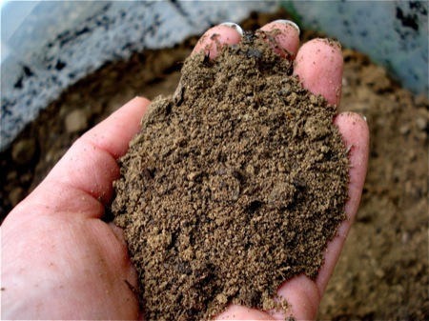
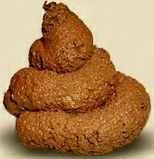
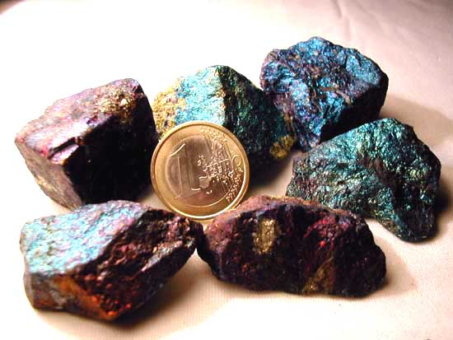
What we’ve just covered…
CHAPTER 2: DIRT
Answer: mostly ionic bonds between (+) and (-) atoms with inert gas count of electrons.
Practical bonus: electron motion as ions form can do useful work, .e.g. make a battery
On to the organic stuff
What makes rocks the way they are ?
(text version, p. 46
“Why do minerals exist?”
Inorganic stuff

Slide 8
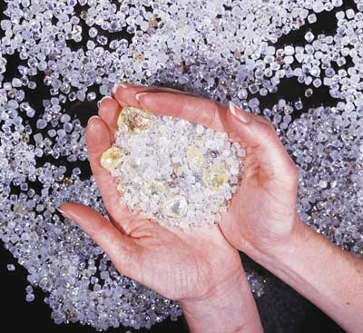
Chapter 3: Diamonds
Chapter 2: Dirt
What about the organic stuff ???
What holds together diamonds, poo and you ???
(text version: Why is carbon special ?)

Slide 9
Organic (Plastics, poo and you) vs. Inorganic (Minerals/Rocks)
Organics Inorganics
Ex: Saran wrap
Ex. limestone
Mostly made of C, H, O Some N (minor pieces of rest of Periodic Table
Mostly made of Metals, O, rest of Periodic Table
(C plays only a small part)
Main electronic arrangement: covalent bonds
Main electronic arrangement:
Ionic bonds

Slide 10
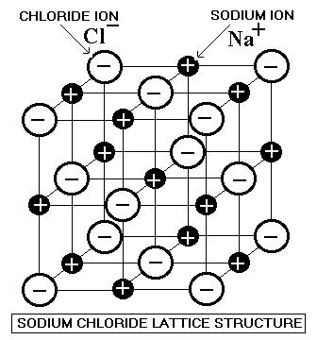
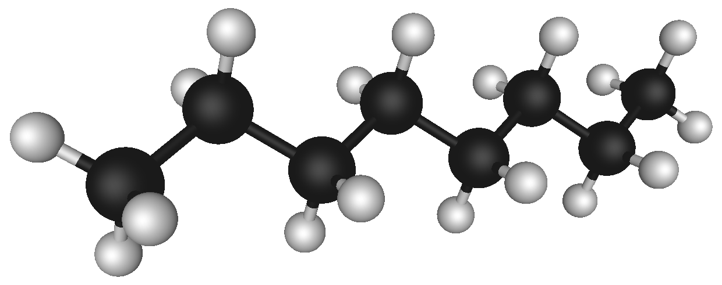
Organics vs Inorganics : the difference in picture form
covalent bond: the `new’ idea
ionic bond
Organics Inorganics
Octane ( gasoline) 2D image
Octane in 3D
model
Note the absence of charge in organic picture

Slide 11
Language basics of the `covalent’ bond
Other common names for covalent bond
Electron pair bond
Valence bond or valence pair bond
Lewis pair bond
Shared electron bond

Slide 12
Language basics of the `covalent’ bond
Bond language and electronic book keeping: part 1
1 line= single bond with 2 electrons
(bond order 1)
2 lines= double bond
with 2 x 2= 4 electrons
(bond order 2)
# bonds
7
6
Total of bonding e-
7 x2=14
6 x 2=12

Slide 13
Language basics of the `covalent’ bond
Bond language and electronic book keeping: part 1 (continued)
3 lines = triple bond
With 3 x 2= 6 electrons
(bond order 3)
# bonds
5
Total of bonding e-
5 x 2=10

Slide 14
In-class Board practice counting bonds and electrons for organics

