Slide 1
Summary: How to Construct Binary Salt and Mineral Compounds
If two elements are combined, the one further to the left side of the table is the + species while the one further to the right side is the – species. (Ex. Ca + C=> Ca→Ca²⁺ C→ C⁴⁻
If two elements in same column, the lower mass element is more -, the higher mass element is more +
Salt and mineral compounds are always neutral (no net charge) in their solid forms.
`Crossing’ trick determines formula (which balances charges)

Slide 2
Crossing the charge trick reviewed
Write stable ions of Na and O
Na⁺¹
O²⁻
2
1
Neutral compound formed
Na₂O₁ = Na₂O
2 x (+1 ) + 1 x (-2) =
2 - 2 = 0

Slide 3
In-class EXERCISE #1
(mole buck challenge)
1.1. Stable Charges
Use the Periodic Table to deduce the likely charges on the elements below
S Mg N As F Al C Sr Li
-2
+2
-3
-3
-1
+3(-5)
+4,-4
+2
+1
1.2 Predict compound formulas for combinations of the elements paired below
Na + P
Mg + F
K + O
Ca + O
Ba + N
Al + Cl
Al + O
Na₃P
MgF₂
K₂O
CaO
Ba₃N₂
AlCl₃
Al₂O₃

Slide 4
Beyond Binary salts
Binary salts have just two elements
NaCl
CaO
AlCl₃
Ca₃P₂
More complex salts have more than 2 elements
Na₂SO₄
Na⁺ and SO₄²⁻
K₃PO₄
K⁺ and PO₄³⁻
Groups like SO₄²⁻ and PO₄³⁻ are called: `oxyanions’

Slide 5
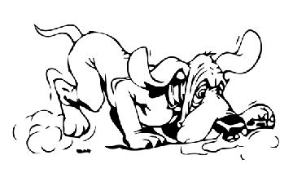
1.3 Deducing element charges in ionic fragments
(left most element in ion fragments are + charged. The fragment charge
means the species is not neutral but bears the charge indicated)
What is the stable charge of O ? ____
What is the charge on S in SO₄²⁻
(the sulfate anion) ? _____
Is this consistent with the Periodic ion
trends discussed for elements ?*
What is the charge on N in NO₃⁻
(the nitrate anion) ? ______
-2
+6
*S should be -2. Not consistent with asserted trends for elements in minerals and salts
+5

Slide 6
Is N⁵⁺ consistent with Periodic ion trends
discussed for the elements ?_**
What is the charge on P in PO₄³⁻
(the phosphate anion) ? _______
Is this consistent with Periodic ion trends
discussed for the elements ?***
**N should be -3. Not consistent with asserted trends for elements in minerals and salts
5+
***P should be -3. Not consistent with asserted trends for elements in minerals and salts

Slide 7
+3
What is the charge on N in NO₂⁻ ? _____
Is this consistent with Periodic ion
trends discussed for the elements ?****
If N’s charge is +5, what would each O
have to be in charge in NO₂⁻ ? _____
****N should be -3. Not consistent with asserted trends for elements in minerals and salts
-3

Slide 8
What the implied element charges in ionic fragments (`oxyanions’) teaches us
The simple charge assignment rules and `crossing’ pattern that works for ionic crystal and mineral compounds are not the whole story. *
*On pp 51-52, figure 2.9 Waldron introduces not only ionic bonding but `covalent’ bonding as a mode of connecting atoms together. The `closer’ elements are to each other in character, the more covalent bonding dominate. Electronegativity quantifies that ‘closeness’. (see also: homework 2 problem 3)

Slide 9
What the implied element charges in ionic fragments (`oxyanions’) teaches us
Consider exercise 1 example SO₄^{2- .} Ionic bonding=> O²⁻ , S⁶⁺ ??
Electronegativity of O= 3.5
Electronegativity of S= 2.5
difference = 1.0 <2.0 => covalent not ionic bonding
Figure 2.9
Pg. 52
Even in ions , non-ionic (“covalent”) behavior lurks

Slide 10
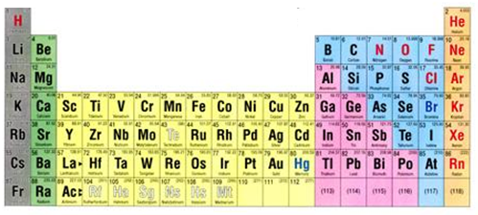
Review of ionic model for how table salt forms
e-
Na + Cl
Na⁺ Cl⁻
+
11 e⁻ → 10 e⁻
17 e-→ 18 e-
(+) and (-)attracted to each other to form ionic bond
Ne
Ar

Slide 11
Ion formation viewed a different way: `redox’ reactions (pp 64-67)
Ionic compound formation results from e⁻ `pitch and catch’
e-
Na + Cl
Na⁺ Cl⁻
Loses e-
Gains e-
Reduction-oxidation
Abbreviated as Redox
Na pitches
=> oxidized (ox)
Cl catches
=> reduced (red)
ox=oxidation
red= reduction

Slide 12
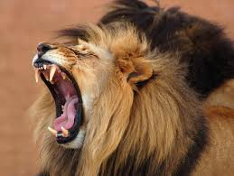

Old school Memory devices:
e-
Na + Cl
Na⁺ Cl⁻
Loses e-
Gains e-
ox=oxidation
red= reduction
Leo-Ger
Lose electrons oxidation-Gain electrons reduction
Oil
Rig
Oxidation is losing (e-).
Reduction is gaining (e-).

Slide 13
Identifying who loses and gains….follow the charge change
ID `ox’ and ‘red’ in reaction below
2e-
Mgº + Cu²⁺
Mg ²⁺ + Cuº
Loses 2e-
Gains 2e-
Memory device: Leo-Ger
Lose electrons oxidation (ox)
Gain electrons reduction (red)
ox
red
2e-
+1
-1
2Naº + Cl₂
2NaCl
Loses 2e-
Gains 2e-
…more practice in class on board….
ox
red

Slide 14
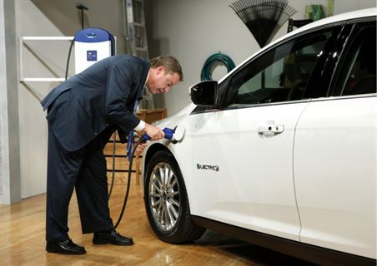
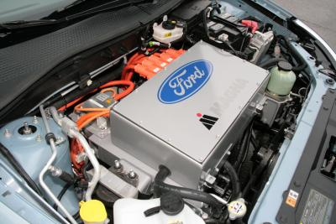
Ford Focus all electric car
High surface area lithium ion batteries

Slide 15
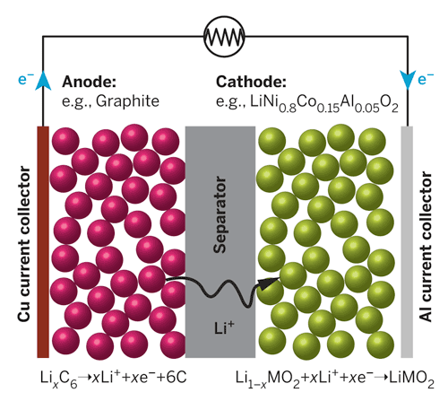
Power cycle – what happens as you drive
Key Chemistry trick:
LOAD
0
+1
Li_{x} C₆→ xLi⁺ + 6C + xe-
Anode (left side =ox)
+1
0
Li_{1-x}CoO₂ + xe- + xLi+→LiCoO₂
Cathode (right side=red)
Liº embedded in `intercalation’ compounds on both sides

Slide 16
http://www.youtube.com/watch?v=6evFK8y-zdw

Slide 17
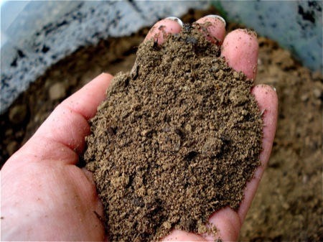
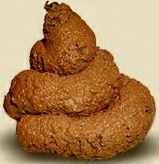
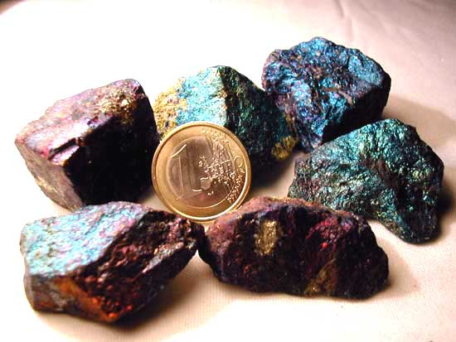
What we’ve just covered…
CHAPTER 2: DIRT
Answer: mostly ionic bonds between (+) and (-) atoms with inert gas count of electrons.
Practical bonus: electron motion as ions form can do useful work, .e.g. make a battery
On to the organic stuff
What makes rocks the way they are ?
(text version, p. 46
“Why do minerals exist?”
Inorganic stuff

Slide 18
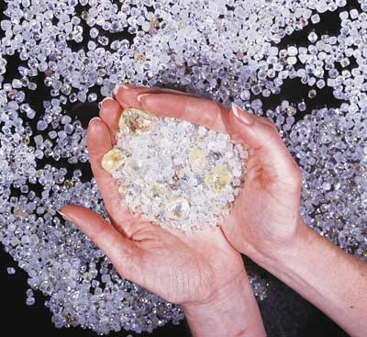
Chapter 3: Diamonds
Chapter 2: Dirt
What about the organic stuff ???
What holds together diamonds, poo and you ???
(text version: Why is carbon special ?)

Slide 19
Organic (Plastics, poo and you) vs. Inorganic (Minerals/Rocks)
Organics Inorganics
Ex: Saran wrap
Ex. limestone
Mostly made of C, H, O Some N (minor pieces of rest of Periodic Table
Mostly made of Metals, O, rest of Periodic Table
(C plays only a small part)
Main electronic arrangement: covalent bonds
Main electronic arrangement:
Ionic bonds

Slide 20
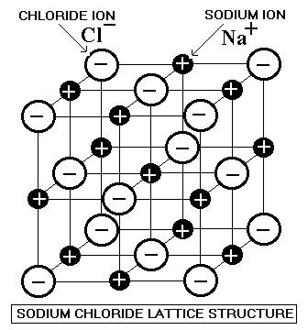
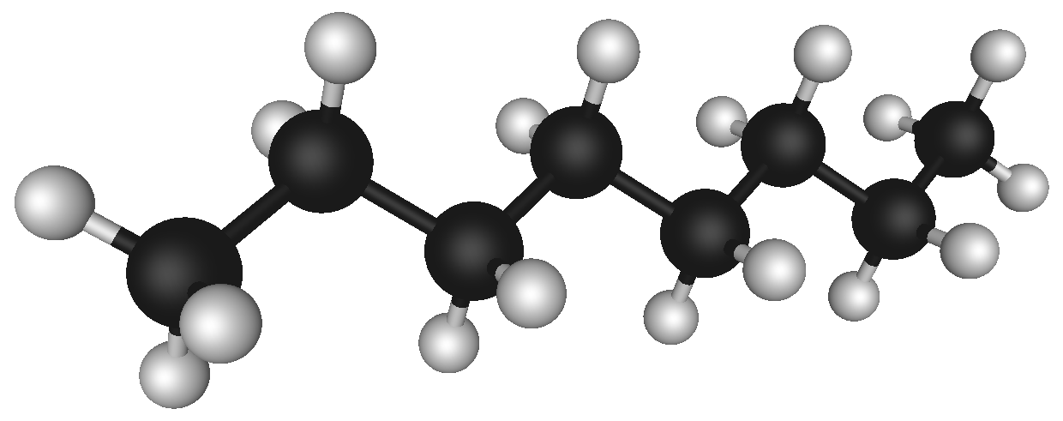
Organics vs Inorganics : the difference in picture form
covalent bond: the `new’ idea
ionic bond
Organics Inorganics
Octane ( gasoline) 2D image
Octane in 3D
model
Note the absence of charge in organic picture

Slide 21
Language basics of the `covalent’ bond
Other common names for covalent bond
Electron pair bond
Valence bond or valence pair bond
Lewis pair bond
Shared electron bond

Slide 22
Language basics of the `covalent’ bond
Bond language and electronic book keeping: part 1
1 line= single bond with 2 electrons
(bond order 1)
2 lines= double bond
with 2 x 2= 4 electrons
(bond order 2)
# bonds
7
6
Total of bonding e-
7 x2=14
6 x 2=12

Slide 23
Language basics of the `covalent’ bond
Bond language and electronic book keeping: part 1 (continued)
3 lines = triple bond
With 3 x 2= 6 electrons
(bond order 3)
# bonds
5
Total of bonding e-
5 x 2=10

Slide 24
In-class Board practice counting bonds and electrons for organics

