Slide 1
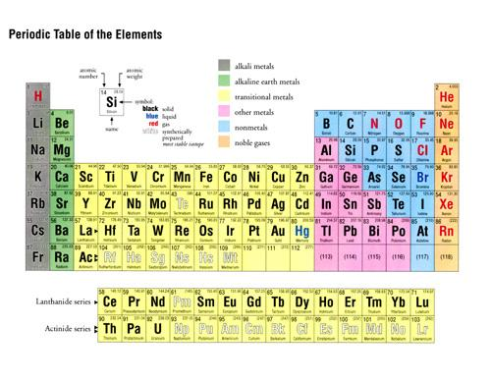
WHICH ELEMENTS REACT LIKE CRAZY ???
CHALCOGENS
PNICTOGENS
HALOGENS
ALKALI METALS
ALKALINE EARTH METALS

Slide 2
EXAMPLES OF HALOGEN REACTIVITY combining Na and Cl
2Na(s) + Cl₂ (g) → 2NaCl (s)
A mineral or `salt’
Combining Al with Br
2Al(s) + 3Br₂(g)→ 2AlBr₃(s)

Slide 3
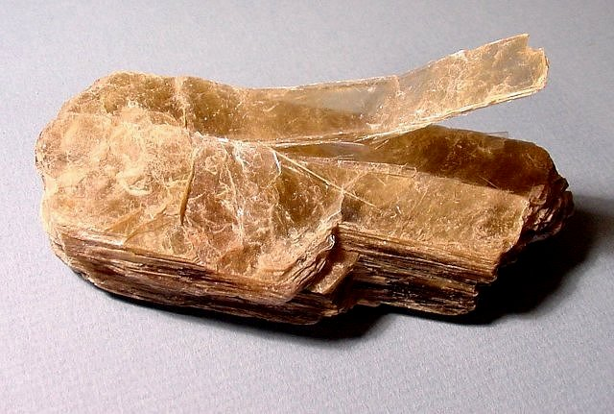
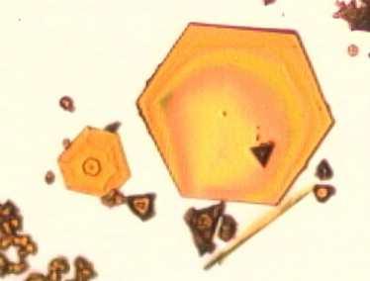
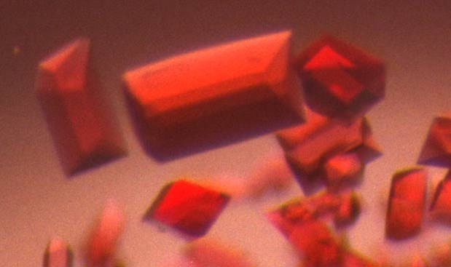
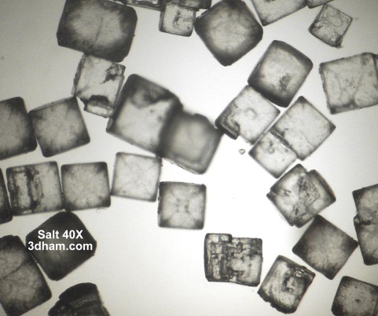
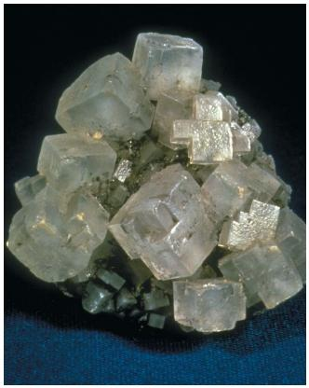
COMMON PROPERTIES OF MINERALS / SALTS
Hard /brittle (mica example)
High melting (800-2000 ºC)
Melts readily conduct electricity
Often soluble in water (demo)
Water solutions of salts and minerals readily conduct electricity (demo)
Structurally ordered (cubes, hexagons, rhomboids) => atomic order is simple
PbI₂
Cytochrome f
NaCl

Slide 4
What the properties of minerals/salts teach
Table salt in water
Salt dissolves easily
Salt doesn’t come back as solid spontaneously
Salt solution is colorless and clear=>homogeneous
(~ atomic scale bits and pieces in solution )
UNDERLYING LESSON:
Whatever the solid becomes in solution…it wants to stay that way ….=>STABLE

Slide 5
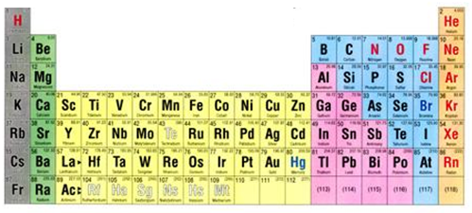
What the properties of minerals/salts teach (continued)
Conductivity experiments in water and molten salts imply:
salts form charges on the elements when dissolved.
sign/size of charges
Observed charges of highly reactive elements/atom in dissolved salts follow simple pattern
+1
+2
-3
-2
-1

Slide 6
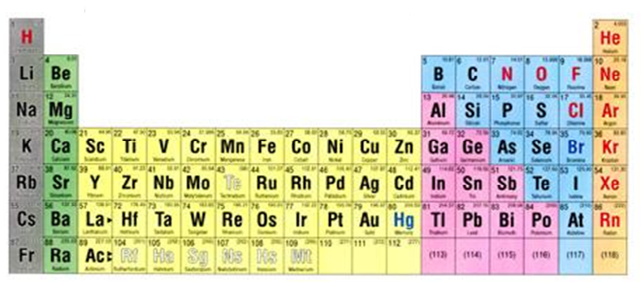
More molten salt and dissolved salt charge data
Unreactive `inert’ gases have no charge
Observed charges on reactive elements in stable states in dissolved salts & melts
+1
+2
0
+4,-4
-3
-2
-1
+3,-5
some elements switch hit

Slide 7
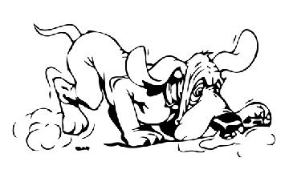
What can we learn from the solubility and conductivity behavior of inorganic salts ????
Follow the electrons…

Slide 8
LOOKING FOR A CONNECTION BETWEEN FINAL CHARGES OF ELEMENTS IN SALTS and INERT GASES…
NEVER REACTS
INSTANTLY REACTS

Slide 9
Not stable stable
Na → Na⁺
Not stable stable
Mg → Mg²⁺
11 e- 10 e-
12 e- 10 e-
Not stable stable
K → K⁺
19 e - 18 e-
10 e-
Ne
12 e-
20 e-
Ar
11 e-
19e⁻

Slide 10
Not stable stable
F → F⁻
Not stable stable
O → O⁻²
9 e- 10 e-
8 e- 10 e-
Not stable stable
N → N⁻³
7 e-
10 e-
7 e- 10 e-
8 e-
9 e-

Slide 11
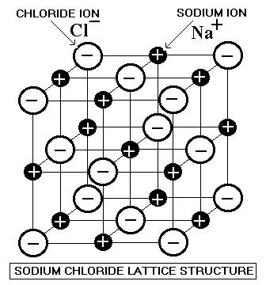
Conductivity & solubility of melts and solutions, and ordered salt structures suggest electrons move between elements to form mutually stable `inert gas’ configurations which are ionically bound in simple, geometric lattices: (see text pp 49-50)
1 e-
Na
11 e-
+1
-1
Cl
17e-
11 e⁻ -1 e⁻ =10 e-
(like Ne)
17 e⁻ + 1 e⁻
=18 e-
(like Ar)
Opposite charges now attract and hold the Na(+) and Cl(-) together via `electrostatic’ = ionic bonds

Slide 12
Stable charges of elements in minerals and salts summarized
Alkali
metals
Alkaline earth metals
halogens
+3- 5
+4
-4
+1
-1
0
noble
gases
-2
Transition metals… many + states possible
-3
+2
3+
4+
5+
6+
+3
+4
+6
+7
+3
+4
+5
+3+4
+3,4,+6 for
Fe,Co,Ni
+3
+1
All transition metals also have +2 charge stable states (huh ?)
`METALLOIDS
MOSTLY +2,3,4
KNOW HOW TO READ TABLE TO FIND CHAGES FOR THESE GROUPS
(ALKALI, ALKALINE EARTHS, AND “REPRESENTATIVE” ELEMENTS

Slide 13
Rules of Thumb for Constructing Salt and Mineral Compounds
If two elements are combined, the one further to the left side of the table is the + species while the one further to the right side is the – species. (Ex. Ca + C=> Ca→Ca²⁺ C→ C⁻⁴
Salt and mineral compounds are always neutral (no net charge) in their solid forms.
These rules are best applied to elements on opposite sides of the table: Ex. (Na + Cl) or (Ca + S) or (Ba + F)

Slide 14
Given stable charges for elements, we can predict neutral compound formulas formed from `+’ and `-’ species
Example:
Crossing the charge trick
Stable ions of Na and O
Na⁺¹
O²⁻
2
1
Neutral compound formed
Na₂O₁ = Na₂O
2 x (+1 ) + 1 x (-2) =
2 - 2 = 0

Slide 15
Given stable charges for elements, we can predict neutral compound formulas formed from `+’ and `-’ species
Example:
Crossing the charge trick
Stable ions of Na and O
Na⁺¹
O²⁻
2
1
Neutral compound formed
Na₂O₁ = Na₂O
2 x (+1 ) + 1 x (-2) =
2 - 2 = 0

Slide 16
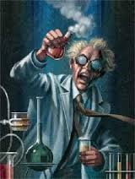
In-class Exercise 1

