Slide 1
How do we organize all the chemicals ??

Slide 2
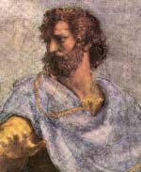
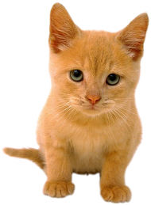
Aristotle’s approach to organizing all the stuff= matter (300 BC):
Define characteristics or properties and divide up stuff based on whether it has or doesn’t have them.
All birds have feathers, lay eggs and fly.
Non-chemical example:
Feathers ?
Lay eggs ?
Have wings ?
∴ No bird
no
Am I a BIRD ?
no
no

Slide 3

Aristotle’s approach to organizing …. (see also: fig 1.20, p. 17)
Alcohol, iodine, table salt, tincture of iodine, salt solution, Pepto-Bismol
(Aristotle’s approach
300 BC )
PURE SUBSTANCES (NOT MIXED)
MIXTURES
Alcohol, iodine, table salt
tincture of iodine, salt solution, Pepto-Bismol
ELEMENTS
COMPOUNDS
HOMOGENEOUS
HETEROGENEOUS
Iodine (I₂ )
Alcohol (C₂H₅OH)
Table salt (NaCl)
tincture of iodine (I₂ in alcohol)
salt solution (NaCl in water)
Pepto-Bismol

Slide 4
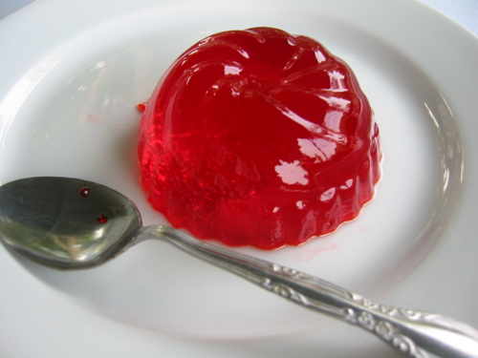
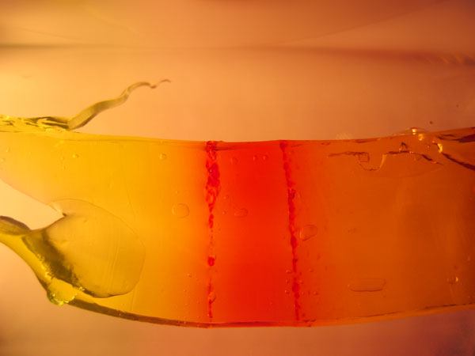
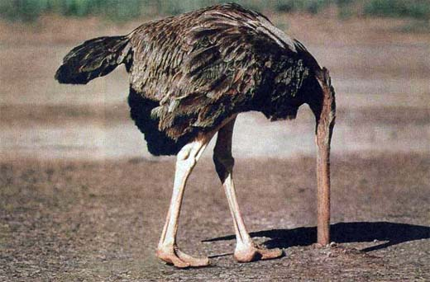
Is Jello homogeneous or heterogeneous ?
Classic Jello
1 mm thick slice of Jello
Aristotle’s approach to matter is a trap. It relies on arbitrary divisions of properties which keep changing as we know more. Not a solid foundation.
EX. All birds have feathers, lay eggs and fly.

Slide 5
Modern Chemical Approach to Matter
To understand chemical PROPERTIES & REACTIONS ….
Follow the electrons…

Slide 6
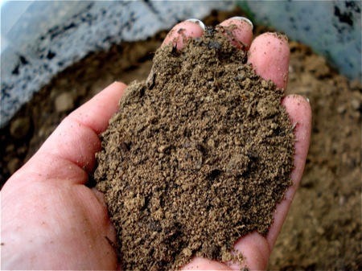
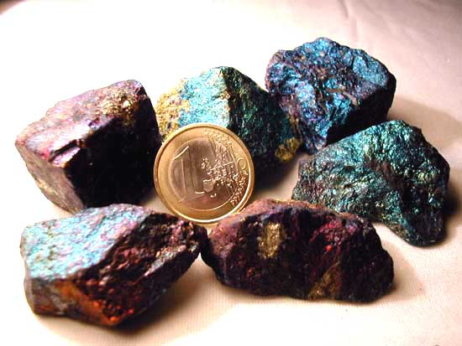
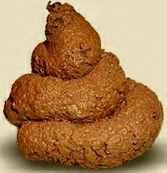
CHAPTER 2: DIRT
I’m back…..
dirt
What makes rocks the way they are ?
(text version, p. 46
“Why do minerals exist?”
Inorganic stuff
organic stuff

Slide 7
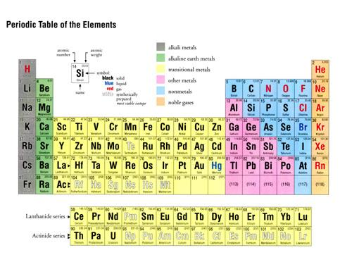
ARE THERE ELEMENTS THAT DON’T REACT AT ALL ???
INERT (NOBLE) GASES

Slide 8
WHICH ELEMENTS REACT LIKE CRAZY ???
CHALCOGENS
PNICTOGENS
HALOGENS
ALKALI METALS
ALKALINE EARTH METALS

Slide 9
EXAMPLES OF HALOGEN REACTIVITY combining Na and Cl
2Na(s) + Cl₂ (g) → 2NaCl (s)
A mineral or `salt’
Combining Al with Br
2Al(s) + 3Br₂(g)→ 2AlBr₃(s)

Slide 10
`SALTS’ (MINERALS) ARE OFTEN THE END PRODUCT OF REACTIONS..SO SALTS MUST BE STABLE
TYPICAL MINERALS /SALTS
NaCl sodium chloride (rock salt)
CaCl₂ calcium chloride (Drierite)
FeO iron (II) oxide (green rust)
CaSO₄ Calcium sulfate (gypsum =dry wall)
CaCO₃ calcium carbonate (limestone)

Slide 11
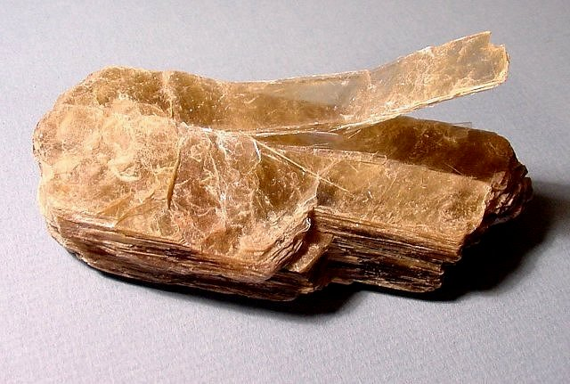
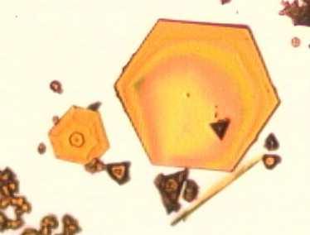
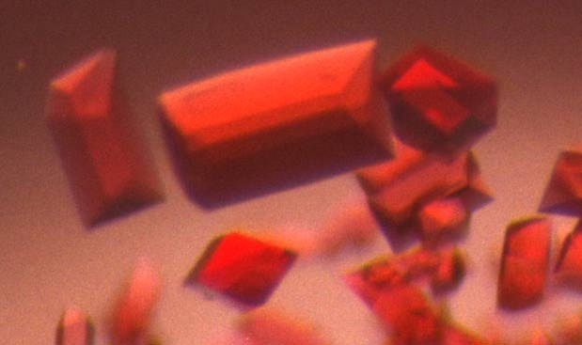
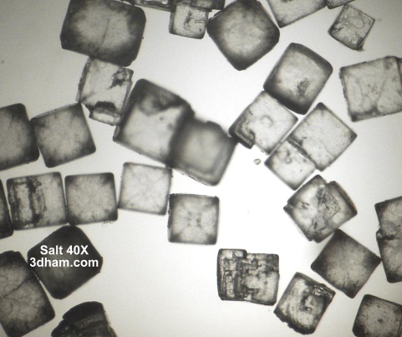
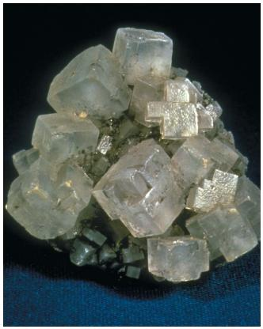
COMMON PROPERTIES OF MINERALS / SALTS
Hard /brittle (mica example)
High melting (800-2000 ºC)
Melts readily conduct electricity
Often soluble in water (demo)
Water solutions of salts and minerals readily conduct electricity (demo)
Structurally ordered (cubes, hexagons, rhomboids) => atomic order is simple
PbI₂
Cytochrome f
NaCl

Slide 12
What the properties of minerals/salts teach
SOLUBILITY DEMONSTRATION: Table salt in water
Salt dissolves easily
Salt doesn’t come back as solid spontaneously
Salt solution is colorless and clear=>homogeneous
(~ atomic scale bits and pieces in solution )
UNDERLYING LESSON:
Whatever the solid becomes in solution…it wants to stay that way ….=>STABLE

