Slide 1
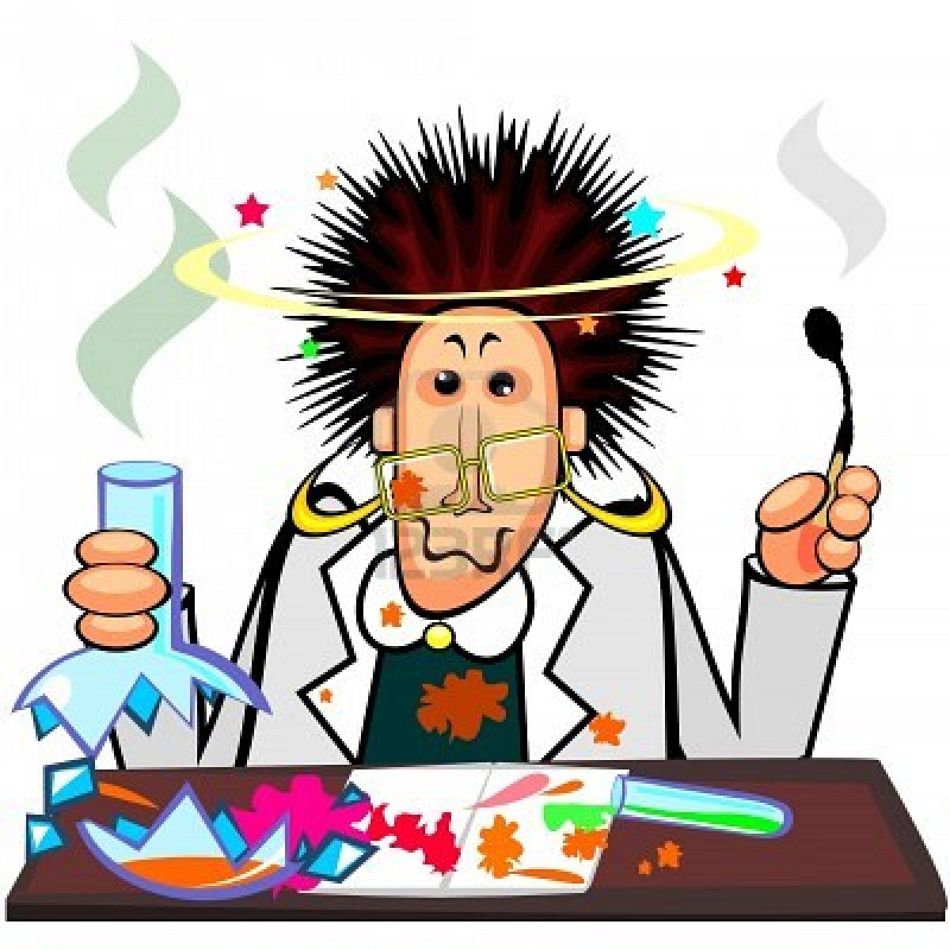
Chemistry is mostly about explaining how molecules interact ……
=> Chemical reactions !

Slide 2
What is the fundamental distinction between physical and chemical change ???
3)An `atomic’ view
Physical change does not involve a substance reshuffling and changing bonds among any atoms
Chemical change involves fundamental re-shuffling of the bonds between atoms

Slide 3
Combinations of atoms (=elements) are called molecules
Element A
Element B
Chemical bond forms to make molecule AB

Slide 4
Example of bond exchange
+
+

Slide 5
Another example of reaction: Decomposition reaction
+
+

Slide 6
chemical `stoichiometry’ : a first step in describing a reaction
`stoichiometric’ coefficients
4 C₃H₅N₃O₉(l) → 6N₂(g) + 10H₂O(g) +1 O₂(g) + 12CO₂(g)
`nitro’
Phases (l=liquid), (g=gas)
( s= solid)
REACTANT
PRODUCTS
TEXTBOOK’S FIRST CHEMICAL REACTION:
THE REACTION OF NITROGLYCERIN (pp 9-13)

Slide 7
MAKING AND REACTING NITROGLYCERIN (pp 9-13)
1) Making nitro
2) What 2 ounces of nitro can do….

Slide 8
Chemical book keeping
4 C₃H₅N₃O₉(l) → 6N₂(g) + 10H₂O(g) +1 O₂(g) + 12CO₂(g)
`nitro’
1) How many atoms of …..in nitro ??????
C ?
H ?
N ?
O ?
4 X 3= 12
4 X 5= 20
4 X 3= 12
4 X 9= 36
2) What is the atom count on the product side ?????
C ?
H ?
N ?
O ?
10 X 1=10 H₂O
12 X 1=12
10 X 2=20
6 X 2=12
36
1 X 2=2 O₂
3) Is equation balanced ??
YES
12 X 2=24 CO₂

Slide 9
More practice interpreting chemical reaction balances
Octane=gasoline
2C₈H₁₈ + 25O₂ → 16CO₂ + 18H₂O
How many molecules of CO₂ are formed ?
16
How many atoms of O are involved ?
50
How many molecules of O₂ are reacted ?
25
How many molecules of H₂O are formed ?
18
How many molecules of octane are burned ?
2
How many atoms of C are burned ?
16

Slide 10
Experiencing some reactions in class
0) Pb(NO₃)₂(aq) + 2KI(aq)→PbI₂(s) +2KNO₃(aq)
Zn(s) + H₂SO₄(aq)→ ZnSO₄(aq) + H₂(g)
+ energy
2) Na(s) + 2H₂O →2 NaOH(aq) + H₂(g)
+ energy
3)C₆H₁₂O₆ +6 O₂→ 6CO₂ + 6H₂O
+ energy
More practice in class assigning atom and molecule counts

