Slide 1
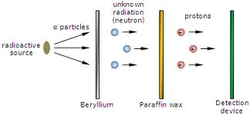
Other odd things about atoms…
Protons seem to account for only ~ ½ the mass of any element
Chadwick’s experiment
Since we know (+) can’t be forced out, why do we see protons out ???
Charged plates don’t cause deflection here
+
-

Slide 2
INSIDE THE ATOM…REVISED
Electrons mostly in condensed rings around nucleus
Nucleus = protons + neutrons
Diameter of electron cloud = 100,000
Diameter of nucleus 1
Atomic part Relative mass % mass of atom
Proton (+) 1 ~44.25
Neutron(0) 1 ~44.25
Electrons(-) 0.005 0.5

Slide 3
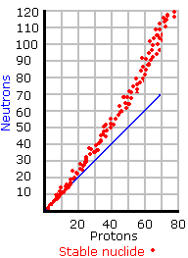
n/p ratio for stable elements
n/p=1.0
Neutrons are fillers that reduce proton repulsion

Slide 4
Some atomic book keeping…(see p 7-8)
Neutrons are `neutered’ protons (no charge)
Nucleus = protons + neutrons = p⁺ + nº
#protons = # electrons in neutral element
#p⁺ = #e⁻
Facts about the atomic parts
mass of p⁺ ≈ mass nº
Mass of e- ~ 1/2000 mass of p⁺
Electrons are light weights

Slide 5
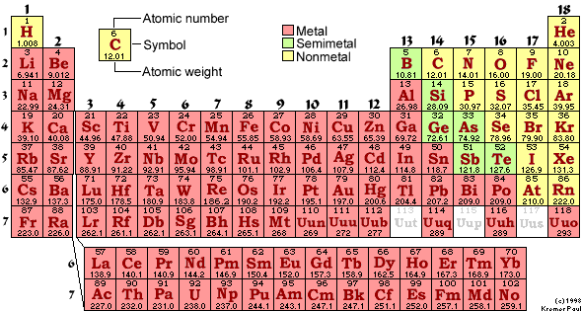
Reading the Periodic table `element’ card

Slide 6
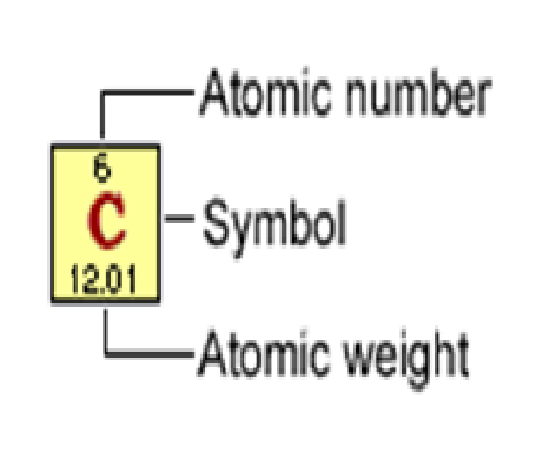
Deconstructing an element card from Periodic Table: think of it as a `parts list’
= # p⁺ in nucleus
Elements are defined by proton count
(carbon)
=# p + average n count
12.01= 6 + ???
6.01

Slide 7
Examples of elements with significant distributions of different neutron counts (different `isotopes’)
Element average mass isotope content
Chlorine Cl 35.453
17 p + 18 n 75%
17 p + 19 n 25%
Bromine Br 79.904
35 p + 44 n 51%
35 p + 46 n 49%

Slide 8

Chemistry is mostly about explaining how molecules interact ……
=> Chemical reactions !

Slide 9
CHEMICAL VS PHYSICAL
CUTTING PAPER
ICE MELTING
DISSOLVING SALT IN WATER
BURNING PAPER
ACID + BASE
PHYSICAL
PHYSICAL
PHYSICAL
CHEMICAL
CHEMICAL

Slide 10
What is the fundamental distinction between physical and chemical change ???
1)Your textbook (p.16)
“Physical change (is) a process that alters a substance without changing it into another substance
Chemical change is the breakdown of a pure substance into one or more other pure substances.”

Slide 11
What is the fundamental distinction between physical and chemical change ???
2) A `practical’ view
Physical changes can be reversed by simple applications of physical acts like heating, cooling, dissolving, crushing…
Chemical changes cannot be reversed by such physical acts

Slide 12
What is the fundamental distinction between physical and chemical change ???
3)An `atomic’ view
Physical change does not involve a substance reshuffling and changing bonds among any atoms
Chemical change involves fundamental re-shuffling of the bonds between atoms

Slide 13
Combinations of atoms (=elements) are called molecules
Element A
Element B
Chemical bond forms to make molecule AB

