Slide 1
More In-Class Practice with Exercise 6
…..more guided practice with students on board

Slide 2
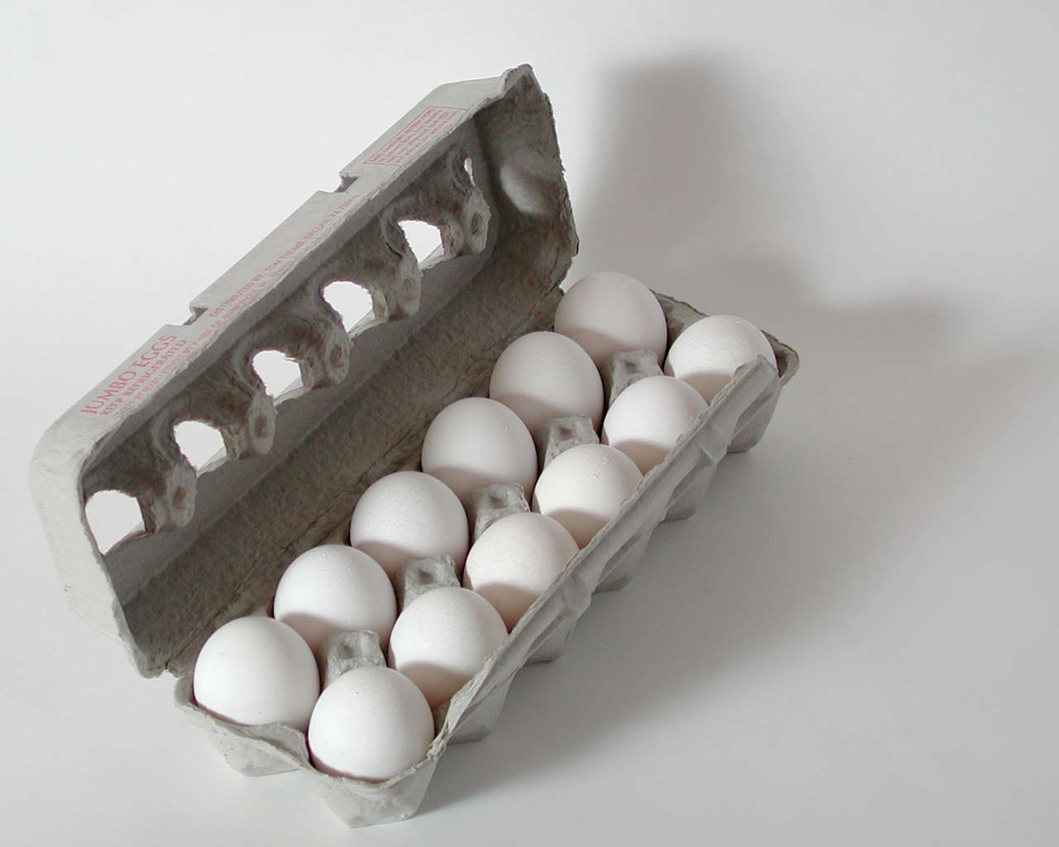
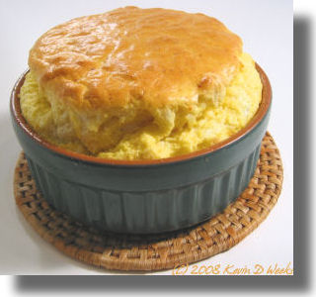
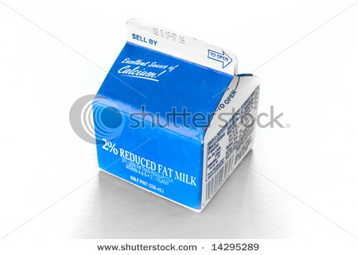
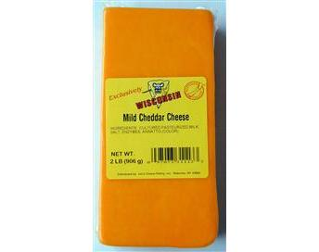
Limiting Reagent Problems: In chemistry & cooking…sometimes you run out of eggs….
Souffle recipe calls for:
1
+
2
+
3
Your kitchen has on hand:
????
2
10
4
50

Slide 3
Chemical Recipe
27 36 133.4 2 g/mol
2Al + 6HCl → 2AlCl₃ + 3H₂
Example of a Limiting Reagent problem
90 moles of Al and 60 moles of HCl are reacted.
What limits ?
How many moles of H₂ can form ?
HCl
30

Slide 4
Chemical Recipe
27 36 133.4 2 g/mol
2Al + 6HCl → 2AlCl₃ + 3H₂
Another, slightly harder limiting reagent problem
90 g Al and 432 g of HCl are reacted.
What limits ?
How many grams of H₂ can form ?
Al
10 grams

Slide 5
Chemical Recipe
27 36 133.4 2 g/mol
2Al + 6HCl → 2AlCl₃ + 3H₂
Another limiting reagent problem involving molecule count
27 g Al and 1.0E24 molecules of HCl are reacted.
What limits ?
How many molecules of H₂ can form ?
HCl
5*10²³

