Slide 1

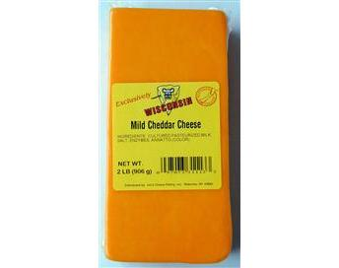
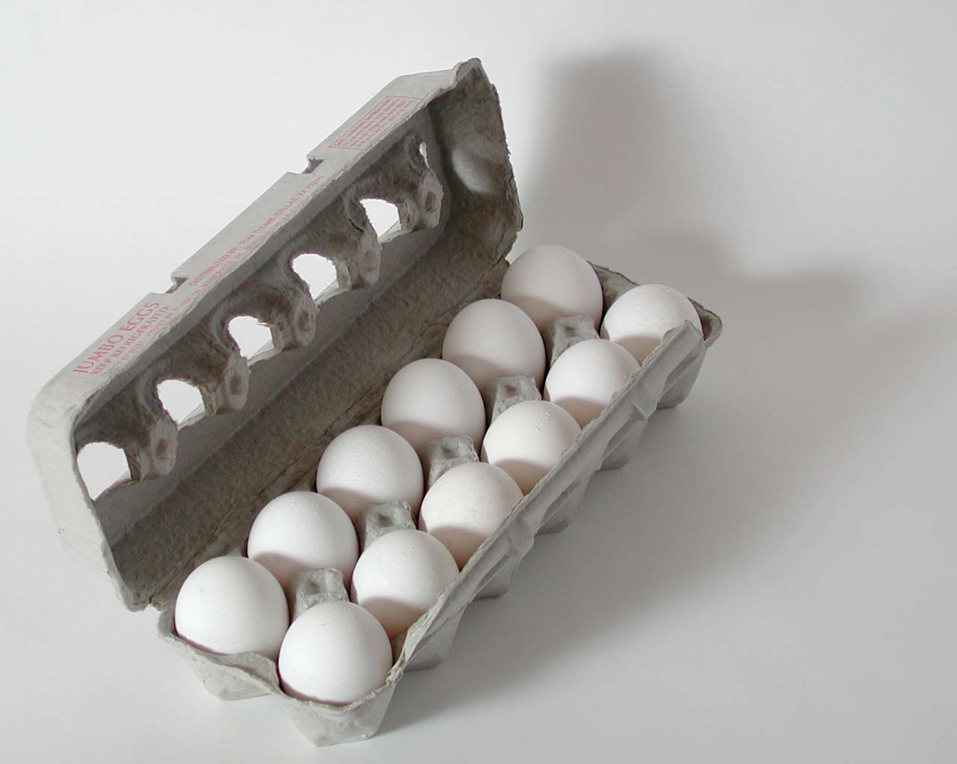
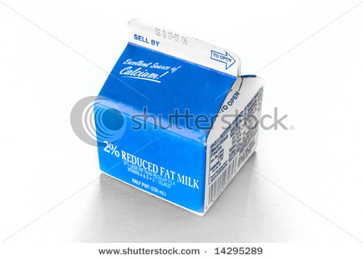
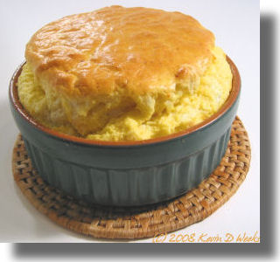
Cooking and stoichiometry (continued)
THE RECIPE
1
+
2
+
3
300 g/block
500 g/dozen
200 g/box
1900 g/souffle
*How many eggs needed to combine with 1200 g cream?
48
*900 grams cheese makes what weight of souffles?
5700 g
*1200 eggs combines with how many grams cheese?
1500 g
*How many boxes of cream combine with 600 g cheese
6

Slide 2

BLACKBOARD EXERCISES
Given the balanced chemical reaction
C₃H₈ + 5O₂--------> 3CO₂ + 4H₂O
Calculate the moles of O₂ necessary to produce 6 moles of CO₂
= 10 mol O₂
Calculate the grams of CO₂ created by burning 0.0757 moles of C₃H₈
= 10 grams CO₂

Slide 3
BLACKBOARD EXERCISES (continued)
Given the balanced chemical reaction
C₃H₈ + 5O₂--------> 3CO₂ + 4H₂O
Calculate the moles of H₂O formed by burning 400 grams of O₂
= 10 mol H₂O
Calculate the grams of O₂ to form 1.506*10²² H₂O molecules
=10.0 gram O₂

Slide 4
More In-Class Practice with Exercise 6
…..more guided practice with students on board

