Slide 1
One more `combustion’ example
A sample of N_{x}H_{y} is burned in O₂ to make 2.300 g of N₂O₄ and 1.350 g of H₂O. Given that the molecular weights of N₂O₄ and H₂O are 92 and 18 g/mol, respectively, what is the empiric formula for N_{x}H_{y} ?
N_{x}H_{y} → N₂O₄ + H₂O
2.300 g 1.350 g
????
mole N = 2*mole N₂O₄
= 2* 2.300
92
= 2* 0.025
=0.05
mole H = 2*mole H₂O
= 2* 1.350
18
= 2* 0.075
=0.15
N_{0.05}H_{0.15}= ??
NH₃

Slide 2

The next leg of the trip through mole land:
Reaction `stoichiometry’ problems
Some Examples of the problem `form’:
Given the balanced chemical reaction
C₃H₈ + 5O₂--------> 3CO₂ + 4H₂O
Calculate the moles of O₂ necessary to produce 0.6 moles of CO₂ .
Calculate the grams of CO₂ created by burning 0.00757 moles of C₃H₈
Calculate the moles of H₂O formed by burning 40 grams of O₂.
Calculate the grams of O₂ to form 1.50*10²² molecules of H₂O .

Slide 3
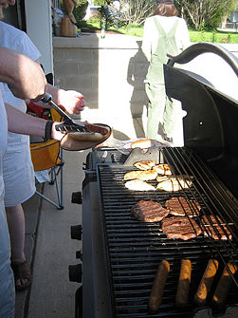
The next leg of the trip through mole land (cont.):
Reaction `stoichiometry’ problems
A sample reaction
C₃H₈ + O₂ CO₂ + H₂O
First concern:
Is the reaction as written balanced???
…no

Slide 4
Balancing a reaction
Unbalanced
_C₃H₈ + _O₂ _CO₂ +_H₂O
After blackboard balancing exercise
1C₃H₈ + 5O₂ 3CO₂ +4H₂O
Stoichiometric coefficients
C
H
O
3
8
10
3
8
10

Slide 5
Reaction Stoichiometry Problems part 1:
Class Practice Balancing Reactions
1
2
1
2
___CH₄ + ___O₂ __CO₂ + __H₂O
2
3
2
4
___CH₄ + ___O₂ __CO + __H₂O
3
1
1
3
__AgNO₃ + ___Na₃PO₄ __Ag₃PO₄ +___NaNO₃
2
6
2
3
____Al + ___HCl __AlCl₃ + ___H₂
Gasoline combustion reaction
2
25
16
18
__C₈H₁₈ + __O₂ __CO₂ + __ H₂O

Slide 6
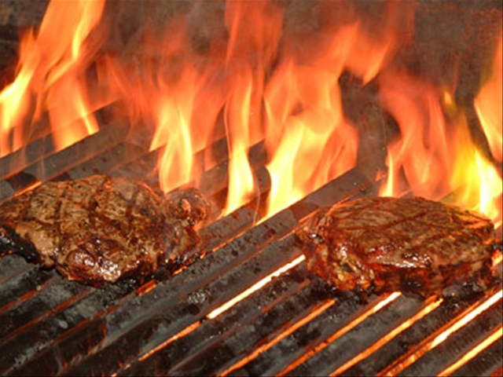
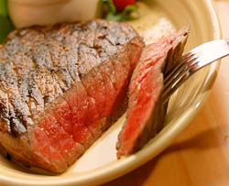
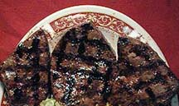
Sometimes several answers possible
Barbecuing steaks…
C₃H₈ + 5O₂ → 4H₂O +3CO₂
Complete combustion
C₃H₈ + 4O₂ → 4H₂O +2CO₂ + C
Incomplete combustion
C₃H₈ + 3O₂ → 4H₂O + CO₂ + 2C
C₃H₈ + 2O₂ → 4H₂O + 3C
Low O₂
→Low CO₂
₋→ High C
(charred)
Hi O₂
→Hi CO₂
→Low C
(no `char’)

Slide 7

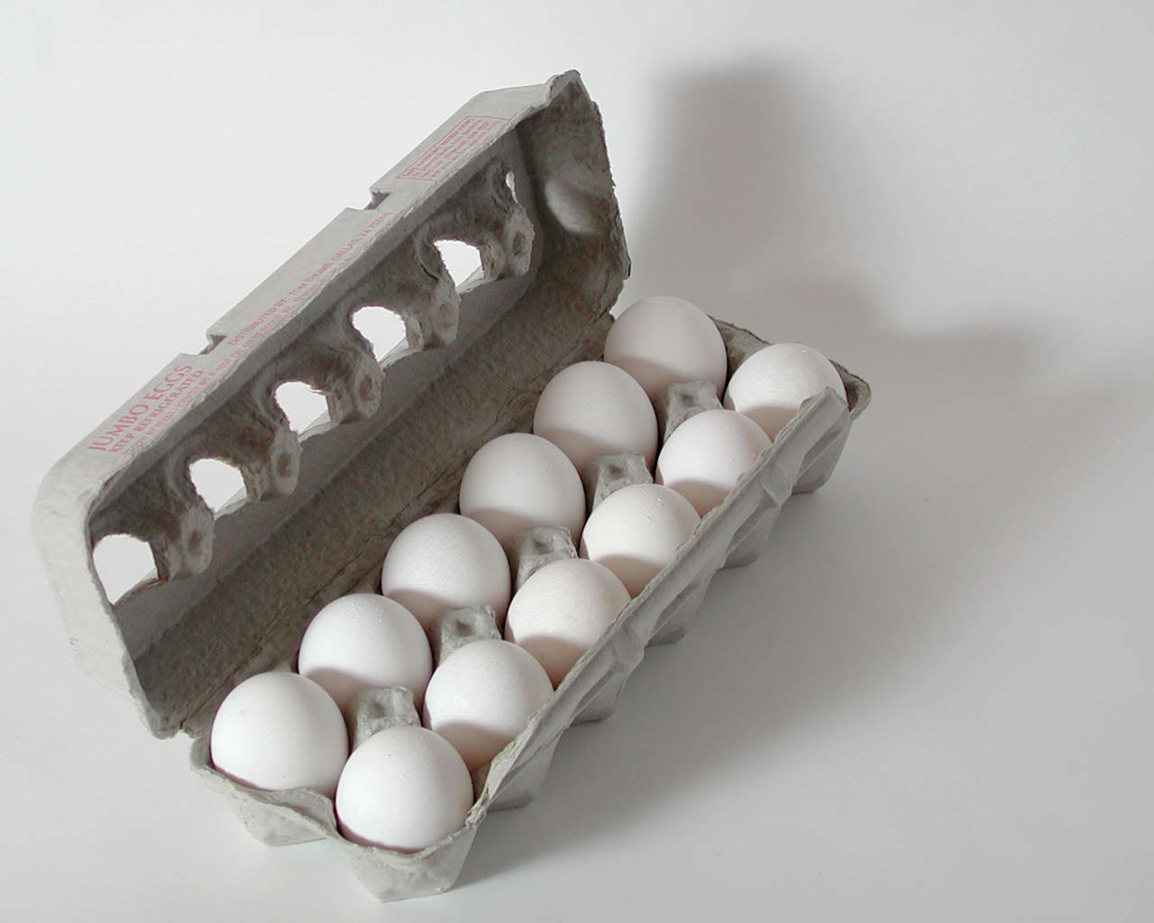
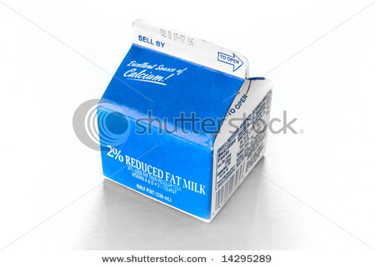
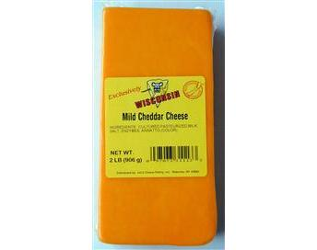
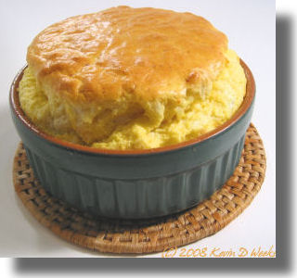
Stoichiometry is cooking: Recipe for egg and cheese souffle
IN
1
+
2
+
3
200 g/box
300 g/block
500 g/dozen
OUT
Mass of 1 output souffle ?
1 *300 g
+
2* 500 g
+
3*200
cheese
eggs
condensed milk
=1900 g/souffle

Slide 8
Cooking and stoichiometry
THE RECIPE
1
+
2
+
3
300 g/block
500 g/dozen
200 g/box
1900 g/souffle
How many….to make whole # of souffles ?
How many boxes of cream to make 4 souffles ?
12
600 grams cheese makes how many souffles ?
2
How many grams of eggs combine with 9 boxes of cream ?
3000 g
48 eggs combine with how many blocks of cheese ?
2

Slide 9
Cooking and stoichiometry (continued)
THE RECIPE
1
+
2
+
3
300 g/block
500 g/dozen
200 g/box
1900 g/souffle
*How many eggs needed to combine with 1200 g cream?
48
*900 grams cheese makes what weight of souffles?
5700 g
*1200 eggs combines with how many grams cheese?
1500 g
*How many boxes of cream combine with 600 g cheese
6

