Slide 1
In-class exercise #5.1: Chemical Composition
Element | Weight % | Atomic mass | moles | ratio
C | 27.27 | 12 g/mol
O | 72.73 | 16
27.27/12
=2.2725
1
4.5456/2.2725 =2
72.73/16
=4.5456
C₁O₂=CO₂
Empiric formula: ____________________
Element | Weight % | Atomic mass | moles | ratio
C | 33.3 | 12
H | 8.3 | 1
O | 44.4 | 16
33.3/12
=2.775
1
8.3/2.775
=3
8.3/1=8.3
44.4/16
=2.775
1
Empiric formula: _____C₁H₃O₁___= CH₃O____

Slide 2
Molecular formula problem
A compound contains: 0.3158 g C, 0.0526 g H and 0.631 g O. It’s molecular weight (MW) is 228 g/mol. What is the molecular formula of the compound ?
element
C
H
O
AW (g/mol)
n=w/AWmoles
n
n _{min}
x 2 to get whole #
w(g)
0.3158
0.0526
0.631
12
1
16
0.0263 = 1
0.0263
0.3158/12=0.0263
1*2=2
0.0526/1
=0.0526
0.0526 = 2 0.0263
2*2=4
0.631/16
=0.0394
0.0394=1.5
0.0263
2*1.5=3

Slide 3
Problem 2: formula determination with a few more twists (continued)
From table: Empirical formula…C₂H₄O₃
Empiric mass = 2*12 + 4*1 + 3*16= 76
Given Molecular mass =228 g/mol
Compute ratio of molecular mass to empiric mass (> 1)
Molecular mass = 228 = 3
Empiric mass 76
Molecular formula= C_{2*3} H_{4*3} O_{3*3}
= C₆ H₁₂ O₉

Slide 4
Combustion Problems
Example 1:
A 36 gram block of charcoal (pure C) is burned to a colorless gas in O₂. The final mass of the combustion product, CO_{x} is 132 g. Given that C has an atomic mass of 12 g/mol and O has an atomic mass of 16 g/mol, what is the formula for CO_{x} (e.g. what is x ??)
x= 2 => CO₂

Slide 5
Example 2:
A hydrocarbon (C_{x}H_{y}) is burned in O₂ to produce
22 grams of CO₂ and 4.5 grams of H₂O. Given that the molecular masses of CO₂ and H₂O are 44 and 18 grams/mole respectively, what is the empiric formula of the hydrocarbon, e.g. what are x and y ?
C_{x}H_{y} = C₁H₁

Slide 6
Combustion problems
Exercise 5

Slide 7

The next leg of the trip through mole land:
Reaction `stoichiometry’ problems
Some Examples of the problem `form’:
Given the balanced chemical reaction
C₃H₈ + 5O₂--------> 3CO₂ + 4H₂O
Calculate the moles of O₂ necessary to produce 0.6 moles of CO₂ .
Calculate the grams of CO₂ created by burning 0.00757 moles of C₃H₈
Calculate the moles of H₂O formed by burning 40 grams of O₂.
Calculate the grams of O₂ to form 1.50*10²² molecules of H₂O .

Slide 8
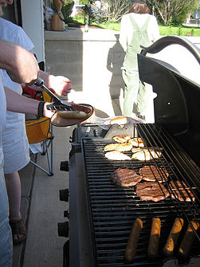
The next leg of the trip through mole land (cont.):
Reaction `stoichiometry’ problems
A sample reaction
C₃H₈ + O₂ CO₂ + H₂O
First concern:
Is the reaction as written balanced???
…no

Slide 9
Balancing a reaction
Unbalanced
_C₃H₈ + _O₂ _CO₂ +_H₂O
After blackboard balancing exercise
1C₃H₈ + 5O₂ 3CO₂ +4H₂O
Stoichiometric coefficients
C
H
O
3
8
10
3
8
10

Slide 10
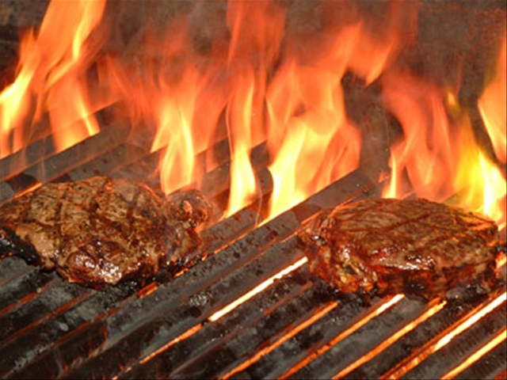
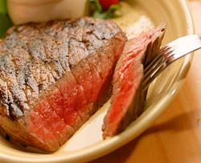
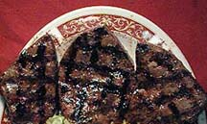
Sometimes several answers possible
Barbecuing steaks…
C₃H₈ + 5O₂ → 4H₂O +3CO₂
Complete combustion
C₃H₈ + 4O₂ → 4H₂O +2CO₂ + C
Incomplete combustion
C₃H₈ + 3O₂ → 4H₂O + CO₂ + 2C
C₃H₈ + 2O₂ → 4H₂O + 3C
Low O₂
→Low CO₂
₋→ High C
(charred)
Hi O₂
→Hi CO₂
→Low C
(no `char’)

Slide 11
Reaction Stoichiometry Problems part 1:
Class Practice Balancing Reactions
1
2
1
2
___CH₄ + ___O₂ __CO₂ + __H₂O
2
3
2
4
___CH₄ + ___O₂ __CO + __H₂O
3
1
1
3
__AgNO₃ + ___Na₃PO₄ __Ag₃PO₄ +___NaNO₃
2
6
2
3
____Al + ___HCl __AlCl₃ + ___H₂
Gasoline combustion reaction
2
25
16
18
__C₈H₁₈ + __O₂ __CO₂ + __ H₂O

