Slide 1
Rutherford’s Atom by the numbers
Diameter of electron cloud = 100,000
Diameter of nucleus 1
Atomic part Relative mass % mass of atom
Nucleus 1 99.5
Electrons 0.005 0.5
Atomic part Relative volume
Nucleus 0.00000000000001
Electrons 1
electron cloud is 99.99999999% of atomic volume but only 0.5% of the mass

Slide 2
Chemical metaphor 2
Atom as …..
String and pencil dot

Slide 3
Chemical Metaphor 2 reasoning
pencil dot and string
Pencil dot = nucleus
~ 0.02 cm radius
Electron radius is _______x nuclear radius
100,000
Electron radius =??
100,000 x 0.02= 2000 cm
(for us `dumb’ Americans, that’s ~ 66 ft)
66 ft of string= electron radius

Slide 4
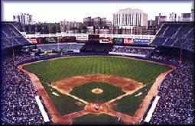


Atom dimensions in familiar terms: Metaphor 3
where is the edge of the electron cloud ? →LectureTools poll
3”
Baseball as nucleus
Old Yankee Stadium, the Bronx

Slide 5
Some useful facts for metaphor 3
baseball radius = 1 ½ inches
12 inches = 1 foot
5280 feet = 1 mile
electron radius=100,000
  nuclear radius

Slide 6
Chemical metaphor 3 reasoning: baseball in Yankee Stadium ?
Baseball =nucleus
= 3 inches in diameter
Nuclear Radius ???
= 3/2 =1 ½ inches in radius
100,000
Electron radius is _________x nuclear radius
Electron radius is ???
=100,000 x 1 ½ =150 ,000 inches
150,000 in
12 in/ft
=12,400 feet
# Feet ?
# miles ?
=> 12,400 ft
5280 ft/mile
=2.37 miles

Slide 7
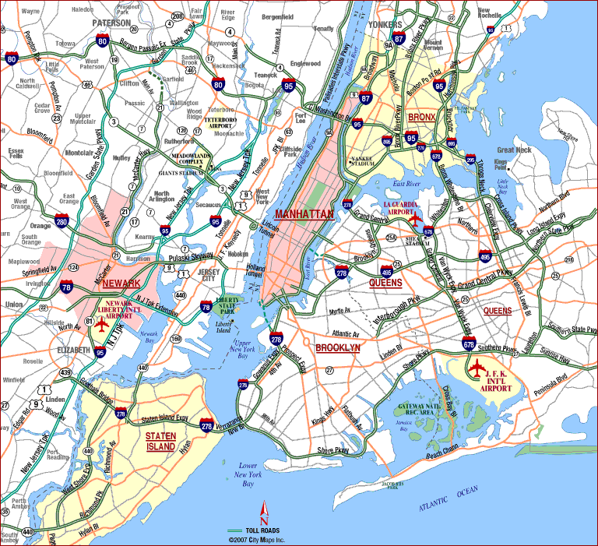
14 12 10 8 6 4 2 0 2 4 6
Nucleus(+)
Notes:
Stadium at 1. E. 161st st., Bronx NY 14051

Slide 8
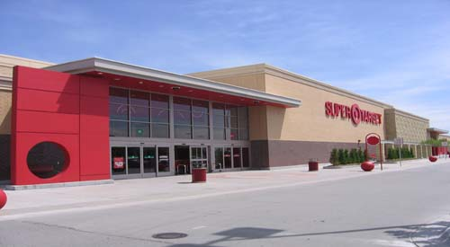
Atom dimensions in familiar terms: Metaphor 4 –Super Target Store in Omaha is the nucleus
( a bigger store than the textbook on p. 8 assumes)
→LectureTools

Slide 9
Some useful facts for metaphor 4:
Super Target Store in Omaha, Nebraska
radius of Super Target store=75 m
1000 m = 1 km=> store radius=0.075
electron radius=100,000
  nuclear radius

Slide 10
100,000 = radius of electron
radius of nucleus
100,000= r
radius of Super Target store
100,000 = r = r
75 m 0.075 km
0.075 km x 100,000 = 7,500 km =r

Slide 11
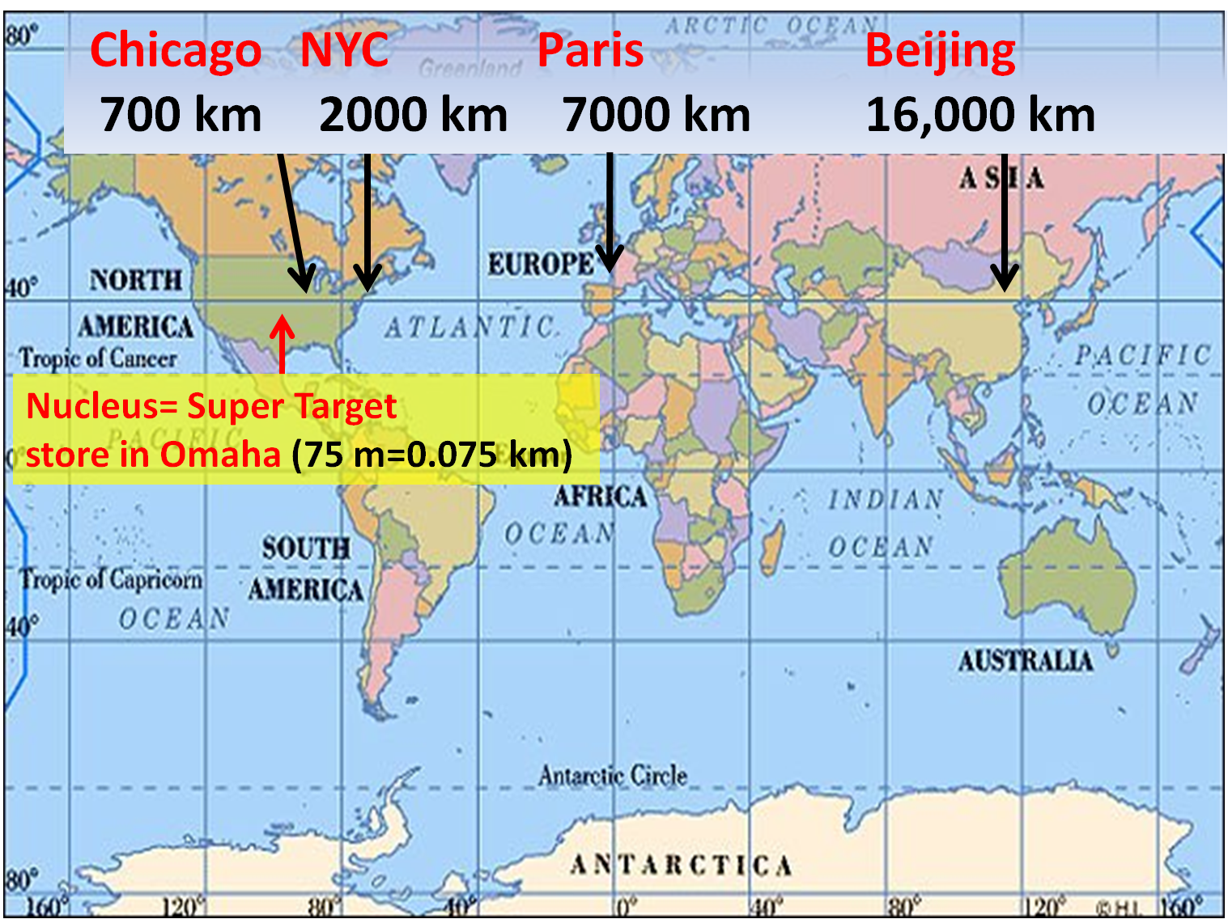
Edge of electron cloud

Slide 12
Rutherford’s atom again: a diffuse, ill defined cloud of electrons around the nucleus
Diffuse electron
Cloud out here
~ 10⁻¹⁰ m
~10⁻¹⁵ m
Nucleus is + charged
Electrons are - charged
Nucleus at center (magnified here ~10,000X)

Slide 13
A closer look at Rutherford’s Gold Leaf experiment:
10,000,000,000,000,000 (~10¹⁵)
Mass/volume
100
1
?? Blips ?
?? What are these Blips??
0.01
0.0001
0 (nucleus here)
+0.0000000001 m
-0.0000000001 m
Distance from scattering center (=nucleus) in meters

Slide 14
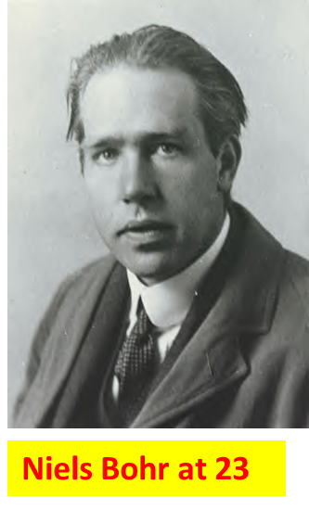
A `kid’ just out of grad school figures out about the `blips’
…and blows up the old world of Physics

Slide 15
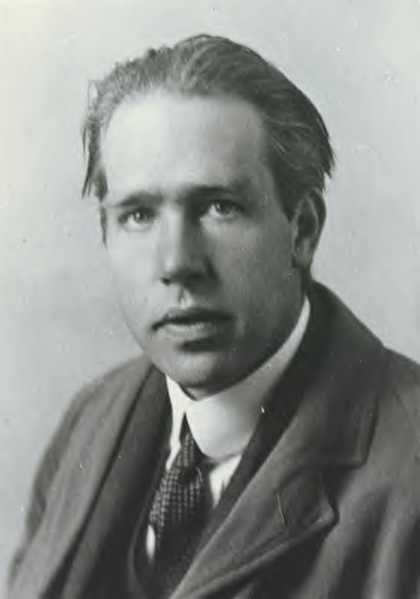
Bohr’s theory of atomic structure : the `planetary’ model of the atom …1913
1) Electrons move in circular orbits around nucleus
Electron (-)
Nucleus (+)
Niels Bohr at 23
model is wrong in detail but broadly
right
2) Electrons “leap” between well defined orbital circles in “quantum jumps”

Slide 16
The current picture of electron motion in atoms:
electrons as magic popcorn (not in text)
Electron here t=t₁
Electron has non-zero chance to `pop out’ anywhere on a sphere at fixed distance from nucleus.
It must be somewhere on that sphere at all times…just can’t say where…
Electron
Here at t=t₃
Electron starts here, t=0
Nucleus magnified 100,000X
Electron
here t=t₂
Electron
Here t=t₄….

