Slide 1

Multiply down
FRIDAY QUIZ
deconstructed
moles
MW (g/mol)
6.022*10²³
# atoms or molecules
weight (g)
Divide up

Slide 2
Mass Moles # molecules: `Bermuda’ triangle approach
How many H₂O molecules in 7200 grams of H₂O ?
400
moles
7200 ÷18
x 6.022*10²³
Calculate # moles
400 x 6.022*10²³
÷MW
Calculate
# molecules
18 g/mol
Fill in MW
weight
# molecules
7200 g
=2.409*10²⁶
Start here

Slide 3
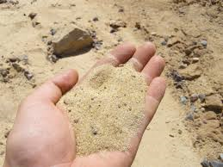

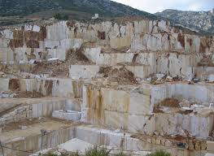
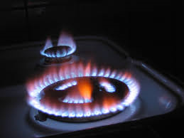

Exercise #4.1 Practice
60 g/mol
Sand, SiO₂
b) Drinking alcohol C₂H₆O
c) Limestone, CaCO₃
c)Methane, CH₄
d)Gasoline, C₈H₁₈
46 g/mol
100 g/mol
16 g/mol
114 g/mol

Slide 4

Divide up
Multiply down

Slide 5
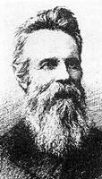
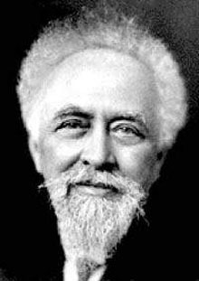
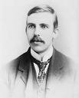

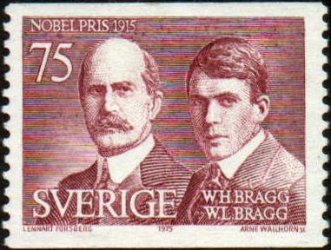
A brief digression on Avogadro’s Number N_{o}
1) There’s nothing magic or special about it. It reflects the arbitrary assumption of the use of grams to replace the unitless `relative’ masses in the Periodic Table. Change the choice of units…change N_{o}
2) Its magnitude has only definitively been determined in the 20th century (It’s a hard one to measure.) Until then, chemists got along fine counting moles not atoms.
1865
Loschmidt
1908
Perrin
1909
Rutherford
1918
The Braggs
2001
De Bièvre et. al.
Aerial view of NIST
72 *10²³
6.7 *10²³
6.16*10²³
6.019*10²³
6.022133530*10²³
1st reasonable guess
(N_{o} originally called Loschmidt’s Number)
uses 4 methods to find N_{o}; wins
Nobel Prize; renames N_{o} `Avogadro’s #’
Counted alpha particles
Used x-rays and counted atoms in a unit cell
Current (NIST) accepted value

Slide 6
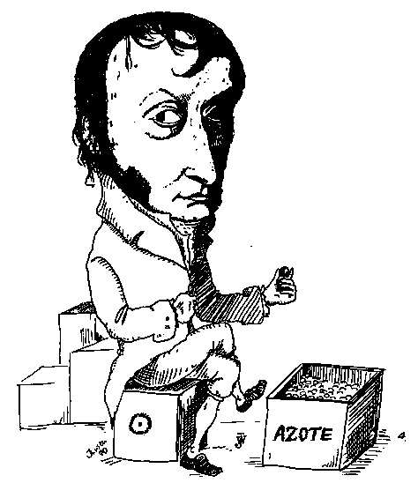
And yet little more trivia about Avogadro’s #, N_{o}
Avogadro Myth debunked:
Avogadro never derived N_{o} and did not count the N₂ molecules in a flask (as the cartoon to the left suggests…)
Lorenzo Romano Amedeo Carlo Avogadro di Quaregna e di Cerreto, Count of Quaregna and Cerreto (9 August 1776 – 9 July 1856)
...ostensibly counting `azote’ = Nitrogen molecules

Slide 7
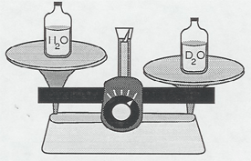
His real contribution: Avogadro’s Gas Law
“Equal numbers of gas particles occupy the same volume if at the same temperature and pressure regardless of gas identity.”
Y nitrogens
weigh 28 g
Y oxygens
weigh 32 g
=> Experimental path to finding the relative masses of elements on Periodic table
Y *Mass of one O atom = 32 g
= 16
14
Y* Mass of one N atom 28 g
Now unit-less ratio
See Periodic table entries

Slide 8
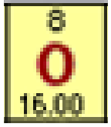
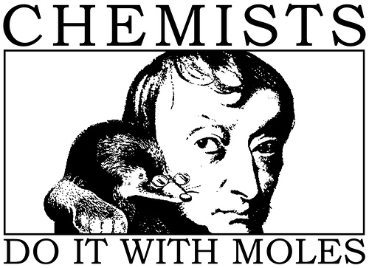
I gave you this…
NOT this….
N_{o} =6.022 133530*10²³

Slide 9
How gram atomic masses (AW) let us know the ratios of atoms in compounds (even if we don’t know how big N_{o} is)
EXAMPLE 1:
Element
C
O
Mass of element in X
GAW
# mole
24.0 grams
12.0 grams/mol C
24/12=2
64.0 grams
16.0 grams/mol O
64/16=4
What is the ratio C atoms to O atoms in compound X ?
2C to 4O
=> C₂O₄
= CO₂

Slide 10
How gram atomic masses (AW) let us know the ratios of atoms in compounds (cont.)
EXAMPLE 2:
Element
C
H
Mass of element in Y
GAW (grams/ mol)
# mol
6.0 grams
12.0 grams/mol C
6/12= ½
2.0 grams
1.0 grams/mol H
2/1 =2
What is the ratio of H to C atoms in compound Y ?
2 H to ½ C
x 2
=> C_{1/2}H₂
CH₄

Slide 11
How gram atomic masses (AW) let us know the ratios of atoms in compounds (cont.)
EXAMPLE 3:
Element
C
H
O
Mass of element in Z
GAW (grams/1 mol)
#mol
8.0 grams
12.0 grams/mol C
8.0/12=0.666
2.0 grams
1.0 grams/mol H
2.0/1= 2.0
5.33 grams
16.0 grams/mol O
5.33/16=0.333
What is the ratio of C to H to O atoms in Z ?
Mol C Mol H Mol O
0.666
2.0
0.333
How to simplify to produce whole numbers only ?
Divide by smallest mol count
0.666
0.333
2.0
0.333
0.333
0.333
2 6 1
=> C₂H₆O (grain alcohol)

Slide 12

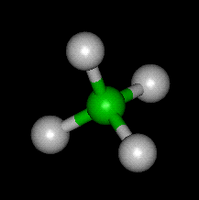
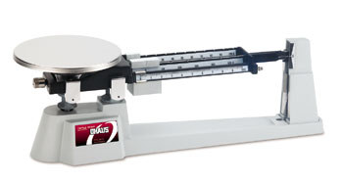
% composition problems: using mole concept to convert weights to formulas
Sample problem #1
A compound of N and O contains 63.63 wt % N and 36.36 wt % O. What is the empiric formula of the compound ?
empiric formula= mole ratio of elements in compound expressed in lowest whole numbers
Definition:
Example: CH₂O = empiric formula of glucose
Actual molecular formula (what it really has in atom count)
C₆H₁₂O₆=
(CH₂O)₆
Sugar =Carbo hydrate

Slide 13
Which formulas below are empiric
(= lowest common denominator form) ??
EMPIRIC
C₃H₆O₃
÷ 3
NOT EMPIRIC
CH₂O
N₃F₇
EMPIRIC…3 & 7 have no shared factors
H₃P₉O₁₂S₅
EMPIRIC …5 has no shared factors with 3,9 or 12
Do not write HP₃O₄S_{5/3}

Slide 14
Sample problem #1 continued
A compound of N and O contains 63.63% N and 36.36 %O. What is the empiric formula of the compound ?
table approach
=>N₂O
=Laughing gas
Dinitrogen monoxide
CORRECT NAME…
n
n_{min}
element
N
O
w(g)
AW=Atomic wt (g/mol)
n=w/AW
moles
63.63/14=
4.545
4.545 = 2
2.273
63.63
14
36.36
36.36/16=
2.273
2.273 =1
2.273
16

Slide 15
Problem 2: formula determination with a few more twists
A compound contains: 0.3158 g C, 0.0526 g H and 0.631 g O. It’s molecular weight (MW) is 228 g/mol. What is the molecular formula of the compound ?
element
C
H
O
AW (g/mol)
n=w/AWmoles
n
n _{min}
x 2 to get whole #
w(g)
0.3158
0.0526
0.631
12
1
16
0.0263 = 1
0.0263
0.3158/12=0.0263
1*2=2
0.0526/1
=0.0526
0.0526 = 2 0.0263
2*2=4
0.631/16
=0.0394
0.0394=1.5
0.0263
2*1.5=3

Slide 16
Problem 2: formula determination with a few more twists (continued)
From table: Empirical formula…C₂H₄O₃
Empiric mass = 2*12 + 4*1 + 3*16= 76
Given Molecular mass =228 g/mol
Compute ratio of molecular mass to empiric mass (> 1)
Molecular mass = 228 = 3
Empiric mass 76
Molecular formula= C_{2*3} H_{4*3} O_{3*3}
= C₆ H₁₂ O₉

Slide 17
In-class exercise #5.1: Chemical Composition
Element | Weight % | Atomic mass | moles | ratio
C | 27.27 | 12 g/mol
O | 72.73 | 16
27.27/12
=2.2725
1
4.5456/2.2725 =2
72.73/16
=4.5456
C₁O₂=CO₂
Empiric formula: ____________________
Element | Weight % | Atomic mass | moles | ratio
C | 33.3 | 12
H | 8.3 | 1
O | 44.4 | 16
33.3/12
=2.775
1
8.3/2.775
=3
8.3/1=8.3
44.4/16
=2.775
1
Empiric formula: _____C₁H₃O₁___= CH₃O____

Slide 18
Molecular formula problem
A compound contains: 0.3158 g C, 0.0526 g H and 0.631 g O. It’s molecular weight (MW) is 228 g/mol. What is the molecular formula of the compound ?
element
C
H
O
AW (g/mol)
n=w/AWmoles
n
n _{min}
x 2 to get whole #
w(g)
0.3158
0.0526
0.631
12
1
16
0.0263 = 1
0.0263
0.3158/12=0.0263
1*2=2
0.0526/1
=0.0526
0.0526 = 2 0.0263
2*2=4
0.631/16
=0.0394
0.0394=1.5
0.0263
2*1.5=3

Slide 19
Problem 2: formula determination with a few more twists (continued)
From table: Empirical formula…C₂H₄O₃
Empiric mass = 2*12 + 4*1 + 3*16= 76
Given Molecular mass =228 g/mol
Compute ratio of molecular mass to empiric mass (> 1)
Molecular mass = 228 = 3
Empiric mass 76
Molecular formula= C_{2*3} H_{4*3} O_{3*3}
= C₆ H₁₂ O₉

Slide 20
Chemical Composition Combustion problems
Exercise 5

