Slide 1

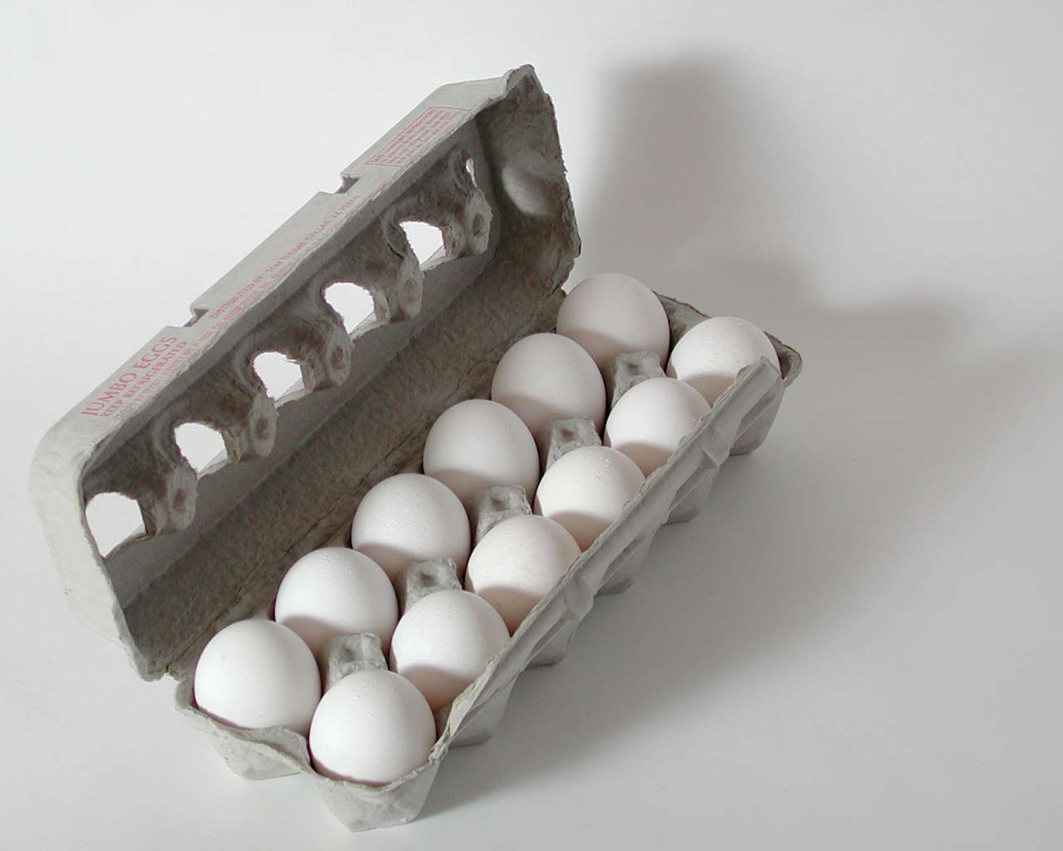
A seemingly silly digression : egg math exercise #1a
dumb Doc questions:
A) A dozen large eggs is how many eggs?
12 eggs/dozen
B)Mass of 1 dozen large eggs =
700 g/dozen*
1) What do 5 dozen large eggs weigh?
5 dozen * 700 g_
dozen
= 3500 g
1 (one) dozen large eggs
* According to Danny Wegman’s site

Slide 2
More dumb Doc questions:
egg math exercise #1b
12
A) 1 dozen eggs =
B)Mass of 1 dozen large eggs =
700 g/dozen
2) How many dozens in 2800 g of large eggs ?
2,800 g * 1 dozen
700 g
=4 dozen

Slide 3
More dumb Doc questions:
egg math exercise #1c
12
A) 1 dozen eggs =
B)Mass of 1 dozen large eggs =
700 g/dozen
3) How many eggs in 14,000 g of large eggs ?
14,000 g * 1 dozen
700 g
* 12 eggs
dozen
20 dozen
* 12 eggs
dozen
=240 large eggs

Slide 4
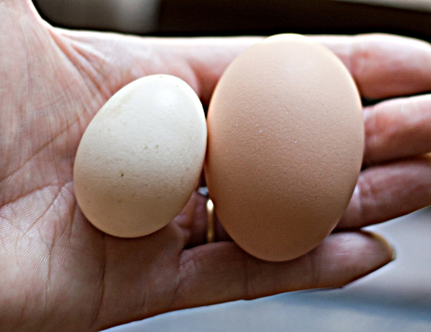
A seemingly silly digression : egg math exercise #2
And Yet More dumb Doc questions:
A) A dozen small eggs is how many eggs?
12 eggs/dozen
B)Mass of 1 dozen small eggs =
400 g/dozen*
2a) What do 5 dozen small eggs weigh?
5 dozen * 400 g
dozen
= 2000 g
Small vs large eggs
* According to Danny Wegman’s site

Slide 5
More dumb Doc questions:
egg math exercise #2b
12
A) 1 dozen eggs =
B)Mass of 1 dozen small eggs =
400 g/dozen
2) How many dozens in 2800 g of small eggs ?
2,800 g * 1 dozen
400 g
=7 dozen

Slide 6
More dumb Doc questions:
egg math exercise #2c
12
A) 1 dozen eggs =
B)Mass of 1 dozen small eggs =
400 g/dozen
3) How many eggs in 14,000 g of small eggs ?
14,000 g * 1 dozen
400 g
* 12 eggs
dozen
35 dozen
* 12 eggs
dozen
=420 small eggs

Slide 7

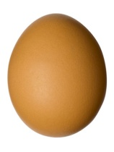

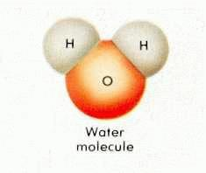
ASSERTION:
EGG MATH AND MOLE MATH ARE THE SAME
EGG WORLD
CHEMISTRY WORLD
quantity
Smallest unit
1 egg
1 molecule
Practical
Counting unit
Dozen
Chemist’s dozen = mole
Count in practical counting unit
6.0221 *10²³
12
(Avogodro’s #)
=grams/mole
=gram molecular weight
= MW (molecular weight)
Practical mass unit
grams/dozen

Slide 8
Egg vs mole
calculations
A)Mass of 1 dozen large eggs =
A)Mass of 1 chemist’s dozen H₂O
(1 mole)=
700 g/dozen
18 g/mole
1) What do 5 dozen large eggs weigh ?
1) What do 5 moles of water weigh ?
5 dozen * 700 g
dozen
5 moles * 18 g
mole
= 3500 grams
=90 grams
D*700 =W
M*18 =W

Slide 9
Egg vs mole
calculations
A)Mass of 1 dozen large eggs =
A)Mass of 1 chemist’s dozen H₂O
(1 mole)=
18 g/mole
700 g/dozen
2) How many dozens in 2800 g of large eggs ?
2) How many moles in 2800 g of H₂O ?
2800 g* 1 dozen
700 g
2800 g * 1 mole
18 g
= 4 dozen
=155.55 moles
W/700 =D
W/18 =M

Slide 10
Egg vs mole
calculations
A)Mass of 1 dozen large eggs =
A)Mass of 1 chemist’s dozen H₂O=
(1 mole)=
700 g/dozen
18 g/mole
B) 1 dozen =
12
6.0221*10²³
3) How many large eggs in 14,000 grams of eggs ?
3) How many H₂O molecules in 14,000 grams of H₂O ?
14,0000 g * 1 mole
18 g
*6.022*10²³
mole H₂O
14,000 g* 1 dozen
700 g
*12 eggs
dozen
777.77 mole H₂O
*6.022*10²³
mole H₂O
20 dozen
*12 eggs
dozen
=240 eggs
=4.68*10²⁶ molecules of H₂O
W * 12=X
700
W *6.02*10²³ =X
18

Slide 11
1 dozen eggs weighs 700 g
1 mole of H₂O weighs 18 g
12 =1 dozen count
6.02*10²³ = 1 mole count
Egg calculations
Mole calculations
1)W Mass →D Dozen
1)W Mass →M moles
W/700 =D
W/18 =M
2)D Dozen →W Mass
2)M Moles →W Mass
D*700 =W
M*18 =W
3)W Mass →X eggs
3)W Mass →X molecules
W/700 * 12=X
W/18 *6.02*10²³ =X

Slide 12
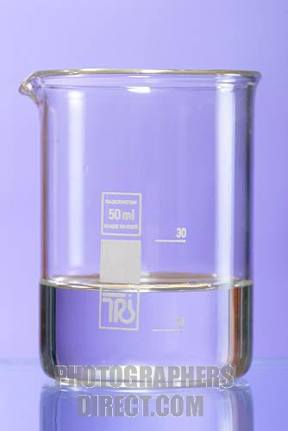
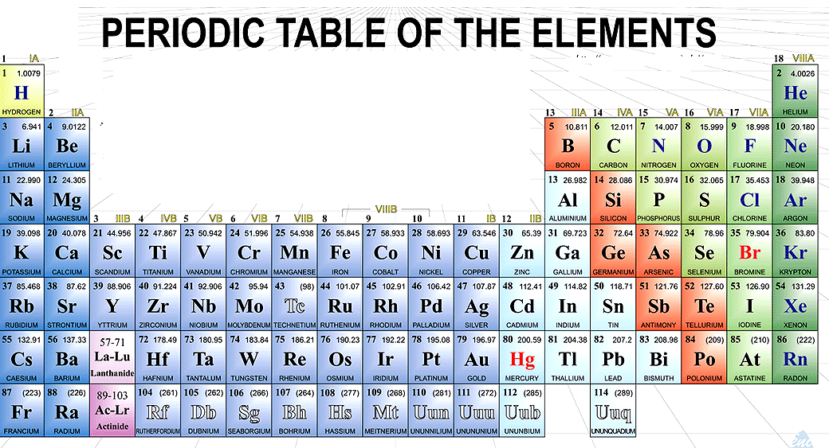

EGG WORLD
CHEMISTRY WORLD
Weight of 1 dozen eggs determined each time by direct weighting
Weight of 1 chemist’s dozen (=1 mole) of any compound determined by adding average masses of compound’s elements from Periodic Table assuming gram units
1 dozen eggs
~ 1 chemist’s dozen of H₂O
2*
1.0078
+ 15.9994
=18.0144
grams
700 GRAMS
Exercise #4.1 Practice

Slide 13
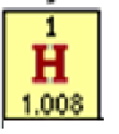
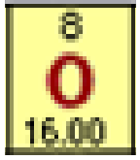
Relative mass vs gram atomic mass or weight (GAW)
~Average relative* mass/1 atom
practical mass =gram Atomic Weight = (GAW)
Average H
C-12
Average O
12.00000 (assumed)
1.008 grams
12.00000 grams
16.00 grams
…N_{o}
*No units !
…N_{o}
(6p⁺ + 6nº)
…N_{o}
*No units !
N_{o} is the same in each gram Atomic weight of all the elements. N_{o} is called Avogadro’s Number. Think of it like the number 12= 1 dozen. If you aren’t interested in counting molecules we don’t even need it ! (But we will count them…so hang on….)

Slide 14
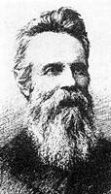
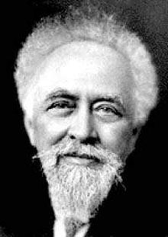


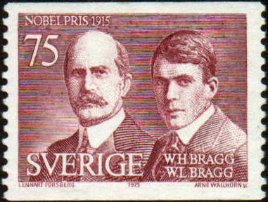
A brief digression on Avogadro’s Number N_{o}
1) There’s nothing magic or special about it. It reflects the arbitrary assumption of the use of grams to replace the unitless `relative’ masses in the Periodic Table. Change the choice of units…change N_{o}
2) Its magnitude has only definitively been determined in the 20th century (It’s a hard one to measure.) Until then, chemists got along fine counting moles not atoms.
1865
Loschmidt
1908
Perrin
1909
Rutherford
1918
The Braggs
2001
De Bièvre et. al.
Aerial view of NIST
72 *10²³
6.7 *10²³
6.16*10²³
6.019*10²³
6.022133530*10²³
1st reasonable guess
(N_{o} originally called Loschmidt’s Number)
uses 4 methods to find N_{o}; wins
Nobel Prize; renames N_{o} `Avogadro’s #’
Counted alpha particles
Used x-rays and counted atoms in a unit cell
Current (NIST) accepted value

Slide 15
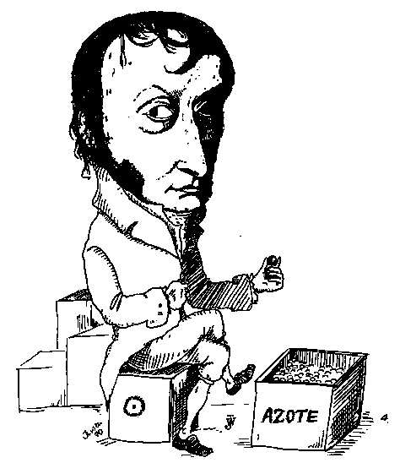
And yet little more trivia about Avogadro’s #, N_{o}
Avogadro Myth debunked:
Avogadro never derived N_{o} and did not count the N₂ molecules in a flask (as the cartoon to the left suggests…)
Lorenzo Romano Amedeo Carlo Avogadro di Quaregna e di Cerreto, Count of Quaregna and Cerreto (9 August 1776 – 9 July 1856)
...ostensibly counting `azote’ = Nitrogen molecules

Slide 16
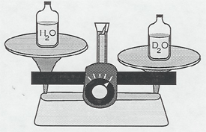
His real contribution: Avogadro’s Gas Law
“Equal numbers of gas particles occupy the same volume if at the same temperature and pressure regardless of gas identity.”
Y nitrogens
weigh 28 g
Y oxygens
weigh 32 g
=> Experimental path to finding the relative masses of elements on Periodic table
Y *Mass of one O atom = 32 g
= 16
14
Y* Mass of one N atom 28 g
Now unit-less ratio
See Periodic table entries

Slide 17
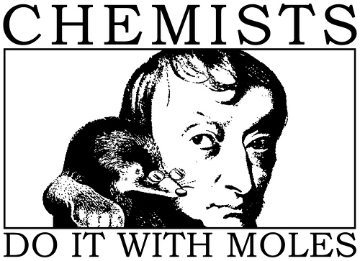
I gave you this…
NOT this….
N_{o} =6.022 133530*10²³

Slide 18
How gram atomic masses (AW) let us know the ratios of atoms in compounds (even if we don’t know how big N_{o} is)
EXAMPLE 1:
Element
C
O
Mass of element in X
GAW
# mole
24.0 grams
12.0 grams/mol C
24/12=2
64.0 grams
16.0 grams/mol O
64/16=4
What is the ratio C atoms to O atoms in compound X ?
2C to 4O
=> C₂O₄
= CO₂

Slide 19
How gram atomic masses (AW) let us know the ratios of atoms in compounds (cont.)
EXAMPLE 2:
Element
C
H
Mass of element in Y
GAW (grams/ mol)
# mol
6.0 grams
12.0 grams/mol C
6/12= ½
2.0 grams
1.0 grams/mol H
2/1 =2
What is the ratio of H to C atoms in compound Y ?
2 H to ½ C
x 2
=> C_{1/2}H₂
CH₄

Slide 20
How gram atomic masses (AW) let us know the ratios of atoms in compounds (cont.)
EXAMPLE 3:
Element
C
H
O
Mass of element in Z
GAW (grams/1 mol)
#mol
4.0 grams
12.0 grams/mol C
4.0/12=0.333
2.0 grams
1.0 grams/mol H
2.0/1= 2.0
5.33 grams
16.0 grams/mol O
5.33/16=0.333
What is the ratio of C to H to O atoms in Z ?
Mol C Mol H Mol O
0.333
2.0
0.333
How to simplify to produce whole numbers only ?
Divide by smallest mol count
0.333
0.333
2.0
0.333
0.333
0.333
1 6 1
=> CH₆O (grain alcohol)

Slide 21
TAKE HOME MESSAGE:
Moles of element A= m_{A}= observed weight A (g)= w_{A} (g)
gram Atomic Weight A GAW
⇒
m_{A} * GAW = w_{A}
Moles of compound Z = m_{Z} = observed mass of Z = w_{z} (g)
gram Molecular Weight Z MW
⇒
m_{Z} * MW = w_{Z}
*MW
Moles m
Weight (w)
÷MW
Exercise 4.2, 4.3

