Slide 1
EXAM 2 Review summary (Friday 4 April)
powerpoints 14-26
mini quizzes 11-16
homework 5-7
exercise 3
1 pt for name
Extensions of Lewis Structure rules (2 pts per answer/20 pts total)
Draw the best structures for molecule SO₃ assuming formal charge is minimized.
Supply the formal charges for the indicated elements in each of the compounds drawn below:
O in :C≡O: N in :NH₃
What are the most likely shape for the molecule: H₂O ? SO₂ ?
Bondline expressions of molecules (14 pts)
Determine the count of H,C and O in the compound drawn here:
Draw a plausible abbreviated bondline structure for a compound
containing 4 C 10 H and 1 O
Number games (8 pts)
Express 0.00312 in scientific notation
Find the log₁₀ of 0.005
Find the best prefix expression for 0.003 s
Find the best prefix expression for 10,000 m
Lessons and Insights from Studying Salts: pH, pOH and osmosis ( 2 pts each/20 pts total)
What is the pH of an acid solution containing 0.003 M H⁺? ____________
If the pOH of a solution is 13, then the solution is : acidic neutral basic
The pH of Sprite is ~3.25. What is the concentration of H+ implied by this? _________ M
A cell with 1 mg salt/mL is put in a solution with 0.1 mg salt/mL. The cell will: a) shrivel b) expand c) stay the same size d) lose salt
Electronic configurations and quantum ideas (32 pts)
How many levels are present for d orbitals ? ________ How many electrons can fit into a single level ? ______
Write the complete electronic configuration for P
Write the abbreviated electronic configuration for Mn (make sure to switch d and s correctly)
Draw the correct pigeonhole configuration for the species below.
(Make sure to correct for charges; a (+1) means the element has lost 1 electron from its usual count.)
Cu⁺ [Ar]

Slide 2

A necessary prequel part 3 : numbers, units, prefixes
RANDOM FACTOIDS
Width of a human blood cell ~0.000002 m
time for computer to do a single operation ~ 0.000000003 s
Average M-1 battle tank weighs ~ 18,200,000 g
Distance to Sun=12,874,800,000 m
Using a single metric measure is often inconvenient….object studied is either too
BIG
Or too small

Slide 3
A necessary prequel : numbers, units, prefixes (continued)
Using prefixes to simplify metric measure
(see also text pp 21-22 and Table 1.1. page 19)
magnitude = prefix =symbol
10⁺⁹ giga- G
10⁺⁶ mega- M
10⁺³ kilo- k
10⁻¹ deci- d
10⁻³ milli- m
10⁻⁶ micro- μ
10⁻⁹ nano- n
10⁻¹² pico- p
EXAMPLE #1
Width of human blood cell ~0.000002 m
1)Convert to scientific notation
2.0 *10⁻⁶ m
2.0 *μm
2) Find the exponent term in the prefix table
3) Replace the exponent term in your measure with the exponent’s symbol

Slide 4
magnitude = prefix =symbol
10⁺⁹ giga G
10⁺⁶ mega- M
10⁺³ kilo- k
10⁻¹ deci- d
10⁻² centi- c
10⁻³ milli- m
10⁻⁶ micro- μ
10⁻⁹ nano- n
10⁻¹² pico- p
EXAMPLE #2
time for computer to do a single operation ~ 0.000000003 s
1)Convert to scientific notation
3.0 *10⁻⁹ s
3.0 *ns
2) Find the exponent term in the prefix table
3) Replace the exponent term in your measure with the exponent’s symbol

Slide 5

A necessary prequel : numbers, units, prefixes (continued)
LISTEN UP, MAGGOTS
PREFIXES
you are responsible for remembering metric PREFIXES, symbols and numeric equivalents on the next page

Slide 6
A necessary prequel : numbers, units, prefixes (continued)
KNOW THESE…MAGGOTS….
magnitude = prefix = symbol
10⁺⁹ giga- G
10⁺⁶ mega- M
10⁺³ kilo- k
10⁻¹ deci- d
10⁻² centi- c
10⁻³ milli- m
10⁻⁶ micro- μ
10⁻⁹ nano- n
10⁻¹² pico- p

Slide 7
More prefix assignments…. with a twist: examples 3 and 4
Done on board
Average M-1 battle tank weighs ~ 18,200,000 g
Distance to Sun=12,874,800,000 m
1.82*10⁷ g= 18.2 Mg
1.2874*10¹⁰ m = 12.874 Gm
10⁺⁹ giga G
10⁺⁶ mega- M
10⁺³ kilo- k
10⁻¹ deci- d
10⁻² centi- c
10⁻³ milli- m
10⁻⁶ micro- μ
10⁻⁹ nano- n
10⁻¹² pico- p

Slide 8
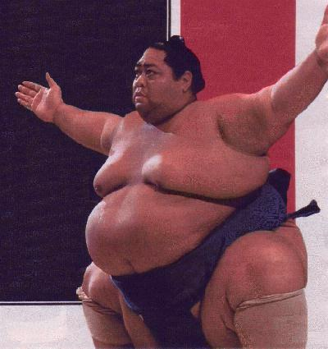
Average Japanese
sumo wrestler weighs
~ 180,000 g.
(~ 400 lbs)
=180 kg
Express this little fella’s
mass with correct prefix
10⁺⁹ giga G
10⁺⁶ mega- M
10⁺³ kilo- k
10⁻¹ deci- d
10⁻² centi- c
10⁻³ milli- m
10⁻⁶ micro- μ
10⁻⁹ nano- n
10⁻¹² pico- p
“I ate a breakfast sushi roll this big today….”

Slide 9
In-class practice picking prefixes
magnitude = prefix = symbol
10⁺⁹ giga- G
10⁺⁶ mega- M
10⁺³ kilo- k
10⁻¹ deci- d
10⁻² centi- c
10⁻³ milli- m
10⁻⁶ micro- μ
10⁻⁹ nano- n
10⁻¹² pico- p

Slide 10
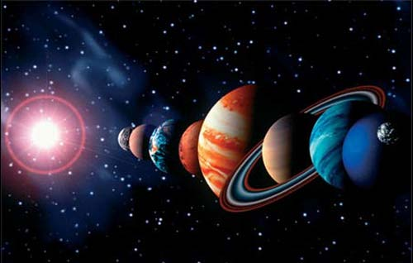
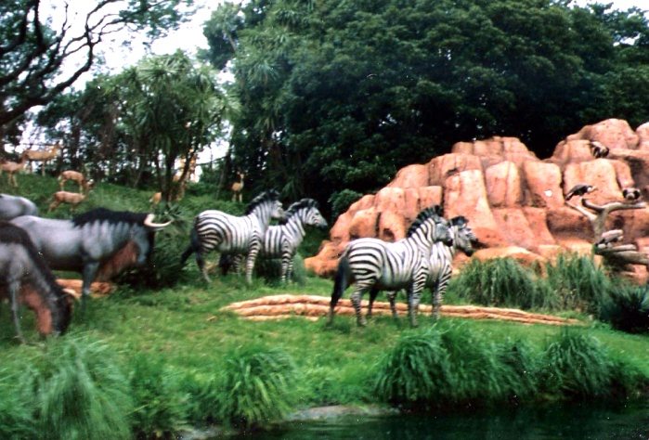
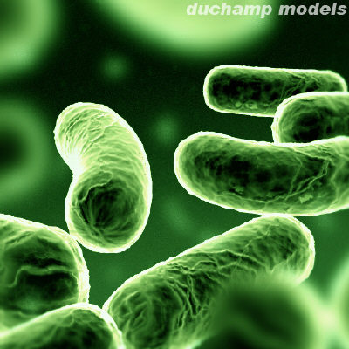
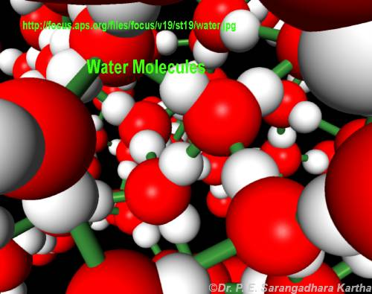
INTRO TO MOLES: Every science involves counting….
Astronomers count ……
Animal biologists count …….
Bacteriologists count …..
Chemists count…….

Slide 11
How chemists count atoms and molecules:
the mole concept
See also: text pp 61-63
Doc’s `dumb question #1
How long would it take the fastest (single chip) computer in the world (The Fujitsu `Venus’) to count all the molecules of water in a teacup assuming it counted at its maximum processor rate = 128,000,000,000 molecules/second (128 GHz) ?
Answer: ~ 2 million years
How do we `count’ atoms and molecules without having to actually count them ???

Slide 12
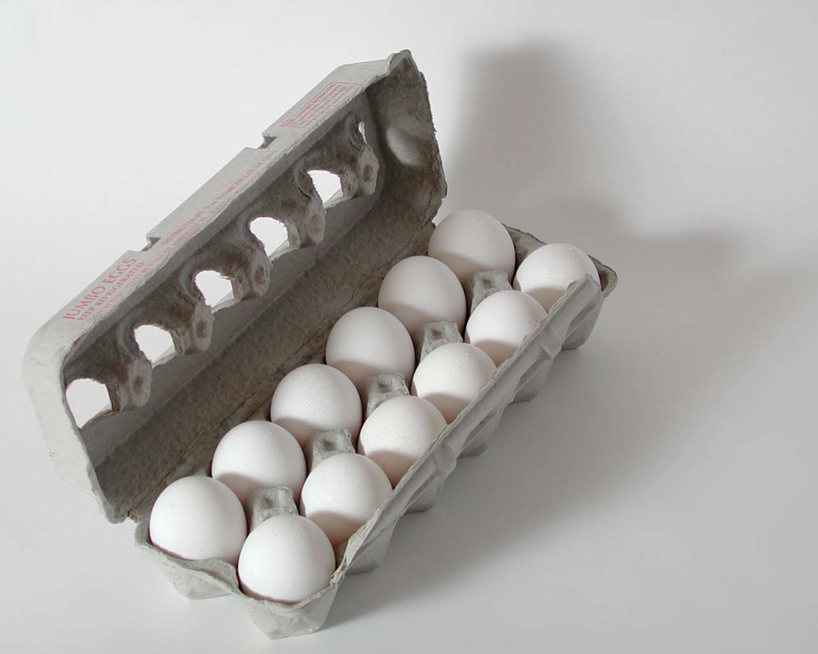
A seemingly silly digression : egg math exercise #1a
dumb Doc questions:
A) A dozen large eggs is how many eggs?
12 eggs/dozen
B)Mass of 1 dozen large eggs =
700 g/dozen*
1) What do 5 dozen large eggs weigh?
5 dozen * 700 g
dozen
= 3500 g
1 (one) dozen large eggs
* According to Danny Wegman’s site

Slide 13
More dumb Doc questions:
egg math exercise #1b
12
A) 1 dozen eggs =
B)Mass of 1 dozen large eggs =
700 g/dozen
2) How many dozens in 2800 g of large eggs ?
2,800 g * 1 dozen
700 g
=4 dozen

Slide 14
More dumb Doc questions:
egg math exercise #1c
12
A) 1 dozen eggs =
B)Mass of 1 dozen large eggs =
700 g/dozen
3) How many eggs in 14,000 g of large eggs ?
14,000 g * 1 dozen
700 g
* 12 eggs
dozen
20 dozen
* 12 eggs
dozen
=240 large eggs

Slide 15
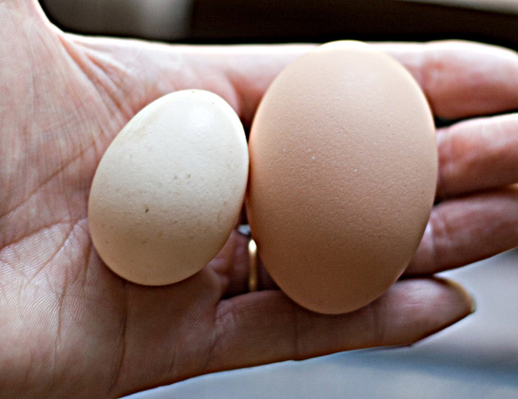
A seemingly silly digression : egg math exercise #2
And Yet More dumb Doc questions:
A) A dozen small eggs is how many eggs?
12 eggs/dozen
B)Mass of 1 dozen small eggs =
400 g/dozen*
2a) What do 5 dozen small eggs weigh?
5 dozen * 400 g
dozen
= 2000 g
Small vs large eggs
* According to Danny Wegman’s site

Slide 16
More dumb Doc questions:
egg math exercise #2b
12
A) 1 dozen eggs =
B)Mass of 1 dozen small eggs =
400 g/dozen
2) How many dozens in 2800 g of small eggs ?
2,800 g * 1 dozen
400 g
=7 dozen

Slide 17
More dumb Doc questions:
egg math exercise #2c
12
A) 1 dozen eggs =
B)Mass of 1 dozen small eggs =
400 g/dozen
3) How many eggs in 14,000 g of small eggs ?
14,000 g * 1 dozen
400 g
* 12 eggs
dozen
35 dozen
* 12 eggs
dozen
=420 small eggs

Slide 18

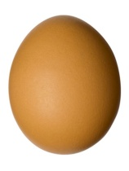

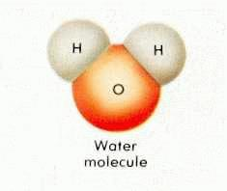
ASSERTION:
EGG MATH AND MOLE MATH ARE THE SAME
EGG WORLD
CHEMISTRY WORLD
quantity
Smallest unit
1 egg
1 molecule
Practical
Counting unit
Dozen
Chemist’s dozen = mole
Count in practical counting unit
6.0221 *10²³
12
(Avogodro’s #)
=grams/mole
=gram molecular weight
= MW (molecular weight)
Practical mass unit
grams/dozen

Slide 19
Egg vs mole
calculations
A)Mass of 1 dozen large eggs =
A)Mass of 1 chemist’s dozen H₂O
(1 mole)=
700 g/dozen
18 g/mole
1) What do 5 dozen large eggs weigh ?
1) What do 5 moles of water weigh ?
5 dozen * 700 g
dozen
5 moles * 18 g
mole
= 3500 grams
=90 grams

Slide 20
Egg vs mole
calculations
A)Mass of 1 dozen large eggs =
A)Mass of 1 chemist’s dozen H₂O
(1 mole)=
700 g/dozen
18 g/mole
2) How many dozens in 2800 g of large eggs ?
2) How many moles in 2800 g of H₂O ?
2800 g* 1 dozen
700 g
2800 g * 1 mole
18 g
= 4 dozen
=155.55 moles

Slide 21
Egg vs mole
calculations
A)Mass of 1 dozen large eggs =
A)Mass of 1 chemist’s dozen H₂O
(1 mole)=
700 g/dozen
18 g/mole
B) 1 dozen =
12
B) 1 mole =
6.0221*10²³
3) How many large eggs in 14,000 grams of eggs ?
3) How many H₂O molecules in 14,000 grams of H₂O ?
14,0000 g * 1 mole
18 g
*6.022*10²³
mole H₂O
14,000 g* 1 dozen
700 g
*12 eggs
dozen
777.77 mole H₂O
*6.022*10²³
mole H₂O
20 dozen
*12 eggs
dozen
=240 eggs
4.68*10²⁶ molecules of H₂O

