Slide 1
EXAM 2 Review summary (Friday 4 April)
powerpoints 14-26
mini quizzes 11-16
homework 5-7
exercise 3
1 pt for name
Extensions of Lewis Structure rules (2 pts per answer/20 pts total)
Draw the best structures for molecule SO₃ assuming formal charge is minimized.
Supply the formal charges for the indicated elements in each of the compounds drawn below:
O in :C≡O: N in :NH₃
What are the most likely shape for the molecule: H₂O ? SO₂ ?
Bondline expressions of molecules (14 pts)
Determine the count of H,C and O in the compound drawn here:
Draw a plausible abbreviated bondline structure for a compound
containing 4 C 10 H and 1 O
Number games (8 pts)
Express 0.00312 in scientific notation
Find the log₁₀ of 0.005
Find the best prefix expression for 0.003 s
Find the best prefix expression for 10,000 m
Lessons and Insights from Studying Salts: pH, pOH and osmosis ( 2 pts each/20 pts total)
What is the pH of an acid solution containing 0.003 M H⁺? ____________
If the pOH of a solution is 13, then the solution is : acidic neutral basic
The pH of Sprite is ~3.25. What is the concentration of H+ implied by this? _________ M
A cell with 1 mg salt/mL is put in a solution with 0.1 mg salt/mL. The cell will: a) shrivel b) expand c) stay the same size d) lose salt
Electronic configurations and quantum ideas (32 pts)
How many levels are present for d orbitals ? ________ How many electrons can fit into a single level ? ______
Write the complete electronic configuration for P
Write the abbreviated electronic configuration for Mn (make sure to switch d and s correctly)
Draw the correct pigeonhole configuration for the species below.
(Make sure to correct for charges; a (+1) means the element has lost 1 electron from its usual count.)
Cu⁺ [Ar]

Slide 2
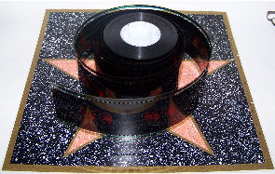


Light and electrons on the move: examples of them working together
(see pp 174-178, section 5.3)
Example #1:
Photographic film

Slide 3
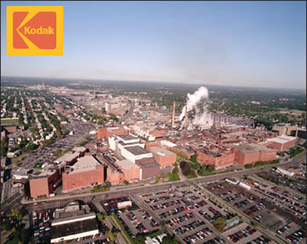
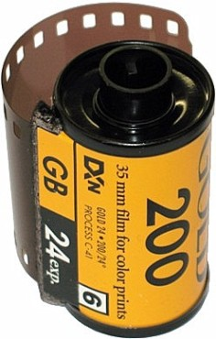
Kodak Park: The House that George Eastman Built
One of the largest industrial parks in the world (3 zip codes)
~ 2 km (1.25 miles)
~1.6 km (1 mile)

Slide 4
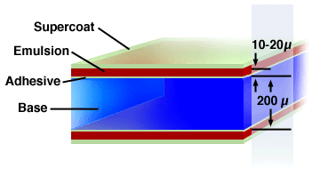
Film deconstructed
1)Emulsion contains AgBr crystals..the active ingredient
2)Base is a gelatin to which emulsion is glued with adhesive¹
3)Supercoat is a protective plastic anti-scratch coating
3
1
2
~0.2 mm
¹ originally gelatin base made from boiling down cow hoofs but now most commonly organic polyester polymer (originally boiled down dinosaur and plant goo= oil)

Slide 5
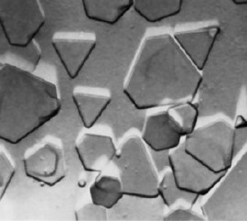
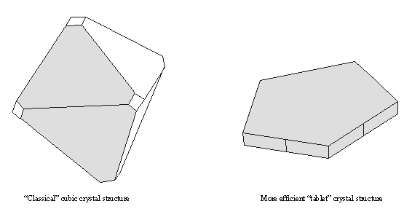

Film deconstructed (continued)
The emulsion at 200X:
Flat crystals of AgBr
=0.2 mm
Absorbed or scattered away
light
Why flat crystals are preferred
light
Absorbed by and scattered into crystal

Slide 6
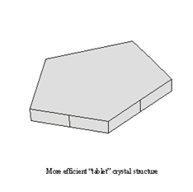
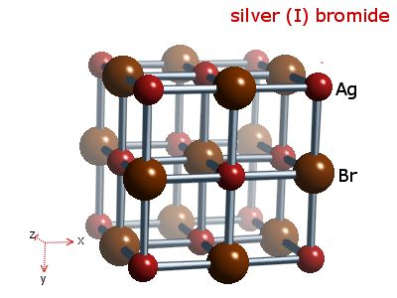
Film deconstructed (continued)
How AgBr absorbs light to make a `latent’ image:
Example of a solid state redox
light
200X view of AgBr crystal
Oxidation
Light + Br ⁻ → Br + e⁻
Latent image (reduced Ag) forms
e⁻
reduction
e⁻ e⁻ + Ag⁺ → Agº
Molecular (10,000,000X view of AgBr crystal)

Slide 7
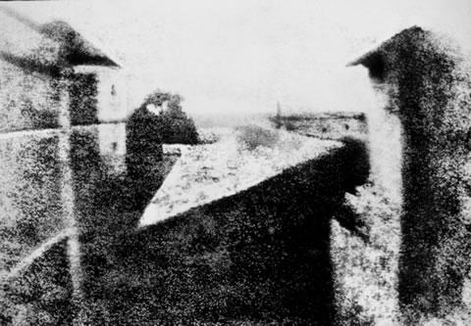
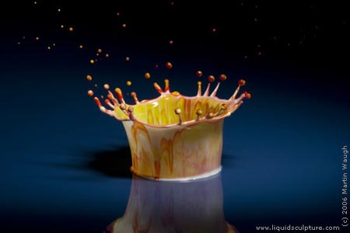
"View from the Window at Le Gras" (circa 1826), taken and developed by French photographer pioneer Joseph Nicéphore Niépce.
~ 120 second exposure time ?
False color image of splash (circa 2000)
~0.0001 second exposure time

Slide 8
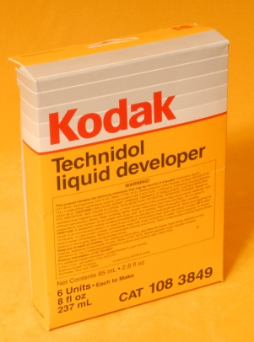
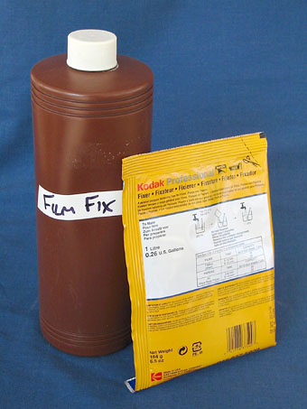
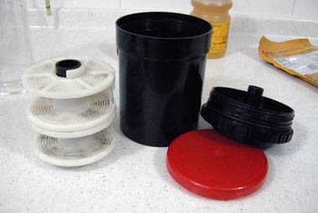

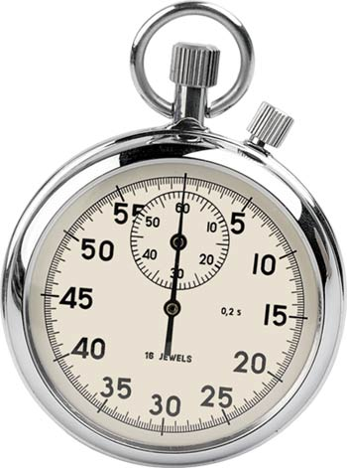
Film deconstructed (continued)
How the latent image is developed: making a negative
Latent image (reduced Ag) forms
Film negative
In a dark room, film canister is unrolled , mounted on developer roller and then sealed in light-tight developer tank.
`developer’ is added (reduces Ag⁺→Ag).
The developer reaction is `timed’ so that only latent images reduce to black Ag, leaving unexposed Ag+ alone. A `stop’ bath solution is added to halt action of developer.
A fixer is added to dissolve Ag+ and Cl- not exposed off film and negative
is removed from developer tank after rinsing and washing with water.

Slide 9
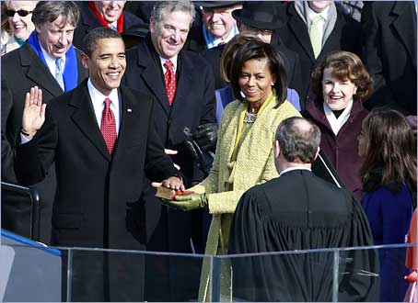
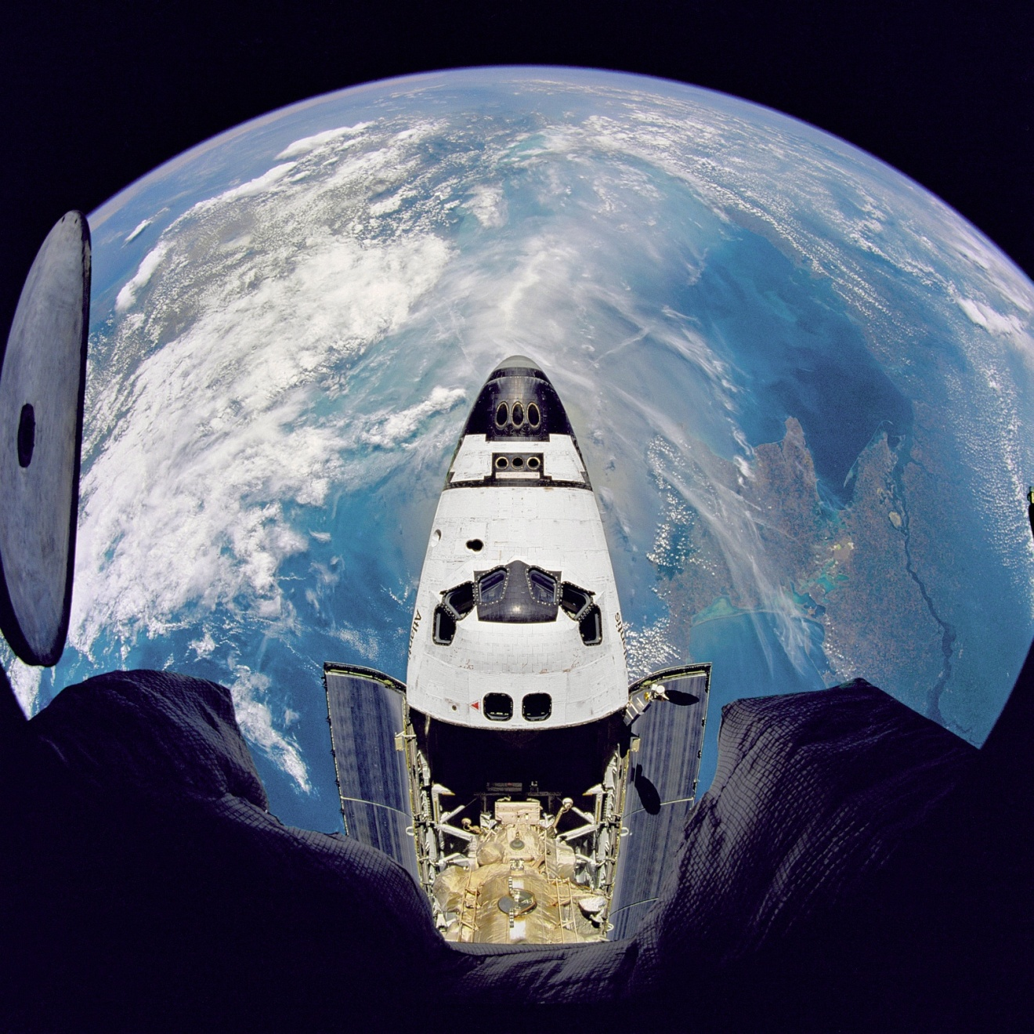
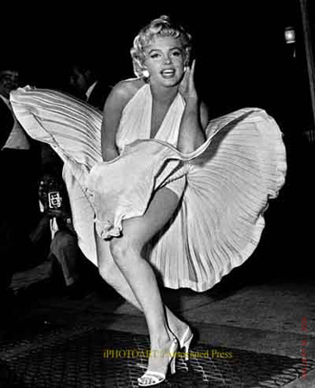
The last 100 years are recorded mostly in film format

Slide 10

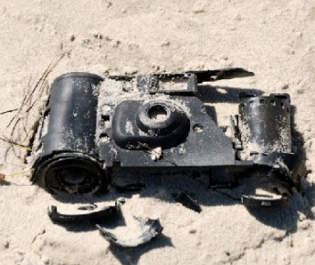
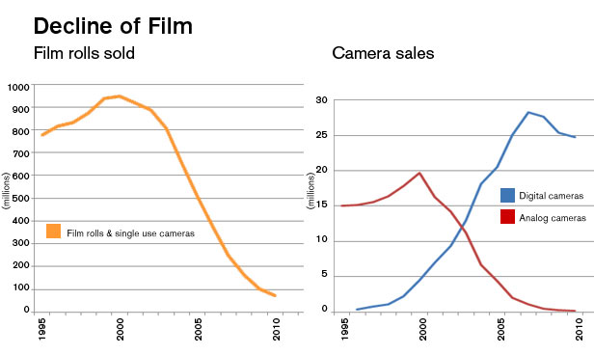

The next 100 years….the electrons still rock and roll with light…but not on film …it now plays on transitorized LCDs

Slide 11
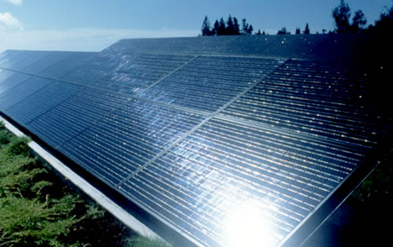
Light and electrons on the move: examples of them working together
Example 2:
Sun powered America (???)
How sunlight can free us from burning oil and coal
Load
e⁻
p n
Sunlight on
e⁻
Sun Light off
p-n solar Si cell junction

Slide 12
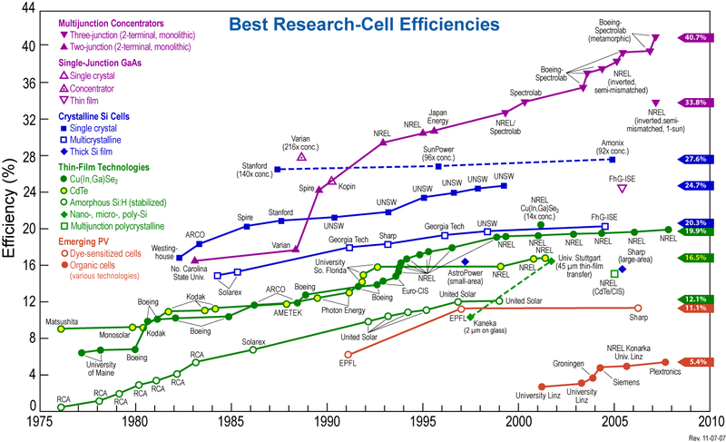
Homo junction (single p/n) theoretical limit
Si-only limit
Current Practical range

Slide 13
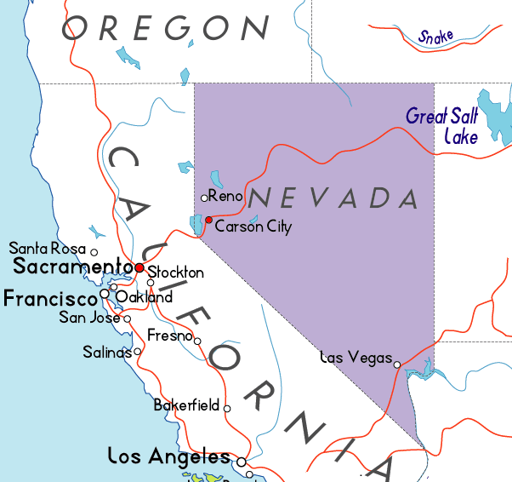
A `what if’ calculation: why not solar ?
Average amount of sunlight falling on Nevada = 0.5 J / (s in²)
Total energy produced daily in USA=> ~1*10¹⁶ J/day
Assume 10 hours (36000 s) of sunlight per day
Assume solar cells convert 10% of sun energy (`cheap cells’)

Slide 14
Energy we generate per day in America
1.0*10¹⁶ J
=
Available Solar Energy in 1 day in Nevada/in²
x cell Conversion
efficiency
x cell area
(0.5 J/s*in² ) x 36000 s
x 0.1 (10%)
x A(in²)
Solve for A
1.0*10¹⁶ J
=
A(in²)
(0.5 J/s*in² ) x 36000 s
x 0.1 (10%)
=5.6*10¹² in²
= 2.4*10⁶ inch x 2.4*10⁶ inch
= 37 miles x 37 miles

Slide 15
A `what if’ calculation: why not solar? (cont.)
=> If we cover 40 mile x 40 mile section of Nevada with 10 % efficient solar cells we can make 1.2*10¹⁶ J in 10 hours
Can get all energy/day generated in USA from just solar in 10 hr

Slide 16
How much would a system cost? Some rough estimates….
Price list from-http://www.solarelectricsupply.com/
System Size | 50kW | 75kW | 100kW | 250kW | 500kW | 1,000kW
System Area | 3,846 sq. ft. | 5,769 sq. ft. | 7,692 sq. ft. | 19,231 sq. ft. | 38,462 sq. ft. | 76,924 sq. ft.
List Price | $108,350 | $158,400 | $206,800 | $486,750 | $912,600 | $1,808,300
Minimum estimate: via kW use
$1,808/kW
Total US power needs per day
1 *10¹⁶ J/10 hours = 2.8*10⁷ kW
(during light hours….store the rest)
=>2.8*10⁷ kW * $1,808/kW =$ 5*10¹⁰
Minimum cost:
50 billion dollars

Slide 17
Maximum estimate: …just cover the 37x 37 mile² area with commercial units
System Size | 50kW | 75kW | 100kW | 250kW | 500kW | 1,000kW
System Area | 3,846 sq. ft. | 5,769 sq. ft. | 7,692 sq. ft. | 19,231 sq. ft. | 38,462 sq. ft. | 76,924 sq. ft.
List Price | $108,350 | $158,400 | $206,800 | $486,750 | $912,600 | $1,808,300
$23.5/ft²
A(to supply all US energy)= 37 x 37 mile² = 4*10¹⁰ ft²
Maximum cost
A(ft²) x $23.5/ft² = 4*10¹⁰ ft²*$23.5/ft² =$9.4*10¹¹ =$ 940 billion

Slide 18

Cost for total clean, green Energy freedom for USA (not including delivery):
$50-940 billion
Another annoying Doc question:
The Iraq war cost the US taxpayers how many $$$$….?
$2000-3000 billion (2-3 trillion)

Slide 19
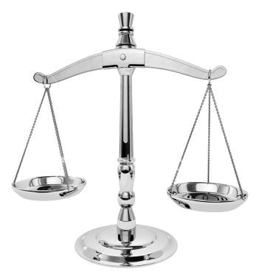
The course so far….
Electronic properties of elements and molecules
Some chemistry and computations for salts , acids and bases
Atomic structure, light, `quantum’ jumps and spectral lines
But all of modern Chemistry…
….starts with experiments using a balance
…which leads to `mole’ calculations

Slide 20
Text does very ,very little with moles… you’ll need to rely on lecture …
☹

Slide 21

A necessary prequel part 1: numbers, units and prefixes
(see also: pp 17-24 and pp 58-61)
1) Review of scientific notation
Mass of 1 molecule of water =
0.00000000000000000000002988 grams
23 hops
Etc…counting hops….till here…..
1)To convert to scientific notation-first do the `bunny hop’ & count
2) …..stop hopping since 2.988 is between 1 and 10
3) Write the hop count as exponent of 10
count if hopped right
+ count if hopped left
4) Multiply by the`pre-exponent’ (2.988 )
5) don’t forget your units !
2.988 x
10⁻²³
grams
0.00000000000000000000002988 grams=

Slide 22
A necessary prequel ….1)Scientific notation review (continued)
Mass of our Sun=
1,988,200,000,000,000,000,000,000,000,000,000 grams
………………………………………..…etc…
1)count Hops to left ….until number is between 1 and 10
33 hops to left
2)Stop hop count where ??
count if hopped right
+ count if hopped left
3) Write exponent
1.9882 x
10⁺³³
grams
4) Multiply by pre-exponent (1.9882)
5) Don’t forget units
…practice in class ??

Slide 23
A necessary prequel, part 2 : numbers, units, prefixes (continued)
2) Base units = building block¹ units of the Universe
Length(L)
Mass (M)
Time (t)
Charge (q)
meters (m)
grams (g)
seconds (s)
Coulombs (C)
¹All other physical effects in the Universe
are combinations built out of these three (except temperature…. which is depends on choice of thermometer, and, mole count)
This class will use metric measures ABOVE for the fundamental units

Slide 24
Derived units are combinations of fundamental units
Example
Speed
= distance
second
= meters
time
What are the units of area A in metric units ?
A=L * L = m *m = m²
What are the units of volume V in metric units ?
V= L * L * L = m*m*m=m³
What are the units of density d in metric units ?
d = M/V = g/m³

Slide 25
Other common examples of derived units
formula
Metric units
Force
(F=ma=mΔv/Δt)
g*m
s²
Mass* distance time²
Energy
(E=F*d)
Mass* distance²
time²
g*m²
s²
Power
(P=E/t)
Mass* distance²
time³
g*m²
s³
Voltage
(V=E/q)
g*m²
C*s²
Mass* distance²
charge*time²

Slide 26
A necessary prequel part 3 : numbers, units, prefixes
RANDOM FACTOIDS
Width of a human blood cell ~0.000002 m
time for computer to do a single operation ~ 0.000000003 s
Average M-1 battle tank weighs ~ 18,200,000 g
Distance to Sun=12,874,800,000 m
Using a single metric measure is often inconvenient….object studied is either too
BIG
Or too small

Slide 27
A necessary prequel : numbers, units, prefixes (continued)
Using prefixes to simplify metric measure
(see also text pp 21-22 and Table 1.1. page 19)
magnitude = prefix =symbol
10⁺⁹ giga- G
10⁺⁶ mega- M
10⁺³ kilo- k
10⁻¹ deci- d
10⁻³ milli- m
10⁻⁶ micro- μ
10⁻⁹ nano- n
10⁻¹² pico- p
EXAMPLE #1
Width of human blood cell ~0.000002 m
1)Convert to scientific notation
2.0 *10⁻⁶ m
2.0 *μm
2) Find the exponent term in the prefix table
3) Replace the exponent term in your measure with the exponent’s symbol

Slide 28
magnitude = prefix =symbol
10⁺⁹ giga G
10⁺⁶ mega- M
10⁺³ kilo- k
10⁻¹ deci- d
10⁻² centi- c
10⁻³ milli- m
10⁻⁶ micro- μ
10⁻⁹ nano- n
10⁻¹² pico- p
EXAMPLE #2
time for computer to do a single operation ~ 0.000000003 s
1)Convert to scientific notation
3.0 *10⁻⁹ s
3.0 *ns
2) Find the exponent term in the prefix table
3) Replace the exponent term in your measure with the exponent’s symbol

Slide 29

A necessary prequel : numbers, units, prefixes (continued)
LISTEN UP, MAGGOTS
PREFIXES
you are responsible for remembering metric PREFIXES, symbols and numeric equivalents on the next page

Slide 30
A necessary prequel : numbers, units, prefixes (continued)
KNOW THESE…MAGGOTS….
magnitude = prefix = symbol
10⁺⁹ giga- G
10⁺⁶ mega- M
10⁺³ kilo- k
10⁻¹ deci- d
10⁻² centi- c
10⁻³ milli- m
10⁻⁶ micro- μ
10⁻⁹ nano- n
10⁻¹² pico- p

Slide 31
More prefix assignments…. with a twist: examples 3 and 4
Done on board
Average M-1 battle tank weighs ~ 18,200,000 g
Distance to Sun=12,874,800,000 m
1.82*10⁷ g= 18.2 Mg
1.2874*10¹⁰ m = 12.874 Gm
10⁺⁹ giga G
10⁺⁶ mega- M
10⁺³ kilo- k
10⁻¹ deci- d
10⁻² centi- c
10⁻³ milli- m
10⁻⁶ micro- μ
10⁻⁹ nano- n
10⁻¹² pico- p

Slide 32
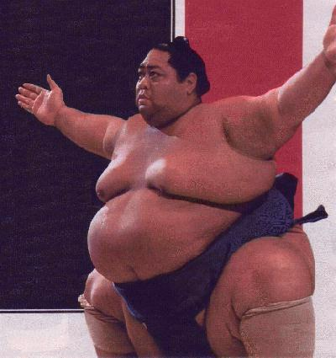
Average Japanese
sumo wrestler weighs
~ 180,000 g.
(~ 400 lbs)
=180 kg
Express this little fella’s
mass with correct prefix
10⁺⁹ giga G
10⁺⁶ mega- M
10⁺³ kilo- k
10⁻¹ deci- d
10⁻² centi- c
10⁻³ milli- m
10⁻⁶ micro- μ
10⁻⁹ nano- n
10⁻¹² pico- p
“I ate a breakfast sushi roll this big today….”

Slide 33
In-class practice picking prefixes
magnitude = prefix = symbol
10⁺⁹ giga- G
10⁺⁶ mega- M
10⁺³ kilo- k
10⁻¹ deci- d
10⁻² centi- c
10⁻³ milli- m
10⁻⁶ micro- μ
10⁻⁹ nano- n
10⁻¹² pico- p

Slide 34
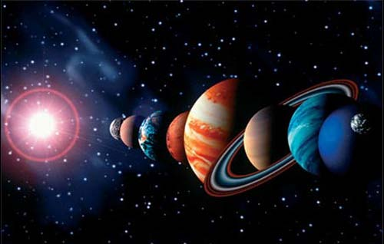
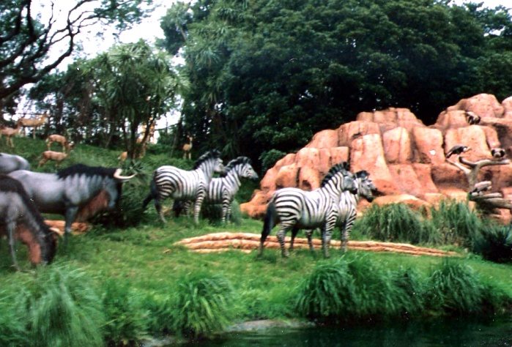
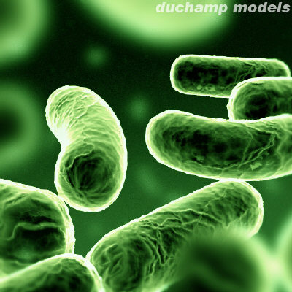
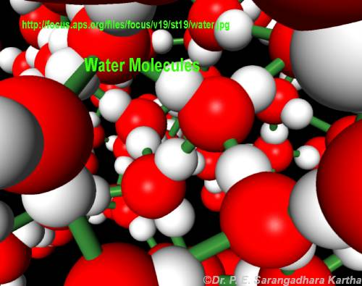
INTRO TO MOLES: Every science involves counting….
Astronomers count ……
Animal biologists count …….
Bacteriologists count …..
Chemists count…….

Slide 35
How chemists count atoms and molecules:
the mole concept
See also: text pp 61-63
Doc’s `dumb question #1
How long would it take the fastest (single chip) computer in the world (The Fujitsu `Venus’) to count all the molecules of water in a teacup assuming it counted at its maximum processor rate = 128,000,000,000 molecules/second (128 GHz) ?
Answer: ~ 2 million years
How do we `count’ atoms and molecules without having to actually count them ???

Slide 36
How chemists count atoms and molecules:
the mole concept
See also: text pp 61-63
Doc’s `dumb question #1
How long would it take the fastest computer in the world (The Fujitsu `Venus’) to count all the molecules of water in a teacup assuming it counted at its maximum processor rate = 128,000,000,000 molecules/second (128 GHz) ?
Answer: ~ 2 million years
How do we `count’ atoms and molecules without having to actually count them ???

