Slide 1
EXAM 2 Review summary (Friday 4 April)
powerpoints 14-26
mini quizzes 11-16
homework 5-7
exercise 3
1 pt for name
Extensions of Lewis Structure rules (2 pts per answer/20 pts total)
Draw the best structures for molecule SO₃ assuming formal charge is minimized.
Supply the formal charges for the indicated elements in each of the compounds drawn below:
O in :C≡O: N in :NH₃
What are the most likely shape for the molecule: H₂O ? SO₂ ?
Bondline expressions of molecules (14 pts)
Determine the count of H,C and O in the compound drawn here:
Draw a plausible abbreviated bondline structure for a compound
containing 4 C 10 H and 1 O
Number games (8 pts)
Express 0.00312 in scientific notation
Find the log₁₀ of 0.005
Find the best prefix expression for 0.003 s
Find the best prefix expression for 10,000 m
Lessons and Insights from Studying Salts: pH, pOH and osmosis ( 2 pts each/20 pts total)
What is the pH of an acid solution containing 0.003 M H⁺? ____________
If the pOH of a solution is 13, then the solution is : acidic neutral basic
The pH of Sprite is ~3.25. What is the concentration of H+ implied by this? _________ M
A cell with 1 mg salt/mL is put in a solution with 0.1 mg salt/mL. The cell will: a) shrivel b) expand c) stay the same size d) lose salt
Electronic configurations and quantum ideas (32 pts)
How many levels are present for d orbitals ? ________ How many electrons can fit into a single level ? ______
Write the complete electronic configuration for P
Write the abbreviated electronic configuration for Mn (make sure to switch d and s correctly)
Draw the correct pigeonhole configuration for the species below.
(Make sure to correct for charges; a (+1) means the element has lost 1 electron from its usual count.)
Cu⁺ [Ar]

Slide 2
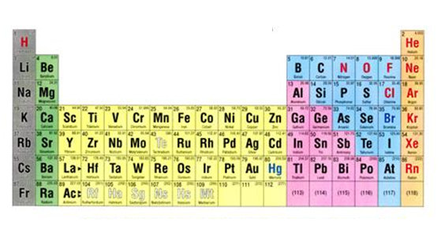

A simple trick with the Periodic Table to remember the electronic addresses of the electrons of C , F and S
n= row number
The simple trick: part 1
See also: figure 5.5 pg 170
n
n s block
n p block
1
2
3
4
5
6
7
Label the various sections of the Table as shown
(n-1) d block
(n-2) f block

Slide 3
Things electronic configuration teaches us (continued)
3) The mysterious behavior of transition metals gets cleared up
In solutions, the transition metal valence d and s energies switch position because of interactions with the solvent
U-predict Cu configuration
Solution phase Cu
[Ar] 4s²3d⁹
→ [Ar] 3d⁹4s²
In water…these swap positions
Explains why all TM have 2+ state in water
Explains why Zn only in 2+ state
Why Cu⁺ ?
Why Mn²⁺ is so stable…
Why Fe³⁺ is so stable….
predict the common charges the other TM take on
Also: with one more modification of the rule can:

Slide 4
The `pigeonhole’ picture for transition metal valences: a third way to look at electron configuration
1) Chemically correct, abbreviated electronic configuration for:
Energy increasing
Fe=
[Ar]
3d⁶
4s²
4s
3d
2)Equivalent energy diagram picture
3) The alternative abbreviated `pigeonhole’ diagram of Fe
[Ar]
= `pigeonhole’
=
3d
4s
Pigeonhole same as one energy level
=>can hold two electrons maximum
Energy increasing

Slide 5
Pigeonhole diagrams for sample transition elements
What is the abbreviated electronic configuration for Mn ?
[Ar]
3d⁵
4s²
What is the equivalent abbreviated pigeonhole diagram for Mn ?
[Ar]
3d 4s

Slide 6
Pigeonhole diagrams for sample transition elements (continued)
What is the abbreviated electronic configuration for Ti ?
[Ar]
3d²
4s²
What is the equivalent abbreviated pigeonhole diagram for Ti ?
4s
3d
[Ar]
3d 4s
Even if not used…the empty pigeonholes are still shown, just like empty energy levels

Slide 7
Pigeonhole diagrams for sample transition elements (continued)
What the abbreviated pigeonhole diagram (or the energy level picture) teaches:
Ti=
4s
3d
[Ar]
3d 4s
Lose the 4s electrons …or
Move them back to 3d
Either diagram implies Ti is `unstable’…
⇒

Slide 8
=>two rules for transition metal electronic structure
RULE 1:
All transition metals are more stable without their ns² electrons*
Ti → Ti²⁺
Mn→ Mn²⁺
Think of ns² as low hanging fruit

Slide 9
General rules for transition metal chemistry
RULE 2: The “filled, half-filled, empty” rule
If the valence d and s electrons of a transition metal in any state of charge can be re-distributed so that some combination of filled, half-filled and/or empty pigeonholes is attained, the resulting configuration is more stable and therefore is adopted.

Slide 10
General rules for transition metal chemistry
RULE 2: The “filled, half-filled, empty” rule
If the valence d and s electrons of a transition metal in any state of charge can be re-distributed so that some combination of filled, half-filled and/or empty pigeonholes is attained, the resulting configuration is more stable and therefore is adopted.

Slide 11

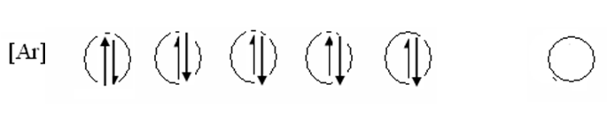

A little more practice with d –s electron shuffling
a) Cr
Ni
Ag⁺
remember…rule is applied ONLY with the s & d electron combos (e.g. transition elements only)

Slide 12
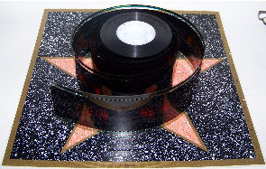


Light and electrons on the move: examples of them working together
(see pp 174-178, section 5.3)
Example #1:
Photographic film

Slide 13
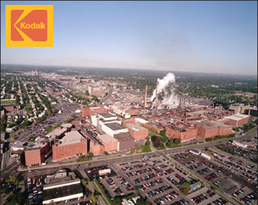
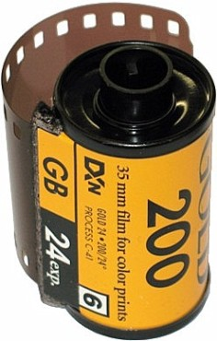
Kodak Park: The House that George Eastman Built
One of the largest industrial parks in the world (3 zip codes)
~ 2 km (1.25 miles)
~1.6 km (1 mile)

Slide 14
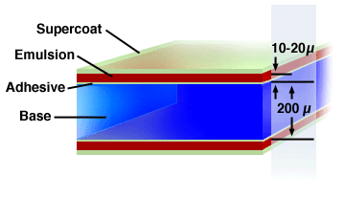
Film deconstructed
1)Emulsion contains AgBr crystals..the active ingredient
2)Base is a gelatin to which emulsion is glued with adhesive¹
3)Supercoat is a protective plastic anti-scratch coating
3
1
2
~0.2 mm
¹ originally gelatin base made from boiling down cow hoofs but now most commonly organic polyester polymer (originally boiled down dinosaur and plant goo= oil)

Slide 15
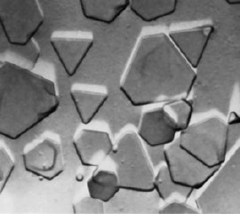
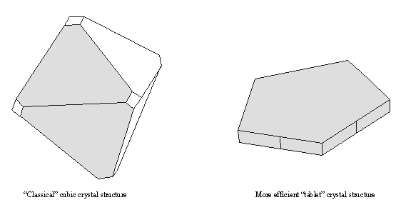

Film deconstructed (continued)
The emulsion at 200X:
Flat crystals of AgBr
=0.2 mm
Absorbed or scattered away
light
Why flat crystals are preferred
light
Absorbed by and scattered into crystal

Slide 16
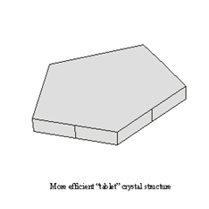
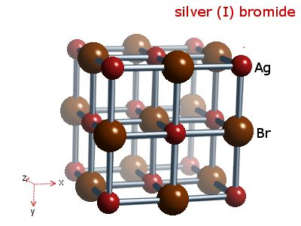
Film deconstructed (continued)
How AgBr absorbs light to make a `latent’ image:
Example of a solid state redox
light
200X view of AgBr crystal
Oxidation
Light + Br ⁻ → Br + e⁻
Latent image (reduced Ag) forms
e⁻
reduction
e⁻ e⁻ + Ag⁺ → Agº
Molecular (10,000,000X view of AgBr crystal)

Slide 17
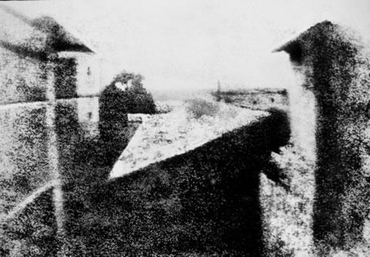

"View from the Window at Le Gras" (circa 1826), taken and developed by French photographer pioneer Joseph Nicéphore Niépce.
~ 120 second exposure time ?
False color image of splash (circa 2000)
~0.0001 second exposure time

Slide 18
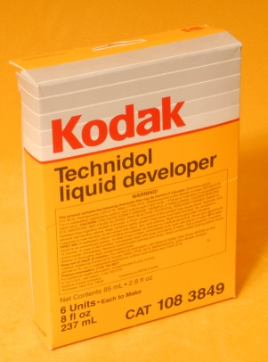
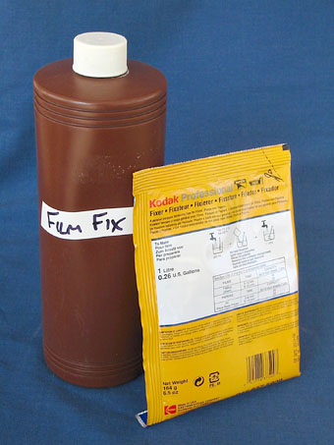
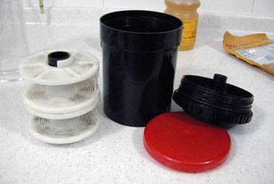


Film deconstructed (continued)
How the latent image is developed: making a negative
Latent image (reduced Ag) forms
Film negative
In a dark room, film canister is unrolled , mounted on developer roller and then sealed in light-tight developer tank.
`developer’ is added (reduces Ag⁺→Ag).
The developer reaction is `timed’ so that only latent images reduce to black Ag, leaving unexposed Ag+ alone. A `stop’ bath solution is added to halt action of developer.
A fixer is added to dissolve Ag+ and Cl- not exposed off film and negative
is removed from developer tank after rinsing and washing with water.

Slide 19
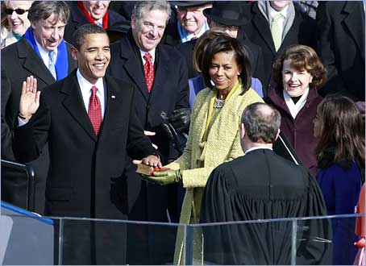
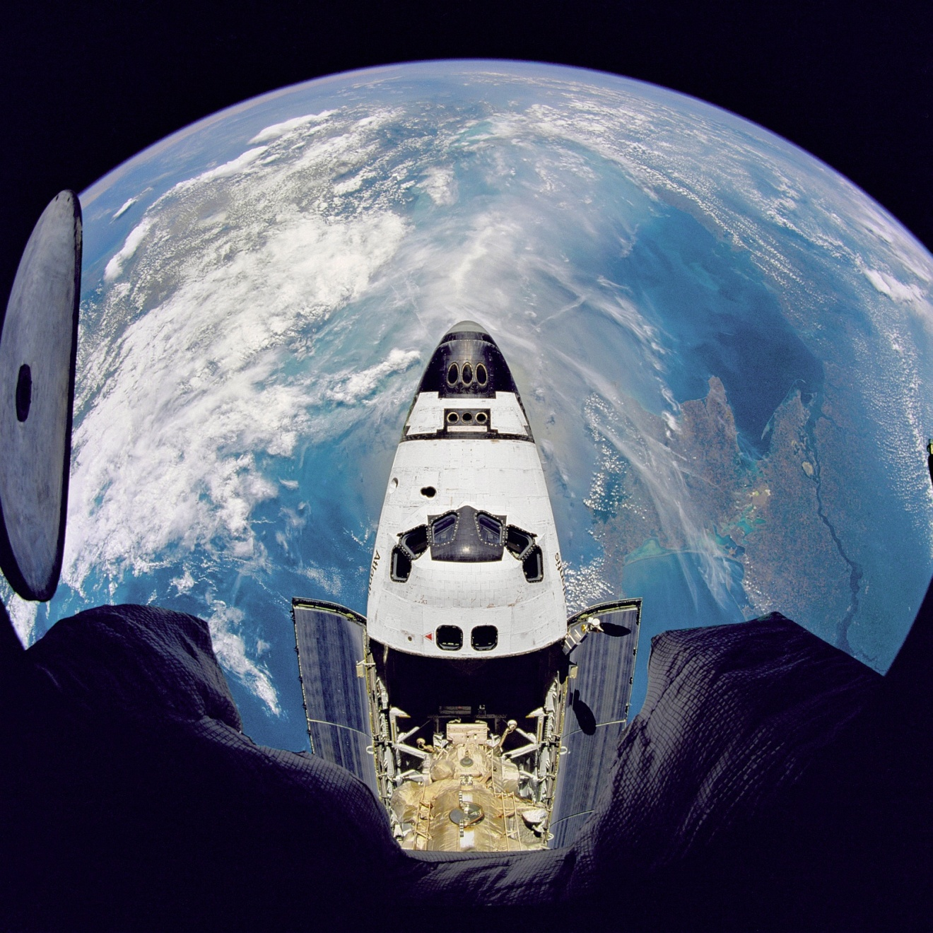

The last 100 years are recorded mostly in film format

Slide 20

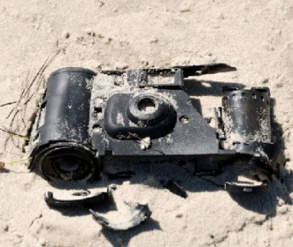
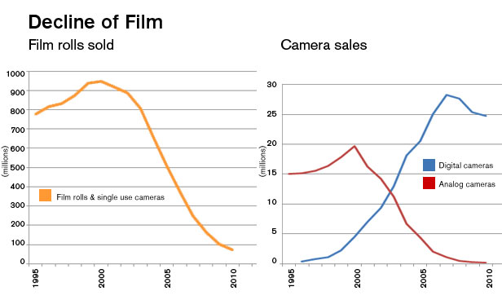

The next 100 years….the electrons still rock and roll with light…but not on film …it now plays on transitorized LCDs

Slide 21
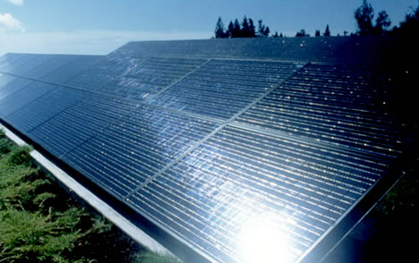
Light and electrons on the move: examples of them working together
Example 2:
Sun powered America (???)
How sunlight can free us from burning oil and coal
Load
e⁻
p n
Sunlight on
e⁻
Sun Light off
p-n solar Si cell junction

Slide 22
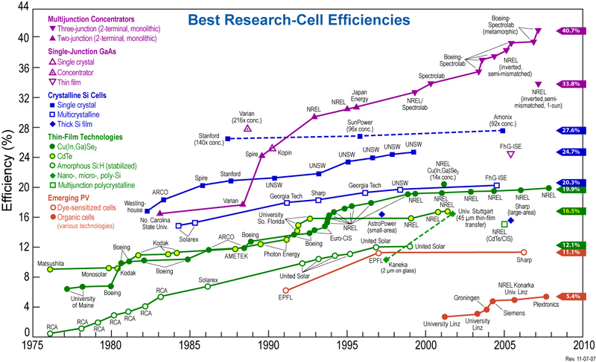
Homo junction (single p/n) theoretical limit
Si-only limit
Current Practical range

Slide 23

A `what if’ calculation: why not solar ?
Average amount of sunlight falling on Nevada = 0.5 J / (s in²)
Total energy produced daily in USA=> ~1*10¹⁶ J/day
Assume 10 hours (36000 s) of sunlight per day
Assume solar cells convert 10% of sun energy (`cheap cells’)

Slide 24
Energy we generate per day in America
1.0*10¹⁶ J
=
Available Solar Energy in 1 day in Nevada/in²
x cell Conversion
efficiency
x cell area
(0.5 J/s*in² ) x 36000 s
x 0.1 (10%)
x A(in²)
Solve for A
1.0*10¹⁶ J
=
A(in²)
(0.5 J/s*in² ) x 36000 s
x 0.1 (10%)
=5.6*10¹² in²
= 2.4*10⁶ inch x 2.4*10⁶ inch
= 37 miles x 37 miles

Slide 25
A `what if’ calculation: why not solar? (cont.)
=> If we cover 40 mile x 40 mile section of Nevada with 10 % efficient solar cells we can make 1.2*10¹⁶ J in 10 hours
Can get all energy/day generated in USA from just solar in 10 hr

Slide 26
How much would a system cost? Some rough estimates….
Price list from-http://www.solarelectricsupply.com/
System Size | 50kW | 75kW | 100kW | 250kW | 500kW | 1,000kW
System Area | 3,846 sq. ft. | 5,769 sq. ft. | 7,692 sq. ft. | 19,231 sq. ft. | 38,462 sq. ft. | 76,924 sq. ft.
List Price | $108,350 | $158,400 | $206,800 | $486,750 | $912,600 | $1,808,300
Minimum estimate: via kW use
$1,808/kW
Total US power needs per day
1 *10¹⁶ J/10 hours = 2.8*10⁷ kW
(during light hours….store the rest)
=>2.8*10⁷ kW * $1,808/kW =$ 5*10¹⁰
Minimum cost:
50 billion dollars

Slide 27
Maximum estimate: …just cover the 37x 37 mile² area with commercial units
System Size | 50kW | 75kW | 100kW | 250kW | 500kW | 1,000kW
System Area | 3,846 sq. ft. | 5,769 sq. ft. | 7,692 sq. ft. | 19,231 sq. ft. | 38,462 sq. ft. | 76,924 sq. ft.
List Price | $108,350 | $158,400 | $206,800 | $486,750 | $912,600 | $1,808,300
$23.5/ft²
A(to supply all US energy)= 37 x 37 mile² = 4*10¹⁰ ft²
Maximum cost
A(ft²) x $23.5/ft² = 4*10¹⁰ ft²*$23.5/ft² =$9.4*10¹¹ =$ 940 billion

Slide 28
Cost for total clean, green Energy freedom for USA (not including delivery):
$50-940 billion
Factoid:
The Iraq war is estimated to have cost the US taxpayers 2-3 trillion dollars
=$2000-3000 billion

