Slide 1
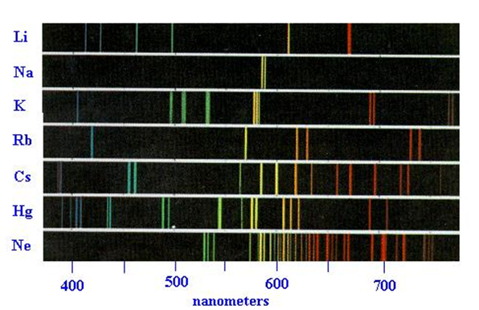
Recap:
The spectra of atoms lets us deduce the energy levels of the elements

Slide 2
Recap : what the levels look like- H & the other elements
Element with many e- (see also: fig 5.4 p. 168)
H atom (1 e⁻ )
5
4
3
2
1
Ground state H

Slide 3
Naming the electron levels of atoms
p
5
4
3
2
1
d
s => 1 level
5
4
3
2
1
s
p
p => 3 levels
d
s
p
d => 5 levels
s
f => 7 levels
(not shown
here)
p
s
# equal levels are called the degeneracy’ of the energy level
The energy levels deduced from atomic emission lines for all atoms except H
s

Slide 4
One more example of `Aufbau’ process (‘Building up’ process to describe electron addresses…): Sulfur with 16 electrons
p
d
S’s electronic configuration
3
2
1
s
p
d
s
p
S=
s
1s²
2s²
2p⁶
3s²
3p⁴
p
s
s

Slide 5

Is there a way to assign electronic addresses without memorizing the electronic level positions ???

Slide 6
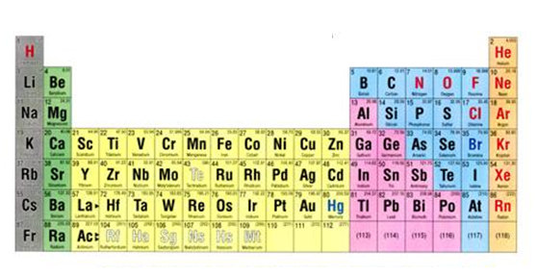

A simple trick with the Periodic Table to remember the electronic addresses of the electrons of C , F and S
n= row number
The simple trick: part 1
See also: figure 5.5 pg 170
n
n s block
n p block
1
2
3
4
5
6
7
Label the various sections of the Table as shown
(n-1) d block
(n-2) f block

Slide 7
Electronic configuration of C
Simple trick: part 2
1s²
2s²
2p²
n= row number
Using the labeling to describe C
n
n s block
See also: figure 5.5 pg 170
n p block
1
2
3
4
5
6
7
(n-1) d block
(n-2) f block

Slide 8
Electronic configuration of F
Simple trick: part 2 (continued)
Using the labeling to describe F
1s²
2s²
2p⁵
n= row number
n
n s block
n p block
1
2
3
4
5
6
7
(n-1) d block
(n-2) f block

Slide 9
Simple trick: part 2 (continued)
Electronic configuration of S
Using the labeling to describe S
1s²
2s²
2p⁶
3s²
3p⁴
n= row number
n
n s block
n p block
1
2
3
4
5
6
7
(n-1) d block
(n-2) f block

Slide 10
IN CLASS PRACTICE ASSIGNING ELECTRONIC CONFIGURATIONS TO ELEMENTS: exercise 3
n
n s block
n p block
1
2
3
4
5
6
7
8
(n-1) d block
(n-2) f block
7
8

Slide 11
The `Who am I game’ :
configurations→ element
Element implied by configuration
Electronic configuration
core valence
N
1s² 2s²2p³
1s²2s²2p⁶ 3s¹
Na
1s²2s²2p⁶3s²3p⁶ 3d⁵4s²
Mn
[Ar] 3d¹⁰ 4s²4p³
As

Slide 12
Things electronic configurations teach us
The octet rule for rows 1-3 are re-expressed as a desire to `fill’ the valence shell to the maximum within a row.
2p
2s
1s
valence
three more to fill totally=>N³⁻
=>octet in ‘valence shell’
N
core
= 1s² 2s² 2p³
= 1s² 2s² 2p⁶
You fill in configuration

Slide 13



2) The combinations of s,p,d define the unique `chemistry’ of the element
Dogs drool, cats rule
s is for silly cow
d is for damned dog
p is for pretty kitty

Slide 14


Visual analogies of specific combo of orbits making unique chemical animals (elements)
Things electronic configuration teaches us (continued)
Be= [He]2s²
Cl=[Ne]3s² 3p⁴
Ti = [Ar] 3d²4s²
100% cow
33% cow+66% kitty
50% cow +50% dog

Slide 15
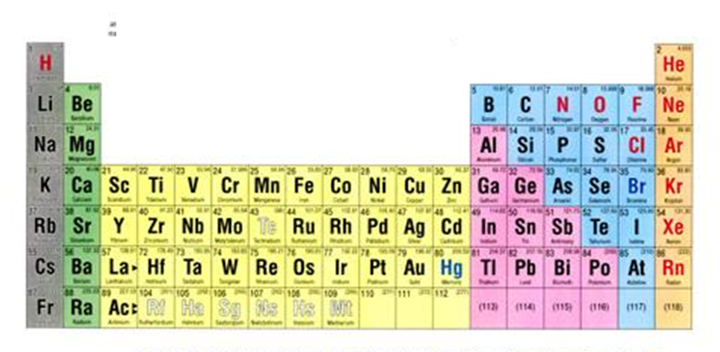
From lecture 6: Jan 29, 2014
WHY SKIP??
0
+1
±4
+2
-3
-2
-1
-5, +3
We sort of skip over the complicated chemistry of the transition elements

Slide 16
Things electronic configuration teaches us (continued)
3) The mysterious behavior of transition metals gets cleared up
In solutions, the transition metal valence d and s energies switch position because of interactions with the solvent
U-predict Cu configuration
Solution phase Cu
[Ar] 4s²3d⁹
→ [Ar] 3d⁹4s²
In water…these swap positions
Explain why all TM have 2+ state in water
Explain why Zn only in 2+ state
Why Cu⁺ ?
Why Mn²⁺ is so stable…
Why Fe³⁺ is so stable….
predict the common charges the other TM take on
Also: with one more modification of the rules….can:

