Slide 1
To understand chemical PROPERTIES ….
Read chapter 5
pp 166-186
Follow the electrons…

Slide 2




Chapter 5 : Film-the study of light and how electrons respond to it
Photoelectric door
What do these four objects have in common ?
photocopier
Light (photons) moves electrons in all 4 objects
Photo
(and film)
Photosynthesis

Slide 3
The real (and wacko) picture of electron motion in atoms:
electrons as magic popcorn (not in text)
Electron here t=t₁
Electron has non-zero chance to `pop out’ anywhere on a sphere at fixed distance from nucleus.
It must be somewhere on that sphere at all times…just can’t say where…
Electron
Here at t=t₃
Electron starts here, t=0
Nucleus magnified 100,000X
Electron
here t=t₂
Electron
Here t=t₄….

Slide 4

yet another annoying Doc question…..
If we’re going to ‘follow the electrons’, …beyond just knowing they act like bits of quantum popcorn …how do we find where the electrons live in atoms ??

Slide 5

How electrons change addresses: moving from n=1 to n=2
See also: Figure 5.3 p 167 and Figure 5.25 p. 195 of text
H nucleus magnified x 100,000
electron promoted to `excited’ state
(n=2) by absorbing light of exactly the right energy E₁₂
n=2
E₁₂
n=1
electron initially in ground state
(n=1)
p⁺
If energy isn’t exactly right, electron won’t move, even if the energy is just a little smaller
n=1
n=2
Electron ignores `wrong’ kind of light…even if its really close to E₁₂

Slide 6
How electrons change addresses: moving back from n=2 to n=1
electron returns from excited state (n=2) to `ground’ state
(n=1) by emitting light of energy E₁₂
Nucleus magnified x 100,000
n=2
E₁₂
n=1
p⁺
n=1
n=2

Slide 7
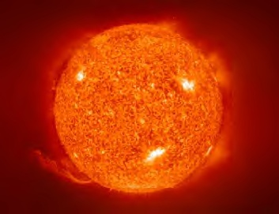
The energy levels (E ) for H (see also: fig 5.25, p 195)
Our Sun: a ball of very hot (excited) H
Electron is free of nucleus
E (eV)
n
∞
0.00
-0.37
6
5
4
3
2
1
-0.54
-0.85
-1.50
-3.40
Sun’s visible emission lines
5→4
5→3
5→2
6→2
λ(nm) 656 486 434 410
-13.6
Source of lines:
transition of excited electron in H to lower state
Ground state

Slide 8
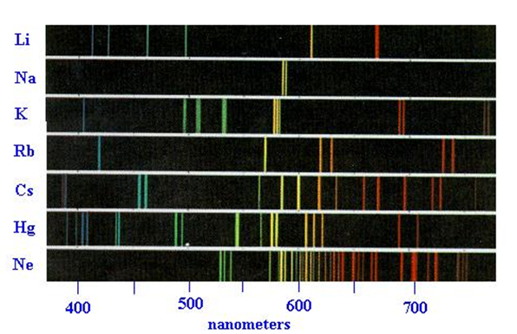
Extension to atoms bigger than H: multi-electron elements
H atom’s `emission spectrum’
…allows us to construct the energy levels
E (eV)
0.00
6
5
4
3
2
-0.37
5→4
5→3
5→2
-0.54
-0.85
-1.50
-3.40
E ∝ 1/λ
(Max Planck)
λ(nm) 656 486 434 410
In similar fashion, the emission spectra of bigger elements allows us to construct `many electron’ atom levels

Slide 9
Electron energy levels deduced for H vs Bigger Elements with many electron (e-)
Element with many e- (see also: fig 5.4 p. 168)
H atom (1 e⁻ )
5
4
3
2
1
Ground state H

Slide 10
Electron energy levels deduced for H vs Bigger Elements with many electron (e-)
Element with many e- (see also: fig 5.4 p. 168)
`building Carbon’s 6 e⁻ ground state
(called the `Aufbau’* process)
*Aufbau is German for `building up’. Each level contains maximum of 2 e⁻
n=3
Spread electrons out if levels have same energy (Hund’s rule)
n=2
n=2 Valence electrons
n=1
n=1 Core electrons

Slide 11
Naming the electron levels of atoms
p
5
4
3
2
1
d
s => 1 level
5
4
3
2
1
s
p
p => 3 levels
d
s
p
d => 5 levels
s
f => 7 levels
(not shown
here)
p
s
# equal levels are called the degeneracy’ of the energy level
The energy levels deduced from atomic emission lines for all atoms except H
s

Slide 12
Using the electron level names to describe the electronic addresses for all 6 electrons of Carbon
p
C’s electron addresses
enumerated
d
3
2
1
s
p
d
s
p
C
1s²
2s²
2p²
s
p
s
The list of addresses for an element is called the electronic configuration of the element
s

Slide 13
Using the electron level names to describe the electronic addresses for all 9 electrons of Fluorine
p
d
F’s electronic configuration
3
2
1
s
p
d
s
p
F
1s²
2s²
2p⁵
s
p
s
s

Slide 14
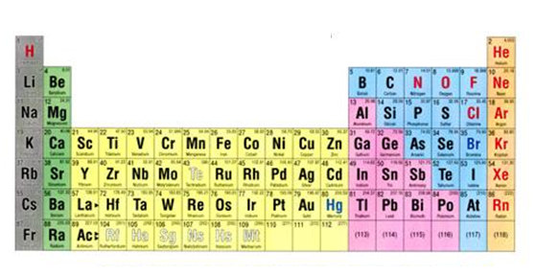

Using a simple trick with the Periodic Table to remember the electronic addresses of the electrons of C & F
n= row number
The simple trick: part 1
See also: figure 5.5 pg 170
n
n s block
n p block
1
2
3
4
5
6
7
Label the various sections of the Table as shown
(n-1) d block
(n-2) f block

Slide 15
Electronic configuration of C
Simple trick: part 2
1s²
2s²
2p²
n= row number
Using the labeling to describe C
n
n s block
See also: figure 5.5 pg 170
n p block
1
2
3
4
5
6
7
(n-1) d block
(n-2) f block

Slide 16
Electronic configuration of F
Simple trick: part 2 (continued)
Using the labeling to describe F
1s²
2s²
2p⁵
n= row number
n
n s block
n p block
1
2
3
4
5
6
7
(n-1) d block
(n-2) f block

Slide 17
IN CLASS PRACTICE ASSIGNING ELECTRONIC CONFIGURATIONS TO ELEMENTS: exercise 4
n
n s block
n p block
1
2
3
4
5
6
7
8
(n-1) d block
(n-2) f block
7
8

Slide 18
The `Who am I game’ :
configurations→ element
Element implied by configuration
Electronic configuration
core valence
N
1s² 2s²2p³
1s²2s²2p⁶ 3s¹
Na
1s²2s²2p⁶3s²3p⁶ 3d⁵4s²
Mn
[Ar] 3d¹⁰ 4s²4p³
As

Slide 19
Things electronic configurations teach us
The octet rule for rows 1-3 are re-expressed as a desire to `fill’ the valence shell to the maximum within a row.
2p
2s
1s
valence
three more to fill totally=>N³⁻
=>octet in ‘valence shell’
N
core
= 1s² 2s² 2p³
= 1s² 2s² 2p⁶
You fill in configuration

Slide 20




2) The combinations of s,p,d define the unique `chemistry’ of the element
Dogs drool, cats rule
s is for silly cow
d is for damned dog
p is for pretty kitty
N=[He] 2s² 2p³
Be= [He]2s²

Slide 21

2) The specific combo of orbits creates the unique chemistry of an element
Things electronic configuration teaches us (continued)
Be= [He]2s²
Cl=[Ne]3s² 3p⁴
Ti = [Ar] 3d²4s²
100% cow
33% cow+66% kitty
50% cow +50% dog

