Slide 1
In class practice converting
pH→ pOH
pOH→ pH
H+→ pH→pOH
OH-→pOH→pH
pH + pOH = 14

Slide 2

How do we recover the original H⁺ and OH⁻ concentrations from pH and pOH ???
step
1) Remember definition
pH = - log [H⁺]
2) Get log [H⁺] by itself
-pH = log [H⁺]
3) Apply the magic `undo’ log key on calculator on -pH
anti-log (…
10^(…
10^{x} … <enter>
Forms of the
`undo log’ key
on various calculators

Slide 3
Example of converting pH back to [H+]
pH = 3.5 is equivalent to what concentration of [H+] ?
1) Remember definition
pH = 3.5= ??
-log [H⁺]
2) Get log [H⁺] by itself
-pH = -3.5 = log [H⁺]
3) Apply the magic `undo’ log key on calculator on -pH
c) Hit <enter>
10^
-3.5
=0.000316 or 3.16 EE-4
a)You hit this key (or similar)
b) Type in –pH value
= [H+]

Slide 4
CONVERTING pH and pOH back to [H+] and [OH-]
1) Compute [H⁺ ] or [OH⁻] from given the pH and pOH below
EXAMPLE
A
B
C
D
pH = 6.5
pOH=9.2
pH= 3.6
pOH=5.4
[H⁺ ] =
[OH⁻] =
[H⁺] =
[OH⁻ ]=
10^{-6.5} =3.16EE-7 = 3.16*10⁻⁷
10^{-9.2} =6.31EE-10 = 6.31*10⁻¹⁰
10^{-3.6} =2.51EE-4 = 2.51*10⁻⁴
10^{-5.4} =3.98EE-6 = 3.98*10⁻⁶

Slide 5
2) Computing the related [OH⁻] or [H⁺] from given pH and pOH: applying pH +pOH=14
example
Step 1 remember pH+pOH=14 and convert pH→pOH or pOH→pH
A
B
C
D
pH = 6.5
pOH=9.2
pH= 3.6
pOH=5.4
pOH =
pH =
pOH=
pH=
14-6.5 =7.5
14-9.2=4.8
14-3.6=11.4
14-5.4=9.6
Steps 2,3
as before
A
B
C
D
[OH⁻] =
[H⁺] =
[OH⁻] =
[H⁺] =
10^{-7.5} =3.16EE-8=3.16*10⁻⁸
10^{-4.8}=1.58EE-5=1.58*10⁻⁵
10^{-11.4}=3.98EE-12=3.98*10⁻¹²
10^{-9.6}=2.51EE-10=2.51*10⁻¹⁰

Slide 6
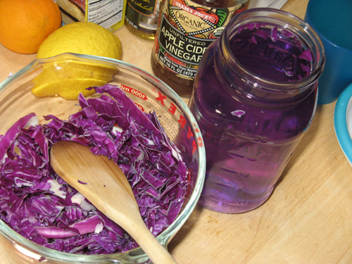
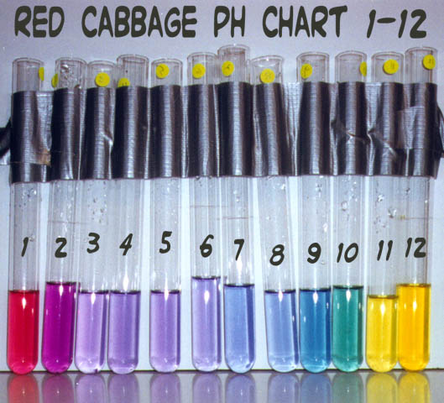
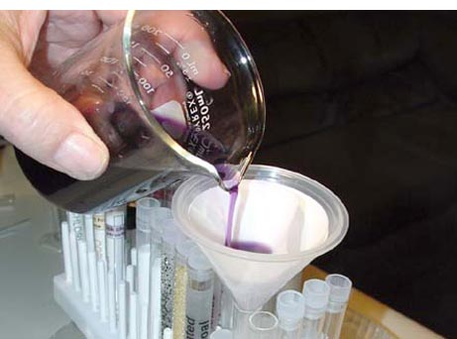
Indicators are almost always plant or fungus extracts
Measuring pH the traditional way: pH `indicators’
1
3
2
Stomach acid
Orange Juice
Lipton Tea
Blood
Household ammonia

Slide 7
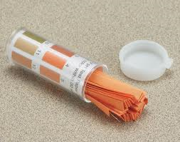
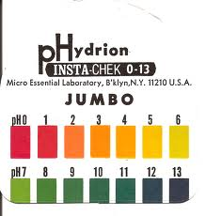
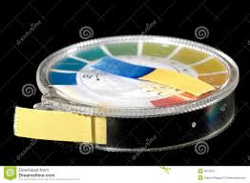
Indicators can be put on paper too…

Slide 8
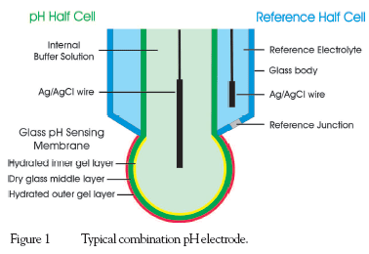
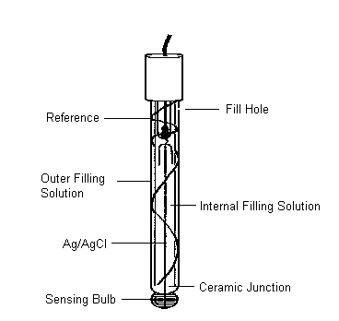
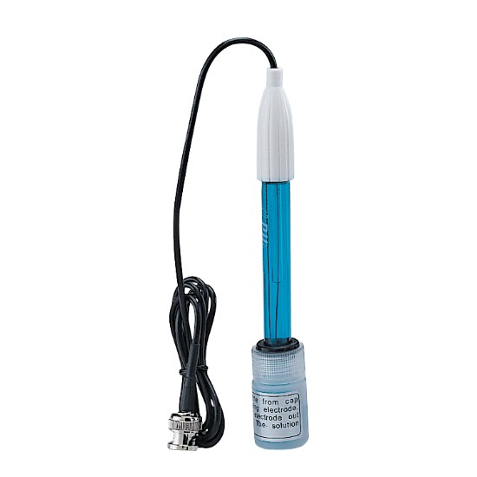
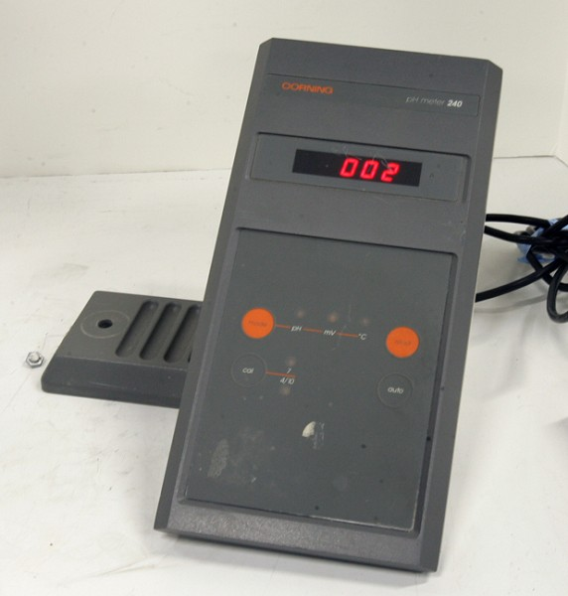
When the test material is too colored to allow indicators to `show (ex.: blood) ’: Use pH electrode
Small Voltage
Created between reference and sensing tip
pH meter is basically a voltmeter
pH electrode

Slide 9
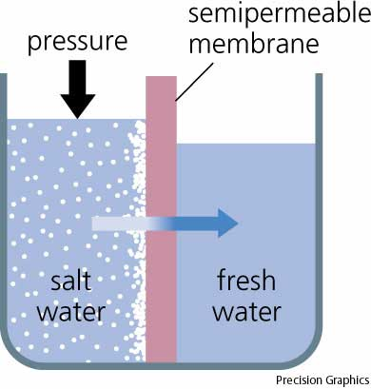
Salt and Why tomatoes suck (water)¹ pp 141-4
¹ How natural osmosis works
Reverse osmosis
Salt water
Fresh water
Osmotic pressure
Water seeks to `dilute’ salty side by migrating there
Applying more than natural osmotic pressure in opposite direction forces fresh water from salt
Semi permeable membrane

Slide 10
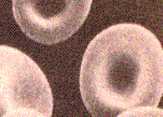
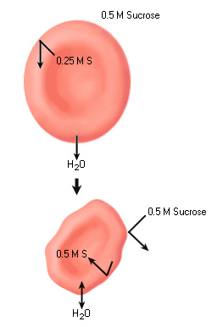
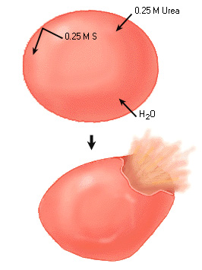
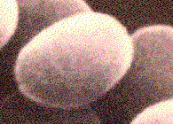
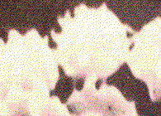
Biological connections
Cell saltier than suroundings
Surroundings saltier than cell
Hypotonic solution
Hypertonic solution
Water moves into cell
Water moves out of cell

Slide 11
Semi-permeable membrane
Pressure applied to dilute saltier side
=> pressure to left
1 g NaCl/L
0.01 g NaCl/L
Which way does the osmotic pressure push the membrane ?

Slide 12
Cell wall
expands
3 % salt
Surrounding solution is 1% salt
Does the cell explode or shrivel ?

Slide 13
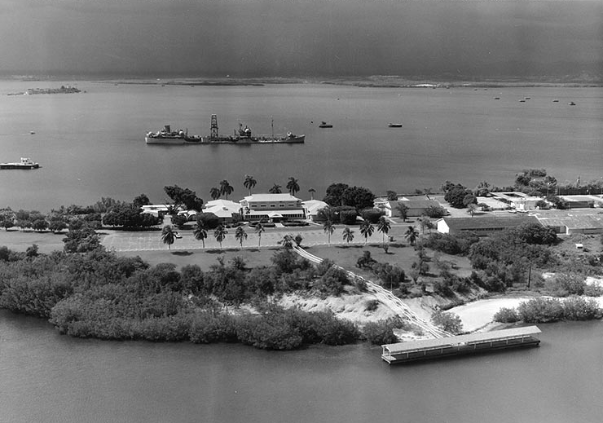
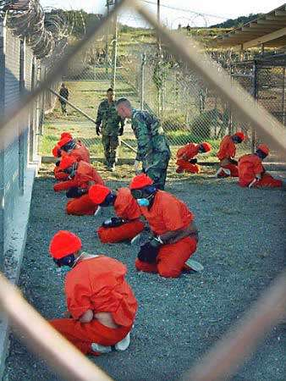
Political Connections
Guantanamo Bay…where terrorists are kept

Slide 14
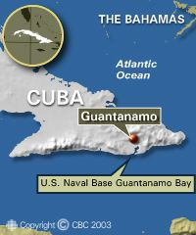
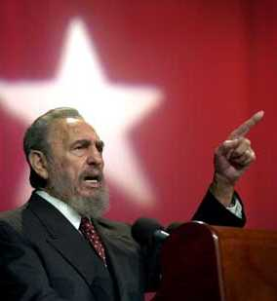

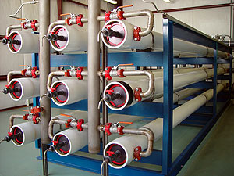
Guantanamo
No water for you, Uncle Sam !
Take that, America !
Large scale
desalinization columns
Thus, all water for Gitmo is extracted by reverse osmosis from Atlantic ocean (Cuba won’t sell us water)

Slide 15
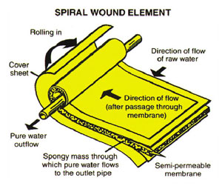
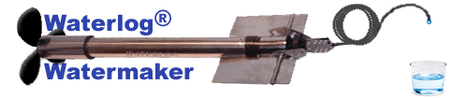
Details of practical desalinators
Membrane design
Required reverse pressures
> 40 psi applied here
For sea water:
P(osmotic) = 2.5 atm ~ 40 psi
Portable life boat desalinator
Output ~5 L/hour
(1.5 gal/h)
at 400 ppm

Slide 16
Chapters 1-4
THE BIG PICTURE
Basic picture of atoms= nucleus (p⁺ & nº) + electrons (e-) + space
Reading, writing and balancing chemical sentences (reactions)
Building ionic molecules using Per. Table + charge balance
Bohr’s circular orbits/e- as ‘quantum’ popcorn
2H₂ + O₂→ 2H₂O
+1 -2
Na + O
Na₂O

Slide 17
THE BIG PICTURE (cont.)
Building simple covalent molecules using Octet & HONC rules
Building more complex molecules using formal charge rule or resonance notions
:N≡N:
Phosgene
(mustard gas)
isopropanol
(Rubbing alcohol)
10 e⁻ on P
12 e⁻ on S
Resonance => 1.5 bond orders and circulating ring of e- in benzene

Slide 18
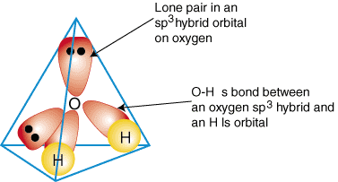
THE BIG PICTURE (cont.)
Use Lewis models and VSEPR `balloon thingies’ to predict molecule shape
6. Behavior of Ionic compounds in water and elsewhere
Lewis model
Lone pair balloons
Ionic formula prediction
Bond pair balloons
Water is a bent structure
atomic scale dissolution pictures
tuning ion behavior: size matters
the special case of H: pH, pOH & acidity
salt, osmosis

Slide 19
NOW WHAT ?
From Powerpoint lecture #4:
To understand chemical PROPERTIES ….
Read chapter 5
pp 166-186
Follow the electrons…

Slide 20
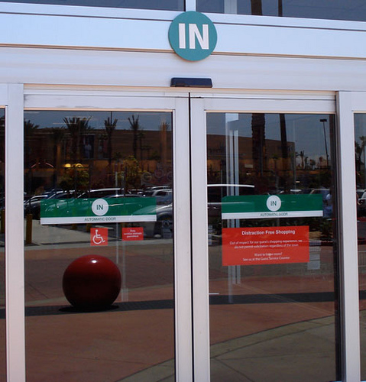
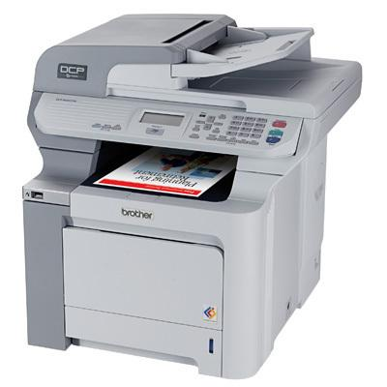


Chapter 5 : Film-the study of light and how electrons respond to it
Photoelectric door
What do these four objects have in common ?
Light moves electrons in all four objects
photocopier
Photo
(and film)
Photosynthesis

