Slide 1
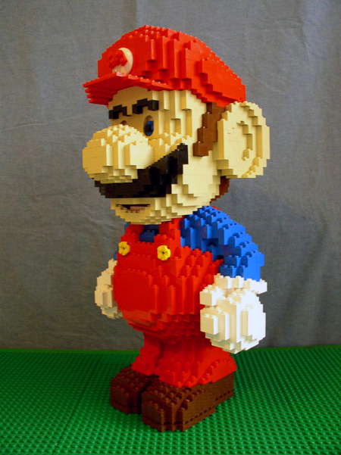
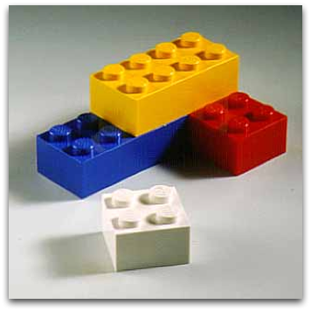
The start of everything….
Chemical Elements: basic building blocks of everything

Slide 2
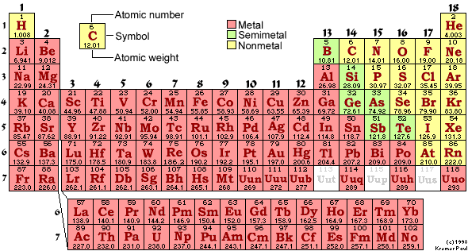
Periodic Table of the Elements:
the building blocks of everything
Know Names and Symbols by Wed:
1st three rows
Main stuff of Sun , living systems, Earth’s oceans and crust
Man Made (short-lived)
Man Made (actinides)

Slide 3
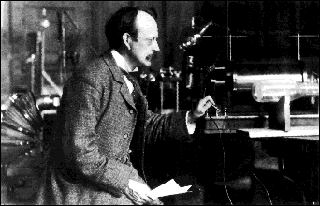
The first real try at probing the atom’s insides:
J. J. Thomson’s `CRT’: 1897
J.J. Thomson Cavendish Labs, Cambridge UK
J.J’s `Cathode Ray Tube’ (CRT)*
Proves that atoms are composed equal amounts of + and – (=electrons)

Slide 4
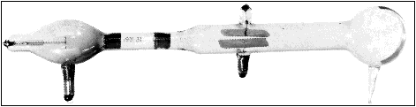
Thompson’s¹ `CRT’ …opposites attract, likes repel
(+)
(-)
What must be charge of outgoing beam ?
(-)
(+)
Negative (-)
Only sees (-) beam,
never a (+) beam
Thomson was astonishingly bad in the lab and fumble-fingered; the CRT was made by a gifted glassblower, E. Everett

Slide 5
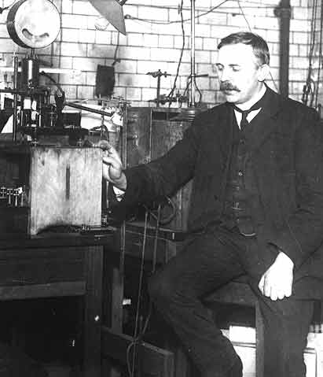
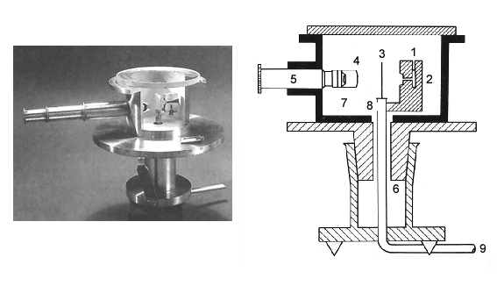
A better look inside an atom: Rutherford’s gold foil experiment (1910)
Ernst Rutherford
Physical Laboratory
Manchester University, UK
Rutherford’s Gold foil apparatus*
*Factoid: it’s really his students-Geiger and Marsden- who machine the device and do the measurements.

Slide 6
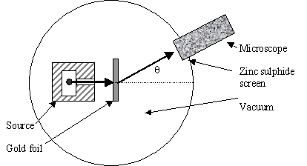
Atomic structure testing (continued)
Schematic of Rutherford’s `gold foil’ apparatus
Microscope
Rotated to detect scintillations
Alpha (α) particles=He⁺
ZnS screen is a scintillating surface
Gold Foil Experiment lore
Marie Curie supplied the radon =α source.
It required ~ 1 hour sitting in absolute dark to condition eyes.
You could only observe scintillations for 1-2 minutes before
desensitizing.

Slide 7
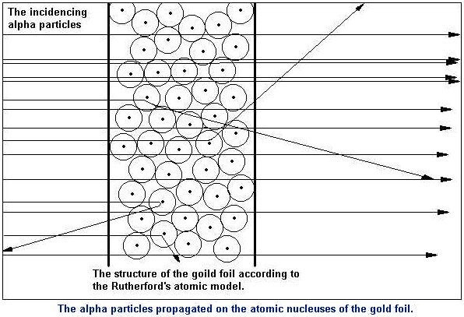
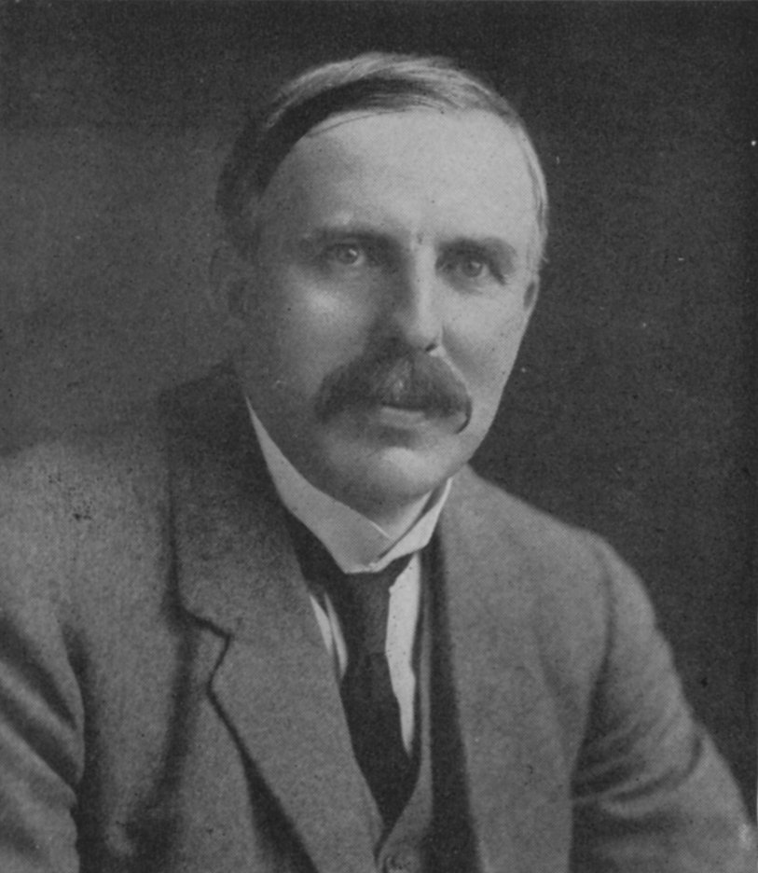
Pictorial version of what gold leaf experiment teaches
“Like firing a howitzer at tissue paper and having the shell bounce back !!”
~Statistics of gold leaf experiment
# He bounced back or deflected =
Total # He fired
1
300,000,000

Slide 8
The Gold leaf statistics led to Rutherford’s Picture of the Atom
Diffuse electron
Cloud out here
~ 10⁻¹⁰ m
~10⁻¹⁵ m
Nucleus is + charged
Electrons are - charged
Nucleus at center (magnified here ~10,000X)

Slide 9
Rutherford’s Atom by the numbers
Diameter of electron cloud = 100,000
Diameter of nucleus 1
Atomic part Relative mass % mass of atom
Nucleus 1 99.5
Electrons 0.005 0.5
Atomic part Relative volume
Nucleus 0.00000000000001
Electrons 1
electron cloud is 99.99999999% of atomic volume but only 0.5% of the mass

Slide 10

N=# cuts
1
2
3
4
20 cm (~8 inches)
Atomic metaphor 1:
Touchy, feely sense of atom dimensions:
paper and scissors example
N=31
N to electron radius ??
N to nuclear radius ??
N=50

Slide 11
Chemical metaphor 2
Atom as …..
String and pencil dot

Slide 12
Chemical Metaphor 2 reasoning
pencil dot and string
Pencil dot = nucleus
~ 0.02 cm radius
Electron orbit is 100,000 x nuclear radius
Electron orbit radius =??
100,000 x 0.02= 2000 cm
(for us `dumb’ Americans, that’s ~ 66 ft
66 ft of string= electron radius

Slide 13
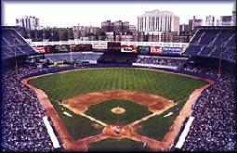


Atom dimensions in familiar terms: Metaphor 3
where is the edge of the electron cloud ? →LectureTools poll
3”
Baseball as nucleus
Old Yankee Stadium, the Bronx

Slide 14
Some useful facts for metaphor 3
baseball radius = 1 ½ inches
12 inches = 1 foot
5280 feet = 1 mile
electron radius=100,000
  nuclear radius

Slide 15
Chemical metaphor 3 reasoning: baseball in Yankee Stadium ?
Baseball =nucleus
= 3 inches in diameter
Radius ???
= 3/2 =1 ½ inches in radius
Electron orbit is _________x nuclear radius
100,000
Electron orbit is ???
=100,000 x 1 ½ =150 ,000 inches
150,000 in =12,400 feet
12 in/ft
# Feet ?
# miles ?
=> 12,400 ft =2.37 miles
5280 ft/mile

Slide 16
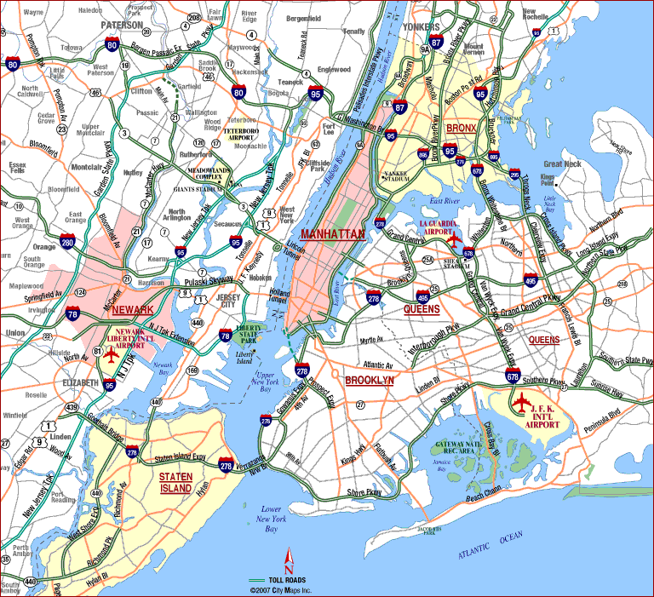
14 12 10 8 6 4 2 0 2 4 6
Nucleus(+)
Notes:
Stadium at 1. E. 161st st., Bronx NY 14051

Slide 17
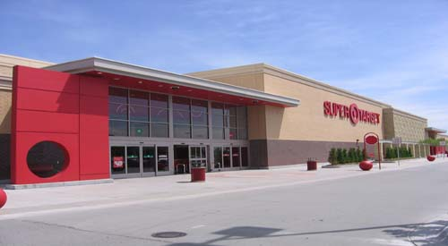
Atom dimensions in familiar terms: Metaphor 4 –Super Target Store in Omaha is the nucleus
( a bigger store than the textbook on p. 8 assumes)
→LectureTools

Slide 18
Some useful facts for metaphor 4:
Super Target Store in Omaha, Nebraska
radius of Super Target store=75 m
1000 m = 1 km=> store radius=0.075
electron radius=100,000
  nuclear radius

Slide 19
100,000 = radius of electron
radius of nucleus
100,000= r
radius of Super Target store
100,000 = r = r
75 m 0.075 km
0.075 km x 100,000 = 7,500 km =r

Slide 20
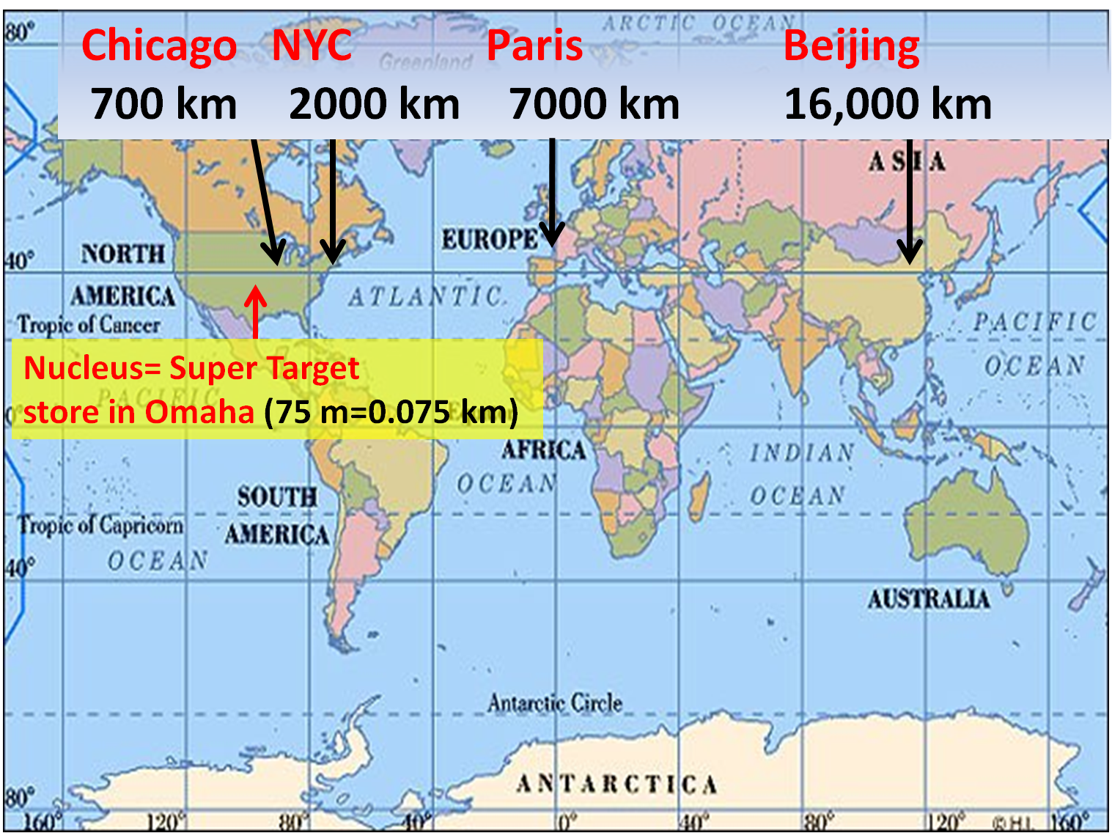
Edge of electron cloud

Slide 21
Rutherford’s atom again: a diffuse, ill defined cloud of electrons around the nucleus
Diffuse electron
Cloud out here
~ 10⁻¹⁰ m
~10⁻¹⁵ m
Nucleus is + charged
Electrons are - charged
Nucleus at center (magnified here ~10,000X)

Slide 22
A closer look at Rutherford’s Gold Leaf experiment:
10,000,000,000,000,000 (~10¹⁵)
Mass/volume
100
1
?? Blips ?
?? What are these Blips??
0.01
0.0001
0 (nucleus here)
+0.0000000001 m
-0.0000000001 m
Distance from scattering center (=nucleus) in meters

Slide 23
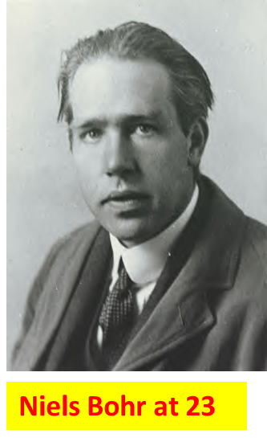
A `kid’ just out of grad school figures out about the `blips’
…and blows up the old world of Physics

Slide 24
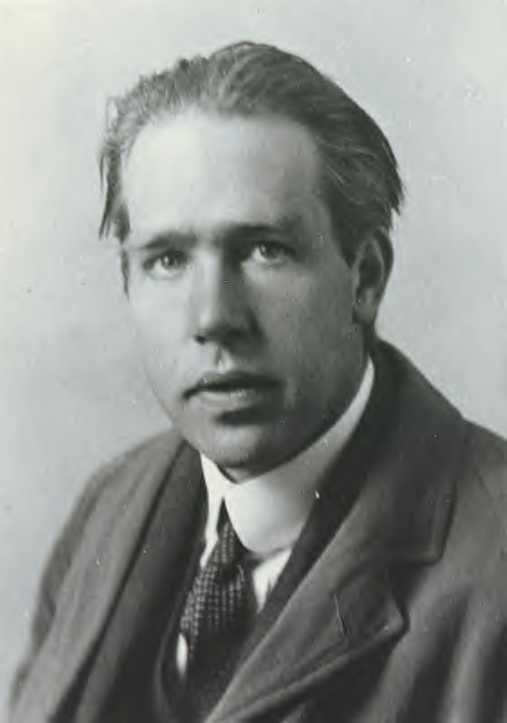
Bohr’s theory of atomic structure : the `planetary’ model of the atom …1913
1) Electrons move in circular orbits around nucleus
Electron (-)
Nucleus (+)
Niels Bohr at 23
model is wrong in detail but broadly
right
2) Electrons “leap” between well defined orbital circles in “quantum jumps”

Slide 25
The current picture of electron motion in atoms:
electrons as magic popcorn (not in text)
Electron here t=t₁
Electron has non-zero chance to `pop out’ anywhere on a sphere at fixed distance from nucleus.
It must be somewhere on that sphere at all times…just can’t say where…
Electron
Here at t=t₃
Electron starts here, t=0
Nucleus magnified 100,000X
Electron
here t=t₂
Electron
Here t=t₄….

