Slide 1

What do dissolved salts look like ? (see also: fig 4.8, 4.10 pp 135-6)
The final atomic scale electrolyte picture in water
Slightly negative lone pair
of O on water solvates Na⁺
Slightly positive H end of water solvates Cl⁻

Slide 2
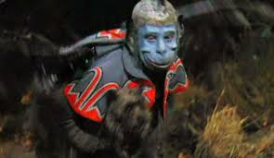
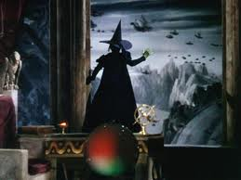
Water is like a `flying monkey’ stealing away salt ions (=Toto)

Slide 3
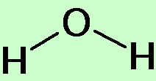
2) What affects the solubility and melting point of salts ??? pp 126-129…A FRESH LOOK AT SALTS
Example of small ion salts : Na⁺ and Cl⁻
(OLD SCHOOL)
-
Short distance between + and - charge=> strongly held and hard to melt
+
Melts at 801 ºC (1472 F)
Small size matches H₂O dimensions so that water can easily `pry apart’ the ionic bonds…NaCl dissolves easily
Saturation= 30 g NaCl/100 mL water

Slide 4
LARGE ions e.g bmim⁺ and PF₆⁻
Small ions Na⁺ and Cl⁻
-
+
-
+
Large distances between charges=> weakly held and easy to melt
Large size makes it hard for puny water molecules to get a handle on ionic bond and pry it apart
Melts at 25 ºC (77 F)
Not water soluble(0 g/100 mL water)

Slide 5
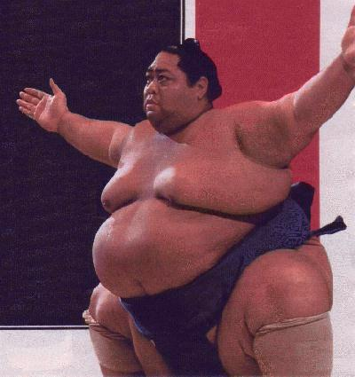
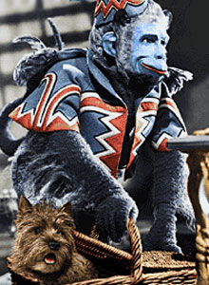
In `new school’ , designed salts:
Size matters !
bmim⁺ and PF₆⁻
Water molecule

Slide 6
Traditional `rigid’ view of salts
  Hard, brittle
  High melting (600 ºC and up)
Often soluble in water
`New Age `flexible’ view of salts
Can be mushy and soft…depends on size
Can melt very low… depends on size
Solubility …depends on size
IT’S ALL ABOUT SIZE
In 21st century , synthetic salt properties can be size adjusted to be UNEXPECTEDLY useful !

Slide 7
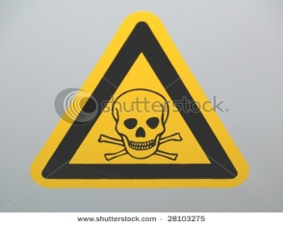

APPLICATION OF NEW AGE SALTS: POISONED WATER TREATMENT
(p 128-129)
bmin⁺ PF₆⁻
Purified, less dense water forced UP, leaving toxic metals concentrated at bottom in small volume of insoluble liquid ionic salt
Insoluble liquid ionic salt sinks into water and dissolves toxic metals
☺
Hg²⁺
As³⁺ Cr⁶⁺
Hg²⁺As³⁺ Cr⁶⁺
J. Roberts in “Erin Brockovich”
Recover original metals by electrolytic deposition from ionic liquid and repeat to purify more poisoned water

Slide 8

Another example of `new’ age thinking about dissolving things…nano-technological material design...
A little touch of chemical magic
http://www.youtube.com/watch?v=IPM8OR6W6WE

Slide 9

Why is H colored red and the rest of its family not ???
LiCl
NaCl
KCl
RbCl
CsCl
FrCl
All white, high melting solids that dissolve in water
Dissolved salts conduct
Solutions un-reactive to metals
+ Cl

Slide 10
Why does HCl act differently than its column 1 cousins ???
+ Cl
HCl
Gas at room temperature
Solution conducts
Solution violently reactive to metals

Slide 11
CHEMICAL REASONING 101
Add M
No reaction
NaCl(s)
Add water
Na⁺ + Cl⁻
Na⁺ + Cl⁻ + M
Add water
Add M
H₂ (gas) + Cl⁻ +dissolved M
HCl(g)
H⁺ + Cl⁻
Reaction !
What is key `reactive’ piece of HCl solution ?
H⁺

Slide 12
Demo of relative reactivities of HCl vs NaCl
With metals
NaCl (aq) + Znº
→ No reaction
HCl (aq) + Znº
→ REACTION !!
With `Drano’(base)
NaCl (aq) + NaOH(aq)
→ No reaction
HCl (aq) + NaOH(aq)
→ REACTION !!

Slide 13
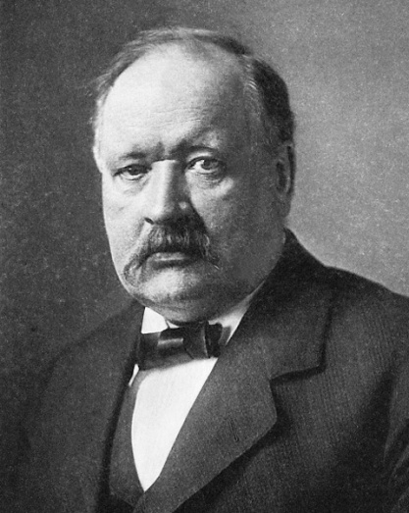
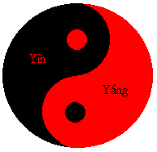
Arrhenius acid-base concepts
(pp 147-49)
H⁺
H⁺ is the source of `acidity’
OH⁻ is the source of `basicity’
Svante Arrhenius
Nobel prize in chemistry for his acid base theory)
H⁺ + OH⁻ → H₂O
`neutralization’ reaction
ACID + BASE → WATER +SALT

Slide 14
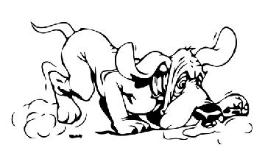
Svante Arrhenius: Father of Acid-Base Theory
Follow the
H⁺ !!!

Slide 15
Measuring amounts of H+ in water: how acid is it ??
Concentration of acid [H⁺] in various common solutions in M units (square bracketted [ H⁺] => `M’ units)
battery acid ~10
Stomach acid 0.01
Coca Cola 0.004
Orange Juice 0.00032
Tomato Juice 0.000032
Pee 0.000001
Pure water 0.0000001
Blood 0.000000032
Sea water 0.0000000025
Household ammonia 0.0000000000030
Drano in toilet 0.00000000000001
Acids
M scale not convenient for measuring acidity
Bases
~ max acidity
0 1
10
H⁺ concentration in M [mol/Liter]

Slide 16
Is there an “easier” way to write the inconvenient H⁺ concentrations ?
SCIENTIFIC NOTATION (see pp 58-60 of text)
Writing 0.000000000019 in scientific notation
=1.9 *10⁻¹¹
=1.9 EE-11
Various versions of scientific notation
=1.9 E-11
=1.9^ -11

Slide 17
Writing 602,213,353,000,000,000,000,000
in scientific notation
=6.022133530 *10⁺²³
= 6.022133530 EE+23
= 6.022133530 E+23
= 6.022133530 ^ +23

Slide 18
material
M, [H+]
Scientific notation equivalent
battery acid ~10
Coca Cola 0.004
Pee 0.000001
Pure water 0.0000001
Blood 0.000000032
ammonia 0.00000000003
Drano 0.00000000000001
1.0EE+1
4.0EE-3
1EE-6
1EE-7
3.2EE-8
3EE-12
1EE-14

