Slide 1
UGLY CHEMICAL FACT OF LIFE #2
For many compounds that should obey the octet rule predicted bond lengths don’t match experiment.
Example 1: Ozone O₃
Lewis model prediction
Expect O-O length = 15 pm
Expect O=O length = 12 pm
Observe : Both bond lengths
are identical=13.5 pm

Slide 2
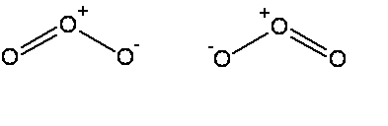


The common thread: if electrons can be moved to make the same molecule => `resonance’ (pp 94-99)
Resonance structure
All bonds are equivalent
in resonance
structures
Resonance structure

Slide 3
`RESONANCE’ circulates the electrons evenly between participating atoms so that the bond lengths between those atoms are identical and an average of the possible single/ double bond distributions.
O-O length = 15 pm
O=O length = 12 pm
Observed O-O bonds all = 13.5 pm
Average = 13.5 pm
C-C lengths= 16 pm
C=C lengths = 13 pm
Average = 14.5 pm
Observed C-C bonds all
= 14.5 pm

Slide 4
Many examples of resonance c an be deduced from simple and extended (formal charge rules) Lewis modeling
EXAMPLES
Carbonate anion CO₃²⁻
Nitrite anion NO₂⁻
Nitrate anion NO₃⁻
Sulfate anion SO₄²⁻
BOARD WORK TO SHOW…

Slide 5
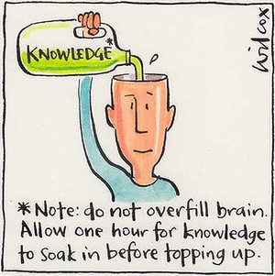
Taking a breath…stepping back and reviewing the BIG picture…
(so far)

Slide 6
CHAPTER 1: ATOMS…THE BASIC BUILDING BLOCKS LOOK ~ SO:
NUCLEUS =PROTONS + NEUTRONS
Electron here t=t₁
Electron
Here at t=t₃
Electron starts here, t=0
Electrons weighs ~1/2000 of proton
NUCLEUS magnified 10,000X
Electron
here t=t₂
Electron
Here t=t₄….

Slide 7
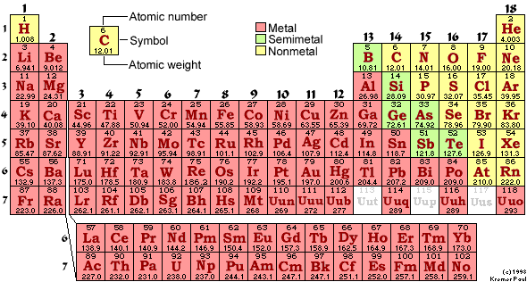
THE FLAVORS OF ATOMS ARE LISTED HERE…
EACH DISTINCT KIND OF ATOM IS CALLED AN…..
element

Slide 8
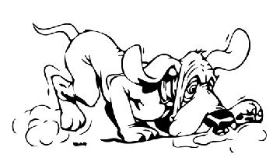
CHAPTER 1: (continued)
ATOMS (elements) COMBINE INTO MOLECULES.
MOLECULES UNDERGO CHEMICAL REACTIONS BY SWAPPING ATOMS.
EXAMPLE: C₆H₁₂O₆ + 6O₂→ 6CO₂ + 6H₂0
(sugar)
REACTIONS UNDERLY ALL LIFE ON THE PLANET. THE ELECTRONS DICTATE WHICH ATOMS SWAP WITH WHICH.
∴ FOLLOW THE ELECTRONS.

Slide 9
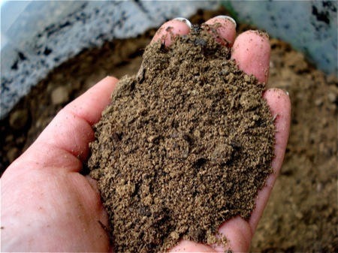

Chapter 2: Dirt
HOW DO WE DESCRIBE AND BUILD IONIC COMPOUNDS, CLASS ???
What makes rocks the way they are ?
(text version, p. 46
“Why do minerals exist?”)
What makes rocks the way they are ?
(text version, p. 46
“Why do minerals exist?”)

Slide 10
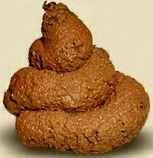
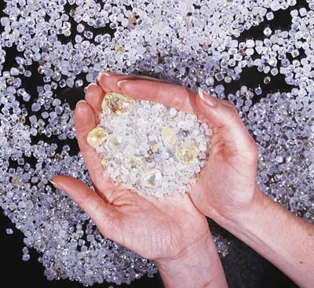

Chapter 3: Diamonds
What holds together diamonds, poo and you ???
(text version: Why is carbon special ?)
HOW DO WE DESCRIBE AND BUILD COVALENT COMPOUNDS, MAGGOTS ?

Slide 11
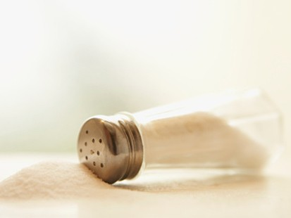

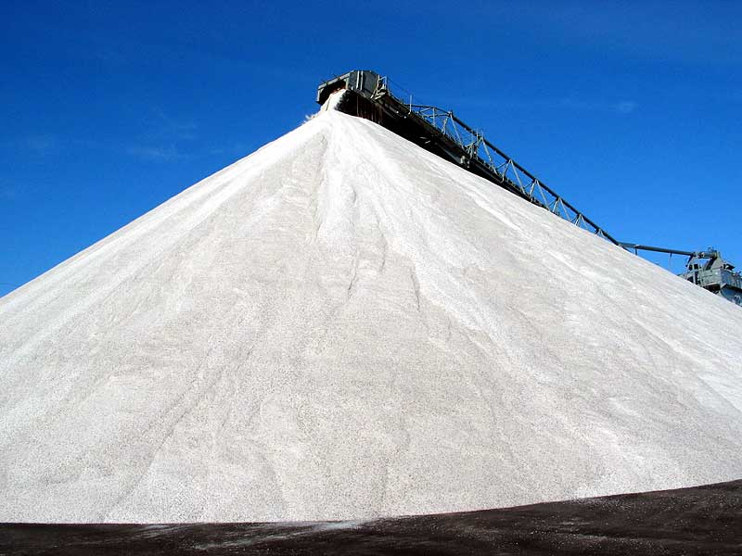
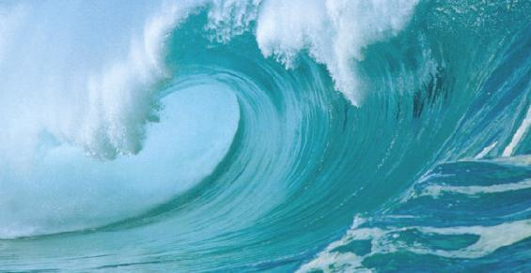
Chapter 4: Salt
Read pages 127-154
What can happen when salts (ionic compounds) dissolve ?
All of us in relation to salt in oceans
500,000,000,000,000,000 tons of salt in the oceans
500,000,000
tons of humans on Earth

Slide 12
Real salt dissolving in H₂O at 200X under a microscope
Animation of salt dissolving in H₂O at atomic scale (~50,000,000X)

Slide 13

What do dissolved salts look like ? (see also: fig 4.8, 4.10 pp 135-6)
The final atomic scale electrolyte picture in water
Slightly negative lone pair
of O on water solvates Na⁺
Slightly positive H end of water solvates Cl⁻

Slide 14
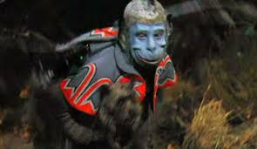
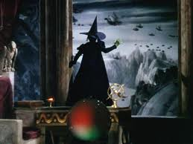
Water is like a `flying monkey’ stealing away salt ions (=Toto)

Slide 15
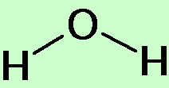
2) What affects the solubility and melting point of salts ??? pp 126-129…A FRESH LOOK AT SALTS
Example of small ion salts : Na⁺ and Cl⁻
(OLD SCHOOL)
-
Short distance between + and - charge=> strongly held and hard to melt
+
Melts at 801 ºC (1472 F)
Small size matches H₂O dimensions so that water can easily `pry apart’ the ionic bonds…NaCl dissolves easily
Saturation= 30 g NaCl/100 mL water

Slide 16
LARGE ions e.g bmim⁺ and PF₆⁻
Small ions Na⁺ and Cl⁻
-
+
-
+
Large distances between charges=> weakly held and easy to melt
Large size makes it hard for puny water molecules to get a handle on ionic bond and pry it apart
Melts at 25 ºC (77 F)
Not water soluble(0 g/100 mL water)

Slide 17
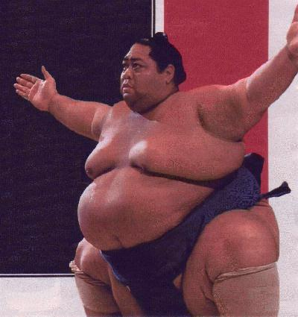
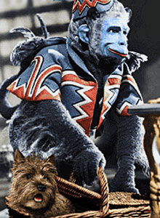
In `new school’ , designed salts:
Size matters !
bmim⁺ and PF₆⁻
Water molecule

Slide 18
Traditional `rigid’ view of salts
  Hard, brittle
  High melting (600 ºC and up)
Often soluble in water
`New Age `flexible’ view of salts
Can be mushy and soft…depends on size
Can melt very low… depends on size
Solubility …depends on size
IT’S ALL ABOUT SIZE
In 21st century , synthetic salt properties can be size adjusted to be UNEXPECTEDLY useful !

Slide 19
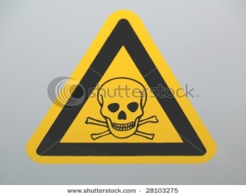

APPLICATION OF NEW AGE SALTS: POISONED WATER TREATMENT
(p 128-129)
bmin⁺ PF₆⁻
Purified, less dense water forced UP, leaving toxic metals concentrated at bottom in small volume of insoluble liquid ionic salt
Insoluble liquid ionic salt sinks into water and dissolves toxic metals
☺
Hg²⁺
As³⁺ Cr⁶⁺
Hg²⁺As³⁺ Cr⁶⁺
J. Roberts in “Erin Brockovich”
Recover original metals by electrolytic deposition from ionic liquid and repeat to purify more poisoned water

Slide 20

Another example of `new’ age thinking about dissolving things…nano-technological material design...
A little touch of chemical magic
http://www.youtube.com/watch?v=IPM8OR6W6WE

Slide 21

Why is H colored red and the rest of its family not ???
LiCl
NaCl
KCl
RbCl
CsCl
FrCl
All white, high melting solids that dissolve in water
Dissolved salts conduct
Solutions un-reactive to metals
+ Cl

Slide 22
Why does HCl act differently than its column 1 cousins ???
+ Cl
HCl
Gas at room temperature
Solution conducts
Solution violently reactive to metals

Slide 23
CHEMICAL REASONING 101
Add M
No reaction
NaCl(s)
Add water
Na⁺ + Cl⁻
Na⁺ + Cl⁻ + M
Add water
Add M
H₂ (gas) + Cl⁻ +dissolved M
HCl(g)
H⁺ + Cl⁻
Reaction !
What is key `reactive’ piece of HCl solution ?
H⁺

Slide 24
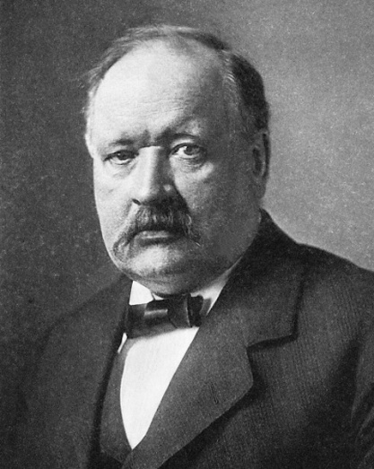
Arrhenius acid-base concepts
(pp 147-49)
H⁺
H⁺ is the source of `acidity’
OH⁻ is the source of `basicity’
Svante Arrhenius
Nobel prize in chemistry for his acid base theory)
H⁺ + OH⁻ → H₂O
`neutralization’ reaction
ACID + BASE → WATER +SALT

Slide 25
Measuring amounts of H+ in water: how acid is it ??
Concentration of acid [H⁺] in various common solutions in M units (square bracketted [ H+] => `M’ units)
battery acid ~10
Stomach acid 0.01
Coca Cola 0.004
Orange Juice 0.00032
Tomato Juice 0.000032
Pee 0.000001
Pure water 0.0000001
Blood 0.000000032
Sea water 0.0000000025
Household ammonia 0.0000000000030
Drano in toilet 0.00000000000001
~ max acidity
0 1
10
H⁺ concentration in M [mol/Liter]

Slide 26
Is there an “easier” way to write the inconvenient H⁺ concentrations ?
SCIENTIFIC NOTATION (see pp 58-60 of text)
Various versions of scientific notation
Converting 0.000000000019 to scientific notation
=1.9 *10⁻¹¹
=1.9 EE-11
1.9 E-11
1.9 ^ -11
Scientific notation equivalent
battery acid ~10
Stomach acid 0.01
Coca Cola 0.004
Orange Juice 0.00032
Tomato Juice 0.000032
Pee 0.000001
Blood 0.000000032
Sea water 0.0000000025
Household ammonia 0.000000000030
Drano in toilet 0.00000000000001
1.0EE+1
1EE-2
4.0EE-3
3.2EE-4
3.2EE-5*
1EE-6
3.2EE-8
2.5EE-9
3EE-12
1EE-14

Slide 27
Is there even a `more’ easier way to express the inconvenient H⁺ concentrations than scientific notation ?
pH=-log₁₀ [H⁺]
H⁺ in Scientific notation
battery acid
Stomach acid
Coca Cola
Orange Juice
Tomato Juice
Pee
Blood
Sea water
Household ammonia
Drano in toilet
1.0EE+1
1EE-2
4.0EE-3
3.2EE-4
3.2EE-5*
1EE-6
3.2EE-8
2.5EE-9
3EE-12
1EE-14
0
2
2.4
3.5
4.5*
6
7.5
8.6
11.5
14
The `more’ easier way to express acidity: pH = - log₁₀ [H⁺]

Slide 28
pH SPEAK
pH < 7 means acid
pH > 7 means basic
pH= 7 is `neutral’
Higher acidity => lower pH
Higher basicity => higher pH
A change of 1 pH unit means a change in [H⁺] of 10
Ex. pH moved from 3→2 means acidity up 10 fold
Ex. pH moved from 3→ 4 means acidity down by 10 fold

