Slide 1
VSEPR BLACKBOARD PRACTICE
SO₂ SO₃ SiH₄ O₃ (0zone)
1) FIGURE OUT BEST LEWIS STRUCTURE
2)USE `BALLOON’ REPULSION TO GUESS
SHAPE*
*(linear, trigonal plane, trigonal pyramid, pyramid, bent…)

Slide 2
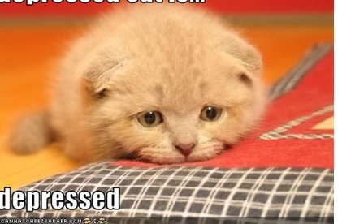
4A. Can we use the bond line and Lewis models to predict the shape of the molecules ?
YES. USE VSEPR THEORY
4b. Why care ??

Slide 3
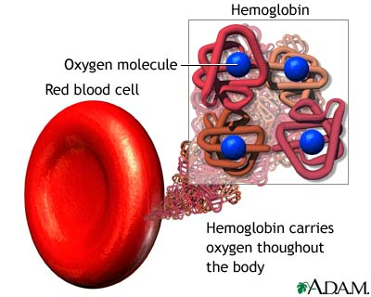
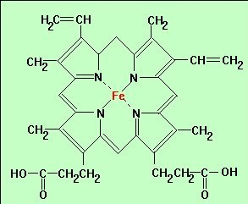
Examples of the role of molecular shape in living systems:
Blood
O₂
Iron porphyrin base of hemoglobin

Slide 4
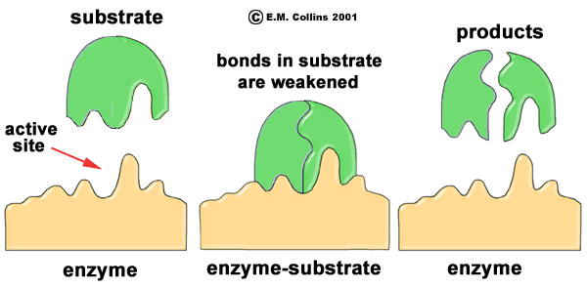
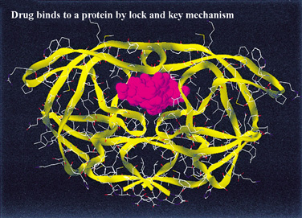
Examples of the role of molecular shape in living systems:
Enzyme and Drug Function…The `lock-in key’ model
How an enzyme catalyzes reaction

Slide 5
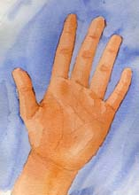
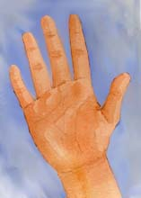
Examples of the role of molecular shape in living systems:
When drug companies screw it up….the thalidomide example
Are these two structures the same or different ??
`left-handed’
thalidomide
`right handed’ thalidomide

Slide 6

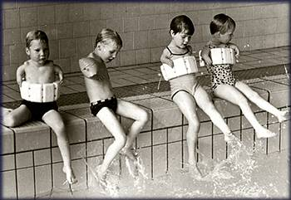
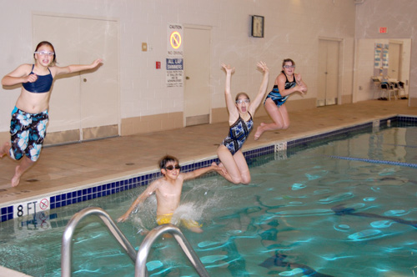
`left-handed’
(bad) thalidomide
`right handed’ (good) thalidomide
DEFORMED CHILDREN
NORMAL CHILDREN
Entymological aside:
In chemistry, Left handed molecules are termed `S’ , short for `SINISTER’ which is Latin for evil

Slide 7
CONVERTS IN MOTHER’ S BODY
40-50% `left-handed’ (bad) thalidomide (over time)
`100 % right handed’ (good) thalidomide (START)

Slide 8
Other interesting `factoids’ on molecular `handedness’
All naturally occurring sugars are right-handed (there are no lefthanded sugars !!!)
All natural amino acids (which form proteins) are left-handed.
Only left-handed ibuprofen is therapeutic.
Advil and Motrin contain equal amounts of
left and right-handed ibuprofen (so only half
of the dose does anything)

Slide 9
UGLY CHEMICAL FACT OF LIFE #2
For many compounds that should obey the octet rule predicted bond lengths don’t match experiment.
Example 1: Ozone O₃
Lewis model prediction
Expect O-O length = 15 pm
Expect O=O length = 12 pm
Observe : Both bond lengths
are identical=13.5 pm

Slide 10
Example 2: Benzene C₆H₆
Lewis Model and HONC prediction
Expect C-C lengths= 16 pm
Expect C=C lengths = 13 pm
Observe: all C-C lengths are identical = 14.5 pm

Slide 11
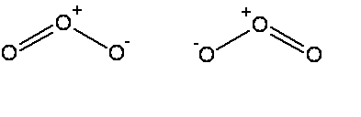


The common thread: if electrons can be moved to make the same molecule => `resonance’ (pp 94-99)
Resonance structure
All bonds are equivalent
in resonance
structures
Resonance structure

Slide 12
`RESONANCE’ circulates the electrons evenly between participating atoms so that the bond lengths between those atoms are identical and an average of the possible single/ double bond distributions.
O-O length = 15 pm
O=O length = 12 pm
Observed O-O bonds all = 13.5 pm
Average = 13.5 pm
C-C lengths= 16 pm
C=C lengths = 13 pm
Average = 14.5 pm
Observed C-C bonds all
= 14.5 pm

Slide 13
Many examples of resonance c an be deduced from simple and extended (formal charge rules) Lewis modeling
EXAMPLES
Carbonate anion CO₃²⁻
Nitrite anion NO₂⁻
Nitrate anion NO₃⁻
Sulfate anion SO₄²⁻
BOARD WORK TO SHOW…

Slide 14
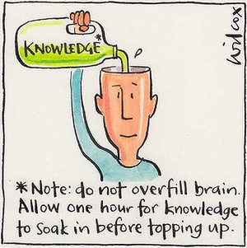
Taking a breath…stepping back and reviewing the BIG picture…
(so far)

Slide 15
CHAPTER 1: ATOMS…THE BASIC BUILDING BLOCKS LOOK ~ SO:
NUCLEUS =PROTONS + NEUTRONS
Electron here t=t₁
Electron
Here at t=t₃
Electron starts here, t=0
Electrons weighs ~1/2000 of proton
NUCLEUS magnified 10,000X
Electron
here t=t₂
Electron
Here t=t₄….

Slide 16
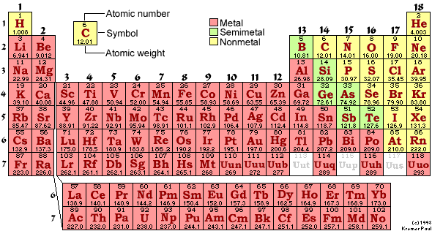
THE FLAVORS OF ATOMS ARE LISTED HERE…
EACH DISTINCT KIND OF ATOM IS CALLED AN…..
element

Slide 17
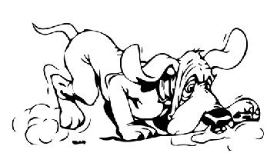
CHAPTER 1: (continued)
ATOMS (elements) COMBINE INTO MOLECULES.
MOLECULES UNDERGO CHEMICAL REACTIONS BY SWAPPING ATOMS.
EXAMPLE: C₆H₁₂O₆ + 6O₂→ 6CO₂ + 6H₂0
(sugar)
REACTIONS UNDERLY ALL LIFE ON THE PLANET. THE ELECTRONS DICTATE WHICH ATOMS SWAP WITH WHICH.
∴ FOLLOW THE ELECTRONS.

Slide 18
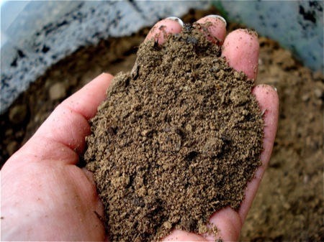

Chapter 2: Dirt
HOW DO WE DESCRIBE AND BUILD IONIC COMPOUNDS, CLASS ???
What makes rocks the way they are ?
(text version, p. 46
“Why do minerals exist?”)
What makes rocks the way they are ?
(text version, p. 46
“Why do minerals exist?”)

Slide 19
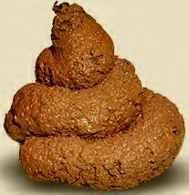
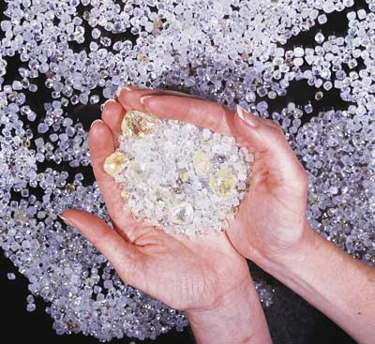

Chapter 3: Diamonds
What holds together diamonds, poo and you ???
(text version: Why is carbon special ?)
HOW DO WE DESCRIBE AND BUILD COVALENT COMPOUNDS, MAGGOTS ?

Slide 20
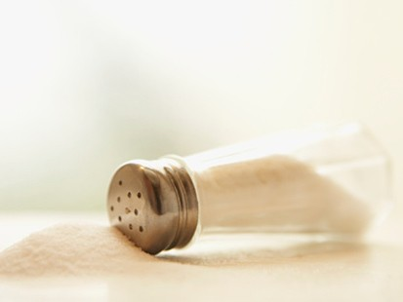

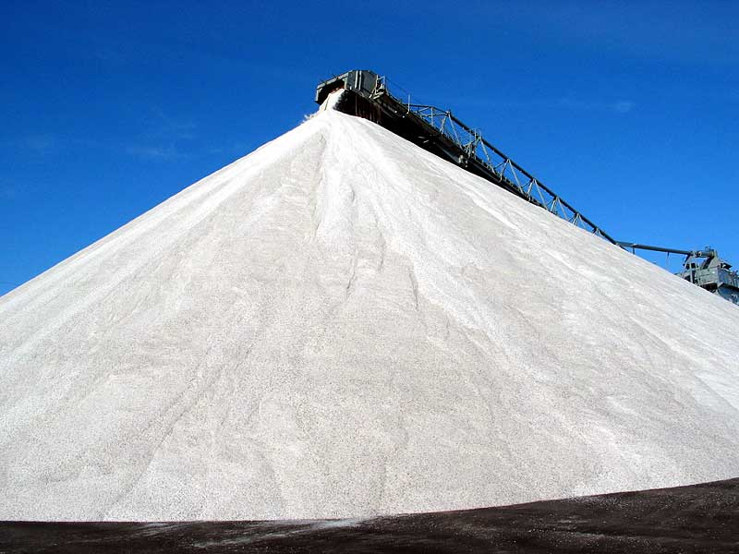
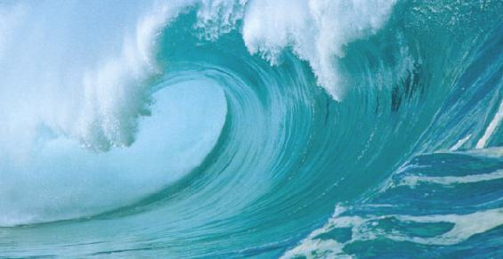
Chapter 4: Salt
Read pages 127-154
What can happen when salts (ionic compounds) dissolve ?
All of us in relation to salt in oceans
500,000,000,000,000,000 tons of salt in the oceans
500,000,000
tons of humans on Earth

Slide 21
Real salt dissolving in H₂O at 200X under a microscope
Animation of salt dissolving in H₂O at atomic scale (~50,000,000X)

Slide 22

What do dissolved salts look like ? (see also: fig 4.8, 4.10 pp 135-6)
The final atomic scale electrolyte picture in water
Slightly negative lone pair
of O on water solvates Na⁺
Slightly positive H end of water solvates Cl⁻

Slide 23
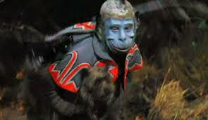
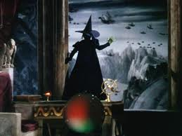
Water is like a `flying monkey’ stealing away salt ions (=Toto)

Slide 24
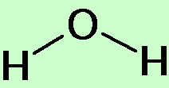
2) What affects the solubility and melting point of salts ??? pp 126-129…A FRESH LOOK AT SALTS
Example of small ion salts : Na⁺ and Cl⁻
(OLD SCHOOL)
-
Short distance between + and - charge=> strongly held and hard to melt
+
Melts at 801 ºC (1472 F)
Small size matches H₂O dimensions so that water can easily `pry apart’ the ionic bonds…NaCl dissolves easily
Saturation= 30 g NaCl/100 mL water

Slide 25
LARGE ions e.g bmim⁺ and PF₆⁻
Small ions Na⁺ and Cl⁻
-
+
-
+
Large distances between charges=> weakly held and easy to melt
Large size makes it hard for puny water molecules to get a handle on ionic bond and pry it apart
Melts at 25 ºC (77 F)
Not water soluble(0 g/100 mL water)

Slide 26
Traditional `rigid’ view of salts
  Hard, brittle
  High melting (600 ºC and up)
Often soluble in water
`New Age `flexible’ view of salts
Can be mushy and soft…depends on size
Can melt very low… depends on size
Solubility …depends on size
IT’S ALL ABOUT SIZE
In 21st century , synthetic salt properties can be size adjusted to be UNEXPECTEDLY useful !

Slide 27
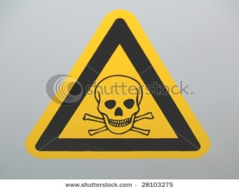

APPLICATION OF NEW AGE SALTS: POISONED WATER TREATMENT
(p 128-129)
bmin⁺ PF₆⁻
Purified, less dense water forced UP, leaving toxic metals concentrated at bottom in small volume of insoluble liquid ionic salt
Insoluble liquid ionic salt sinks into water and dissolves toxic metals
☺
Hg²⁺
As³⁺ Cr⁶⁺
Hg²⁺As³⁺ Cr⁶⁺
J. Roberts in “Erin Brockovich”
Recover original metals by electrolytic deposition from ionic liquid and repeat to purify more poisoned water

