Slide 1


…and now for the bad news….
Ugly chemical fact #1:
Lewis Octet rule doesn’t always work

Slide 2
Exploring the octet vs `experimental’ structures below (on the board)-
what can we learn ?:
H₂SO₄
H₃PO₄
HClO₄

Slide 3
EXPLAINING DEVIATIONS FROM OCTET RULE:
FORMAL CHARGE MINIMIZATION
TRUMPS OCTET RULE BEYOND Si
`Formal Charge Rule #2
Beyond Si, you can throw away the octet rule to minimize formal charge (=> zero charge)

Slide 4
More examples using formal charge rule 2
SO₃, SO₂, H₃PO₃

Slide 5


???
I ‘M NOT DONE YET ASKING ANNOYING QUESTIONS….
4A. Can we use the bond line and Lewis models (both octet and formal charge rules) to predict the shape of the molecules ?
4b. Why care ??

Slide 6
4A. Can we use the bond line and Lewis models to predict the shape of the molecules ?
YES
HOW:
Valence Shell Electron Pair Repulsion theory=
VSEPR theory

Slide 7
Basic ideas of VSEPR theory
(see pp 111-115)
lone pairs and any collection of bonds between two atoms can be viewed as fat balloon-like blobs of electrons. (=`Thingies’)
LEWIS PICTURE OF N₂
VSEPR PICTURE OF N₂
:N≡N:
N N
Each Lone pair is one Thingie
3 Bonds are one
‘Thingie’

Slide 8
Basic ideas of VSEPR theory (cont.)
2. The electron `balloons’ repel each other to the maximum allowed by `balloon’ geometry. This creates the final geometry of the molecule.
N₂ geometry
reasoned with real balloons as electron clouds
N N
Conclusion: based on `balloon’ repulsion N₂ is linear

Slide 9
Basic ideas of VSEPR theory (cont.)
Using VSEPR Theory- Step 1: Do Lewis octet structures of selected molecules
CH₄
H₂O
NH₃
LEWIS OCTET STRUCTURES

Slide 10
Using VSEPR Theory- Step 2: Use Balloon modeling (or common sense) to determine geometry
H₂O
NH₃
CH₄
Bent
Trigonal pyramid
Tetrahedral
WHAT BALLOON `EXPERIMENT’ PREDICTS

Slide 11
MOLECULE SHAPES PREDICTED BY VSEPR THEORY AND LEWIS MODEL
LINEAR
TRIGONAL PLANAR
PYRAMID
TRIGONAL PYRAMID
BENT
OCTAHEDRON
O=O O=C=O
BH₃
CH₄ (methane)
NH₃
H₂O
SF₆

Slide 12
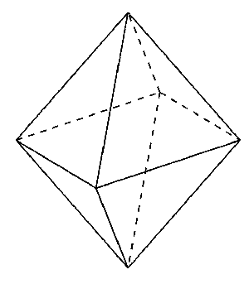
Demonstrating Octahedral shape of SF₆
SF₆
S
F
Highly stable !

Slide 13
BLACKBOARD PRACTICE
SO₂ SO₃ SiH₄ O₃ (0zone)
1) FIGURE OUT BEST LEWIS STRUCTURE
2)USE `BALLOON’ REPULSION TO GUESS
SHAPE*
*(linear, trigonal plane, trigonal pyramid, pyramid, bent…)

Slide 14
4A. Can we use the bond line and Lewis models to predict the shape of the molecules ?
YES. USE VSEPR THEORY
4b. Why care ??

Slide 15
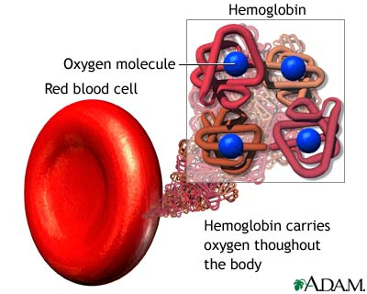
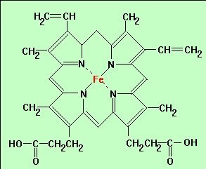
Examples of the role of molecular shape in living systems:
Blood
O₂
Iron porphyrin base of hemoglobin

Slide 16
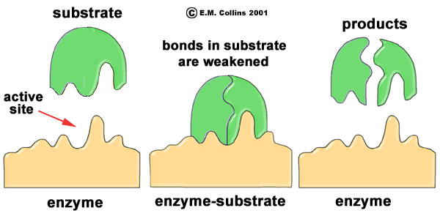
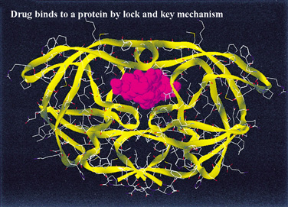
Examples of the role of molecular shape in living systems:
Enzyme and Drug Function…The `lock-in key’ model
How an enzyme catalyzes reaction

Slide 17
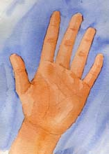
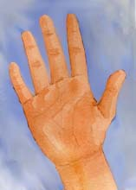
Examples of the role of molecular shape in living systems:
When drug companies screw it up….the thalidomide example
Are these two structures the same or different ??
`left-handed’
thalidomide
`right handed’ thalidomide

Slide 18

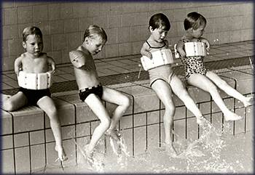

`left-handed’
(bad) thalidomide
`right handed’ (good) thalidomide
DEFORMED CHILDREN
NORMAL CHILDREN
Entymological aside:
In chemistry, Left handed molecules are termed `S’ , short for `SINISTER’ which is Latin for evil

Slide 19
CONVERTS IN MOTHER’ S BODY
40-50% `left-handed’ (bad) thalidomide (over time)
`100 % right handed’ (good) thalidomide (START)

Slide 20
Other interesting `factoids’ on molecular `handedness’
All naturally occurring sugars are right-handed (there are no lefthanded sugars !!!)
All natural amino acids (which form proteins) are left-handed.
Only left-handed ibuprofen is therapeutic.
Advil and Motrin contain equal amounts of
left and right-handed ibuprofen (so only half
of the dose does anything)

Slide 21
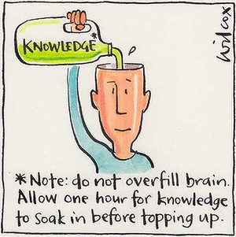
Taking a breath…stepping back and reviewing the BIG picture…
(so far)

Slide 22
CHAPTER 1: ATOMS…THE BASIC BUILDING BLOCKS LOOK ~ SO:
NUCLEUS =PROTONS + NEUTRONS
Electron here t=t₁
Electron
Here at t=t₃
Electron starts here, t=0
Electrons weighs ~1/2000 of proton
NUCLEUS magnified 10,000X
Electron
here t=t₂
Electron
Here t=t₄….

Slide 23
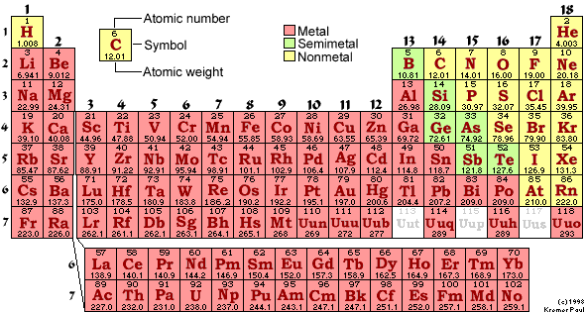
THE FLAVORS OF ATOMS ARE LISTED HERE…
EACH DISTINCT KIND OF ATOM IS CALLED AN…..
element

Slide 24

CHAPTER 1: (continued)
ATOMS (elements) COMBINE INTO MOLECULES.
MOLECULES UNDERGO CHEMICAL REACTIONS BY SWAPPING ATOMS.
EXAMPLE: C₆H₁₂O₆ + 6O₂→ 6CO₂ + 6H₂0
(sugar)
REACTIONS UNDERLY ALL LIFE ON THE PLANET. THE ELECTRONS DICTATE WHICH ATOMS SWAP WITH WHICH.
∴ FOLLOW THE ELECTRONS.

Slide 25
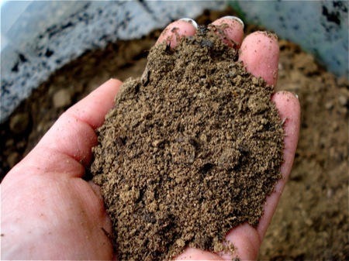

Chapter 2: Dirt
HOW DO WE DESCRIBE AND BUILD IONIC COMPOUNDS, CLASS ???
What makes rocks the way they are ?
(text version, p. 46
“Why do minerals exist?”)
What makes rocks the way they are ?
(text version, p. 46
“Why do minerals exist?”)

Slide 26

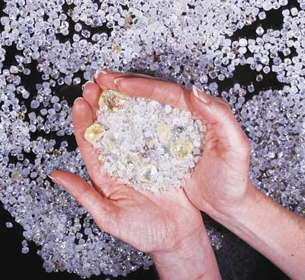

Chapter 3: Diamonds
What holds together diamonds, poo and you ???
(text version: Why is carbon special ?)
HOW DO WE DESCRIBE AND BUILD COVALENT COMPOUNDS, MAGGOTS ?

Slide 27
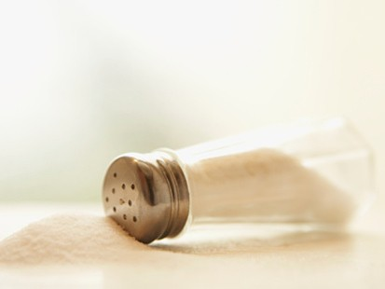

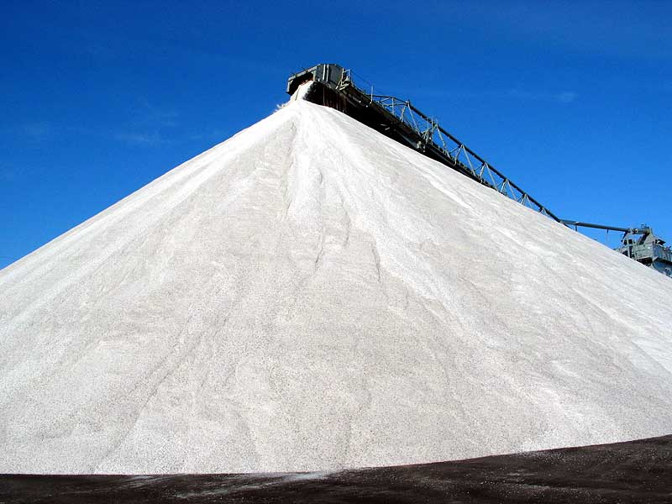
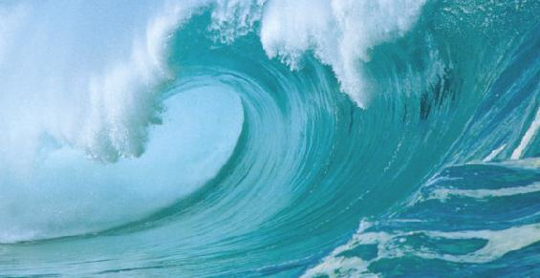
Chapter 4: Salt
Read pages 127-154
What can happen when salts (ionic compounds) dissolve ?
All of us in relation to salt in oceans
500,000,000,000,000,000 tons of salt in the oceans
500,000,000
tons of humans on Earth

