Slide 1
The simple as 1,2,3,4 …HONC bonding rules
(for organic compounds only)
Element bond count to element lone pairs on element
H 1 0
O 2 2
N 3 1
C 4 0
O, N & C BOND COUNT + LONE PAIR COUNT = 4
*USE FOR EXERCISE 2.4

Slide 2
Simple Bonding Rules for Organic* compounds:
the HONC Rules
*Compounds made of C+ H with options to include O and N
EXAMPLE #1: ethane (C₂H₆)
= one of the `natural’ gases

Slide 3
EXAMPLE #2: ethanol (C₂H₆O) =drinking alcohol

Slide 4
EXAMPLE #3: aspirin (C₁₀H₁₂O₅ )
= what to take after excess alcohol

Slide 5
EXAMPLE #4: glycine (C₂H₅NO₂) =amino acid, building block of proteins (building block of all living things )

Slide 6
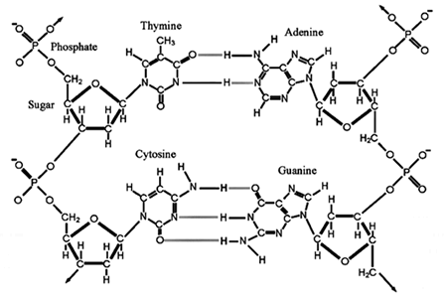
EXAMPLE #5:
Deoxyribonucleic acid
DNA (BLUEPRINT for all living things)

Slide 7
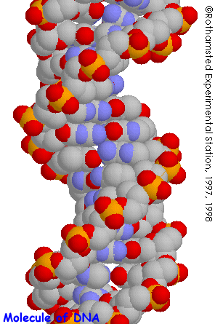
POPULAR GRAPHIC FOR DNA

Slide 8
organic chemical notation (see also pp 108-109 of text)
3 different ways to read/draw HONC structures
1) Complete skeletal form
Rubbing alcohol
All or most all lone pairs, bonds and atoms shown explicitly.

Slide 9
Aside on organic chemical notation (see also pp 108-109 of text)
3 Different ways to read/draw HONC structures (continued)
2) Condensed form
Complete skeletal form
Methyl (CH₃) and methylene groups (CH₂) written without C-H bonds, but lone pairs still shown.

Slide 10
Aside on organic chemical notation (see also pp 108-109 of text)
3 Different ways to read/draw HONC structures (continued)
3) Abbreviated bond line form (most used by organic chemists)
Complete
Skeletal
form
All kinks , ends and crossings are C. If no other groups showing,assume H around C to reach 4 bonds to C. Lone pairs assumed via HONC rules(though text doesn’t.)

Slide 11
Why bond line form is preferred by organic chemists
SIMPLER LOOKING IS PRETTIER
aspirin
Bond line form
Complete skeletal form
I’m neat & pretty
☹ messy,ugly

Slide 12
+ more board practice :
complete skeletal→ condensed →bond line
bond line →condensed→ complete skeletal

Slide 13


…and now for the bad news….
Ugly chemical fact #1:
Lewis Octet rule doesn’t always work

Slide 14

EXAMPLE #1: BATTERY ACID (H₂SO₄) (see also, pg 130 Fig 4.5)
+2
Lewis octet prediction for H₂SO₄ structure
From Experiment
(Kuczkowski et. al. 1983)
Lone pairs
not shown

Slide 15
EXAMPLE #2: Phosphoric acid (H₃PO₄)
EXAMPLE #2: Phosphoric acid (H₃PO₄)
From experiment Smith et. al. 1954
Lewis octet prediction for H₃PO₄ structure

Slide 16
EXAMPLE #3: Perchloric acid (HClO₄)
+3
From experiment
Casper et. al. 1994
Lewis octet prediction for HClO₄

Slide 17
Exploring the octet vs `experimental’ structures below (on the board)-
what can we learn ?:
H₂SO₄
H₃PO₄
HClO₄

Slide 18
`Old’ Formal Charge Rule #1
The most stable octet structure also minimizes formal charge (=> zero charge)

Slide 19
Most stable
`excited state’ molecule of phosgene
vs.
“Mickey”
“Minnie”

Slide 20
EXPLAINING DEVIATIONS FROM OCTET RULE:
FORMAL CHARGE MINIMIZATION
TRUMPS OCTET RULE BEYOND Si
`Formal Charge Rule #2
Beyond Si, you can throw away the octet rule to minimize formal charge (=> zero charge)

Slide 21
More examples using formal charge rule 2
SO₃, SO₂, H₃PO₃

