Slide 1
EXAM 1 STUDY GUIDE…EXAM COVERAGE AND EXAMPLES OF TYPICAL QUESTIONS
EXAM 1 on Friday 21 February
1)Atomic Structure and General Atomic Properties (fill-in the blanks) 8 pts
Ex. The atomic number is the same as the number of _____________________ in an given element.
Ex. A marble is 0.5 inch in radius. If it is the nucleus how many feet away is the electron cloud ? (12 inches=1 foot)
2)Element ID 12 pts
Fill in the name or symbol for the elements below: (spelling counts)
Ex. Fluorine_____ Au_______________ ….
3) Chemical Book keeping:-Reading and Balancing Chemical Reactions 13 pts
Given the reaction: ……
Ex. How many atoms of C are involved in the reaction ? _______
How many molecules of N₂ are created in the reaction ? _______
4) Stable Element Charges and Inorganic Compound Building 18 pts
Ex. What are likely stable charges for the elements listed below ? (Make sure to include sign)
Ca _____
Ex. Write the most likely compound formula formed from combining the element pairs below:
Al and O ___________________
5)Minerals and Salts vs Organics (poo) 12 pts
Ex . Briefly characterize the listed properties for both minerals and organics as high or low (4 pts)
Property Minerals/salts Organics
Ex. Solubility in water_____high_________________ ________low_______________
Conductivity of melts_________________________ ___________________________

Slide 2
5)Minerals and Salts vs Organics (poo) cont. 12 pts
How do you correctly write the formulas for compounds composed of the element counts below ?
1 Ba + 4 O + 1 S _____________________________________
6) Building and describing Organic compounds 27 pts
Ex. Draw to electron dot picture for the elements Ba C
Ex. The compound shown is: saturated unsaturated polyunsaturated
How many valence electrons are in this compound ?? ______
Ex. Valence electrons take on two forms in molecules _______pairs and _______pairs.
Ex. Draw the correct Lewis bonding structures for the combinations of elements below, making sure to indicate all lone pairs.
N2, CO2, SiO2…
Ex, What element is likely to be in the center of CS₂ ?
7) Beyond Lewis 8 pts
Ex. What are the formal charges on C and O in the stable Lewis structure of CO
Look at mini-quizzes 1-11
Homework 1-3
Exercises 1-2

Slide 3

???
Doc’s annoying question habit rears it ugly head again….

Slide 4
“I am so annoying…”
???
How do we know what `hooks’ to what in more complicated molecules ?
Examples where confusion can arise:
CO₂
C-O-O or O-C-O ??
SO₂
S-O-O or O-S-O ??
What about rings ?
C
O O
S
O O

Slide 5
CO₂
C-O-O or O-C-O ??
SO₂
S-O-O or O-S-O ??
Simple rule of thumb #1:
Elements closer to the center of the Periodic Table tend to be in the center of a molecule

Slide 6
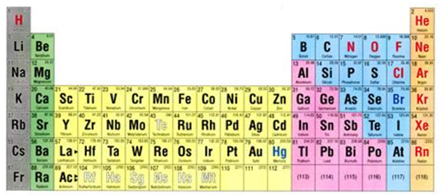
Applying Rule of Thumb 1 to CO₂
C is closer to center line=> C in center of CO₂
C-O-O or O-C-O ??
`center’ of Table
`center’ line

Slide 7
Applying Rule of Thumb 1 to SO₂
S-O-O or O-S-O ??
S is closer to center =>S in center of SO₂

Slide 8
What about rings ?
C
O O
S
O O
Simple rule of thumb #2:
Compound structures tend to minimize `strain’ and maximize bond angles

Slide 9
Doc’s questions revisited
What’s `shared’ in a shared electron bond ?
What rules govern the number of bonds to the elements and how do we use these rules to build organic (and other non-ionic) compounds ?
How do we `read’ organic compound formulas and deduce their bond and electron arrangements ?
Valence electrons only; 2 per bond
Lewis Octet Rule + Rules of Thumb 1 and 2
???

Slide 10
The simple as 1,2,3,4 …HONC bonding rules
(for organic compounds only)
Element bond count to element lone pairs on element
H 1 0
O 2 2
N 3 1
C 4 0
O, N & C BOND COUNT + LONE PAIR COUNT = 4
*USE FOR EXERCISE 2.4

Slide 11
Simple Bonding Rules for Organic* compounds:
the HONC Rules
*Compounds made of C+ H with options to include O and N
EXAMPLE #1: ethane (C₂H₆)
= one of the `natural’ gases

Slide 12
EXAMPLE #2: ethanol (C₂H₆O) =drinking alcohol

Slide 13
EXAMPLE #3: aspirin (C₁₀H₁₂O₅ )
= what to take after excess alcohol

Slide 14
EXAMPLE #4: glycine (C₂H₅NO₂) =amino acid, building block of proteins (building block of all living things )

Slide 15
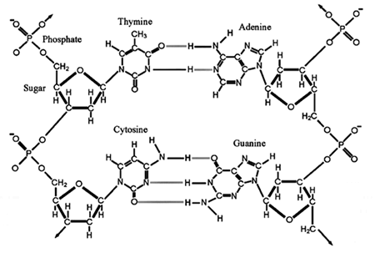
EXAMPLE #5:
Deoxyribonucleic acid
DNA (BLUEPRINT for all living things)

Slide 16
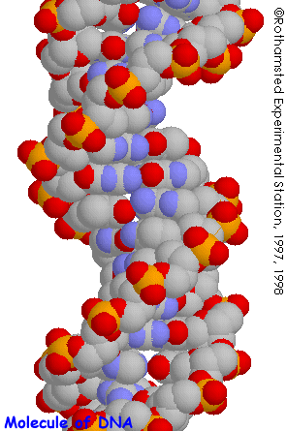
POPULAR GRAPHIC FOR DNA

Slide 17
organic chemical notation (see also pp 108-109 of text)
3 different ways to read/draw HONC structures
1) Complete skeletal form
Rubbing alcohol
All or most all lone pairs, bonds and atoms shown explicitly.

Slide 18
Aside on organic chemical notation (see also pp 108-109 of text)
3 Different ways to read/draw HONC structures (continued)
2) Condensed form
Complete skeletal form
Methyl (CH₃) and methylene groups (CH₂) written without C-H bonds, but lone pairs still shown.

Slide 19
Aside on organic chemical notation (see also pp 108-109 of text)
3 Different ways to read/draw HONC structures (continued)
3) Abbreviated bond line form (most used by organic chemists)
Complete
Skeletal
form
All kinks , ends and crossings are C. If no other groups showing,assume H around C to reach 4 bonds to C. Lone pairs assumed via HONC rules(though text doesn’t.)

Slide 20
Why bond line form is preferred by organic chemists
SIMPLER LOOKING IS PRETTIER
aspirin
Bond line form
Complete skeletal form
I’m neat & pretty
☹ messy,ugly

Slide 21
+ more board practice :
complete skeletal→ condensed →bond line
bond line →condensed→ complete skeletal

