Slide 1
What’s `shared’ in a shared electron bond ?
Answer:
Just the outer shell or `valence’ electrons of bonding atoms.
..
:S:
The main `visual ’:
Lewis dots
Exercise 2.1 √

Slide 2
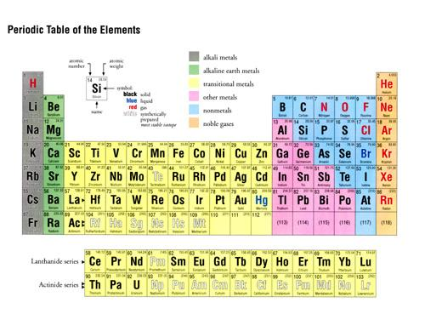
‘Valence’ vs `Core’ electrons
How many `core’ electrons does S have ?
10
(Ne)
Inert gas core electrons for S
How many total electrons does S have ?
16
How many valence electrons does S have ?
..
Valence shell or outer shell of S
:S:
6
1 2 3 4 5 6
.
Dot picture shows only valence electrons

Slide 3
Practice a few….exercise 2.2

Slide 4
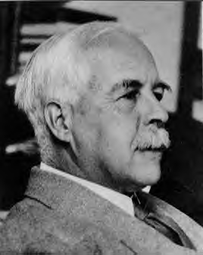
2. What rules govern the number of bonds to the elements and how do we use these rules to build organic (and other non-ionic) compounds ?
Uncle `Gil’ sez:
“If you can count to 8, even you can do it, maggot…..”
Gilbert Newton Lewis: (Uncle Gil)
American Chemist

Slide 5
Foundations of the `Lewis Octet’ Rule
What we learned From chapter 2:
e-
Na + Cl
Na⁺ Cl⁻
+
11 e⁻ → 10 e⁻
17 e-→ 18 e-
(+) and (-)attracted to each other to form ionic bond
Ne
Ar
like Ne
Like Ar
# valence electrons ?
8
8
..
: [X]:
DOT PICTURE VISUAL
Lewis `octet’ is the most stable form of elements
all atoms (X) want to look like this,whether ionic or not ionic
..

Slide 6
USING THE `OCTET’ RULE
How to build a covalent compound using `Lewis Rules’
(same process as on pp 102-106 of text.
The Lewis Octet Rule
1) Count all the valence electrons on all the bonding elements
Ex. CO₂
Valence e- on C = 1 x 4 = 4
Valence e- on 2O = 2 x 6 = 12
total valence e- = 4+12= 16

Slide 7
How to build a covalent compound using `Lewis Rules’
(same process as on pp 102-106 of text)…the Lewis Octet Rule
(continued)
Start by drawing single bonds to each atom and compute the total number of electrons in those.
Electrons in bonds= 2 bonds x 2 e-/bonds = 4
Ex. O-C-O

Slide 8
How to build a covalent compound using `Lewis Rules’
(same process as on pp 102-106 of text) ….continued
3) Distribute the remaining valence electrons not in bonds one by one and evenly to each element in the molecule. If an element reaches an `octet’, stop placing electrons on it and distribute what’s left to the other elements.
Electrons not in bonds = 16-4=12
Ex. O-C-O
Distribute them evenly among C and O

Slide 9
How to build a covalent compound using `Lewis Rules’
(same process as on pp 102-106 of text) ….continued
4) Check each atom for an octet. If all have octets, you have the right Lewis structure. If not, go back to step 2, include a double bond somewhere and repeat steps 2-4 until a complete octet is achieved around each element assuming the given electron count
Ex. O-C-O
x
x
√

Slide 10
Step 2 repeat: add another bond
√
√
x
Electrons in bonds
= 3 bonds x 2 e-/bonds = 6
O=C-O
Skip C now…has octet
Electrons not in bonds = 16-6 =10
Step 3 repeat: distribute 10 non-bonded electrons evenly
Step 4 repeat: check to see if every element has an octet

Slide 11
Back to Step 2 repeat: add another bond
√
√
x
Electrons in bonds
= 3 bonds x 2 e-/bonds
= 6
O=C-O
Skip C now…has octet
Electrons not in bonds = 16-6 =10
Step 3 repeat: distribute 10 non-bonded electrons evenly (into lone pairs)
Step 4 repeat: check to see if every element has an octet

Slide 12
Step 2 repeat repeat: add yet another bond
Electrons in bonds
= 4 bonds x 2 e-/bonds
= 8
√
√
√
O=C=O
Skip C..already has octet
Electrons not in bonds = 16-8 =8
Step 3 repeat repeat: distribute 8 non-bonded electrons evenly (into lone pairs)
Step 4 repeat repeat: check to see if every element has an octet

Slide 13
LEWIS PREDICTION FOR BONDING IN CO₂
Lone pair (2 e- per pair): 2 dots = one pair
O=C=O
Bond pairs (2 e-/bond): one line = 1 bond
Some helpful Lewis language:
bond pairs vs lone pairs

Slide 14
2. 2) What rules govern the number of bonds to the elements and how do we use these rules to build organic (and other non-ionic) compounds ?
Lewis’ s Answer:
LEWIS (OCTET) RULE

Slide 15

EXERCISE 2…. PLAYING THE LEWIS ELECTRON DOT GAME
Mole $$ !!!!

