Slide 1
What’s `shared’ in a shared electron bond ?
Answer:
Just the outer shell or `valence’ electrons of bonding atoms.
..
:S:
The main `visual ’:
Lewis dots
Exercise 2.1 √

Slide 2
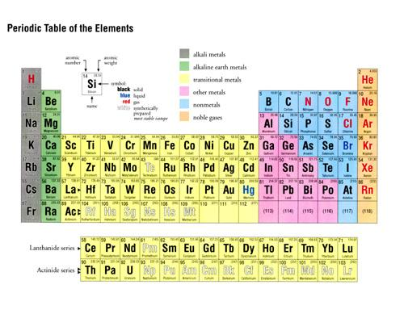
‘Valence’ vs `Core’ electrons
How many `core’ electrons does S have ?
10
(Ne)
Inert gas core electrons for S
How many total electrons does S have ?
16
How many valence electrons does S have ?
..
Valence shell or outer shell of S
:S:
6
1 2 3 4 5 6
.
Dot picture shows only valence electrons

Slide 3
Practice a few….exercise 2.2

Slide 4
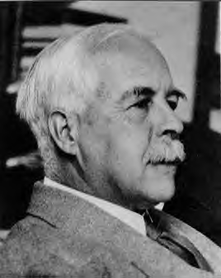
2. What rules govern the number of bonds to the elements and how do we use these rules to build organic (and other non-ionic) compounds ?
Uncle `Gil’ sez:
“If you can count to 8, even you can do it, maggot…..”
Gilbert Newton Lewis: (Uncle Gil)
American Chemist

Slide 5
Foundations of the `Lewis Octet’ Rule
What we learned From chapter 2:
e-
Na + Cl
Na⁺ Cl⁻
+
11 e⁻ → 10 e⁻
17 e-→ 18 e-
(+) and (-)attracted to each other to form ionic bond
Ne
Ar
like Ne
Like Ar
# valence electrons ?
8
8
..
: [X]:
DOT PICTURE VISUAL
Lewis `octet’ is the most stable form of elements
all atoms (X) want to look like this,whether ionic or not ionic
..

Slide 6
USING THE `OCTET’ RULE
How to build a covalent compound using `Lewis Rules’
(same process as on pp 102-106 of text.
The Lewis Octet Rule
1) Count all the valence electrons on all the bonding elements
Ex. CO₂
Valence e- on C = 1 x 4 = 4
Valence e- on 2O = 2 x 6 = 12
total valence e- = 4+12= 16

Slide 7
How to build a covalent compound using `Lewis Rules’
(same process as on pp 102-106 of text)…the Lewis Octet Rule
(continued)
Start by drawing single bonds to each atom and compute the total number of electrons in those.
Electrons in bonds= 2 bonds x 2 e-/bonds = 4
Ex. O-C-O

Slide 8
How to build a covalent compound using `Lewis Rules’
(same process as on pp 102-106 of text) ….continued
3) Distribute the remaining valence electrons not in bonds one by one and evenly to each element in the molecule. If an element reaches an `octet’, stop placing electrons on it and distribute what’s left to the other elements.
Electrons not in bonds = 16-4=12
Ex. O-C-O
Distribute them evenly among C and O

Slide 9
How to build a covalent compound using `Lewis Rules’
(same process as on pp 102-106 of text) ….continued
4) Check each atom for an octet. If all have octets, you have the right Lewis structure. If not, go back to step 2, include a double bond somewhere and repeat steps 2-4 until a complete octet is achieved around each element assuming the given electron count
Ex. O-C-O
x
x
√

Slide 10
Step 2 repeat: add another bond
√
√
x
Electrons in bonds
= 3 bonds x 2 e-/bonds = 6
O=C-O
Skip C now…has octet
Electrons not in bonds = 16-6 =10
Step 3 repeat: distribute 10 non-bonded electrons evenly
Step 4 repeat: check to see if every element has an octet

Slide 11
Back to Step 2 repeat: add another bond
√
√
x
Electrons in bonds
= 3 bonds x 2 e-/bonds
= 6
O=C-O
Skip C now…has octet
Electrons not in bonds = 16-6 =10
Step 3 repeat: distribute 10 non-bonded electrons evenly (into lone pairs)
Step 4 repeat: check to see if every element has an octet

Slide 12
Step 2 repeat repeat: add yet another bond
Electrons in bonds
= 4 bonds x 2 e-/bonds
= 8
√
√
√
O=C=O
Skip C..already has octet
Electrons not in bonds = 16-8 =8
Step 3 repeat repeat: distribute 8 non-bonded electrons evenly (into lone pairs)
Step 4 repeat repeat: check to see if every element has an octet

Slide 13
LEWIS PREDICTION FOR BONDING IN CO₂
Lone pair (2 e- per pair): 2 dots = one pair
O=C=O
Bond pairs (2 e-/bond): one line = 1 bond
Some helpful Lewis language:
bond pairs vs lone pairs

Slide 14
2. 2) What rules govern the number of bonds to the elements and how do we use these rules to build organic (and other non-ionic) compounds ?
Lewis’ s Answer:
LEWIS (OCTET) RULE

Slide 15

EXERCISE 2…. PLAYING THE LEWIS ELECTRON DOT GAME
Mole $$ !!!!

Slide 16

???
Doc’s annoying question habit rears it ugly head again….

Slide 17
“I am so annoying…”
???
How do we know what `hooks’ to what in more complicated molecules ?
Examples where confusion can arise:
CO₂
C-O-O or O-C-O ??
SO₂
S-O-O or O-S-O ??
What about rings ?
C
O O
S
O O

Slide 18
CO₂
C-O-O or O-C-O ??
SO₂
S-O-O or O-S-O ??
Simple rule of thumb #1:
Elements closer to the center of the Periodic Table tend to be in the center of a molecule

Slide 19
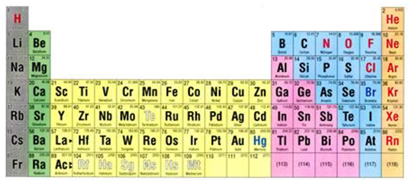
Applying Rule of Thumb 1 to CO₂
C is closer to center line=> C in center of CO₂
C-O-O or O-C-O ??
`center’ of Table
`center’ line

Slide 20
Applying Rule of Thumb 1 to SO₂
S-O-O or O-S-O ??
S is closer to center =>S in center of SO₂

Slide 21
What about rings ?
C
O O
S
O O
Simple rule of thumb #2:
Compound structures tend to minimize `strain’ and maximize bond angles

Slide 22
Doc’s questions revisited
What’s `shared’ in a shared electron bond ?
What rules govern the number of bonds to the elements and how do we use these rules to build organic (and other non-ionic) compounds ?
How do we `read’ organic compound formulas and deduce their bond and electron arrangements ?
Valence electrons only; 2 per bond
Lewis Octet Rule + Rules of Thumb 1 and 2
???

Slide 23
The simple as 1,2,3,4 …HONC bonding rules
(for organic compounds only)
Element bond count to element lone pairs on element
H 1 0
O 2 2
N 3 1
C 4 0
O, N & C BOND COUNT + LONE PAIR COUNT = 4
*USE FOR EXERCISE 2.4

Slide 24
Simple Bonding Rules for Organic* compounds:
the HONC Rules
*Compounds made of C+ H with options to include O and N
EXAMPLE #1: ethane (C₂H₆)
= one of the `natural’ gases

Slide 25
EXAMPLE #2: ethanol (C₂H₆O) =drinking alcohol

Slide 26
EXAMPLE #3: aspirin (C₁₀H₁₂O₅ )
= what to take after excess alcohol

Slide 27
EXAMPLE #4: glycine (C₂H₅NO₂) =amino acid, building block of proteins (building block of all living things )

Slide 28
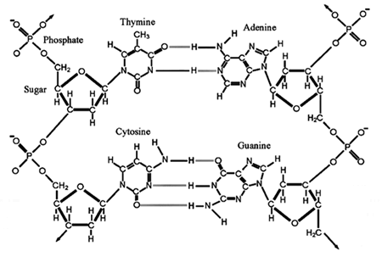
EXAMPLE #5:
Deoxyribonucleic acid
DNA (BLUEPRINT for all living things)

Slide 29
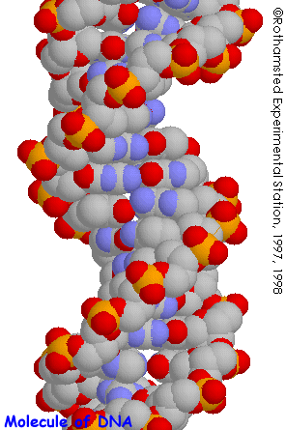
POPULAR GRAPHIC FOR DNA

Slide 30
organic chemical notation (see also pp 108-109 of text)
3 different ways to read/draw HONC structures
1) Complete skeletal form
Rubbing alcohol
All or most all lone pairs, bonds and atoms shown explicitly.

Slide 31
Aside on organic chemical notation (see also pp 108-109 of text)
3 Different ways to read/draw HONC structures (continued)
2) Condensed form
Complete skeletal form
Methyl (CH₃) and methylene groups (CH₂) written without C-H bonds, but lone pairs still shown.

Slide 32
Aside on organic chemical notation (see also pp 108-109 of text)
3 Different ways to read/draw HONC structures (continued)
3) Abbreviated bond line form (most used by organic chemists)
Complete
Skeletal
form
All kinks , ends and crossings are C. If no other groups showing,assume H around C to reach 4 bonds to C. Lone pairs assumed via HONC rules(though text doesn’t.)

Slide 33
Why bond line form is preferred by organic chemists
SIMPLER LOOKING IS PRETTIER
aspirin
Bond line form
Complete skeletal form
I’m neat & pretty
☹ messy,ugly

Slide 34
+ more board practice :
complete skeletal→ condensed →bond line
bond line →condensed→ complete skeletal

