Slide 1
In-class Board practice counting bonds and electrons for organics

Slide 2
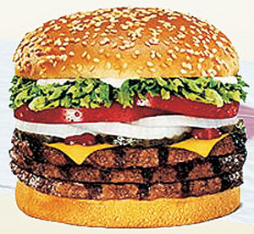
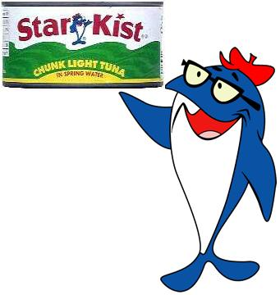
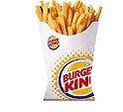
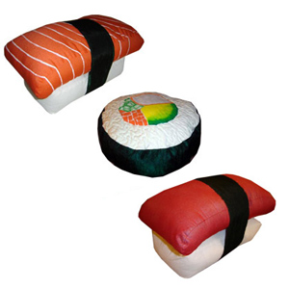
bond energies , bond lengths and bond order’s role in food
(see also p 91 table 3.1 of text)
Bond
C-C
C=C
C≡C
C-H
Bond order
1
2
3
1
Bond energy kJ/mol
376
611
835
470
Bond length pm
154
133
120
109
Saturated => all C-C
no C=C or C≡C
Unsaturated => C-C and
some C=C and C≡C
Hard fats (Crisco )
Oils (Olive oil)
sushi
WHY BAD ???

Slide 3
The straight story on why `saturated’ is bad…..
Bond
C-C
C=C
C≡C
C-H
Bond energy kJ/mol
376
611
835
470
poly unsaturated
Bond energy
contributions
Saturated
Unsaturated
1 C-C bond * 376 kJ
1 C=C bond*611 kJ
1 C≡C bond*835 kJ
Total bond energy
6 C-H bonds* 470 kJ
4 C-H bonds*470 kJ
2 C-H bonds*470 kJ
3196 kJ
2490 kJ
1775 kJ
“relative energy comparison”
100% (ref)
78%
56%

Slide 4
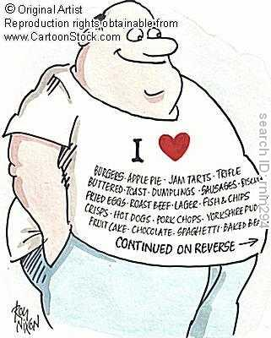
MOST PROCESSED FOODS ARE SATURATED FAT PRODUCTS

Slide 5


Slide 6
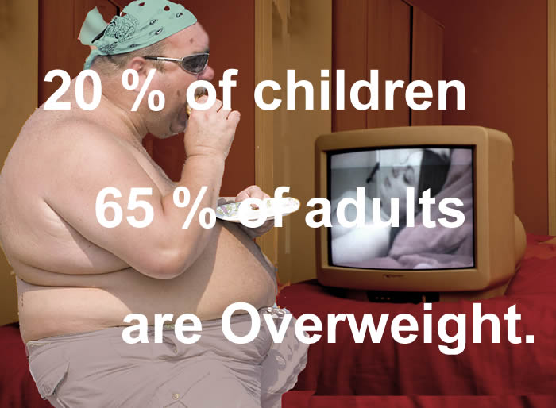

Slide 7

Tongue in `cheek’….but not far from the mark….

Slide 8

???
Can I have four bonds between C ? Five bonds ? ½ bonds ?
Can C=H exist ? C≡H ??
Do I use all or just some of the electrons of participating atoms in bonds?
Doc’s annoying questions habit rears it ugly head….

Slide 9
Some MORE annoying Doc questions
(see also: pp 100-106)
What’s `shared’ in a shared electron bond ?
What rules govern the number of bonds to the elements and how do we use these rules to build organic (and other non-ionic) compounds ?
How do we `read’ organic compound formulas and deduce their bond and electron arrangements ?

Slide 10
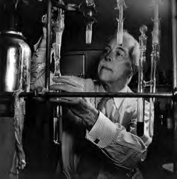

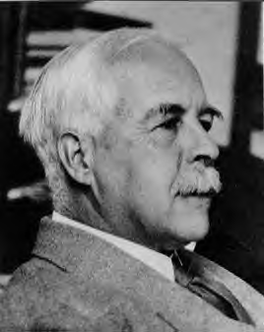
The `Inventor’ of the Shared Electron Pair Bond
Gilbert Newton Lewis
As an undergrad…young Doc Fong sits in here staring every day at…
The House that Lewis Built: Lewis Hall of Chemistry
UC Berkeley

Slide 11
What’s `shared’ in a shared electron bond ?
Uncle `Gil’ sez:
“That’s easy, maggot…..”
Gilbert Newton Lewis: (Uncle Gil)
American Chemist

Slide 12
What’s `shared’ in a shared electron bond ?
Answer:
Just the outer shell or `valence’ electrons of bonding atoms.
..
:S:
The main `visual ’:
Lewis dots

Slide 13
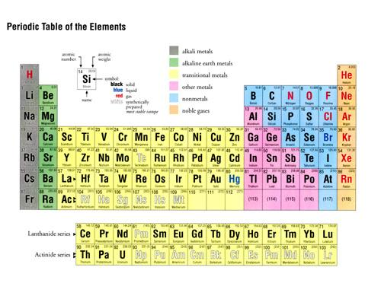
‘Valence’ vs `Core’ electrons
How many `core’ electrons does S have ?
10
(Ne)
Inert gas core electrons for S
How many total electrons does S have ?
16
How many valence electrons does S have ?
..
Valence shell or outer shell of S
:S:
6
1 2 3 4 5 6
.
Dot picture shows only valence electrons

