Slide 1
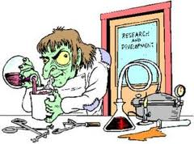
The `problem’ with Chemistry…

Slide 2
“Chemistry is the subject 6.0000 out of 6.0225 Americans happily insist ‘they flunked in high school.’ “
Natalie Angiers
From The Canons: a Whirlygig Tour of the Beautiful Basics of Science” p. 121

Slide 3
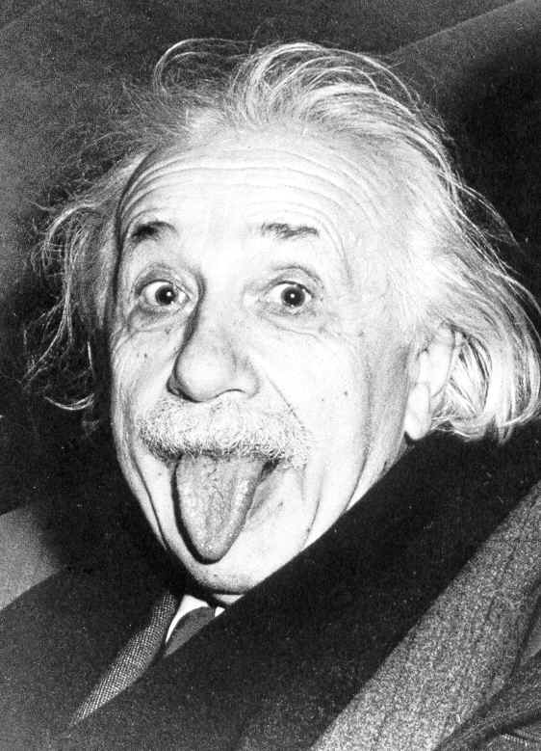
The Physicist….
Albert Einstein
“Imagination is
more important
than knowledge.”

Slide 4
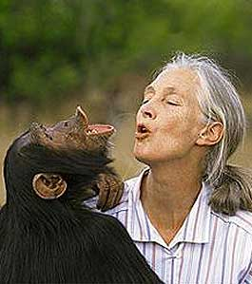
The Biologist….
Jane Goodall
“Once we have labeled the things around us we do not bother to look at them so carefully. Words are part of our rational selves, and to abandon them for a while is to give freer reign to our intuitive selves.“

Slide 5
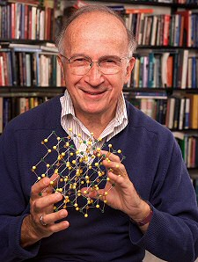
The Chemist….
Roald Hoffman
1981 Nobel Laureate in Chemistry, Cornell University
“We can seem a bit dull and tedious…”

Slide 6
“Chemists are poised between the physical and biological universes. We don’t deal with either the infinitely small or large, making us fussy and neither fish nor fowl…. the way things in the middle are.”
Roald Hoffman
Chemistry is the ignored middle child of the modern sciences… ☹

Slide 7
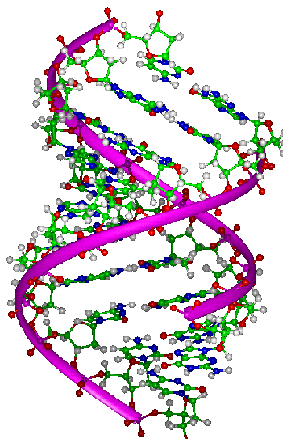
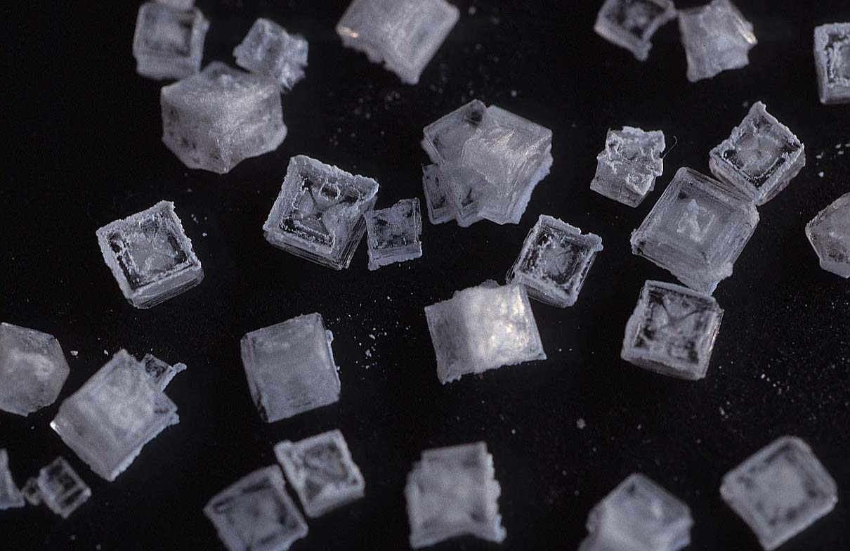
The chemist’s middle ground…
Explaining and manipulating how…
~600,000,000,000,000,000,000,000 atoms < 0.0000000001 inches across become items as different as ….
DNA
TABLE SALT

Slide 8
THE “PROBLEM” WITH CHEMISTS …..
Chemists are obsessed with molecules- which is like being infatuated with car parts- but not in driving the car….
You can name famous race car drivers…but what are their chief mechanics named ?

Slide 9
The strength and weakness of chemists is that we sweat the details and revel in them.
EXAMPLE #1
Hoffmann’s 1981 Nobel Prize in Chemistry awarded for explaining ……..
+
Concerted 1,3 cycloaddition
(Diels-Alder Reaction)

Slide 10
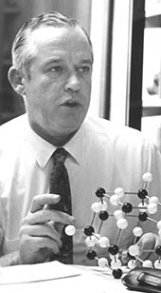
Enol→keto tautomeric shift
EXAMPLE #2
keto
enol
Resonance shift
The `real’ shape
of Thymine (T)
Perfect fit for
`H’ bonding A→T
Jerry Donahue
structure chemist
Adenosine (A)

Slide 11
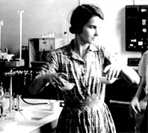
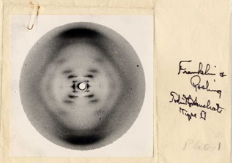
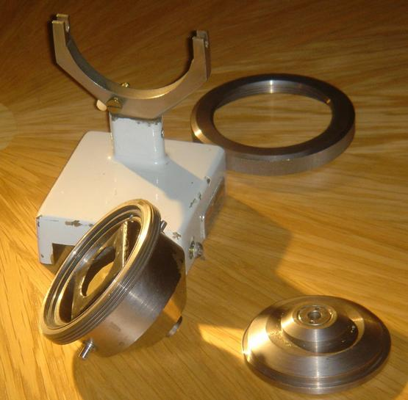
First recorded diffraction
picture of A form DNA
EXAMPLE #3
Rosalind Franklin, physical chemist
Phillips micro x-ray camera mount modified by Franklin for mounting DNA in controlled humidity at King’s College, UK.

Slide 12
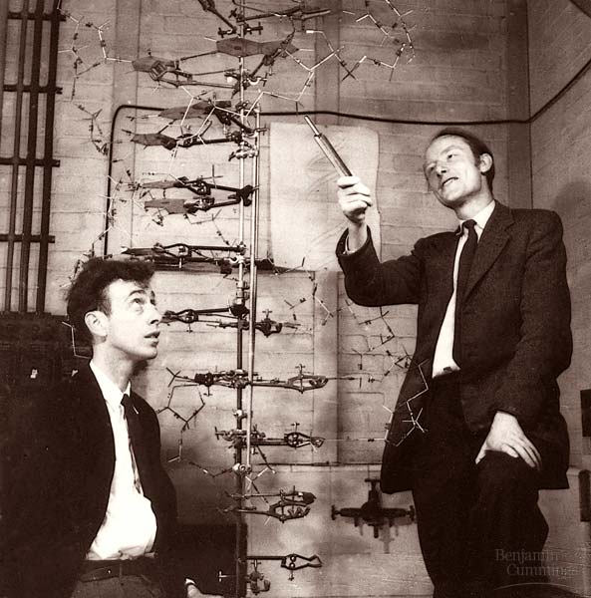
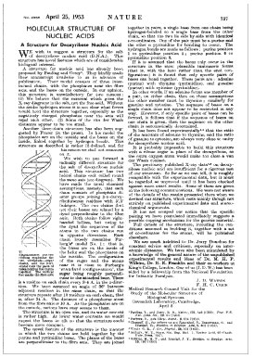
Biologist
CHEMIST
Physicist
Nature 171, 737-738 (1953)
The paper that changed everything.
WATSON
CRICK

Slide 13
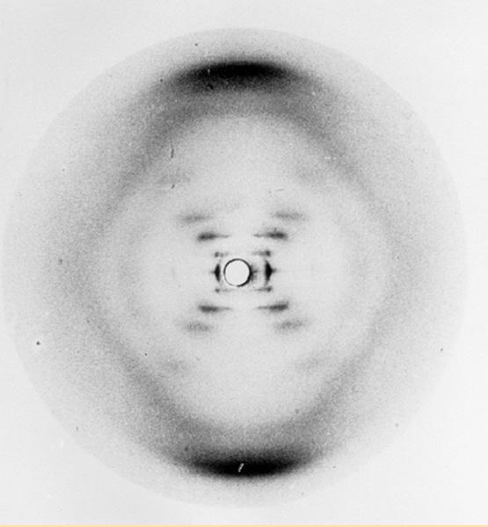
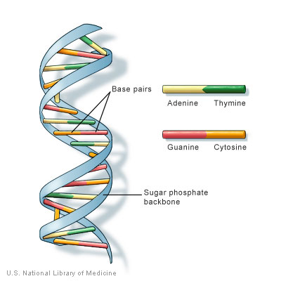
CHEMISTS:
EVERYWHERE IN THE DETAILS

Slide 14
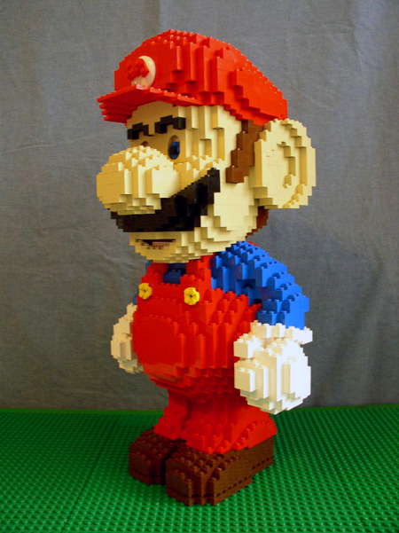
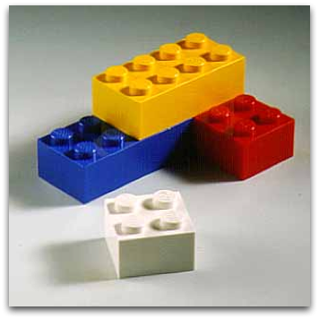
The start of everything….
Chemical Elements: basic building blocks of everything

Slide 15
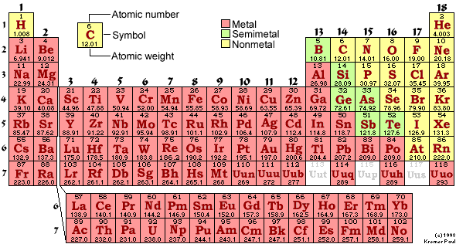
Periodic Table of the Elements:
the building blocks of everything
Know Names and Symbols by Wed:
1st three rows
Main stuff of Sun , living systems, Earth’s oceans and crust
Man Made (short-lived)
Man Made (actinides)

Slide 16
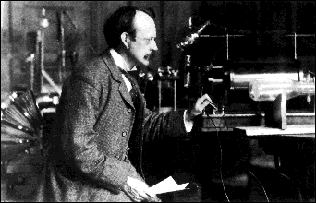
The first real try at probing the atom’s insides:
J. J. Thomson’s `CRT’: 1897
J.J. Thomson Cavendish Labs, Cambridge UK
J.J’s `Cathode Ray Tube’ (CRT)*
Proves that atoms are composed equal amounts of + and – (=electrons)

Slide 17
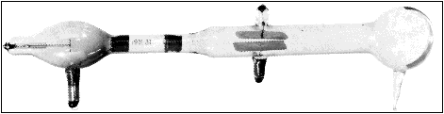
Thompson’s¹ `CRT’ …opposites attract, likes repel
(+)
(-)
What must be charge of outgoing beam ?
(-)
(+)
Negative (-)
Only sees (-) beam,
never a (+) beam
Thomson was astonishingly bad in the lab and fumble-fingered; the CRT was made by a gifted glassblower, E. Everett

Slide 18
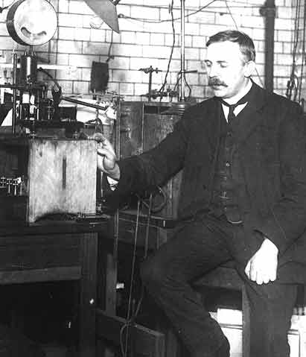
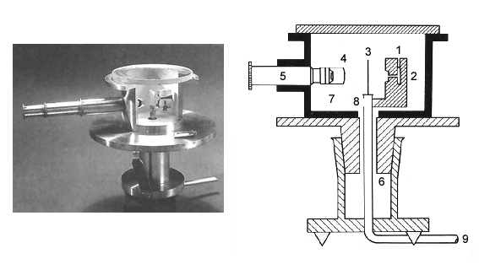
A better look inside an atom: Rutherford’s gold foil experiment (1910)
Ernst Rutherford
Physical Laboratory
Manchester University, UK
Rutherford’s Gold foil apparatus*
*Factoid: it’s really his students-Geiger and Marsden- who machine the device and do the measurements.

Slide 19
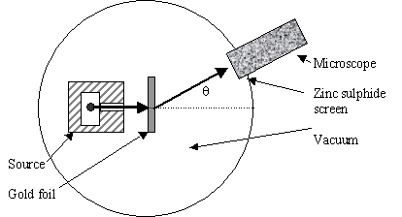
Atomic structure testing (continued)
Schematic of Rutherford’s `gold foil’ apparatus
Microscope
Rotated to detect scintillations
Alpha (α) particles=He⁺
ZnS screen is a scintillating surface
Gold Foil Experiment lore
Marie Curie supplied the radon =α source.
It required ~ 1 hour sitting in absolute dark to condition eyes.
You could only observe scintillations for 1-2 minutes before
desensitizing.

Slide 20
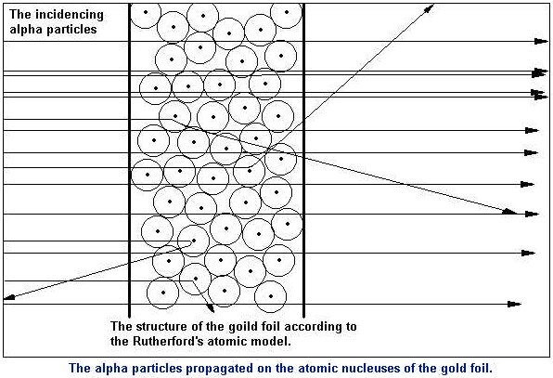
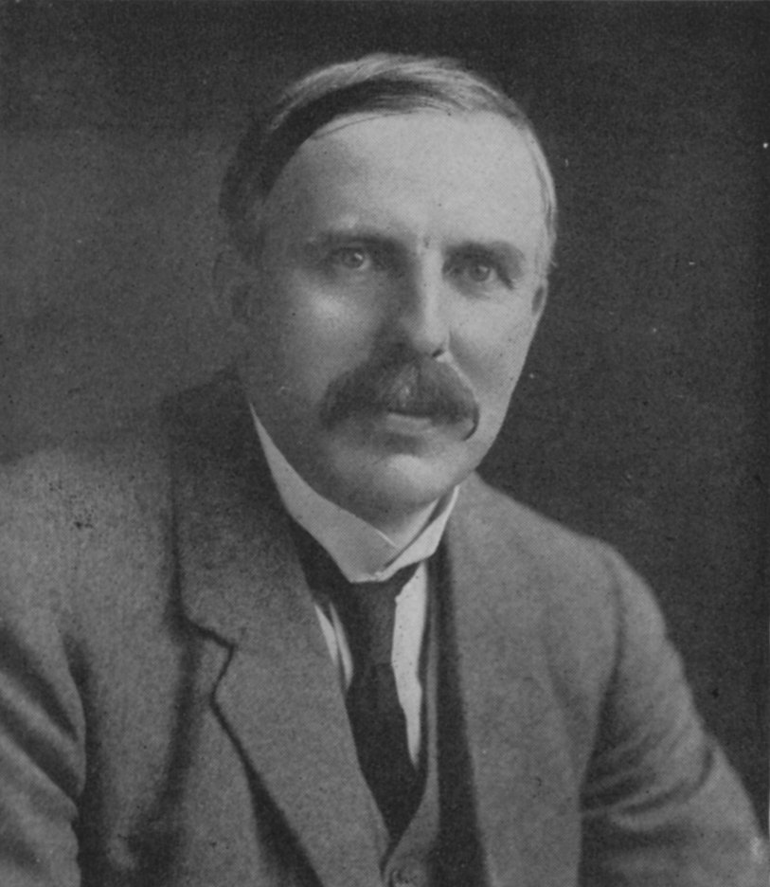
Pictorial version of what gold leaf experiment teaches
“Like firing a howitzer at tissue paper and having the shell bounce back !!”
~Statistics of gold leaf experiment
# He bounced back or deflected =
Total # He fired
1
300,000,000

Slide 21
The Gold leaf statistics led to Rutherford’s Picture of the Atom
Diffuse electron
Cloud out here
~ 10⁻¹⁰ m
~10⁻¹⁵ m
Nucleus is + charged
Electrons are - charged
Nucleus at center (magnified here ~10,000X)

Slide 22
Rutherford’s Atom by the numbers
Diameter of electron cloud = 100,000
Diameter of nucleus 1
Atomic part Relative mass % mass of atom
Nucleus 1 99.5
Electrons 0.005 0.5
Atomic part Relative volume
Nucleus 0.00000000000001
Electrons 1
electron cloud is 99.99999999% of atomic volume but only 0.5% of the mass

Slide 23

N=# cuts
1
2
3
4
20 cm (~8 inches)
Atomic metaphor 0:
Touchy, feely sense of atom dimensions:
paper and scissors example
N=31
N to electron radius ??
N to nuclear radius ??
N=50

Slide 24
Pre-test and sayanora for today

