Slide 1
Organic Naming

Slide 2
What is an Alkane?
An alkane is a hydrocarbon in which all of the carbon-carbon bonds are single bonds.

Slide 3
Important Things for naming Alkanes
Prefix
Suffix
  1 =meth-
  2 =eth-
  3 =prop-
  4 =but-
  5 =pent-
  6 =hex-
  7 =hept-
  8 =oct-
  9 =non-
  10 =dec-
  -ane
Example of use:
=propane
11 =unidec-
12 =duodec-
13 =triskadec-

Slide 4
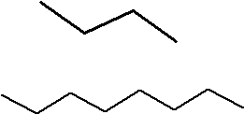
Straight Chain Alkanes
Count the number of carbons
Pick the right prefix
Attach the prefix to the suffix
Examples:
propane
octane

Slide 5
Branched Alkanes
Count the longest continuous chain – this is called the parent chain
All the other pieces are called substituent groups
Prefixes
  1 – Mono
  2 – di
  3 – tri
  4 – tetra

Slide 6
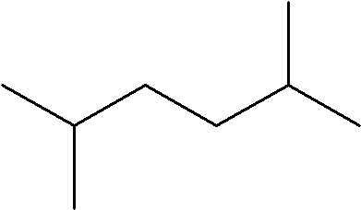
Examples of Branched Alkanes
methyl
Count and name longest Parent Chain
Name substituent groups
Number substituent groups
1
3
5
2
4
6
methyl
2,5-
dimethyl
hexane

Slide 7
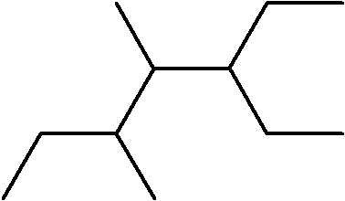
Examples of Branches Alkanes
ethyl
Count and name longest Parent Chain
Name substituent groups(in alphabetical order)
Number substituent groups(using lowest numbers)
methyl
4
5
2
4
3
7
3
6
6
5
2
1
1
7
methyl
3-
ethyl-
4,5-
dimethyl
heptane

Slide 8
Now Let’s practice
Naming Alkanes Exercise #1

Slide 9
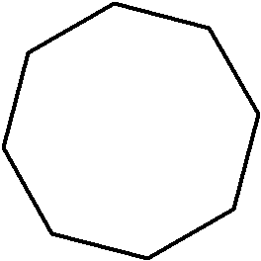
Cycloalkanes
Count number of carbons
Take known prefix
Add known suffix
Add cyclo in front of name
8
1
7
cyclo
oct
ane
2
6
3
5
4

Slide 10
Naming Alcohols

Slide 11
What is an alcohol?
    An alcohol is a carbon chain with an –OH group attatched
    When naming alcohols the suffix if -ol

Slide 12

Naming Alcohols
3
1
4
2
but
ane
anol
  The carbon with the OH group is the #1 carbon and then count the longest chain from that carbon.
  Pick the proper prefix and attach alkane suffix.
  Remove the –e and add alcohol suffix

Slide 13
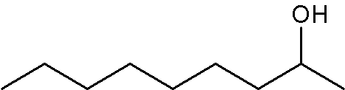
Naming alkanes
methyl
8
7
6
5
3
2
1
4
1-
methyl
octanol
  The carbon with the OH group is the #1 carbon and then count the longest chain from that carbon.
  Pick the proper prefix and attach alkane suffix.
  Remove the –e and add alcohol suffix
Name substituent groups
Number substituent groups

Slide 14
Now Let Us Practice
Naming Alkanes Exercise #2

