Slide 1
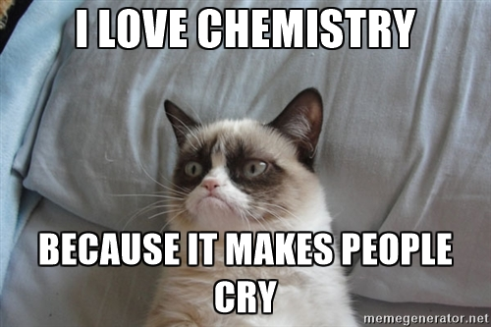
TGIF ! Quiz Monday assigning complete and abbreviated electron configurations. Use Periodic Charts we `colored’ in to assign s, p , d…electron regions

Slide 2
4
d
5
s
4
s
OBSERVED ATOMIC ENERGY LEVEL ORDERING SIMPLIFIED
3
d
3
p
2
p
s
n=1
s

Slide 3
4
d
5
s
4
s
3
d
3
p
Describing Carbon’s ground state energy levels
C=1s²
2s²
2p²
2
p
s
C has 6 electrons
n=1
s

Slide 4
4
d
5
s
4
s
3
d
3
p
Describing Fluorine’s ground state energy levels
F=1s²
2s²
2p⁵
2
p
s
F has 9 electrons
n=1
s

Slide 5
F*=1s²2s²2p⁴3p¹
4
d
Excited state: an electron gets `promoted’
5
s
4
s
3
d
F=1s²
2s²
2p⁵
3
p
Ground state
(all crowded in at bottom)
2
p
s
F has 9 electrons
n=1
s

Slide 6
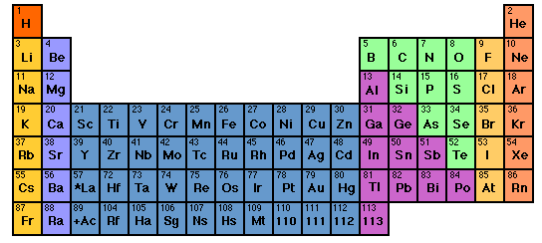

How to sing the spdf song without memorizing the energy levels: electron neighborhoods: s, p, d and f
Student exercise marking s,p,d f regions
Imagine He here
s
d
p
1
2
3
4
5
6
7
3d
4d
5d
6d
f
4f
5f

Slide 7
Text book problems section 2.3 and 2.4

Slide 8
Singing the song…what is the complete electronic configuration of….simplifications
Will stay in first 3 rows so d, f orbitals can be dropped
s
p
1
2
3
4
5
6
7
1s² 2s¹
d
3d
4d
5d
6d
f
H =
1s¹
He =
1s²
Li=
1s²
+
2s¹
1s²
Be=
+
2s²

Slide 9
spdf song –continued: YOU complete electronic configuration of:
1
2
3
s p
H
He
Li
Be
B
C
N
1s¹
1s²
1s² 2s¹
1s² 2s²
1s² 2s² 2p¹
O
F
Ne
1s² 2s² 2p⁴
1s² 2s² 2p²
1s² 2s² 2p⁵
1s² 2s² 2p³
1s² 2s² 2p⁶

Slide 10
s p
He is s not p
3d
4d
5d
6d
IN-CLASS EXERCISE :
COMPLETE ELECTRONIC CONFIGURATIONS: row 3
And textbook problems section 2.5

Slide 11
Practice writing abbreviated electronic configurations:
Converting complete configurations to a compact form that reveals the “chemistry” piece of the atom

Slide 12
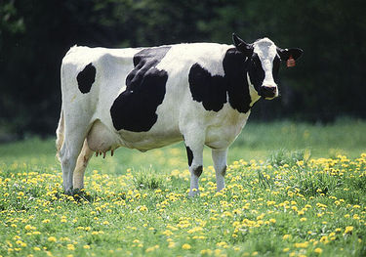


Why (really) the spdf song is sung…..
Valence electrons utterly rule how elements react to make compounds.
What kind of electronic orbitals they possess decides how they behave chemically.
Dogs drool, cats rule
s is for silly cow
p is for pretty kitty
d is for dumb dog

Slide 13
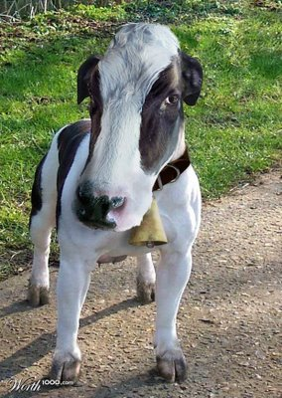
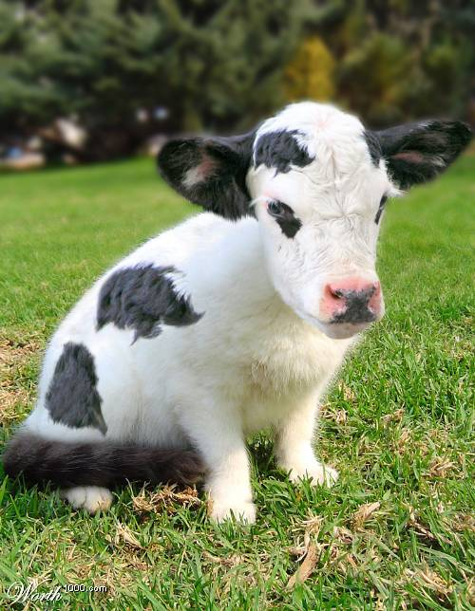
The specific combo of orbits creates the unique chemistry of an element
Be= [He]2s²
Cl=[Ne]3s² 3p⁴
Ti = [Ar] 3d²4s²
100% cow
33% cow+66% kitty
50% cow +50% dog

Slide 14


