Slide 1

Mini-quiz on light, energy and Bohr
Homework 2 due Friday
Homework 3 posted

Slide 2
More textbook problems on basic Bohr model
Text 2.2

Slide 3

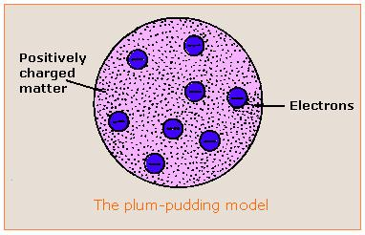
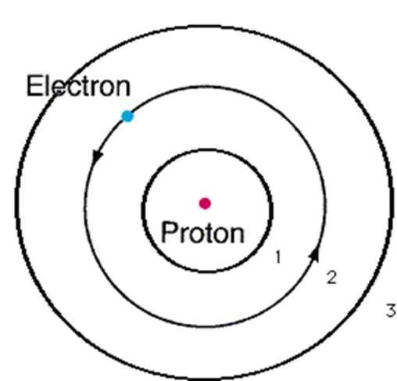
Evolution of the atomic model so far….
Thomson Model
1897
Bohr Model
1913
Philosophical Magazine 44, 295 (1897)
Philosophical
Magazine Series 6,
21, 669-688 (1911)
Philosophical Magazine Series 6
26. 1-25 (1913)

Slide 4


What happened to chemistry ?????
Walter White talking chemistry in “Breaking Bad”

Slide 5



Bohr’s little Problem…
Observed
Na-`D’ line
Is yellow
1930
Bohr theory
Even worse..
Spectroscopists observe….
Bohr’s prediction: 1 green line
11 lines !!
1≠11
Bohr can’t predict anything right except H. The other elements have too many lines, e.g. Na
Bohr
1 line predicted
EXPERIMENT
11 LINES OBSERVED

Slide 6
Bohr model’s failures (continued)
even Bohr’s predictions for H have problems
Can’t predict magnetic `fine’ structure of H, e.g
…magnetize H and even n=1 splits into 2 lines
1 ≠ 2
Turn on magnet near H
☹ Not even the smartest theoretical physicists of the day (Sommerfeld, Planck, Dirac) can make 1=2 or 1=11…. with Bohr’s model

Slide 7

??
1≠11
Evolution of the atomic model so far….
Thomson Model
1897
Bohr Model
1913
Philosophical Magazine 44, 295 (1897)
Philosophical Magazine Series 6
26. 1-25 (1913)
Philosophical
Magazine Series 6,
21, 669-688 (1911)

Slide 8

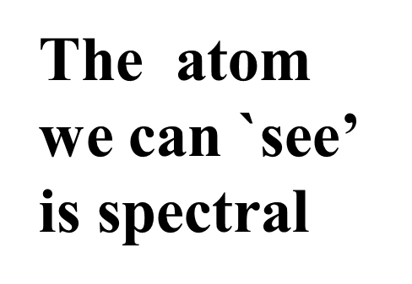
“Model 4: The spectroscopist’s atom
My way or the highway…
…or why we sing the spdf song
The spectroscopists description of what they deduce from observing lines is the `atom’

Slide 9
The observed spectra define the energy levels in the elements
Link to atomic line spectra of elements…none of which Bohr can explain except H
http://chemistry.bd.psu.edu/jircitano/periodic4.html

Slide 10
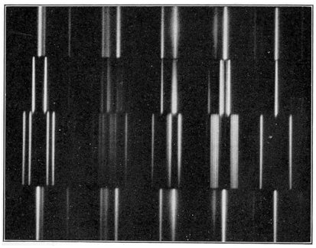
Close ups of emission lines from elements:
all lines are not created equal

Slide 11
Four main `line’ types are observed in atomic spectra:
abbreviations
Sharp lines (=> very narrow)
s
p
d
f
2. Principal lines (=> most intense)
3. Diffuse lines (=> weak, broad )
4. Fundamental lines (=> family of lines terminating spectra at high energy)

Slide 12
The kind of line tells us that the emission started from a specific kind of electron level.
Evidently there are four kinds of levels
labeled by the kind of emission line it gives rise to.

Slide 13
5
4
4
4
3
d
3
3
The qualitative, general distribution of multi-electron atomic energy levels grouped by line type
2
2
p
n=1
s

Slide 14
4
d
5
s
4
s
OBSERVED ATOMIC ENERGY LEVEL ORDERING SIMPLIFIED
3
d
3
p
2
p
s
n=1
s

Slide 15
4
d
5
s
4
s
3
d
3
p
Describing Carbon’s energy levels
C=1s²
2s²
2p²
2
p
s
C has 6 electrons
n=1
s

Slide 16
4
d
5
s
4
s
3
d
3
p
Describing Fluorine’s energy levels
F=1s²
2s²
2p⁵
2
p
s
F has 9 electrons
n=1
s

Slide 17
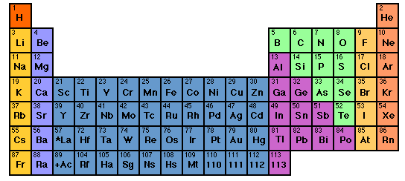

How to sing the spdf song without memorizing the energy levels: electron neighborhoods: s, p, d and f
Student exercise marking s,p,d f regions
Imagine He here
s
d
p
1
2
3
4
5
6
7
3d
4d
5d
6d
f
4f
5f

Slide 18
Text book problems section 2.3 and 2.4

Slide 19
Singing the song…what is the complete electronic configuration of….simplifications
Will stay in first 3 rows so d, f orbitals can be dropped
s
p
1
2
3
4
5
6
7
1s² 2s¹
d
3d
4d
5d
6d
f
H =
1s¹
He =
1s²
Li=
1s²
+
2s¹
1s²
Be=
+
2s²

Slide 20
spdf song –continued: YOU complete electronic configuration of:
1
2
3
s p
H
He
Li
Be
B
C
N
1s¹
1s²
1s² 2s¹
1s² 2s²
1s² 2s² 2p¹
O
F
Ne
1s² 2s² 2p⁴
1s² 2s² 2p²
1s² 2s² 2p⁵
1s² 2s² 2p³
1s² 2s² 2p⁶

Slide 21
s p
He is s not p
3d
4d
5d
6d
IN-CLASS EXERCISE :
COMPLETE ELECTRONIC CONFIGURATIONS: row 3
And textbook problems section 2.5

Slide 22


