Slide 1

Oooh %^&*!!
Its ^$#U^) Monday
Mini-quiz on light, energy and Bohr
next Wednesday

Slide 2
The assertion from your text, page 31
For light, new school thinking:
As wavelength increases, energy decreases
As frequency increases, energy increases
Light is a massless particle (bullet) of energy
with wave-like properties

Slide 3
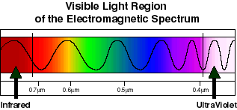
More Text Problems illustrating E vs. f. vs. λ vs. color connections (2.1)
Low energy
large λ
small f
HIgh energy
small λ
large f

Slide 4
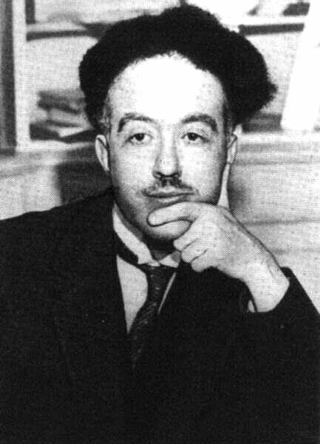
De Broglie’s* hypothesis
If light acts `particle-like’ ….
then matter can act `wave-like’ and have a `wavelength’
*Louis-Victor-Pierre-Raymond, 7th duc de Broglie

Slide 5
Light energy depends on f not amplitude and acts like matter
DeBroglie’s hypothesis: matter has a `λ’
How do these fix the problems with Rutherford’s atom ?????

Slide 6
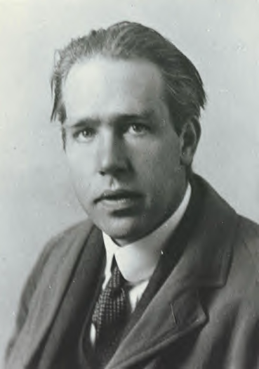
Ask him !
(see also pp. 34-40)
Niels “the kid” Bohr at 27 soon after he makes
his big theoretical breakthrough.

Slide 7
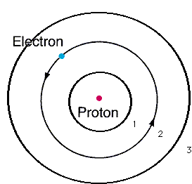
Using DeBroglie’s idea and Einstein’s idea Bohr derives an equation for Energy, E_{H}, of the electron around Hydrogen and proposes the Bohr model of the atom:
n=3
n=2
n=1
E_{H}(J)= -2.178*10⁻¹⁸
n²
n=1,2,3…are integers defining circular orbits around positive nucleus

Slide 8
Bohr Model Predictions vs. Experiment
0% error between observed
and calculated !!!
Calc λ_{theory}
obs λ
434
486
656
n_{i} n_{f}
434
486
656
5 2
4 2
3 2
n=5
4
2
1
3
Observed H (sun) spectrum (Balmer series)
5→2
4→2
3→ 2
Bohr’s `explanation of H spectrum’: quantum transitions between levels
λ = 434 486 656 nm

Slide 9
Bohr Model Predictions vs. Experiment (continued)
Theoretical Computed radius of first H orbit:
5.20 nm
Experimentally measured ground state radius of H:
0% error between observed and calculated (again) !!!
5.20 nm

Slide 10
Bohr’s Quantum jump pix…really weird stuff
Mr. electron sez FU…hell no
I won’t go
Light with different energy than E₁₂ (even if a tiny, tiny bit smaller)
n=2
n=1
Light with exactly energy E₁₂
Magic happens
E₁₂

Slide 11
The Bohr picture of electron motion in atoms:
electrons as magic popcorn : or why the electron never goes to the proton
Electron here t=t₁
But never, ever here
Electron
Here at t=t₃
Electron starts here, t=0
Nucleus magnified 100,000X
Electron
here t=t₂
Electron
Here t=t₄….

Slide 12
Visualizing Bohr atom absorptions for H atom p. 38

Slide 13
Visualizing
Bohr atom emissions for H atom
(Text pg. 39)

Slide 14
Text Problems illustrating Bohr atom E vs. f. vs. λ connections (2.2)

Slide 15

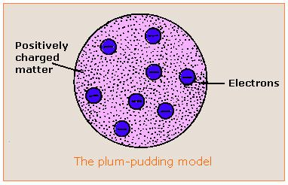

Evolution of the atomic model so far….
Thomson Model
1897
Bohr Model
1913
Philosophical Magazine 44, 295 (1897)
Philosophical
Magazine Series 6,
21, 669-688 (1911)
Philosophical Magazine Series 6
26. 1-25 (1913)

