Slide 1

Oooh %^&*!!
Mini-Quiz 4

Slide 2
Homework 1 due Friday 8 September in class (today)
Homework 2 posted.
Due Friday 15 September in class

Slide 3
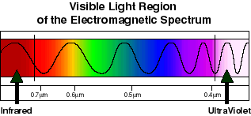
Frequency (f) is inverse to wavelength (λ)
Text examples exploring this (2.1)
R O G B I V
red orange green blue indigo violet

Slide 4
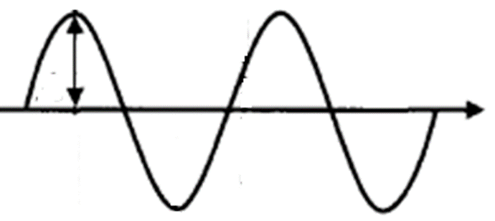

An assertion from your text, page 31
For light:
As wavelength increases, energy decreases
As frequency increases, energy increases
Huh ?????
Wave Energy ~ A²
A

Slide 5
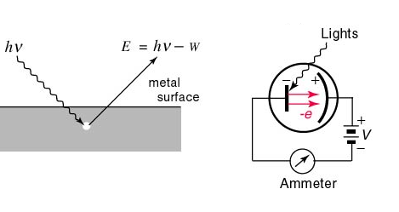
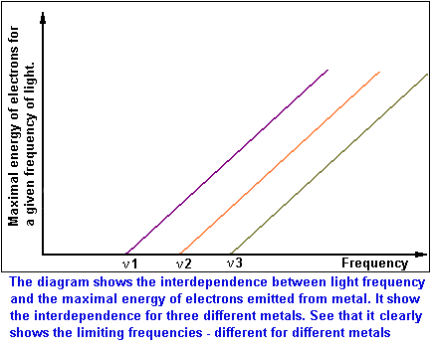
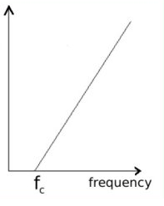
Photoelectric effect: typical textbook version
E=Energy of ejected electron from metal
Threshold frequency for emission varies with metals (f₁=ν₁ for metal 1, f₂=ν₂ for metal 2 etc.)

Slide 6
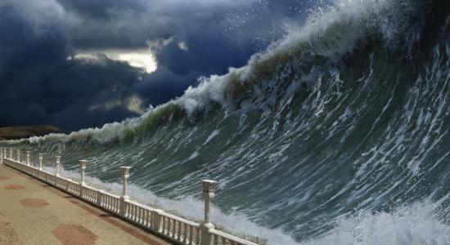

Photoelectric effect analogies
Huge Amplitude
Red light
(long wavelength, low frequency)
Tiny amplitude
Blue light
(short wavelength,
High frequency

Slide 7

According to `common’ sense, which wave capsizes Mickey and the gang ?
High amplitude (A)
Low frequency (f)
Low amplitude (A)
high frequency (f)
Let Mickey and friends be electrons in a metal

Slide 8
What actually happens in the photoelectric effect experiment
High amplitude (A)
Low frequency (f)
Low amplitude (A)
high frequency (f)
Let Mickey and friends be electrons in metal

Slide 9

WHAT THE PHOTOELECTRIC EFFECT MEANS
1) THE ENERGY, E, OF LIGHT IS NOT CONNECTED TO AMPLITUDE

Slide 10

WHAT THE PHOTOELECTRIC EFFECT MEANS (continued):
2) The energy of light depends on
frequency , f , not amplitude!!
The Planck equation
E_{light} = h*f
Planck’s constant: 6.26*10⁻³⁴ J*s

Slide 11

WHAT THE PHOTOELECTRIC EFFECT MEANS (continued)
3) LIGHT IS NOT A WAVE !!!!

Slide 12
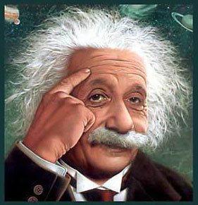
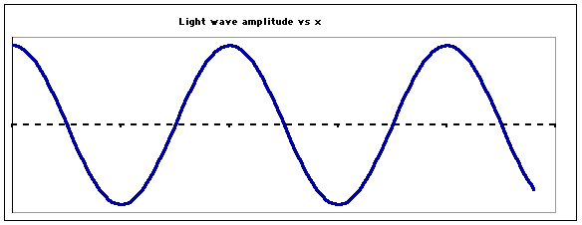
…so what is light if not a wave ??????
“I GOT THIS…”
Einstein’s image….
LIGHT IS A “PHOTON”
=A MASSLESS BULLET OF ENERGY
OLD
wave
NEW
Stream of photons

Slide 13
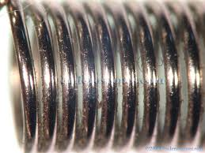
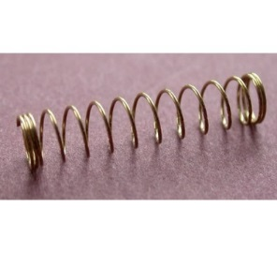
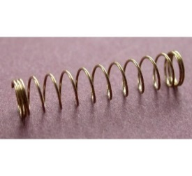
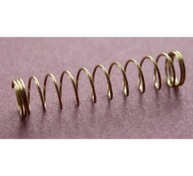
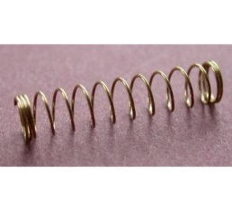
Planck’s equation: hf=E_{photon}
hf
hf
hf
hf
Stream of photons
Doc’s analogy: A Photon is like a unit of coiled spring
High frequency(high f)…high energy
tight
low frequency (low f)…low energy
loose

Slide 14
The assertion from your text, page 31
For light, new school thinking:
As wavelength increases, energy decreases
As frequency increases, energy increases

Slide 15
Text Problems illustrating E vs. f. vs. λ connections (2.1)

