Slide 1

Oooh %^&*!!
Mini-Quiz 3

Slide 2
Homework 1 due Friday 8 September in class
Homework 2 posted.
Due Friday 15 September in class

Slide 3
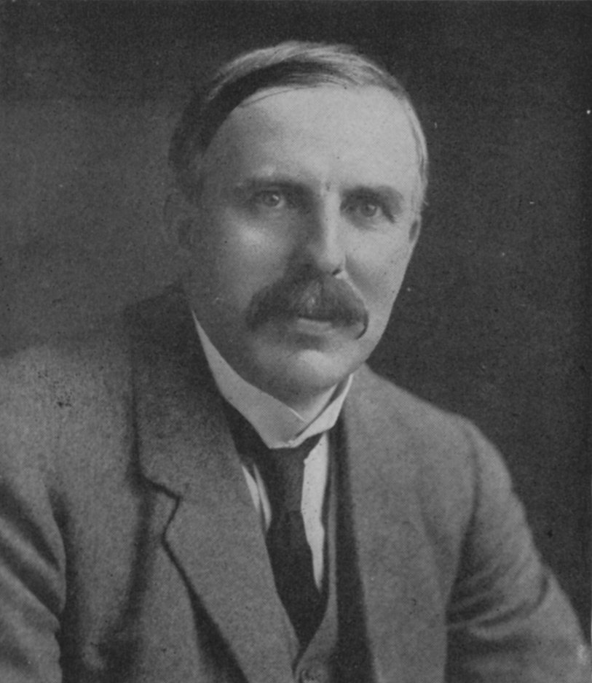
1912 : Ernst Rutherford is the `Man’…and presides over the `Golden Age of Experimental Physics’…THE ATOM APPEARS CONQUERED
vintage Rutherford:
“All science is either Physics or stamp collecting.”

Slide 4
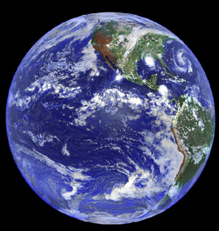


But there are 2 BIG Problems
with Rutherford’s model
1)Why don’t the p⁺ and e⁻ attract and come together ??? (or…why isn’t Earth the size of a golf ball?)
???

Slide 5

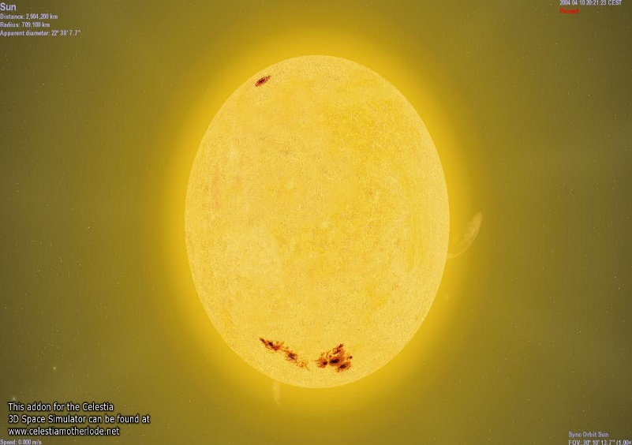
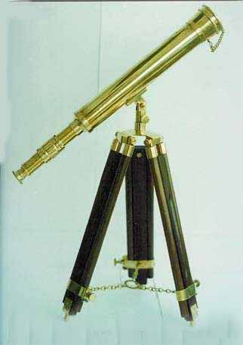
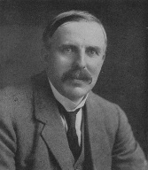
Rutherford atom’s problems (continued)
2)Why doesn’t the sun show all colors (e.g. show white light) when telescopes record spectrum?
Diffraction grating divides up light colors
???
Why only few really strong lines

Slide 6

AN EVEN BIGGER third PROBLEM FOR RUTHERFORD’S LAB
3) The photoelectric effect problem
and the trouble with the theory of light
Help!!!!

Slide 7
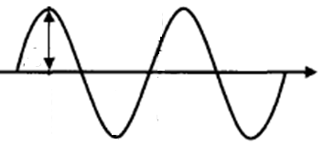
Language of classical light theory (see also: p 31-33)
λ
A
c
A= amplitude
λ= wavelength (meters)
c= speed of light = 3*10⁸ meters/second

Slide 8
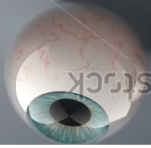
Frequency of light
λ
“nu”
ν=f = frequency = # full waves observed passing a point in 1 (one) second (cycles/second)

Slide 9
Equations of classical light theory (not in text)
Amplitude
λ
A
C
f*λ=c
Classical wave equation
Wave Energy ~ A²
ν=f = frequency
= # full waves passing a point in a second

Slide 10
Units for classical wave equation
frequency * wavelength = speed of light
f * λ =c
1
seconds(s)
*
meters(m)
= 3.0*10⁸ m
s
=Hertz (Hz)
=Cycles/second (cps)

Slide 11
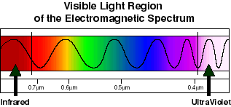
Ways to write the classical wave equation
f * λ =c
or
f=c/ λ
or
λ= c/ f
Frequency (f) is inverse to wavelength (λ)
Text examples exploring this (2.1)

Slide 12


An assertion from your text, page 31
For light:
As wavelength increases, energy decreases
As frequency increases, energy increases
Huh ?????
Wave Energy ~ A²
A

Slide 13
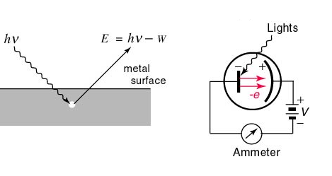
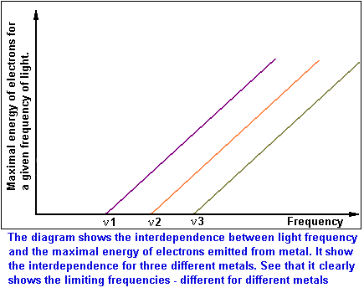
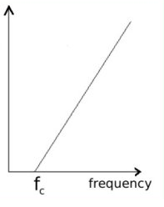
Photoelectric effect: typical textbook version
E=Energy of ejected electron from metal
Threshold frequency for emission varies with metals (f₁=ν₁ for metal 1, f₂=ν₂ for metal 2 etc.)

