Slide 1

I know it’s Monday…but try to act as if its okay….

Slide 2

Oooh %^&*!!
Mini-Quiz 2

Slide 3
Why the chemist’s C lists 12.01 and not 12
Imagine `fishing’ out 100 atoms of Carbon from a sample of graphite (pure carbon). What would you catch ?
# p # n mass # caught out of 100 C atoms
6
6
12
99
Both kinds isotopes of C act exactly the same, chemically so chemists
just average the masses
6
7
13
1
99*12 + 1*13
100
= 12.01
Average mass of each C=

Slide 4
Averages Written As Sums Of Fractional Contributions
Average mass =
of each C
99*12 + 1*13
100
= 12.01
= 99 *12 + 1 * 13
100 100
f_{m} = fraction of C atoms with mass M
=f₁₂*12 + f₁₃*13

Slide 5
Averages written as sums of % contributions
Average mass
of each C
= 99 *12 + 1 * 13
100 100
=(99 % *12 + 1% * 13)
100
P_{m} = % of C atoms with mass M
= (P₁₂ *12 + P₁₃ *13)
100

Slide 6
Take home lesson
: Average mass is computable from fractional abundances f_{k} and m_{k} so:
AV. MASS =f₁*m₁+f₂*m₂ +…..
Or, from % abundances P_{k} and m_{k} so:
AV. MASS =P₁*m₁+P₂*m₂ +…..
100

Slide 7
Board Practice calculating average atomic masses

Slide 8
In- class example with mercury: Compute the average mass of Hg from abundance data
# p | #n | Isotope mass, m_{k} | P_{k} | m_{k} *P_{k}
80 | 118 | 198 | 9.5
80 | 119 | 199 | 15.8
80 | 120 | 200 | 28.6
80 | 121 | 201 | 12.4
80 | 122 | 202 | 27.5
80 | 124 | 204 | 6.2
1881
Sum=
20057
3144
5720
2492
5555
1246

Slide 9
AV. MASS =P₁*m₁+P₂*m₂ +…..
100
Average mass of Hg
=20057 =200.57
100

Slide 10
One more `U-Do-it’ Example: Boron
Isotope P= % abundance
¹¹B 81%
¹⁰B 19%
Average B mass ???
AV. MASS =P₁*m₁+P₂*m₂ +…..
100
=81*11 + 19*10
100
=10.81

Slide 11

Need more, or are you exhausted ???

Slide 12
In Case you aren’t exhausted: estimate average atomic masses for elements below
Isotope ~mass % abundance
~ average mass
¹H 1.008 99.985
²H 2 .014 0.015
1.008
²⁸Si 27.98 92.2
²⁹Si 28.98 4.8
³⁰Si 29.97 3.0
28.081
³⁵Cl 34.97 75.8
³⁷Cl 36.97 24.2
35.454

Slide 13
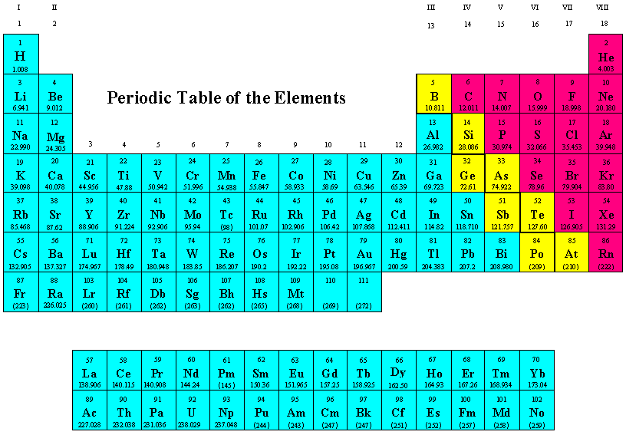
Dividing Up the Periodic Table: The Big Three
Metalloids
Non-Metals
Metals

Slide 14
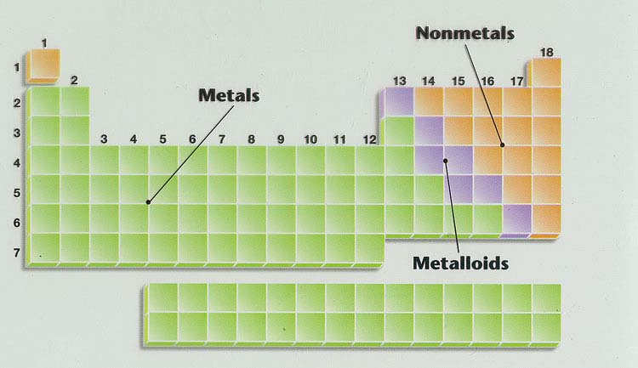
Geography of Periodic Table see also: text pages 14 -16 (use blank tables provides to label these regions)
Main group elements
Noble metals
Ag, Au, Pt (Cu)
Alkaline earth metals
Noble gases
Transition metals
halogens
Alkali metals
lanthanides
actinides
Know names of regions in yellow boxes too
Know where metals, metalloids and non metals are

Slide 15

In-Class Point-to-it Periodic Table Geography Practice

Slide 16
U-PICK : Which categories of element type do each of the elements fall into here ?
Symbol | Main group element | Transition element | Metal | Metalloid | Alkali metal | Alkaline earth metal | Halogen | Noble Gas
Na
Cu
Si
Cl
X
X
X
X
X
X
X
X

Slide 17
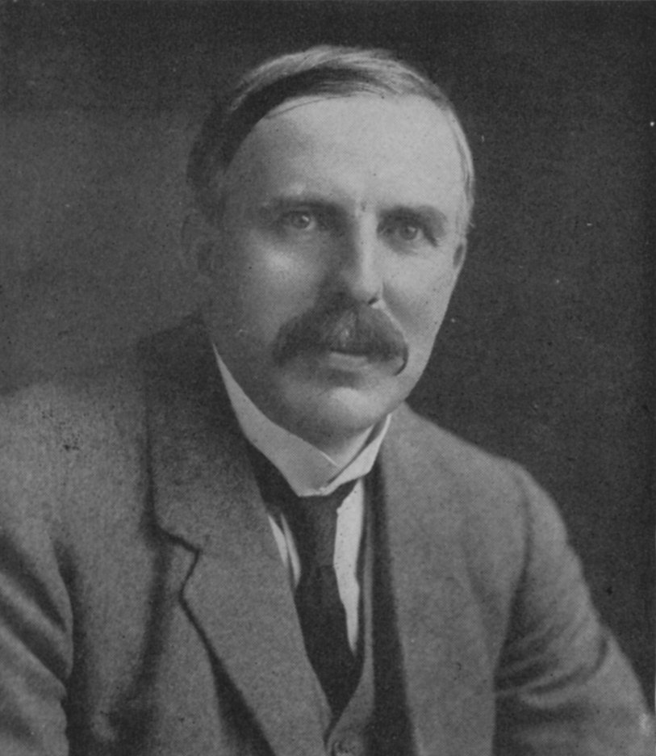
1912 : Ernst Rutherford is the `Man’…and presides over the `Golden Age of Experimental Physics’…THE ATOM APPEARS CONQUERED
vintage Rutherford:
“All science is either Physics or stamp collecting.”

Slide 18
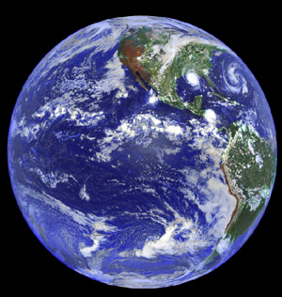
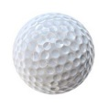

But there are 2 BIG Problems
with Rutherford’s model
1)Why don’t the p⁺ and e⁻ attract and come together ??? (or…why isn’t Earth the size of a golf ball?)
???

Slide 19

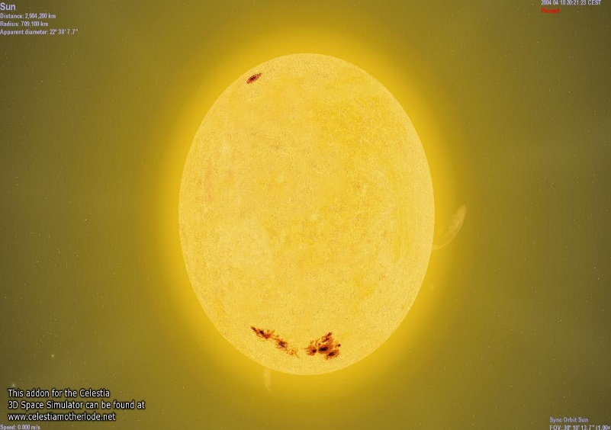
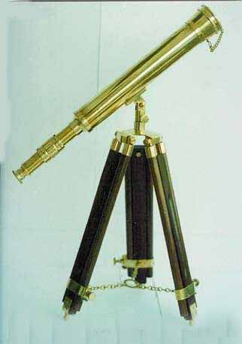
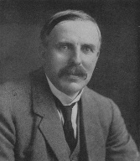
Rutherford atom’s problems (continued)
2)Why doesn’t the sun show all colors (e.g. show white light) when telescopes record spectrum?
Diffraction grating divides up light colors
???
Why only few really strong lines

Slide 20


