Slide 1

Read Chapter 8 (Combined Gas Law and Ideal Gas Law)
Final Exam Tuesday 12 Dec 12:30 (This room)

Slide 2
The `Combined’ Gas Law (page 281, equation 8.2):
when gas moles (n) are constant
P₁V₁ = P₂V₂
T₁ T₂
P in atm
V in liters (L)
T in K

Slide 3
Where the Combined Gas comes from
(see pages 285-290)
1) Boyle’s Law: hold n and T constant and let P and V vary
Boyle’s law in words:
If P increases, V decreases
Boyle’s law in math-speak:
P = a/V
=> P₁V₁=P₂V₂
Boyle’s Law Observed
httsp://www.youtube.com/watch?v=N5xft2fIqQU

Slide 4
Where the Combined Gas comes from (continued)
2) Charle’s Law: hold n and P constant and let T and V vary
Charle’s law in words:
If T increases, V increases
Charle’s law in math-speak:
=> V₁ = V₂
T₁ T₂
V = bT
Charle’s Law Observed: can crush

Slide 5
Where the Combined Gas comes from (continued)
3) Gay-Lussac’s Law: hold n and V constant and let T and P vary
Gay-Lussac’s law in words:
If T increases, P increases
Gay-Lussac’s law in math-speak:
P₁ = P₂
T₁ T₂
P = cT
Gay-Lussac’s Law Observed: egg in a bottle
egg https://www.youtube.com/watch?v=xceBXe5YHj0
P vs T https://www.youtube.com/watch?v=1pVVZGOBIVg

Slide 6
How Boyle, Gay-Lussac and Charles Laws are reflected in the Combined Gas Law (when n is constant)
Conditions
Gas Law Equation
Name of Gas Law
constant
n
P₁V₁ = P₂ V₂
T₁ T₂
Combined Gas Law
constant n,P
P₁V₁ = P₂ V₂
T₁ T₂
Charles’ Law (P₁=P₂)
constant n, T
P₁V₁ = P₂ V₂
T₁ T₂
Boyle’s Law (T₁=T₂)
P₁V₁ = P₂ V₂
T₁ T₂
Gay-Lussac’s Law (V₁=V₂)
constant n, V

Slide 7
In-class practice on board working combined gas law problems

Slide 8
An ideal gas at constant V and P=2 atm is heated from 300 to 600 K. What is the final P ?
1 atm
2 atm
3 atm
4 atm

Slide 9
COMBINED GAS LAW PROBLEMS…BOARD WORK
A sample of oxygen gas is expanded from 20 to 50
liters at constant temperature. The final pressure is 4 atm. What was the initial pressure ?
P₁=10 atm

Slide 10
A sample of ideal gas arrives at 300K when expanded from 3 to 9 L at constant P. What was the original temperature ?
900 K
100 K
600 K
150 K

Slide 11
COMBINED GAS LAW PROBLEMS…BOARD WORK (CONT.)
2. A child’s balloon originally occupies 5 liters at sea level
(P=1 atm) and room temperature (300 K) . It is released
and is allowed to rise to an altitude where the pressure
is 0.25 atm and the temperature is 150 K.
What is the balloon’s new volume ?
10 L

Slide 12
An ideal gas in a fixed volume and an initial pressure of 10 atm and initial T of 177 C has a final pressure of 3.33 atm. What is the final T(K)
(K=C+273)
150 K
59 K
450 K
531 K

Slide 13
COMBINED GAS LAW PROBLEMS…BOARD WORK (CONT.)
The volume of a piston at fixed pressure changes as it is
cooled from 500 ºC to 250ºC. If the final volume is 6.76 L,
what is the initial volume ?
V₁=10 L

Slide 14
COMBINED GAS LAW PROBLEMS…BOARD WORK (CONT.)
4. Autoclaves are essentially pressure cookers. At 1 atm,
steam has a temperature of 100º C. Would you expect the
pressure to double if the autoclave to attains a steam
temperature of 200ºC ?
a) NO…must convert C→ K…ratio is not 200/100
What pressure do you actually expect to reach at 200 ºC?
473.15 =1.73 atm
373.15

Slide 15

Need more practice with Combined Gas Law ????

Slide 16

What happens if we let n vary too ??

Slide 17
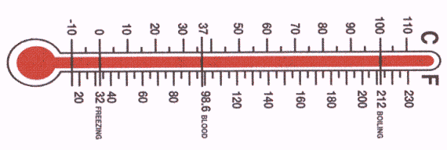
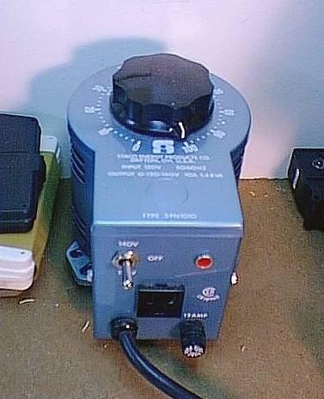
Ideal Gas Law: letting T,P,V, n and gas ID all vary. P 277-8
P (piston head)
Hypothetical Gas Property testing apparatus
piston walls
insulation
T
n
V (varies
GAS
GAS VALVE
Heating/cooling coils

Slide 18
Ideal Gas derived: Why gas identity not important
Vary gas and fix three out of four gas variables…
..see what happens
∴Gas ID (and size) not important
Variables fixed at constant values (`STP’)
Gas varied
T(^{O}C) P(atm) n(moles)
V(obs)
H₂(2)
He(4)
N₂(28)
CO₂(44)
SF₆ (146)
0º 1 1 22.414
0º 1 1 22.414
0º 1 1 22.414
0º 1 1 22.414
0º 1 1 22.414
STP =Standard Temperature & Pressure ( and n=1)

Slide 19
Ideal Gas Law derived (cont.): origin of R
What happens if we hold different sets of three variables constant and watch the fourth for a given gas ?
Anything constant ??
P(atm) V(L) T(K) n(moles)
PV/nT
16.43
2 400 1
0.08206
1
24.65
300 1
0.08206
5 2 300
0.406
0.08206
101
3
0.08206
5 5

Slide 20
PV = 0.08205746
nT
=R (atm L)
(mol K )
Or…
PV =nRT

Slide 21
The ideal gas law leads to :
molecular masses
verification of stoichiometries

Slide 22
1. An 11 gram sample of a gas occupies 2.0 liters at 2.0538 atm and 200 K. What is the molecular mass of the gas ? (R=0.08206)
44 g/mol
2. What volume is occupied by 0.09 g of gas phase H₂O (MW=18 g/mol) at 300 K and 0.123 atm ?
1.00 L

Slide 23
3. A 1.5 liter can of gas reaches a pressure of 45.45 atm at 500 K. How many molecules of gas are in the can ? (R=0.08206 atm L/K mol)
1 mol count =6.02*10²³
1.0*10²⁴

