Slide 1

Welcome Back ! Hooray !!
You’ve survived your first week in Intro to Chem !!

Slide 2

What do you remember so far ???

Slide 3
Representing Elements with Atomic symbols
p = atomic number (Z) defines element
p + n = mass number=M (several choices for an element)
p = e in neutral atom
Isotope = element with specific count of n
M
How to represent an isotope
Z
^{p}

Slide 4
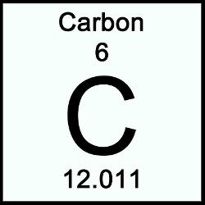
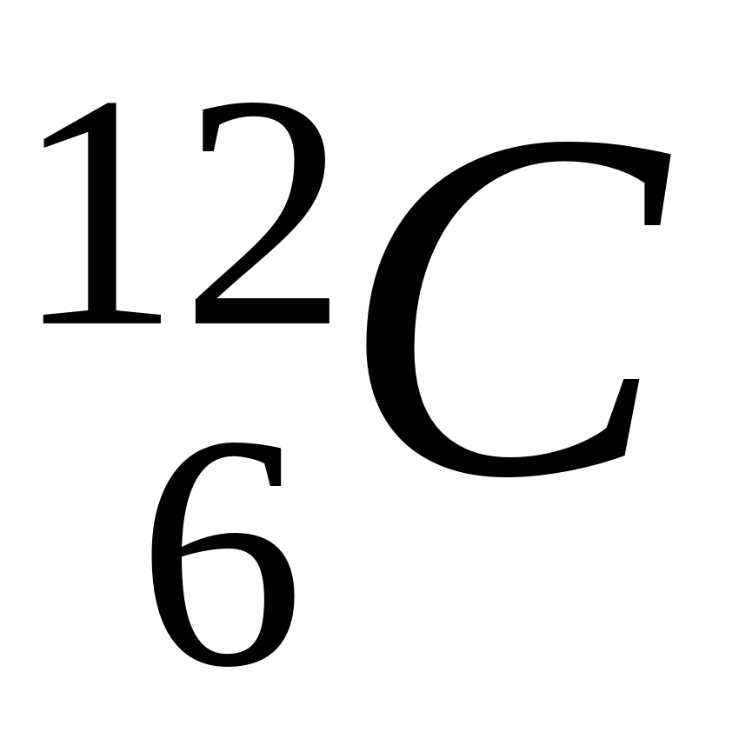
Isotopic C (¹²C)
Chemist’s C
≠

Slide 5
U-Do-IT for Neon Isotopes
Isotope symbol ?
Proton count (p⁺) neutron count (nº) p⁺ + nº
10 10 20
²⁰Ne
¹⁰
10 11 21
²¹Ne
¹⁰
10 12 22
²²Ne
¹⁰
Alternative symbol
(drop p…)
₂₁
Ne

Slide 6
More Examples with alternate symbol
You tell me the p and n count: (use Periodic Tables provided)
Boron 10 (¹⁰B) =
Boron 11 (¹¹B) =
Hydrogen 1 (¹H) =
Hydrogen 3 (³H) =
Copper 63 (⁶³Cu) =
Copper 65 (⁶⁵Cu) =
5 p + 5 n
5 p + 6 n
1 p + 0 n
1 p + 3 n
29 p + 34 n
29 p + 36 n

Slide 7
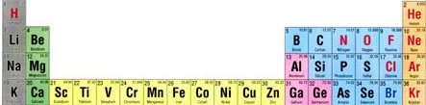
ATOMIC BOOKKEEPING
Atomic # mass# symbol #p⁺ #nº #e⁻ atom charge
. |  |  | 12 | 12 |  | 0
 | 31 |  | 15 |  |  | 0
 | 17 | O |  | 9 | 10
12
24
Mg
12
15
P
16
15
8
8
-2
Pertinent section of Periodic table

Slide 8
ATOMIC BOOKKEEPING (cont.)
Brain toss variant….
Atomic # mass# symbol #p⁺ #nº #e⁻ atom charge
 | 20 |  |  |  | 10 | 0
7 | 14 |  |  |  |  | -1
 |  | Fe |  | 30 |  | 0
17 |  |  |  | 18 | 19
10
Ne
10
10
N
7
7
8
26
56
26
26
35
Cl
17
-2
Let’s go down a column left to right….
1 mole buck/right answer with explanation

Slide 9
Why the chemist’s C lists 12.01 and not 12
Imagine `fishing’ out 100 atoms of Carbon from a sample of graphite (pure carbon). What would you catch ?
# p # n mass # caught out of 100 C atoms
6
6
12
99
Both kinds isotopes of C act exactly the same, chemically so chemists
just average the masses
6
7
13
1
99*12 + 1*13
100
= 12.01
Average mass of each C=

Slide 10
Averages Written As Sums Of Fractional Contributions
Average mass =
of each C
99*12 + 1*13
100
= 12.01
= 99 *12 + 1 * 13
100 100
f_{m} = fraction of C atoms with mass M
=f₁₂*12 + f₁₃*13

Slide 11
Averages written as sums of % contributions
Average mass
of each C
= 99 *12 + 1 * 13
100 100
=(99 % *12 + 1% * 13)
100
P_{m} = % of C atoms with mass M
= (P₁₂ *12 + P₁₃ *13)
100

Slide 12
Take home lesson
: Average mass is computable from fractional abundances f_{k} and m_{k} so:
AV. MASS =f₁*m₁+f₂*m₂ +…..
Or, from % abundances P_{k} and m_{k} so:
AV. MASS =P₁*m₁+P₂*m₂ +…..
100

Slide 13
In- class example with mercury: Compute the average mass of Hg from abundance data
# p | #n | Isotope mass, m_{k} | P_{k} | m_{k} *P_{k}
80 | 118 | 198 | 9.5
80 | 119 | 199 | 15.8
80 | 120 | 200 | 28.6
80 | 121 | 201 | 12.4
80 | 122 | 202 | 27.5
80 | 124 | 204 | 6.2
1881
Sum=
20057
3144
5720
2492
5555
1246

Slide 14
AV. MASS =P₁*m₁+P₂*m₂ +…..
100
Average mass of Hg
=20057 =200.57
100

Slide 15
One more `U-Do-it’ Example: Boron
Isotope P= % abundance
¹¹B 81%
¹⁰B 19%
Average B mass ???
AV. MASS =P₁*m₁+P₂*m₂ +…..
100
=81*11 + 19*10
100
=10.81

Slide 16

Need more, or are you exhausted ???

Slide 17
In Case you aren’t exhausted: estimate average atomic masses for elements below
Isotope ~mass % abundance
~ average mass
¹H 1.008 99.985
²H 2 .014 0.015
1.008
²⁸Si 27.98 92.2
²⁹Si 28.98 4.8
³⁰Si 29.97 3.0
28.081
³⁵Cl 34.97 75.8
³⁷Cl 36.97 24.2
35.454

Slide 18
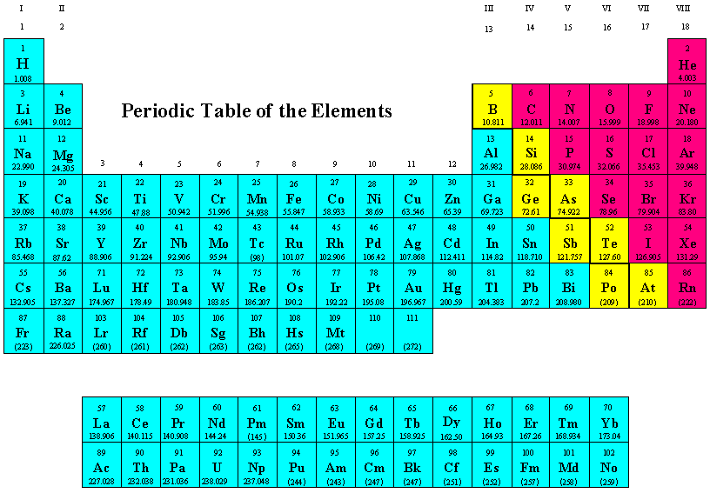
Dividing Up the Periodic Table: The Big Three
Metalloids
Non-Metals
Metals

Slide 19
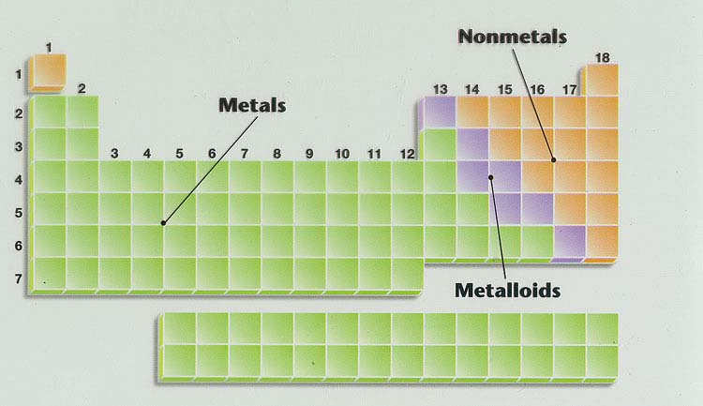
Geography of Periodic Table see also: text pages 14 -16
Main group elements
Noble metals
Ag, Au, Pt (Cu)
Alkaline earth metals
Noble gases
Transition metals
halogens
Alkali metals
lanthanides
actinides
Know names of regions in yellow boxes too
Know where metals, metalloids and non metals are

Slide 20

In-Class Point-to-it Periodic Table Geography Practice

Slide 21
U-PICK : Which categories of element type do each of the elements fall into here ?
Symbol | Main group element | Transition element | Metal | Metalloid | Alkali metal | Alkaline earth metal | Halogen | Noble Gas
Na
Cu
Si
Cl
X
X
X
X
X
X
X
X

