Slide 1

Please hand in your letter !!!

Slide 2
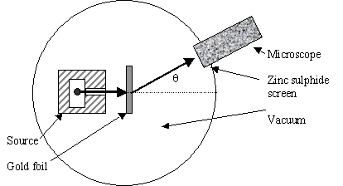
Schematic of Rutherford’s `gold foil’ apparatus
Microscope
Rotated to detect scintillations
Alpha (α) particles=He⁺
ZnS screen is a scintillating surface

Slide 3
The Gold Leaf Experiment led to Rutherford’s Atom
Nucleus is + charged
Electrons (e⁻) are - charged
Diffuse electron
Cloud out here
~ 10⁻¹⁰ m
~10⁻¹⁵ m
Nucleus contains protons (p⁺) and neutrons
Nucleus at center (magnified here ~10,000X)

Slide 4
Chemical metaphor 1
Atom as …..
String and pencil dot√

Slide 5
Rutherford’s Atom by the numbers
Diameter of electron cloud = 10⁻¹⁰ m
Diameter of nucleus 10⁻¹⁵ m
Do the math…
Diameter of electron cloud = 100000
Diameter of nucleus 1

Slide 6
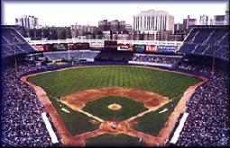
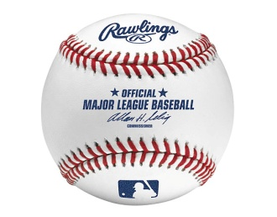

Atom dimensions in familiar terms: Metaphor 2
where is the edge of the electron cloud ?
3”
Baseball as nucleus
Old Yankee Stadium, the Bronx

Slide 7
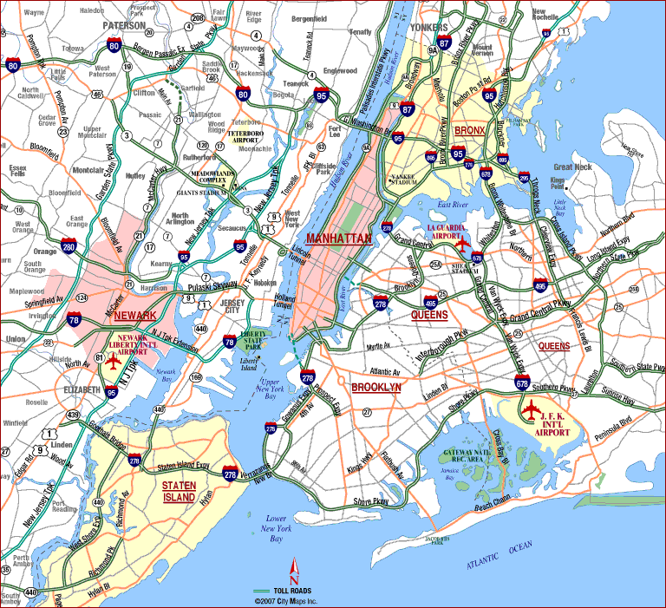
Nucleus(+)
~ dimension of electronic cloud (-) (2.4 mile radius from baseball nucleus)
Notes:
Stadium at 1. E. 161st st., Bronx NY 14051

Slide 8
details of Rutherford atom’s subatomic pieces
Subatomic piece | Mass (g) | Charge
proton
1.67*10⁻³⁰
+
neutron
1.67*10⁻³⁰
0
electron
9.11*10⁻³⁴
-
In neutral atoms # protons = # electrons
Relative mass ratio ?
Proton mass
Electron mass
=
1.67*10⁻³⁰
=1836 ~ 2000
9.11*10⁻³⁴
Do the math….

Slide 9
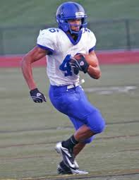
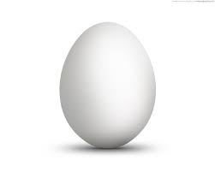
Chemical metaphor 3:
nuclear vs. electron mass
Proton mass
Electron mass
1 running back ~ 2000 large eggs

Slide 10
Rutherford’s Atom by the numbers (continued)
Atomic part Relative volume
Nucleus 0.00000000000001
Electrons 1
electron cloud is 99.99999999% of atomic volume but only 0.5% of the mass

Slide 11
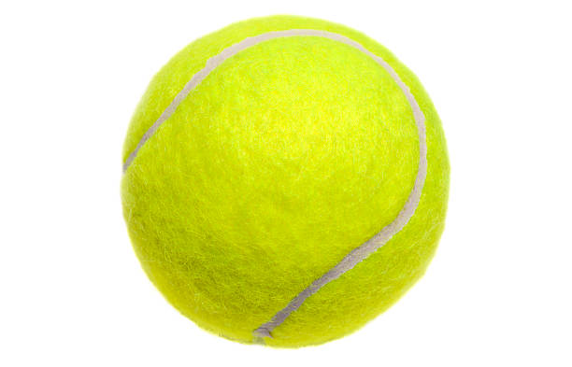
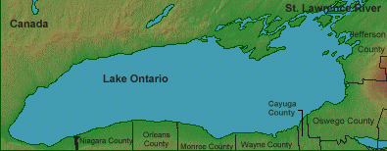
Chemical metaphor 4:
volume comparison-nucleus vs. electron cloud
Volume occupied by nucleus
Volume occupied by electrons

Slide 12
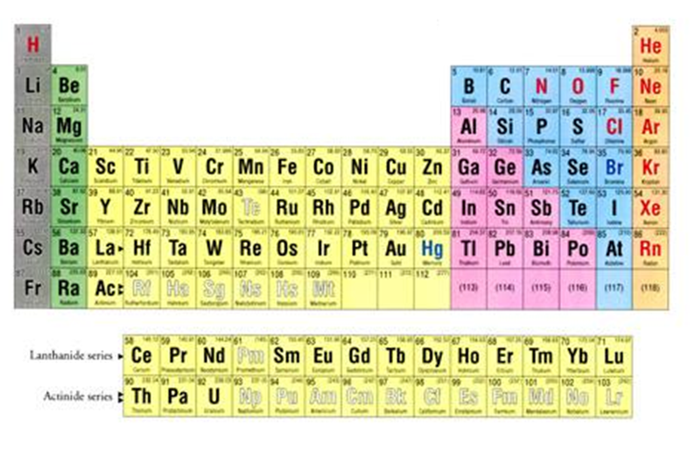
Describing elements using the atomic bits and pieces
(see p. 10-13)
Modern Periodic Table of the Elements:
How Chemists List the Elements

Slide 13
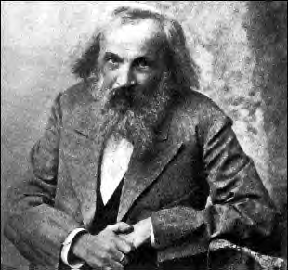
Father of Modern Periodic Table: Dimitri Mendeleev ~1865
Chemistry Professor, St. Petersburg University, Russia
Dedicated Teacher
Known Vodka enthusiast
Political troublemaker
Card Shark

Slide 14
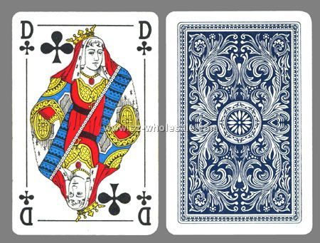

2) Card player insights
Analogies (continued)
⁶C
12.01
GRAPHITE
MP 1710 ^{O}C
d=2.11 g/cm³
BLACK
CO, CO₂
2 other crystal forms
Playing card
Element card

Slide 15
A brief aside on element names and symbols…

Slide 16
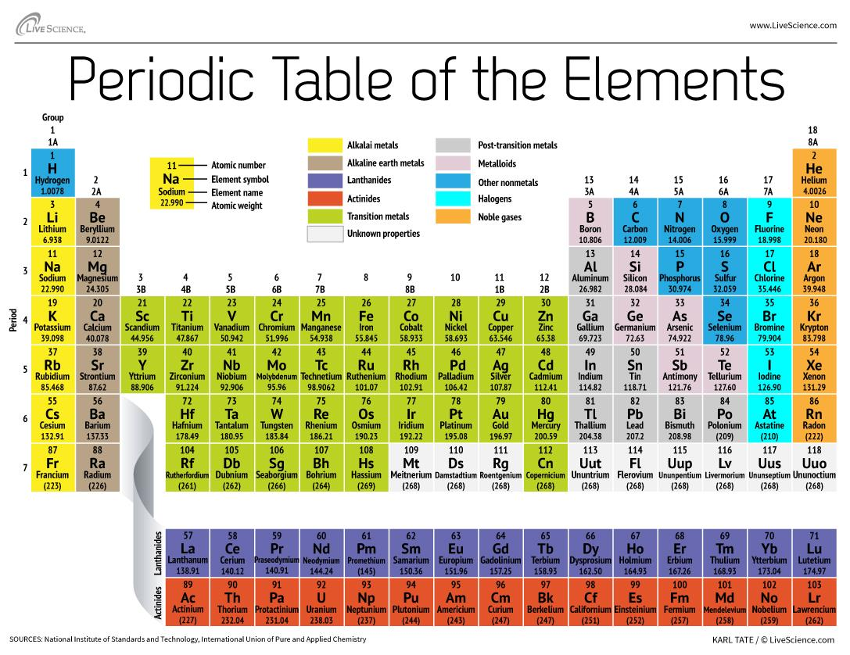

1) The proton count is the same as the Periodic Table’s Atomic # . Proton count defines the element
Atomic # =#p⁺

Slide 17
2) In a neutral element:
positive charge sum = proton count=#p⁺
= negative charge sum =electron count=#e⁻
#p⁺ = #e⁻

Slide 18

How many protons in an Aluminum atom ?
26
26.982
13
varies

Slide 19
How many electrons does neutral Carbon C have ?
12.01
6
12.01-6
12.01 + 6

Slide 20
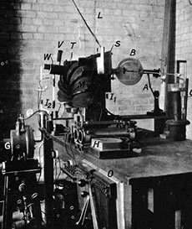
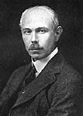
3) Elements come in several `flavors’= isotopes
=# p⁺
Aston’s
Mass Spectrometer
??????
Francis William Aston
Cambridge University UK
Nobel Prize in Chemistry 1922
What Aston sees in his mass spectrometer when he puts in pure Ne
Mass/p
20.0
22.0

Slide 21
Mass/p
20.0
22.0
Something else besides protons is in nucleus, but it has no charge. Dubbed a neutron =nº .
The neutron weighs the same as a proton (Mass/p=whole #)
You can have different numbers of nº in a given element.
(A specific # of nº = a specific isotope)
=# p⁺
What Aston ‘s result teach….

Slide 22
How many electrons (e), protons (p) and neutrons (n) in the Ne isotope circled below?
10 e 20 p 20 n
10 e 12 p 10 n
10 e 10 p 22 n
10 e 10 p 12 n
Mass/p
20.0
22.0
22.0

Slide 23
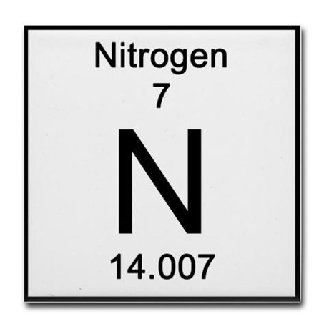
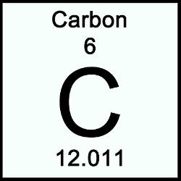
How the entries on the Modern Periodic Table reflect the `Modern’ definition of an element
proton count
Average mass of protons and
neutrons

Slide 24
Representing Elements with Atomic symbols
p = atomic number (Z) defines element
p + n = mass number=M (several choices for an element)
p = e in neutral atom
Isotope = element with specific count of n
M
How to represent an isotope
Z
^{p}

