Slide 1
WHY TAKE CHEMISTRY ?
Your thoughts ?

Slide 2
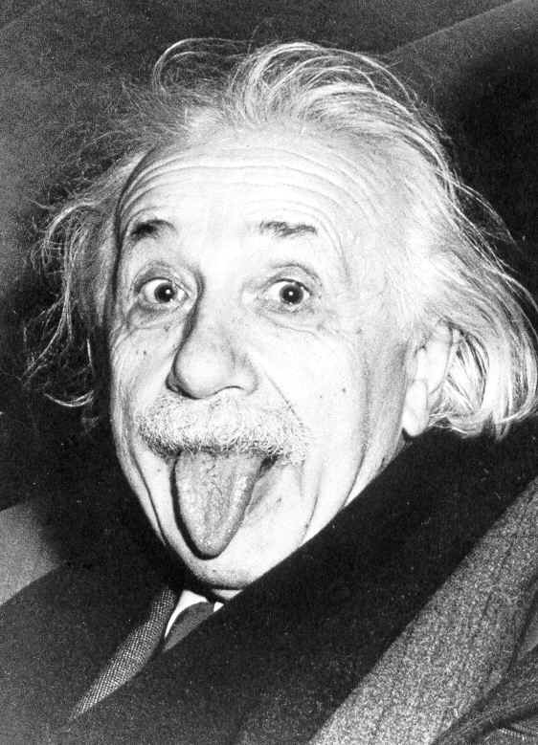
The Physicist….
Albert Einstein
“Imagination is
more important
than knowledge.”

Slide 3
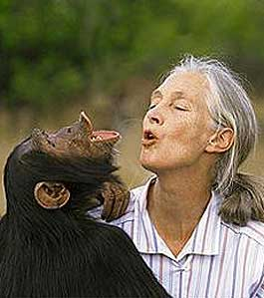
The Biologist….
Jane Goodall
“Once we have labeled the things around us we do not bother to look at them so carefully. Words are part of our rational selves, and to abandon them for a while is to give freer reign to our intuitive selves.“

Slide 4
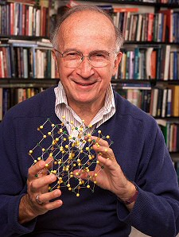
The Chemist….
Roald Hoffman
1981 Nobel Laureate in Chemistry, Cornell University
“We can seem a bit dull and tedious…”

Slide 5
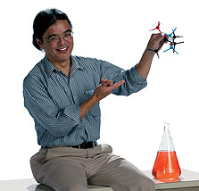
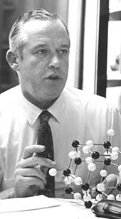
Can you locate the chemist’s universal obsession…..?
Structure Chemist
Nut case Chemist
Organic Chemist

Slide 6
Molecules
You can’t see molecules directly.
You can’t measure molecules directly.
You can’t watch how molecules react.
They’re just too damned small.

Slide 7
Chemistry involves imaginative, BUT deeply abstract metaphors for molecules, things we can’t experience directly through our senses.

Slide 8
WHY CHEMISTRY ? My Take…
CHEMISTRY…is a 250 year old discipline that can take apart, put back together, manipulate and transform objects (molecules) which are objects we have no chance to directly see nor directly measure.
Thinking Like a Chemist (TLC)
is powerful (but hard to acquire)

Slide 9
THE “PROBLEM” WITH CHEMISTS …..
Chemists are obsessed with molecules- which is like being infatuated with car parts- but not in driving the car….
You can name famous race car drivers…but what are their chief mechanics named ?

Slide 10
The strength and weakness of chemists is that we sweat the details and revel in them.
EXAMPLE #1
Hoffmann’s 1981 Nobel Prize in Chemistry awarded for explaining ……..
+
Concerted 1,3 cycloaddition
(Diels-Alder Reaction)

Slide 11
Enol→keto tautomeric shift
EXAMPLE #2
keto
enol
Resonance shift
The `real’ shape
of Thymine (T)
Perfect fit for
`H’ bonding A→T
Jerry Donahue
structure chemist
Adenosine (A)

Slide 12
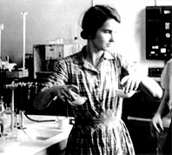
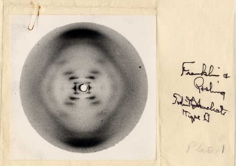
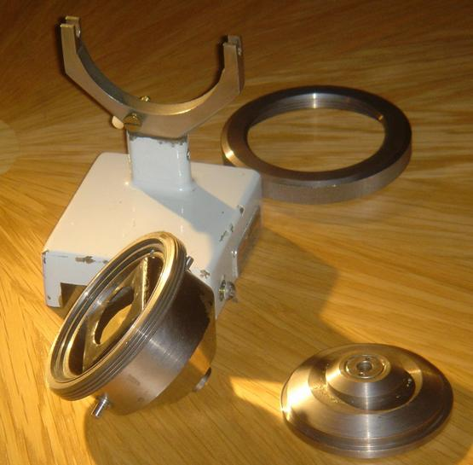
First recorded diffraction
picture of A form DNA
EXAMPLE #3
Rosalind Franklin, physical chemist
Phillips micro x-ray camera mount modified by Franklin for mounting DNA in controlled humidity at King’s College, UK.

Slide 13
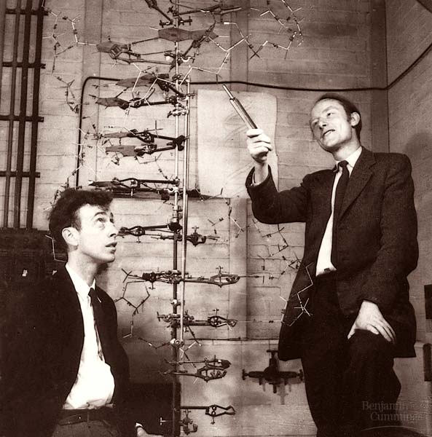
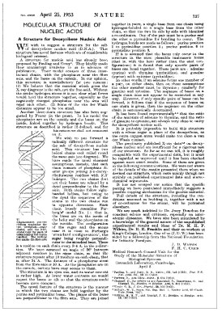
Biologist
CHEMIST
Physicist
Nature 171, 737-738 (1953)
The paper that changed everything.
WATSON
CRICK

Slide 14
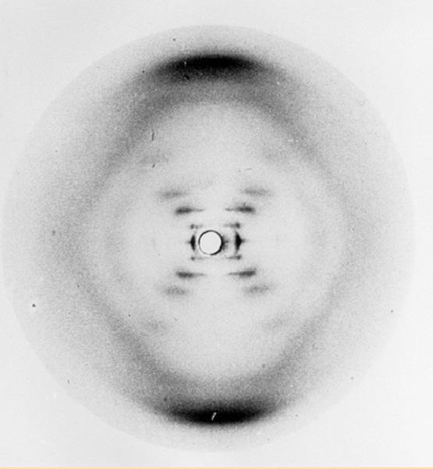
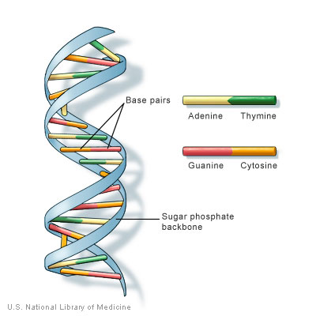
CHEMISTS:
EVERYWHERE IN THE DETAILS

Slide 15
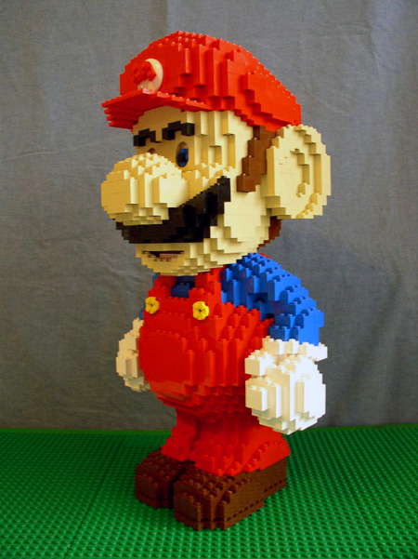
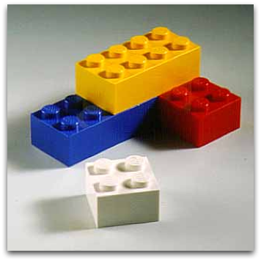
The start of everything….
Chemical Elements: basic building blocks of everything
Elements
Molecules

Slide 16
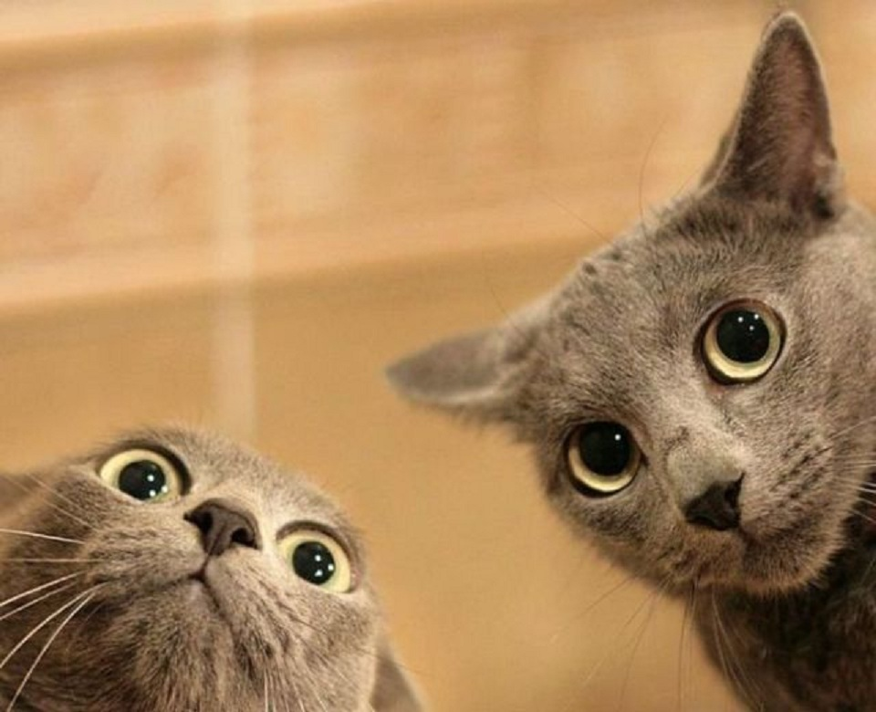
GREAT… SO WHAT THE FU%K IS AN ELEMENT ?

Slide 17
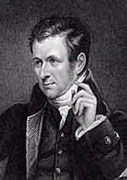
Matter is composed of tiny, indivisible particles called atoms
all atoms of a given element are identical.
Atoms of one element are different from atoms of all other elements
Dalton’s Model
(1766-1844) (p. 5)
Dalton’s implied `picture’ of atoms:
indivisible, unchangeable balls

Slide 18
Dalton’s Model (1766-1844) (p. 5)
Not said, but critical…
Dalton’s Theory based on careful measurements of weight change during chemical reaction. See chapter 5

Slide 19

What’s inside the marble ?

Slide 20
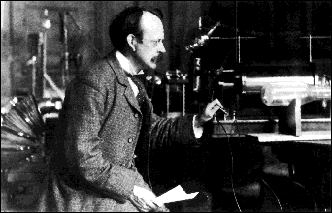
The first real try at probing the atom’s insides:
J. J. Thomson’s `CRT’: 1897
J.J. Thomson Cavendish Labs, Cambridge UK
J.J’s `Cathode Ray Tube’ (CRT)*
Proves that atoms are composed equal amounts of + and – (=electrons)

Slide 21
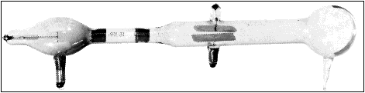
Thompson’s¹ `CRT’ …opposites attract, likes repel
(+)
(-)
What must be charge of outgoing beam ?
(-)
(+)
Negative (-)
Only sees (-) beam,
never a (+) beam

Slide 22
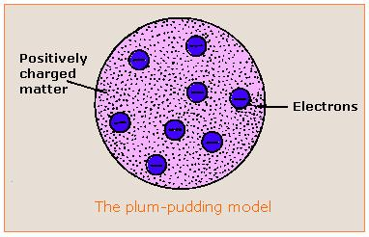
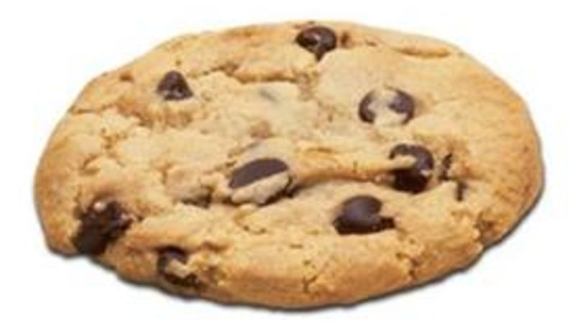
Thomson `Plum Pudding’ Model of atom¹
1897
¹Alternative analogy for us Americans
Electrons=chocolate chips
Philosophical Magazine 44, 295 (1897)
Dough=`positively charged matter’

Slide 23
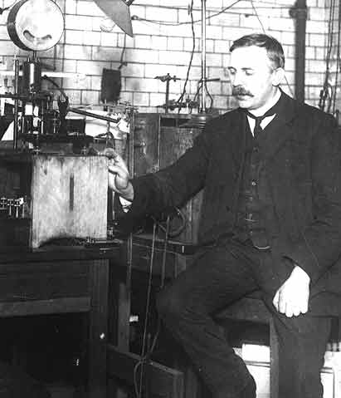
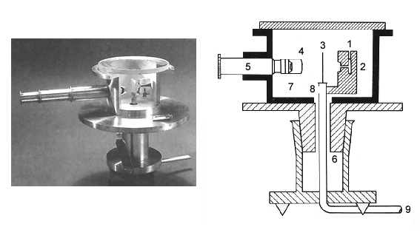
A better look inside an atom: Rutherford’s gold foil experiment (1910) see also: figure 1.5, p. 7
Ernst Rutherford
Physical Laboratory
Manchester University, UK
Rutherford’s Gold foil apparatus*

Slide 24
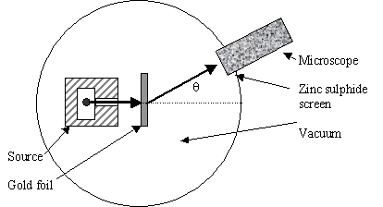
Atomic structure testing (continued)
Schematic of Rutherford’s `gold foil’ apparatus
Microscope
Rotated to detect scintillations
Alpha (α) particles=He⁺
ZnS screen is a scintillating surface
Gold Foil Experiment lore
Marie Curie supplied the radon =α source.
It required ~ 1 hour sitting in absolute dark to condition eyes.
You could only observe scintillations for 1-2 minutes before
desensitizing.

Slide 25
The Gold Leaf Experiment led to Rutherford’s Atom
Diffuse electron
Cloud out here
~ 10⁻¹⁰ m
~10⁻¹⁵ m
Nucleus is + charged
Electrons are - charged
Nucleus at center (magnified here ~10,000X)

