Slide 1
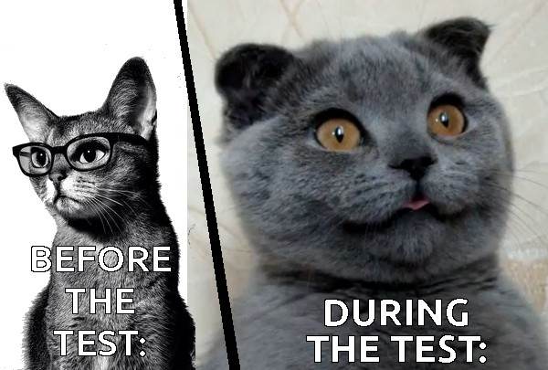
Homework 9 (last one) assigned: due Monday 4 December
Reading Chapter 7: Liquids and Solids- pp 235-260
Exam 3 Friday 1 December (Review Wednesday 29 November)

Slide 2
More Video of super critical phenomena

Slide 3
ice melting- the Movie-frame by frame : heating/cooling curves (on board too, with numbers)
Heating up a block of ice at P=1 atm
Water boils
Steam heats
T ( ºC)
Water heats
Ice
Heats
Ice melts
STARTHERE
S
S + L
L
L + G
G
0
-10
Heat Energy in

Slide 4
how phase diagrams are built from ZILLIONS of heating curves
Heating curve
Phase diagram
P
Put a big dot here to indicated L-G phase change
T
P=1 atm
Heat gas until anything else happens
After melting…watch liquid warm until L-G transition (30 ºC)
S all along the line
Put a big dot here to indicate S-L phase change
+30
Heat up and wait for S-L transition (at 10 ºC)
start
S
L
G
+10
P=1
start
Keep heating and melt…
S
-20
Heat in (J)
-20
+10
+30
T
Liquid all along line after dot
Gas all along line after dot
Keep heating and vaporize

Slide 5
Adding more data at different Pressures, P
P
T
G
L
L/ G
solid
liquid
S
P₁
S/L
P₂
P₁
S/G*
P₃
gas
P₂
Heat in
P₃
* =sublimation
T
Heating Curve
Phase Diagram

Slide 6
In-Class Practice reading a heating curve

Slide 7
Exam 3 Review
3.0 Your name: ( 1 pt)
3.1. % Composition Problems (23 pts)
3.2. Lewis Octet and Formal Charge (24 pts)
3.3. Resonance: part 1 (4 pts)
3.4. Beyond the Octet Rule (12 pts)
3.5. Bond Order and Resonance: part 2 (8 pts)
3.6. Molecular Structure Using VSEPR (10 pts)
3.7. Liquids and Solids (18 pts)

