Slide 1

Homework 8 due today
Homework 9 (last one) assigned: due Monday 4 December
Start reading Chapter 7: Liquids and Solids- pp 235-260

Slide 2
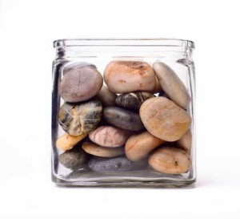
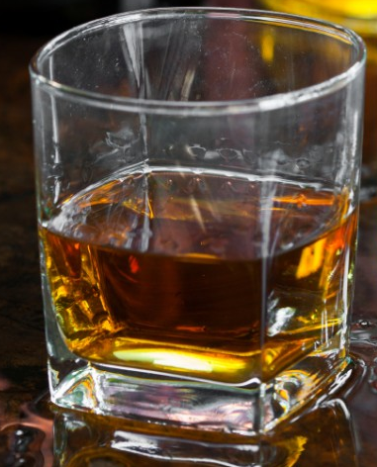
Solids are rigid and don’t fill up space they’re put in
Solids are ~incompressible
Liquids are fluid and fill up any space they’re put in
Liquids are ~ incompressible

Slide 3
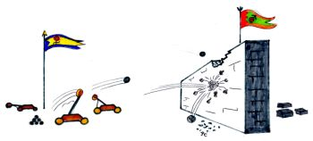
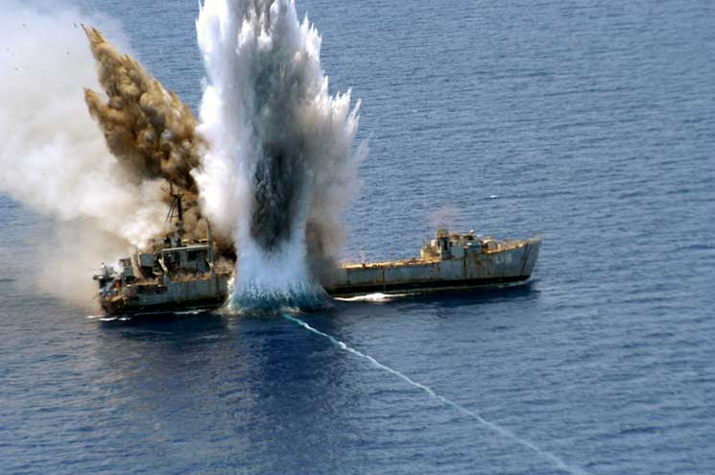
Evidence of the incompressibility
of solids
Evidence of the incompressibility of liquids

Slide 4
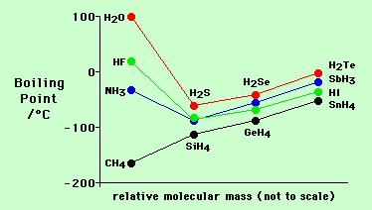
Evidence of the unusual strength of `H-O, H-F and H-N intermolecular `H-bonding’ force
(see also Figure 7.9, p. 245 of your text)

Slide 5

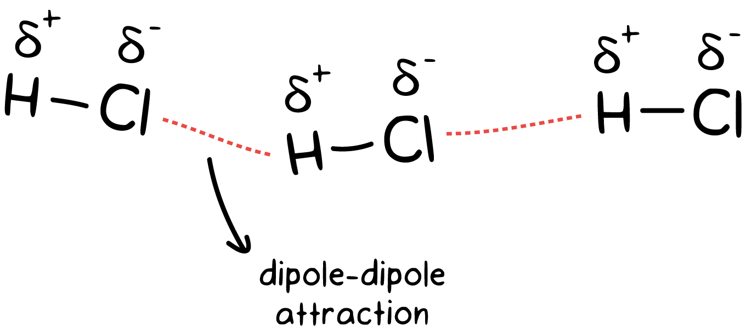
Dipole-Dipole forces
Melting point of HCl = -114 ºC=-174 ºF
Boiling point of HCl = -85 ºC =-122 ºF

Slide 6
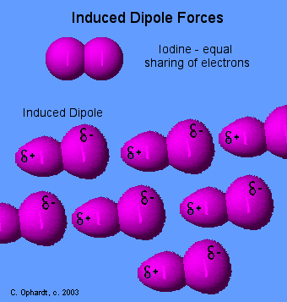
Induced dipole = Dispersion forces= `London’ forces
N₂-initially equal sharing of electrons

Slide 7
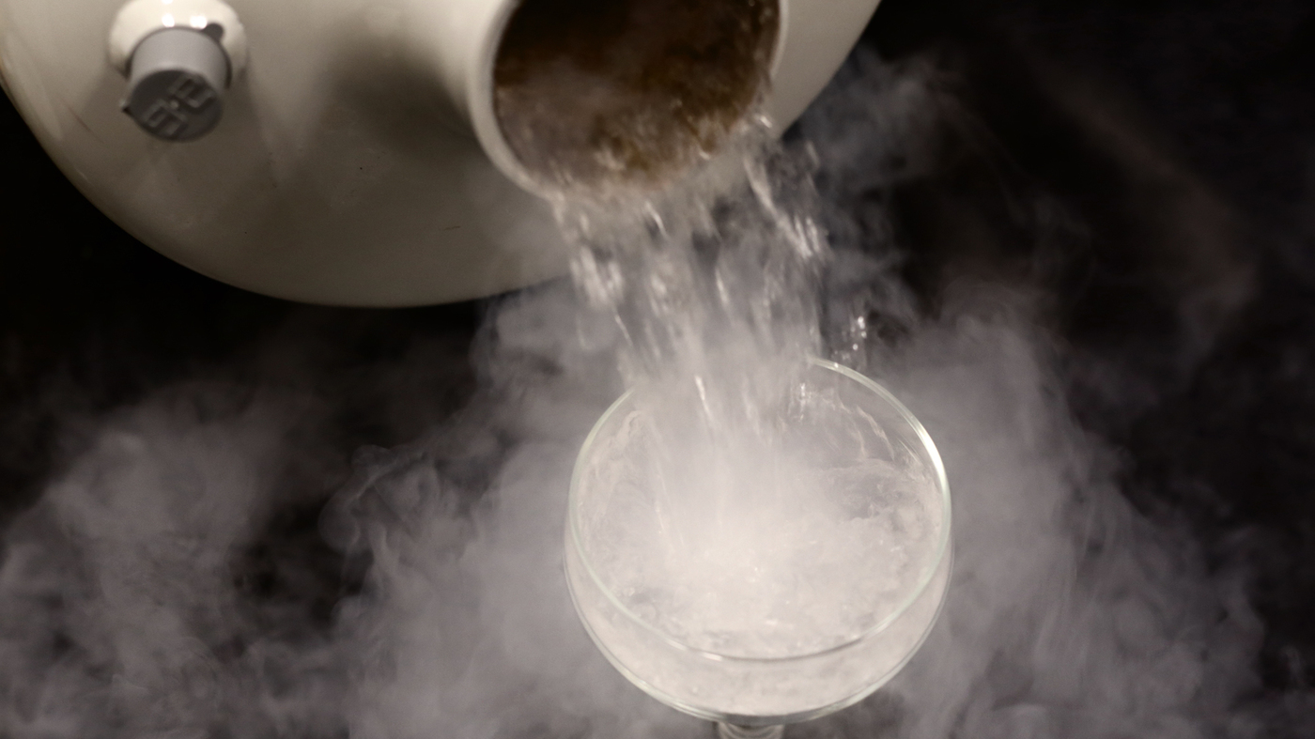
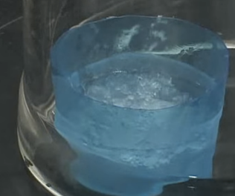
N₂ melts at -231ºC=-346 ºF
boils at -196 ºC=-321 ºF
example of London-only dispersion bonds

Slide 8
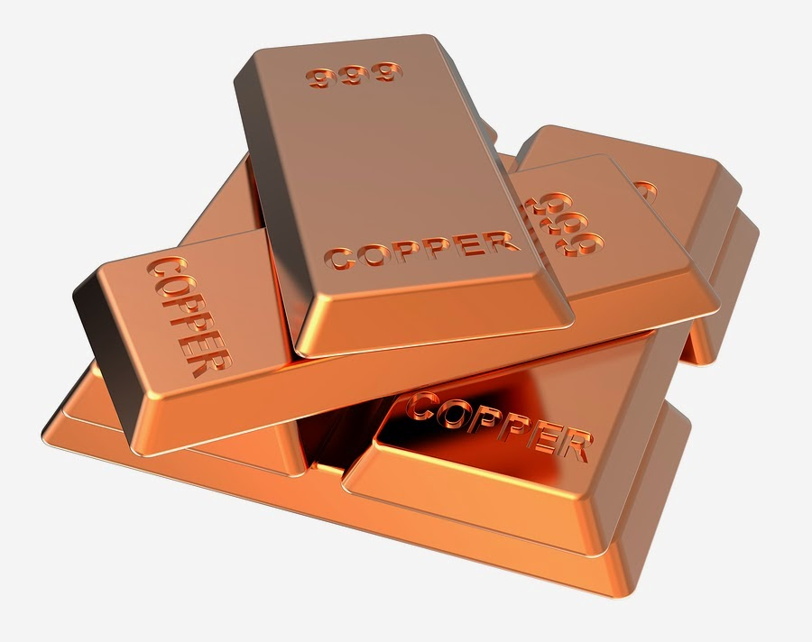
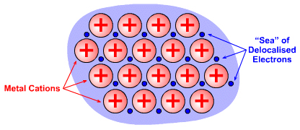
Model for atomic metal bonding:
`Sea of electrons’
Electrons move and `flow’ about freely in around cations
These don’t move

Slide 9
Atomic solid

Slide 10
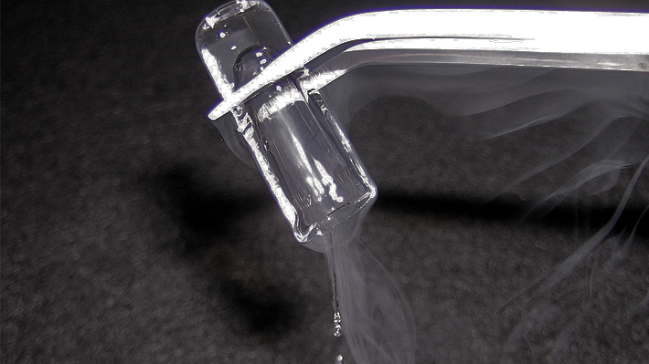
Solid Argon (mp= -189 C= -309 F):
atomic bonding- example of London dispersion in atoms

Slide 11
Trends in intermolecular forces
Ionic and network covalent interactions are the strongest examples: NaCl (ionic) melts at 820 ºC, SiO₂ (network covalent) melts at 1800ºC
H-bonding is the the next most powerful interaction (see Figure 7.9-despite being smallest water melts the highest)
Dipole-dipole interactions are less potent than H-bonding (see Figure 7.9 again…)
Dispersion is the weakest and is present in every molecule or atom.

Slide 12
More trends in intermolecular forces
Bigger molecules always have more intermolecular interaction than smaller ones, if the same collection of intermolecular interactions exist for them.
Example: compound F₂ Cl₂ Br₂ MW 38 86 160 g/mol
Order boiling points ?
-188 -34 +59 ºC

Slide 13
In-class practice ordering melting and boiling points (text book problems)

Slide 14
Describing phase changes
P vs. T diagrams (liquid-vapor)
Phase diagrams (solid-liquid-gas (not in text)

Slide 15
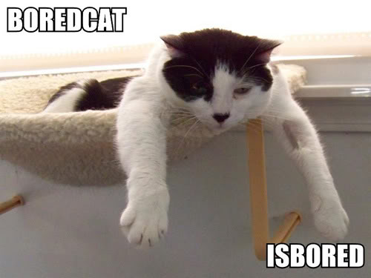
Pressure (P) concepts & measures in “Physics-speak “
∴
1 kg = 1 Pascal (Pa)= force
m s^{2 area}

Slide 16

Some lowbrow chem insights
into Pressure
Getting hammered
Bed of nails

Slide 17

What the bed of nails demonstration illustrates….
Pressure expresses how much a (constant) impressed force is spread out…
MORE AREA, LOWER PRESSURE
LESS AREA, HIGHER PRESSURE

Slide 18
Atmospheric Pressure in `lowbrow’ Chem speak:
barometers
outer space
Pressure =1 atm at sea level
~20 mile tall
column of air in Earth’s atmosphere creates pressure we all feel
Earth
Edge of Earth’s atmosphere

Slide 19
Measuring Pressure in `lowbrow’ Chem speak (continued): barometers
Evacuated space
External atmospheric pressure, P
P in mm Hg=760
A Torricelli barometer
Hg

Slide 20
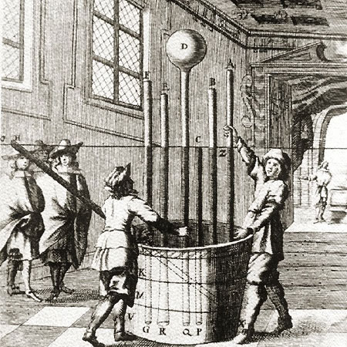
Atmosphere demonstrated the Italian Way (BIG time Torricelli Barometers)
Lesson from 17th century picture
Height of Hg columns is independent of cross-sectional areas of tubes
Vat of mercury (Hg)

Slide 21
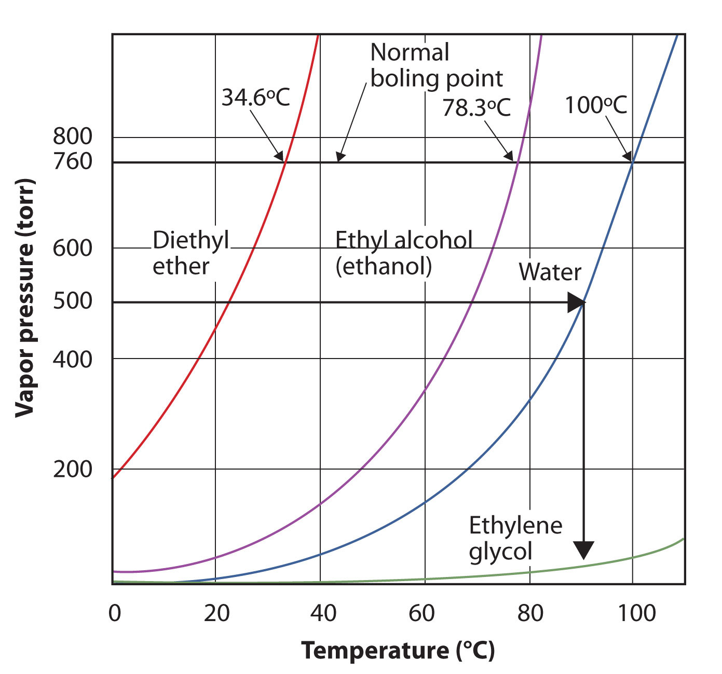
Variation of Various Liquid Vapor Pressures with Temperature (see also Fig. 7.16 p. 251)
Normal boiling point is the temperature where the liquid vapor pressure = 1 atm

Slide 22
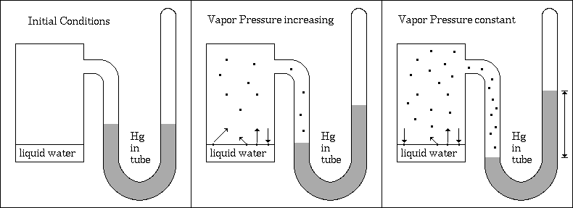
How vapor pressure (P) vs. T curves are generated
Vacuum state to start:
T constant
Rate of H₂O escape from liquid higher than return to liquid
Rate of H₂O leaving liquid and returning to liquid becomes equal

Slide 23
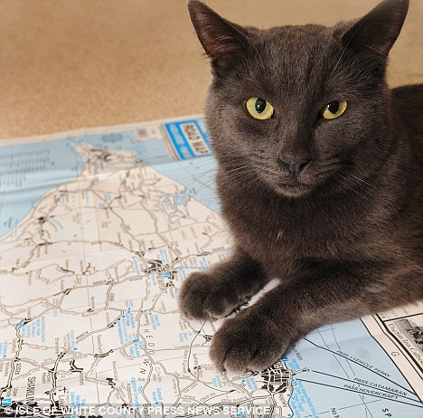
Phase diagrams: mapping the phase behavior of materials as a function of T and P

Slide 24
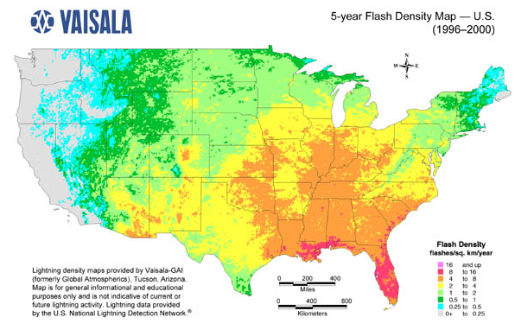
Map reading & Phase diagrams
longitude
(42°16'N, 77°48‘W)
(a,b)
= Alfred, NY
b
latitude
a

Slide 25
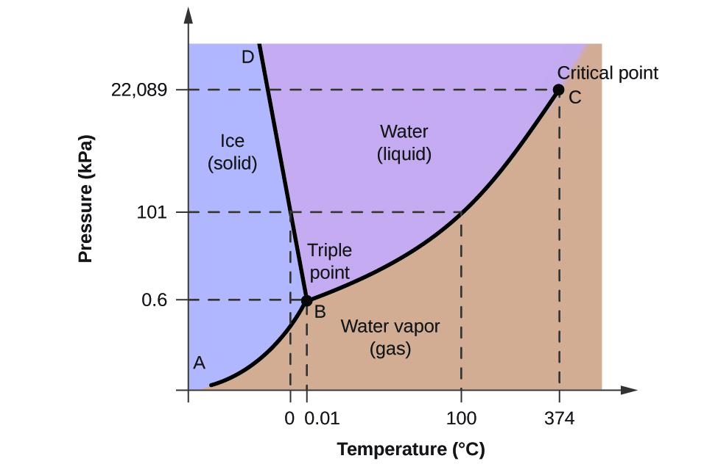
Part of the Phase `map’ of water

Slide 26
Phase diagram map reading (on board too…)
P(atm)
Liquid (l) only
Supercritical region
Solid (s) only
s + l
melting (mp)
l + g
boiling (bp)
Critical pt (cp)
normal line*
1
s + l + g
triple point (tp)
Gas (g) only
*Temperature of LIQ/GAS transition at 1 atm is called the normal boiling point
s + g sublimation (sp)
T (º C)

Slide 27
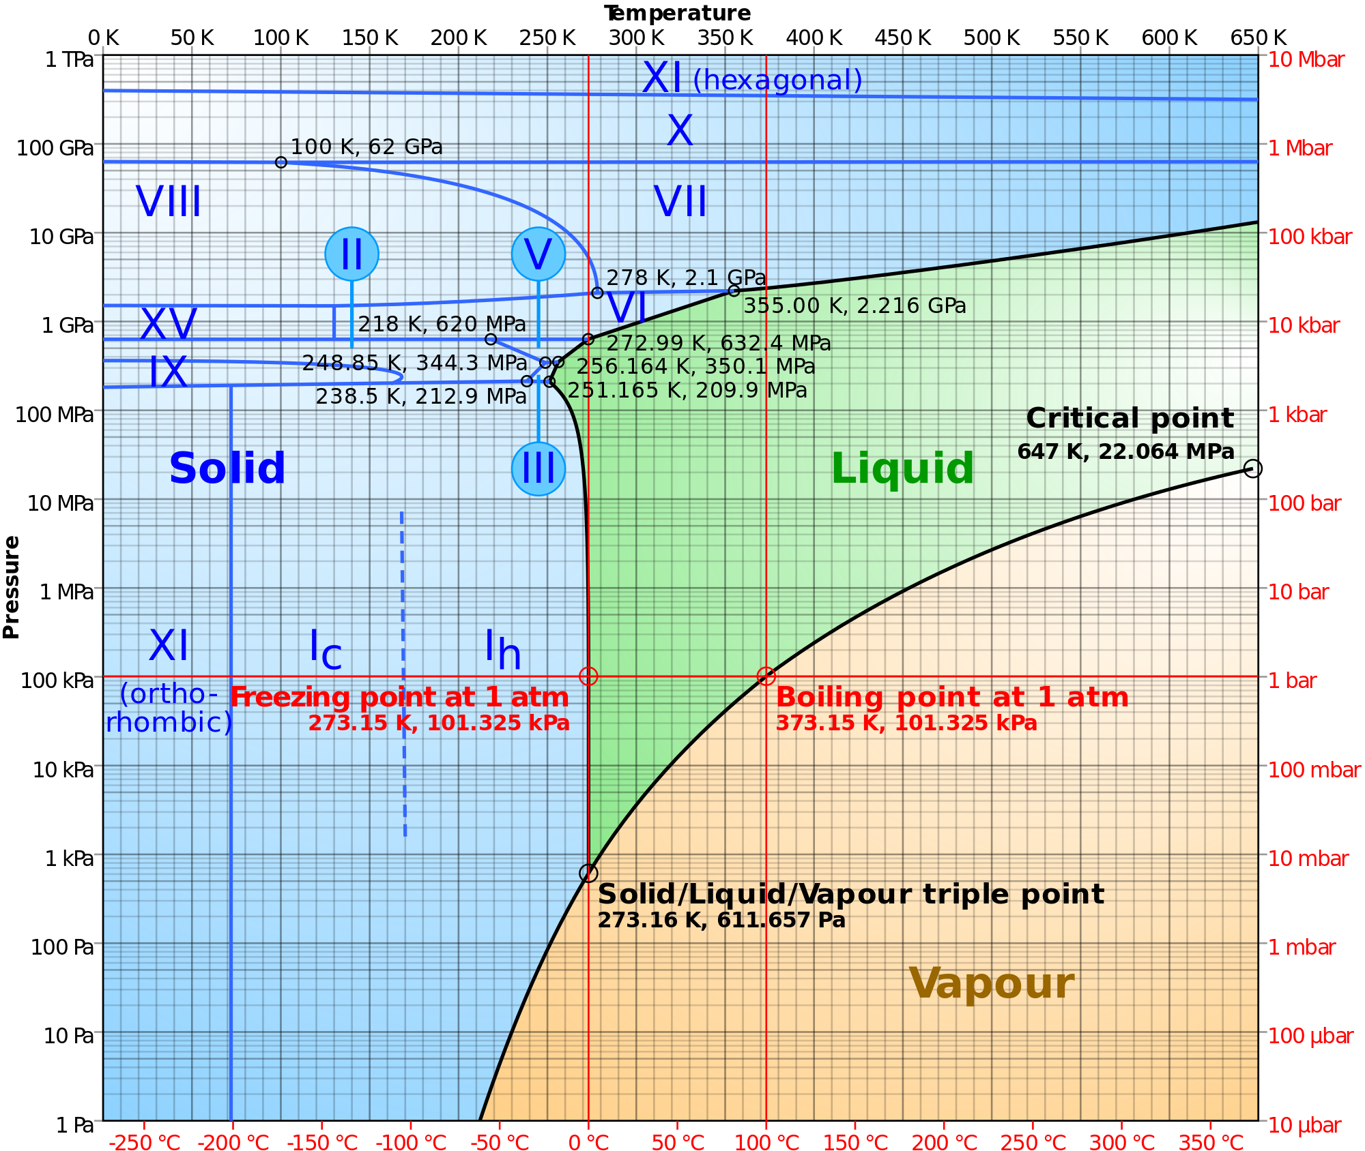

More complete phase map of water
Cat’s Cradle
By Kurt Vonnegut
…where Ice 9 freezes everything….

Slide 28
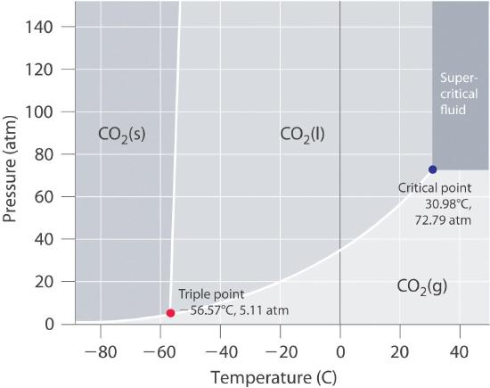

Slide 29
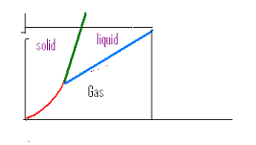


Supercritical behavior:CO₂ example
5
4
Supercritical region
1
2
3
73 atm
https://www.youtube.com/watch?v=L6IxVPxkfQE
~31 ºC
5
Supercritical
1
all solid
2
Solid/liquid
3
All liquid
4
Liquid/gas
Phase line gone

Slide 30
More Video of super critical phenomena

Slide 31
ice melting- the Movie-frame by frame : heating/cooling curves (on board too, with numbers)
Heating up a block of ice at P=1 atm
Water boils
Steam heats
T ( ºC)
Water heats
Ice
Heats
Ice melts
STARTHERE
S
S + L
L
L + G
G
0
-10
Heat Energy in

Slide 32
how phase diagrams are built from ZILLIONS of heating curves
Heating curve
Phase diagram
P
Put a big dot here to indicated L-G phase change
T
P=1 atm
Heat gas until anything else happens
After melting…watch liquid warm until L-G transition (30 ºC)
S all along the line
Put a big dot here to indicate S-L phase change
+30
Heat up and wait for S-L transition (at 10 ºC)
start
S
L
G
+10
P=1
start
Keep heating and melt…
S
-20
Heat in (J)
-20
+10
+30
T
Liquid all along line after dot
Gas all along line after dot
Keep heating and vaporize

Slide 33
Adding more data at different Pressures, P
P
T
G
L
L/ G
solid
liquid
S
P₁
S/L
P₂
P₁
S/G*
P₃
gas
P₂
Heat in
P₃
* =sublimation
T
Heating Curve
Phase Diagram

